Slide 1
KT4TT / T²RERC Ignite Session AT Products & Life Cycles
James A. Leahy
KT4TT Center, University at Buffalo
http://sphhp.buffalo.edu/cat/kt4tt.html
11:45am -12:45 pm
January 19, 2017
ATIA, Orlando, Florida

Slide 2
Hard Facts of Life
50-65% of invention disclosures from U.S. universities are converted into U.S. patent applications. (AUTM 2008)
30-50% of U.S. Patent applications are converted into Utility patents. (AUTM 2008)
99.8% of inventions fail. Only 3,000 patents out of 1.5 million are commercially viable. (Richard Maulsby, Director of Public Affairs USPTO)

Slide 3
Hard Facts of Life
AT Products are Normally Niche Market Products
Some AT Products may be Orphan Products with an extremely small target market.
Most Successful AT Products have a Mainstream Market Component
Current Smart Home Technology is an Example
Very Difficult to Survive as a One Product Company
Everyone will age into a Functional Limitation or a Disability if you live long enough!!

Slide 4
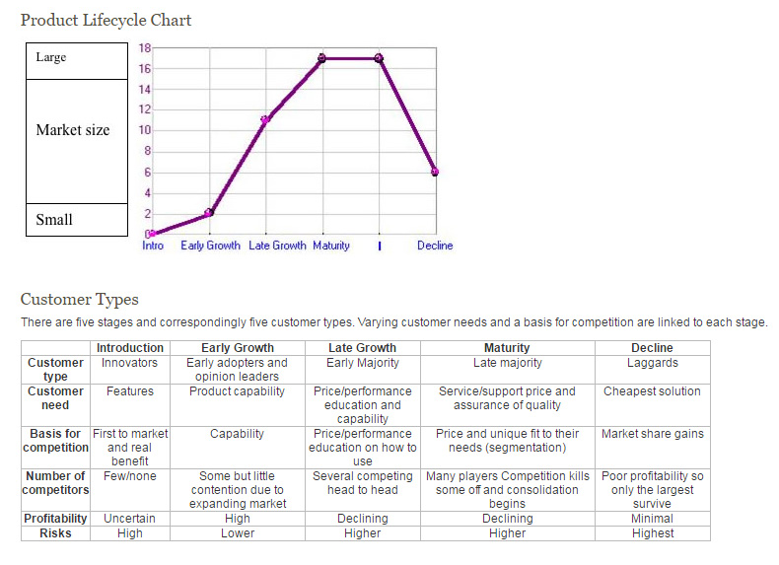
Product Life Cycle
Retrieved from: http://web.stanford.edu/class/ee204/product_lifecycle.html

Slide 5
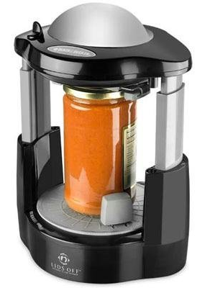
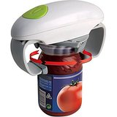
Lids Off Automated Jar Opener
from Black & Decker
One Touch Jar Opener
from One Touch

Slide 6
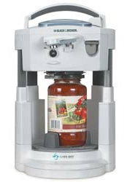
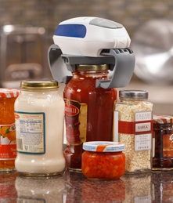
Lids Off Open-It All Jar, Can, & Bottle Opener
from Black & Decker
Open Ease Automatic Jar Opener from Hamilton Beach

Slide 7
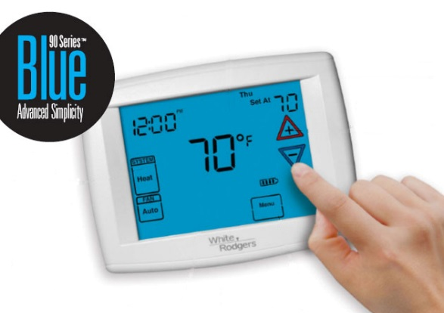
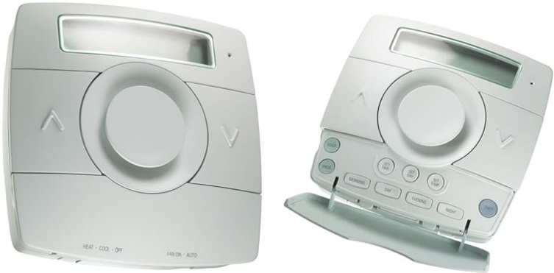
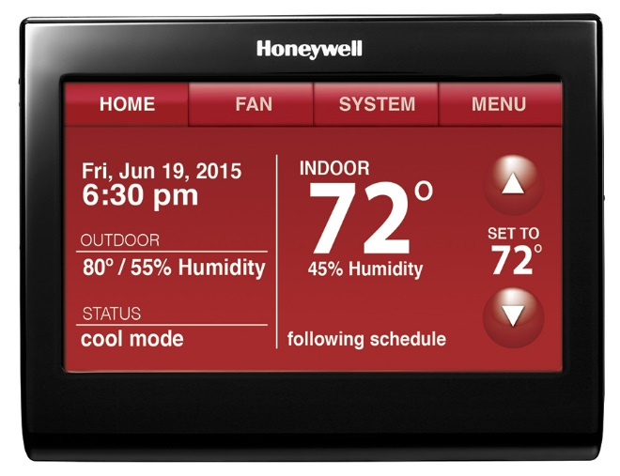
Kelvin - Interactive
Voice Controlled Thermostat from Independent Living Aid
90 Series Premium Thermostat from White Rodgers
Smart Thermostat with Voice Control from Honeywell

Slide 8
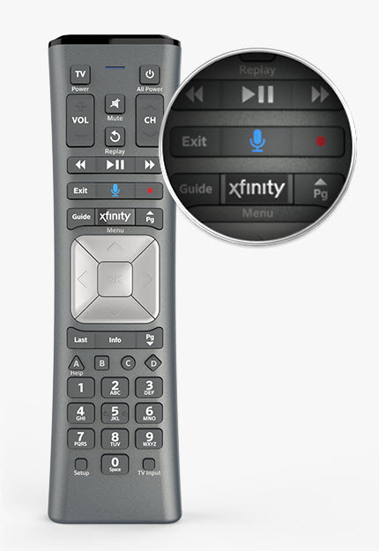
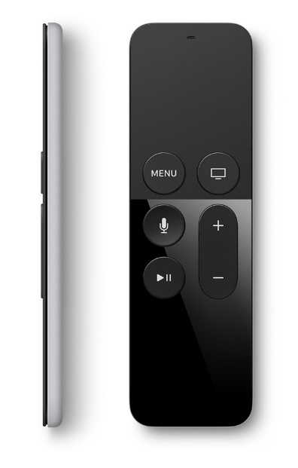
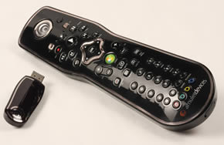
Surfboard Voice Interactive Universal Remote Control from Innotech Systems Inc.
X1 Voice Remote
from Xfinity
Amulet Remote
from Amulet
Siri Remote
from Apple

Slide 9
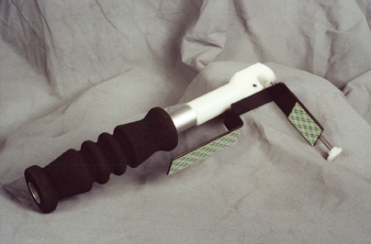
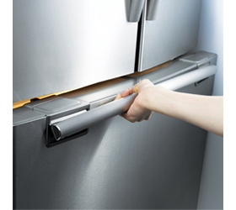
Refrigerator Door Opener
from Dynamic Living
EZ Open Handle from Samsung

Slide 10
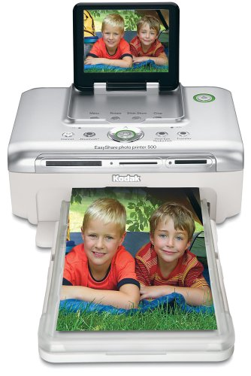
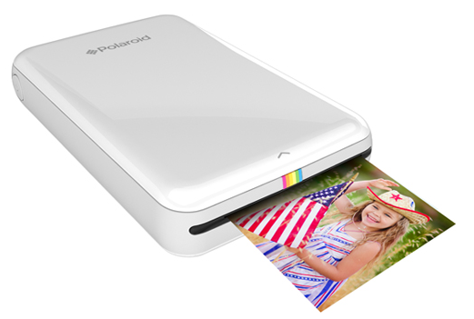
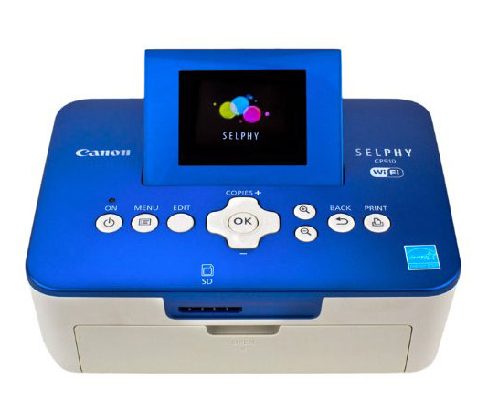
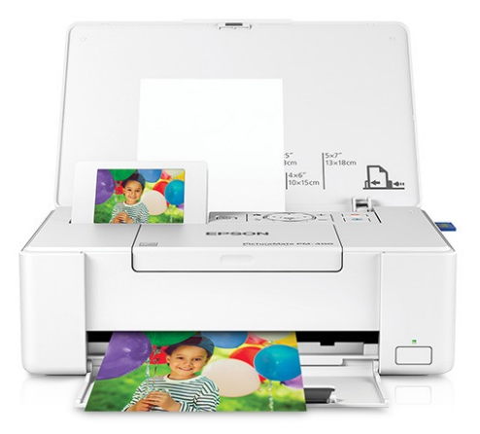
Easyshare Photo Printer 500 from Kodak
Zip Insta Photo Printer
from Polaroid
SHELPHY from Canon
PictureMate from Epson

Slide 11
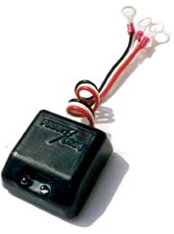
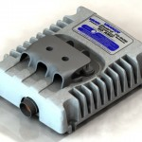
PowerCheq Battery String Equalizer from Power Designers
Battery Equalizers (2 - 12v)
from Vanner, Cooper Industries, Eaton

Slide 12
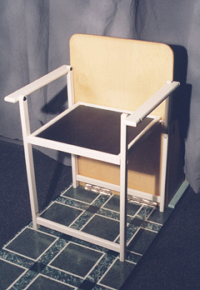
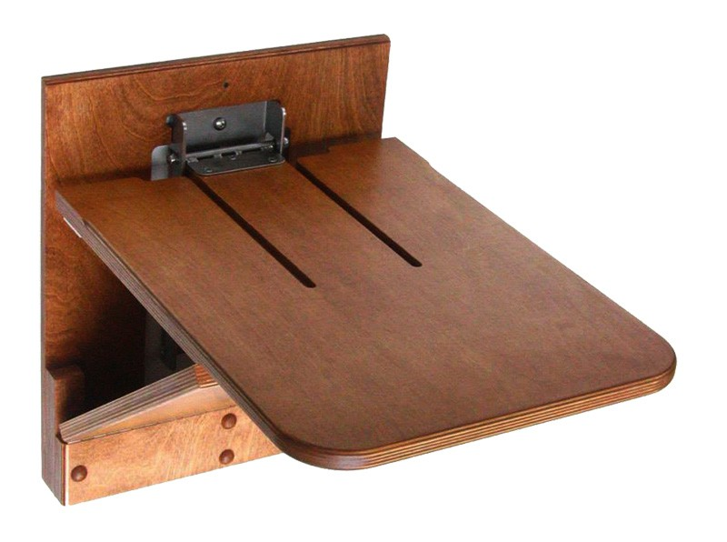
Easy Seat from Dynamic Living
The Original Wall Chair
from Wall Chair
Wallmount Folding Chairs
from Southwest Solutions Group

Slide 13
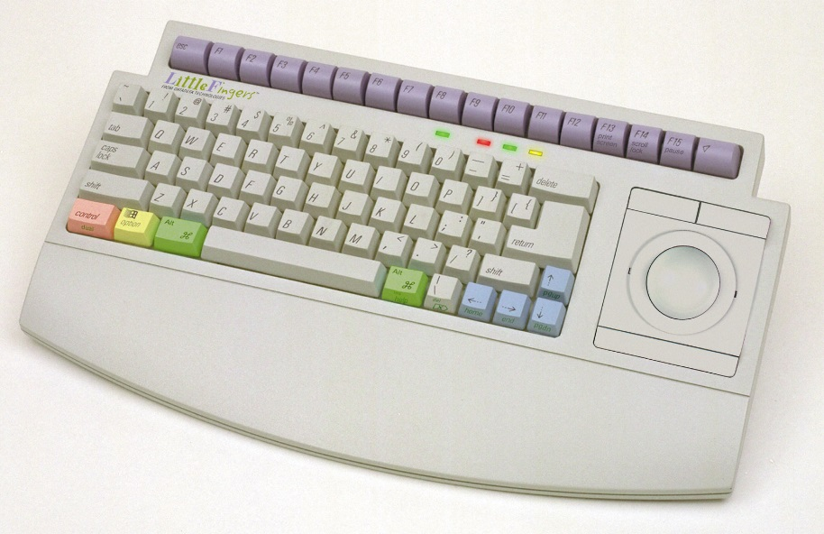
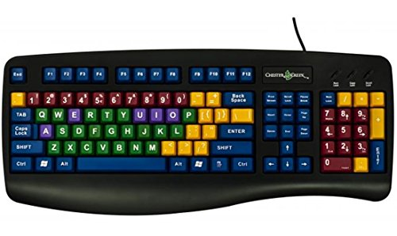
Little Fingers Keyboard
from Datadesk Technologies
Kids Keyboards
from Kidcomputers

Slide 14
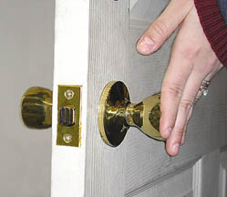
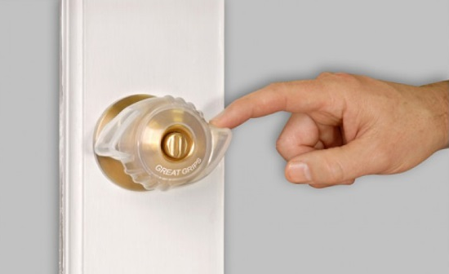
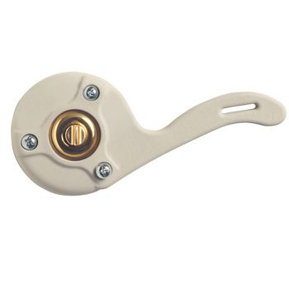
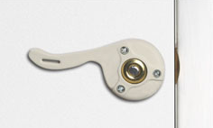
Magic Motion Lockset
from Dynamic Living
EZ Doorknob Grips from Able Life Solutions
Doorknob Extender from Patterson Medical
Doorknob Extender from Maddak

Slide 15
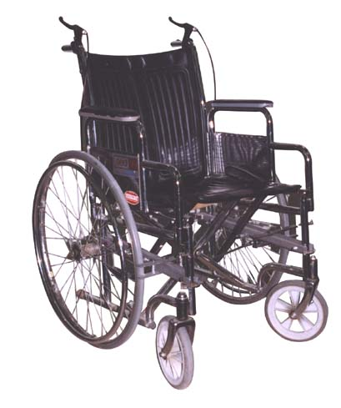
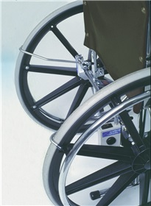
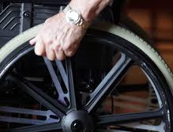
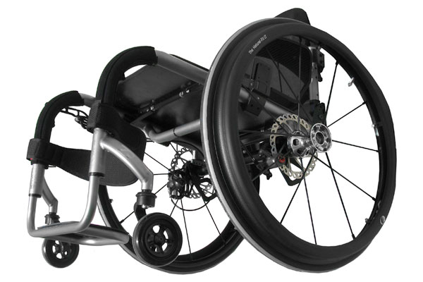
UpStop Wheelchair Braking System
from AliMed
Automatic Braking System from Pratiko
Disk Break System
from Stealth Products
Anti Rollback System
from AliMed

Slide 16
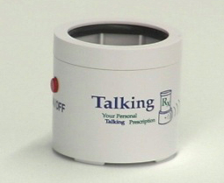
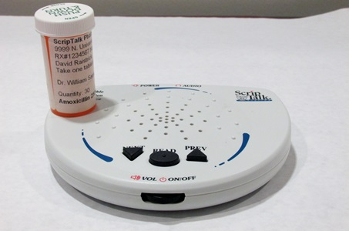
Electronic Prescription Label Devices
from MEDVOX
ScripTalk
from En-Vision American

Slide 17
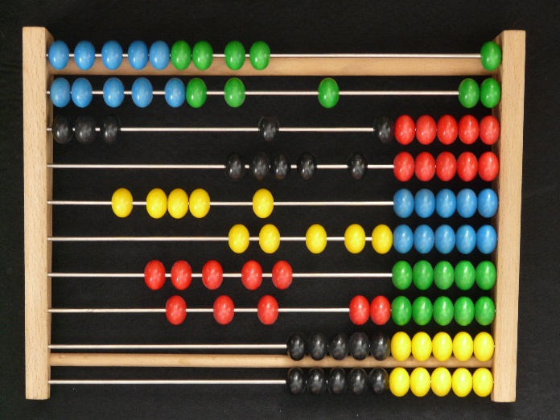
Coin-u-lator from PCI Education

Slide 18
Where Are We Headed from Here???
We all Know Technology is Progressing Rapidly
We all Know About the Aging Baby Boomer Population and the Gen Xers’ and Millennials, but the Silent Generation seems to be very well funded too.
We are seeking Technologies and Products that address the needs of the aging population while possessing Universal or Transgenerational Design Features.

Slide 19
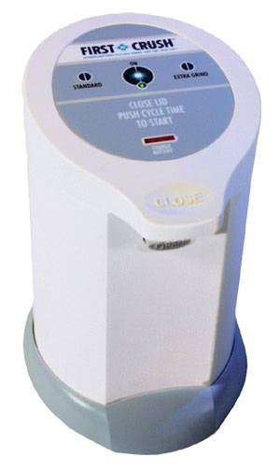
First Crush from First Wave Technologies

Slide 20
Acknowledgement
The contents of this presentation were developed under a grant from the National Institute on Disability, Independent Living, and Rehabilitation Research (NIDILRR grant number 90DP0054-01-00). NIDILRR is a Center within the Administration for Community Living (ACL), Department of Health and Human Services (HHS). The contents of this presentation do not necessarily represent the policy of NIDILRR, ACL, HHS, and you should not assume endorsement by the Federal Government.

