Slide 1
Idea for a New A/T Product?
Here’s Where to Begin
James A. Leahy
KT4TT Center, University at Buffalo
http://sphhp.buffalo.edu/cat/kt4tt.html
8:00 – 9:00 a.m.
January 19, 2017
ATIA, Orlando Florida

Slide 2
Key Learning Objective
  Identify and Discuss 5 Crucial Steps in New Product Development an inventor needs to take at the beginning.
  Identify and Explain 5 Key Components of a Market Assessment.
  Discuss and Explain 6 or more key terms ranging from scoping reviews to prior art and patenting.

Slide 3
Presentation Outline
Take you through the first 180 days of the invention process.
Provide you with definitions and explanation of terms you will be hearing and using.
Protecting your idea so that you can discuss it with others.
Beginning of due diligence – what homework do you have to do to see if your product or idea is already in the marketplace?
Identify which path you must travel – funded Researcher/Technology developer versus Independent Inventor
What is Intellectual Property (IP)?

Slide 4
What You Need to Become!
Change – Need to become a detail oriented individual
Procure a notebook – bound type with pre-numbered pages
First dated, signed entry should be a description of your idea
All your notes, drawings and any information regarding your invention is placed in this invention ‘diary’
If patenting is an option, US is now ‘First to File’ not ‘First to Invent’

Slide 5
Definitions
What is Intellectual Property?
  “Creations of the mind – creative works or ideas embodied in a form that can be shared or can enable others to recreate, emulate, or manufacture them” (USPTO)

Slide 6
Definitions (cont.)
Non–disclosure or Confidentiality Agreement
  What is it?
  Why do I need one so early on in the invention process?
  Where can I get one?
Co-Invention
  What is it?

Slide 7
Day 5: Protecting Your Invention
Need to have people sign your NDA prior to discussing your invention with them.
US patent system is NOW a First to File not First to Invent!!
Provisional Patents become Important.

Slide 8
Day 10: Homework Time
Check to see if your product/idea is already in the marketplace. How?
  Catalogs, stores and of course the Internet are
  starting points
  Focus on companies making similar products
  Visit retailers and professionals to learn how individuals currently address the function your device addresses
  Contact prospective users of your device – Be Careful – Protect Yourself!!!

Slide 9
Prior Art Searching
  If someone else has already invented or published information about your device, you may not be able to get a patent on the device
  Searches can save you a significant amount of time and money in both development and pursuit of intellectual property protection
  Will ensure your invention isn’t already in the marketplace

Slide 10
Day 10: Homework Time
What Not to say when approaching potential users
Definitions:
  Prospective user
  Device function
  Enabling information
  Prototype
  Patenting

Slide 11
Day 30: Which Path do You Take?
Funded Researcher or Technology Developer at a University?
Independent Inventor?

Slide 12
Funded Researcher or Technology Developer at a University?
Intellectual Property ownership in a University setting
  If you are a university researcher and develop your invention as part of your employment at a university, you do not have exclusive ownership rights to your development
    The legal rights to the invention belong to the university and to any funding agency that may be helping to pay for the development
    This information should have been included in the terms you agreed to upon being hired at the University
  However, you will still remain eligible for some royalties from
  your invention
  If the government and your university decline ownership of the invention, all legal rights to the invention will revert to the inventors
    The inventors are third in line to claim ownership for the invention

Slide 13
Funded Researcher or Technology Developer at a University?
Assistive Technology Development
  Expected returns on your invention may be very low since the potential market size for most assistive technologies is very small
  Therefore, in many cases the University Technology Transfer Office may decide that it is not worth investing time and resources to bring the product to market

Slide 14
Independent Inventor
Use your own resources
Don’t have to share ownership or royalties/profits
Chart your own course and timeframe
Should contact a qualified patent attorney on how
to proceed.

Slide 15
Day 45: Prototype Time
If you are going to license your invention – you need to have a proof of concept prototype
Build a prototype to see if your idea is plausible
Look at materials and components
Working prototype assists tremendously in patent application (creation of drawings, describing
the claims)

Slide 16

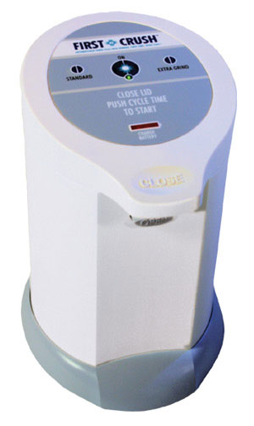
Automated Pill Crusher Example
First Crush from First Wave Technologies

Slide 17
Voice of the Customer in Funded Research and Development Projects
Inclusion of consumer input early on in funded researchers proposal shows reviewers increased likelihood of successful product outcome.
Historically, manufacturers of consumer products have made product design decisions without factoring in the needs, wants, and expectations of the full range of end consumers.
This process leads to ineffective products in the marketplace, new product failures, and product abandonment. Failure rates for new product introductions vary by industry but range from 30% to 90%.
The primary cause of these failures can be traced back to a point early in the product design process where significant consumer or device user information failed to be collected and analyzed prior to the initial fabrication of the device (aka prototype).

Slide 18
Voice of the Customer in Funded Research and Development Projects
Method of inclusion of consumer input – Targeted Focus Groups!!!
Targeted focus groups employ purposive sampling, rigorous primary and secondary recruitment screens, and state of the art product and feature demonstrations early in the design process.
Focus groups allow new product developers to obtain specific design functions and features for the product being developed directly from the product’s targeted end users.
Farther on in the product development process these same targeted, educated, end users are reconvened to review functional prototypes of the new product prior to its initial production run.

Slide 19
Focus Group Methodology
Steps Prior to the Focus Groups
Step 1: Identification of product target area
  Have you identified an unmet need in the consumer marketplace?
Step 2: Identification of focus group participants and the use of Purposive Sampling.
  With Purposive Sampling you are seeking a predefined group of consumers not a random selection of the general population.
Step 3: Use of general media outlets to recruit potential focus
  This includes newspaper, television or radio ads, and targeted placement of recruitment flyers
Step 4: Rigorous primary and secondary screens administered to potential focus group participants.

Slide 20
Focus Group Methodology
Focus Group Process
Step 5: Decision point:
  If this is a product refinement focus group, does the group have to be educated on the current state of the science through information or product demonstrations prior to the focus group so that the participants are not just identifying design functions and features of products currently available in the marketplace? If yes, see Step 6. If not, skip to Step 7.
Step 6: Prepare state of the art product demonstrations.
  Demonstrations will be performed prior to the start of the actual focus group. Or prepare a listing of the state of the art features currently available in products in the marketplace and discuss them with participants prior to the focus groups.
Notes:
Need to make this flow – or look like it is a flow chart of sorts…

Slide 21
Focus Group Methodology
Step 7: Run the Alpha Focus Groups or Concept Definition Focus Groups which involve consumers in defining product requirements and setting priorities for product design.
To determine the current status and consumer satisfaction levels with their product function techniques and devices, the participants will be asked to provide background information on a variety of topics involving the product.
On the topic of ideal product, participants will be asked to provide the attributes of what they perceive to be the ideal device to perform the function.
The focus group participants undertake an evaluation of static product concept models prepared in advance for the groups.
Purchase intent and price point questions are asked of the participants for both the Conceptualized Ideal Product and for the concept models shown.
Notes:
Lots of info – try to shorten. Don’t forget to add footnote below to the formatting:
Merges, Robert Patrick, et al. Patent Law and Policy: Cases and Materials. Newark: LexisNexis, 2002 (p. 644)

Slide 22
Focus Group Methodology
Step 8: Beta Focus Groups.
  Primarily allow the refinement of a product’s appearance by the manufacturer through a critique of key design features of a prototype. They provide an opportunity to rank a product’s function and design features previously identified in concept definition focus groups.
  Beta focus group participants are a representative sample of the Alpha focus group participants.
  Two Beta groups of twelve participants each are usually sufficient.
  Beta groups provide the ability to score how well a prototype meets consumer expectations and gauge consumer desire or intent to purchase the product.

Slide 23
Focus Group Methodology
Step 8: Beta Focus Groups
  Beta groups provide the ability to obtain quantitative data on the previously collected qualitative information and allows that data to be applied to the prototype being evaluated. They answer the question as to whether or not a prototype addresses the top function and design features a product must have to be deemed desirable by the consumer.

Slide 24
Day 120: What’s Next?
You have documented your idea, verified it’s unique, and fabricated a prototype
Next is the market analysis
  Identification of target market
  Market projections
  Market growth
  Distribution channels
  Development of competing product matrix

Slide 25
Key Components of a Market Assessment
Prior Art Searching – do it again
  If someone else has already invented or published information about your device, you may not be able to get a patent on the device
  Searches can save you a significant amount of time and money in both development and pursuit of intellectual property protection
    Will ensure your invention isn’t already in the marketplace

Slide 26
Key Components of a Market Assessment
Marketing Section
  Target market
  Market Projections or Segments
  Market Growth
  Competing Products & Manufacturers
  Opportunity for the Device
  Marketing Strategy
  Sales Projections

Slide 27
Other Considerations
Marketability Assessment
  It will help determine whether you could potentially
  make a profit (and how much profit) on your device
    If you find that you will not be able to make enough profit on the device prior to development to justify the potential costs, you may be better off not going through the invention process
      Potential costs include the time and cost of development, manufacturing costs, the time and cost to pursue intellectual
      property protection, etc.

Slide 28
Day 180: Journey Continues
Commercialization
  Decision point – what do you do?
  Patent?
  Start your own business versus licensing
  Two different processes
  Many decisions have to be made

Slide 29

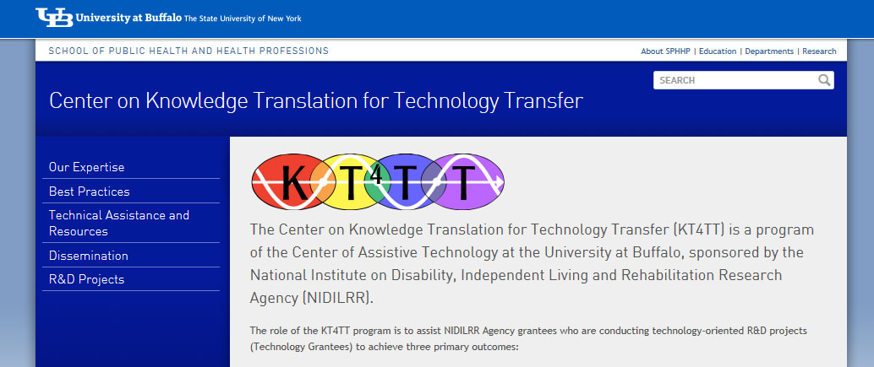
Summary
Visit the KT4TT web site for additional information, more examples and a chronological step by step guide for inventors. http://sphhp.buffalo.edu/cat/kt4tt.html
Thank you!

Slide 30
Acknowledgement
The contents of this presentation were developed under a grant from the National Institute on Disability, Independent Living, and Rehabilitation Research (NIDILRR grant number 90DP0054-01-00). NIDILRR is a Center within the Administration for Community Living (ACL), Department of Health and Human Services (HHS). The contents of this presentation do not necessarily represent the policy of NIDILRR, ACL, HHS, and you should not assume endorsement by the Federal Government.

