Slide 1
RSCH-20: The Nuts and Bolts of Publishing with ATOB
Lori Geist, ATOB Editorial Board Member
Chris Klein, ATOB Author
Carolyn Phillips, ATOB Associate Editor
Ben Satterfield, ATOB Editorial Board Member
Caroline Van Howe, ATIA COO, ATOB Production Manager
Jennifer Flagg, ATOB Editor-in-Chief
Email: ATOBEditor@ATIA.ORG

Slide 2
Learning Objectives
Describe three submission categories for articles, and types of articles appropriate for each.
Describe two unique aspects of ATOB’s manuscript submission and peer review process, as compared to scientific journals.
Demonstrate knowledge of the six major stages of the ATOB publication process.

Slide 3
ATOB Editorial Board
Editor-in-Chief
Jennifer Flagg
Center on KT4TT
University at Buffalo
Associate Editor
Carolyn Phillips
AMAC |Tools for Life
Georgia Institute of Technology
Copy Editor
Beverly Nau
Production Manager
Caroline Van Howe
ATIA
Editorial Board Members
Russell Cross
Prentke Romich Company
Anya Evmenova
Assistive and Special Education Technology
George Mason University
Lori Geist
Center for Literacy & Disability Studies
UNC Chapel Hill
Ben Satterfield
Center for AT Excellence
GA Tools for Life at Georgia Institute of Technology
Joy Zabala
National Center on Accessible Educational Materials for Learning
CAST

Slide 4
ATOB History
First published in 2004
Partnership between ATIA and The Special Education Assistive Technology (SEAT) Center at Illinois State
Editor-in-Chief: Howard P Parette
Production Manager: Brian Wojcik
Focused Issue Editors: Multiple contributors
Archived issues available on ATOB webpage
www.atia.org/atob

Slide 5
Purpose and Audience
“…to advance the AT industry by
(a) fostering communication among stakeholders interested in the field of AT, including manufacturers, vendors, practitioners, policy makers, researchers, consumers with disabilities, and family members;
(b) facilitating evidence-based demonstrations and case-based dialogue regarding effective AT devices and services; and
(c) helping stakeholders advocate for effective AT devices and services.”

Slide 6
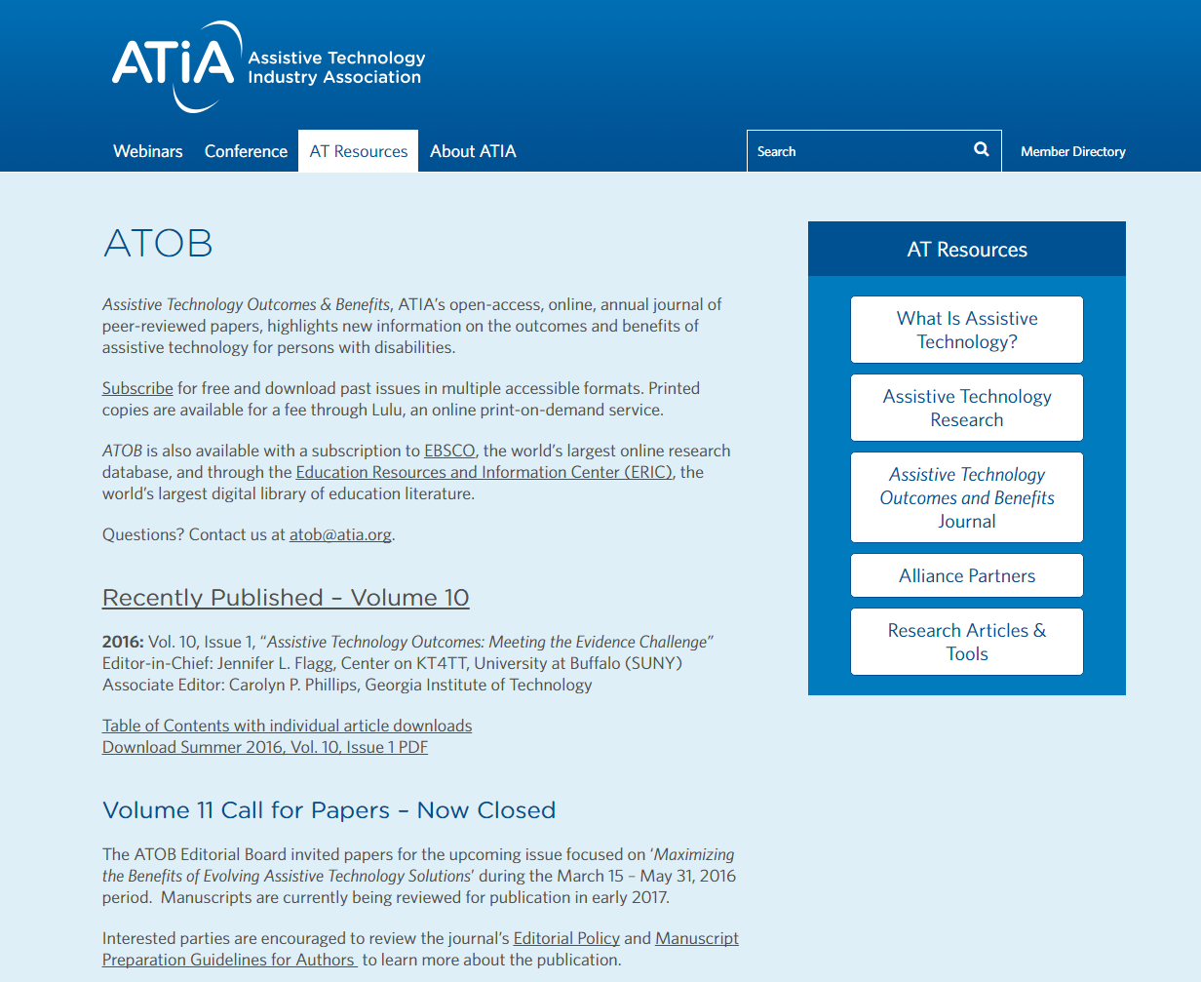
ATOB Webpage
Link to subscribe
Information regarding recent publications
Call for papers, including Editorial Policy and Author Guidelines

Slide 7
ATOB Webpage - Archives
All archived issues of ATOB can be accessed here.

Slide 8
Editorial Policy - Key Points
3 Submission Categories
Field, Industry, and Academia
Types of Articles
Applied/Clinical Research; Case Studies; Design; Marketing Research; Project/Program Description; Approaches to Service Delivery; Consumer and Caregiver Perspectives.
Open Access Policy

Slide 9
Manuscript Submission Process
Initial Submission
Desk Acceptance
Peer Review & Revisions
Copy Editing
Galley proofs
Publication
The ATOB Editorial Board is available to provide assistance at any point in the process.

Slide 10
Publishing Guidelines
Each manuscript must reflect the style guidelines of the Publication Manual of the American Psychological Association (6th edition, 2009).
Manuscripts should be no more than 25 pages in length (double-spaced), including references, tables, and figures. Due to the electronic format of the journal, all submissions should be submitted as email attachments in a Microsoft® Word format.
See detailed Manuscript Preparation Guidelines for Authors for more information on formatting requirements and submission instructions.

Slide 11
Institutional Review Board
An Institutional Review Board (IRB) is a committee established to review and approve research involving human subjects. The purpose of the IRB is to ensure that all human subject research be conducted in accordance with all federal, institutional, and ethical guidelines.

Slide 12
10 Tips for Producing a Quality Paper
Begin with a well-defined, relevant question – move the AT field forward
Follow IRB Guidelines
Use person-first, disability positive language
Make sure your document is in accessible format
Figures & tables should be adequately labeled – understood on their own
Make it clear & concise
Cite appropriately
Be candid about your work’s limitations
Acronyms should be spelled out in the first instance
Revise, revise, revise. Step back, & then revise again.
Thanks to Kara Kockelman University of Texas, Austin

Slide 13
Peer Review Process
All manuscripts are initially reviewed by two individuals.
One or both reviewers may be asked to reconsider a revised manuscript.
Reviews are focused on answering three main questions:
Does this paper make an important substantive contribution to the field of assistive technology?
For research studies, does the methodology (design and execution) permit one to draw the conclusions the author wishes to make?
Is the paper well organized and complete in explaining what was done and why and how it was done?
APA, Kazdin, 1998
Manuscripts are reviewed by individuals who are in the author’s peer group.

Slide 14
Peer Review Evaluation Criteria
Significance of the manuscript to the field
Relevance to focused topic area
Adequacy of discussion regarding state of the practice
Organization
Clarity
Appropriateness of the research design, data analysis, and interpretation of results (if applicable)
Outcomes and Benefits
Relevance to Readers

Slide 15
Become a Peer Reviewer
We are seeking subject matter experts from diverse backgrounds.
Email atobeditor@atia.org
Name
Company/Organization
Email Address
Peer Group (Field, Industry, Academia, Consumer)
Area of Expertise (Education, ADL, Workplace, etc)

Slide 16
ATOB Consumer Perspectives
ATOB welcomes submissions from individuals with disabilities, their family members, or caregivers.
Intended to highlight the user’s perspective and opinions about AT.
Author Spotlight:
Chris Klein will share insights from his experience publishing with ATOB.
Communication and Developing Relationships for People who use Augmentative and Alternative Communication

Slide 17
ATOB Consumer Perspectives
Communication and Developing Relationships for People who use Augmentative and Alternative Communication
Overview of article
Comments regarding the submission and revision processes from the author’s perspective
Experience versus research
Advice for others interested in publishing with ATOB

Slide 18
What’s New with ATOB?
Volume 10 available for download!
Assistive Technology Outcomes: Meeting the Evidence Challenge
Volume 11 coming soon- subscribe to ATOB or check the website this winter for details.
Maximizing the Benefits of Evolving Assistive Technology Solutions

Slide 19
ATOB Volume 12 Theme
Implementing AT in Practice: New Technologies and Techniques
A great deal of ongoing research is exploring how assistive technology is being used in practice, and how well it is working in various contexts. This issue of ATOB invites authors to share their research and practice experience, including information about new products and interventions, or new and unique strategies for implementing assistive technology in practice.

Slide 20
ATOB Volume 12 2017 Timeline
Winter 2017: Announce call for papers
April 2017: Manuscript submission deadline
Summer: Peer review and revisions
Fall: Copy editing and galley proofs
Winter 2018: Publication

Slide 21
Thank you for attending!
CEUs – Session Code: RSCH-20
More info at: https://www.atia.org/conference/education-program/ceus/
For ACVREP, AOTA and ASHA CEUs, hand in completed Attendance Forms to INFORMATION DESK at the end of the conference. Please note there is a $15 fee for AOTA CEUs.
Session Evaluation
Please help us improve the quality of our conference by completing your session evaluation form in the mobile app.
Handouts
Handouts are available at: http://s3.goeshow.com/atia/orlando/2017/handouts.cfm
Handout link remains live for 3 months after the conference ends.

Slide 22
Thank you for attending!
Questions?

Slide 23
For more information, contact:
ATOB Editor-in-Chief
Jennifer L Flagg
Email: atobeditor@atia.org

