Slide 1
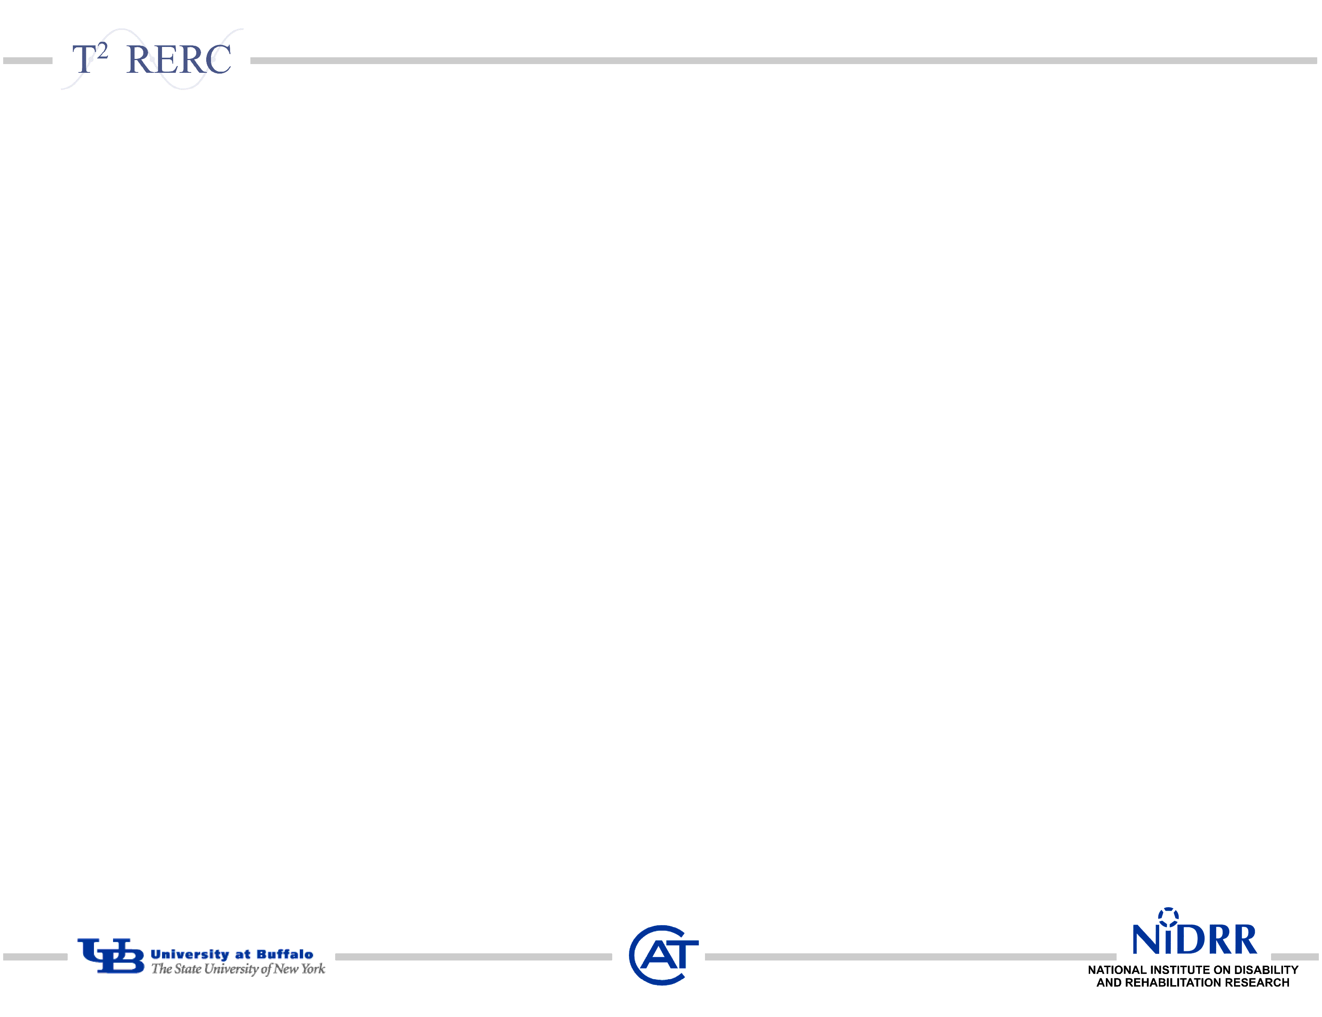
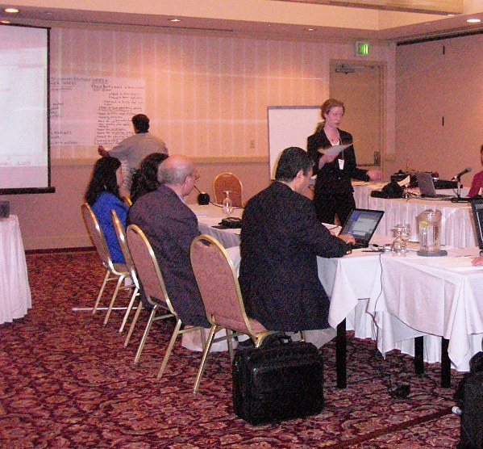

Expanding Product Accessibility with Primary Market Research Techniques
Jennifer L Flagg
Center on Knowledge Translation for Technology Transfer, University at Buffalo

Slide 2
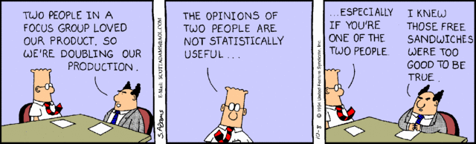
Voice of the Customer
Overview of Paper
Key Points
Resources
Notes:
Introduction- Rather than reiterate what you can read in my conference paper, I would like to take this opportunity to discuss a few key points in the paper, and to introduce you to a few resources that may be helpful to those of you who are conducting focus groups and developing surveys of your own.
Brief recap of paper: The paper discusses two case examples of academics utilizing voice of the customer techniques to gather consumer input to guide product development. In both cases, there was a goal of generating product specifications to increase the accessibility and usability of the products being developed. In one case, focus groups were used to generate a listing of desired function and features of an ideal accessible glucose monitoring device. In the other case, surveys were used to identify desired functions and features of a toaster oven. Both cases represented opportunities for academics to add value to projects being led by industry partners. However, these same techniques can be used for internal research and development projects as well. Whether you yourself will bring the product to market, or transfer it to another organization to do so, rigorous voice of the customer methods will help to increase your chances of success.
2

Slide 3
Key Point 1
You MUST understand your customer’s needs!
Manufacturers and service providers
Customer = End User/Consumer
R&D staff/ academics
Customer = Manufacturer
Academics can bring end user/consumer needs to a manufacturer, but the information must meet the manufacturer’s own needs.
Notes:
Worked hand in hand with company representatives to design appropriate survey questions
Raised awareness of accessibility considerations through discussion and final report
Provided services as technical assistance- no cost to the company so long as they provided a thank you letter to share with our sponsor
Design suggestions presented such that engineering would decide what to implement and how to go about doing so
Helped to avoid “not invented here syndrome”

Slide 4
Example Glucose Meter Specifications

Slide 5
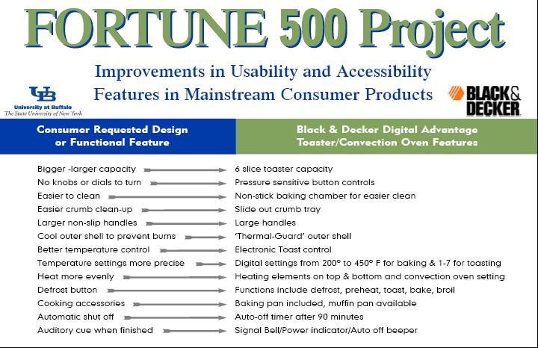
Meeting the Manufacturer’s Needs
Notes:
5

Slide 6
Key Point 2
Use methods recognized as rigorous by industry standards
Problematic Approach | Rigorous Approach
Single focus group | Multiple groups
End users only | Include other stakeholders
Inexperienced moderator | Trained knowledgeable moderator
Inadequate facilities | Accessible, state-of-the-art facilities
Lengthy report | Top line summary, concise function listing, appendices
Notes:
Structured focus group using industry standard techniques
Expanded company’s concept of “the consumer” to include related stakeholders
Navigated human subjects testing requirements
Provided skilled and knowledgeable moderator
Ensured accessibility of all focus group activities
Sign language translators; electronic, braille and large print formats for documents; braille signage, handrails

Slide 7
Resources
Primary Market Research Training Module
Sampling and recruitment
Focus groups
Surveys
Outsourcing considerations
Evaluation Resource Guide
Basic concepts
Case studies
Sample Instruments
Notes:
7

Slide 8

ACKNOWLEDGEMENT This is a presentation of the Center on Knowledge Translation for Technology Transfer, which is funded by the National Institute on Disability and Rehabilitation Research, U.S. Department of Education under grant #H133A080050.
The opinions contained in this presentation are those of the grantee, and do not necessarily reflect those of the
U.S. Department of Education.

Slide 9
Thank you!
Any Questions?

