Slide 1
Knowledge Translation Across RERC Activities
Jennifer L Flagg, MBA
Center on KT4TT
University at Buffalo

Slide 2
Presentation Outline
KT- What is it and why does it matter?
What is currently being done by RERC’s?
What else can be done?

Slide 3

NIDRR’s Goal: Impacts

Slide 4
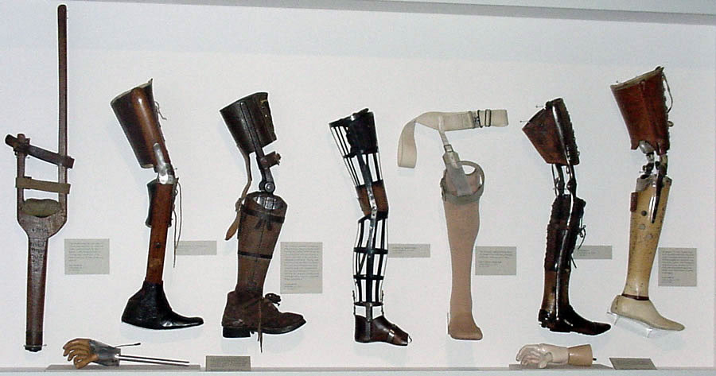


Outcomes

Slide 5



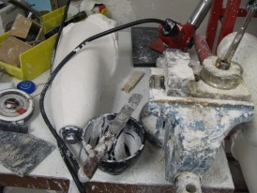






How do we get there?
Outputs
Stakeholders
Outcomes
Impacts
KT
KT

Slide 6
What is KT?
All of NIDRR’s centers and projects will carry out KT.
KT is a process of ensuring that new knowledge and products gained through research and development will ultimately be used to improve the lives of individuals with disabilities and further their participation in society. (2010-2014 proposed LRP)

Slide 7
What is KT?
KT takes place in a complex system
Interactions vary in intensity, complexity and level of engagement
Focus on the needs of the knowledge users
Key Components:
  Involve relevant stakeholders in design and conduct
  Assess and disseminate
  Translating findings into usable information

Slide 8
KT versus KDU?
KDU
  End of grant activity
  Linear, mechanical process of information transfer
  Focus on “pushing” knowledge out into use
KT
  Integrated activity
  Interactive, nonlinear process
    Dependent on the beliefs, values, circumstances, and needs of intended users
  Needs and anticipated barriers shape research, development, and dissemination activities

Slide 9
Relationships
Relationships

Slide 10
What is
Currently
Being Done?

Slide 11
Target Audiences

Slide 12
Dissemination and
Research Utilization Strategies
Present papers or lectures (95.5%)
Scholarly articles (91.9%)
Annual/final reports (74.8%)
Trainings (71.7%)
Websites/pages (68.5%)

Slide 13

Measuring Impact
Participant counts (72.2%)
Material requests/distributions (56.7%/52.6%)
Citation searches (51.5%)
Participant surveys (40.2%)
Interviews (24.7%)

Slide 14
Barriers to Reaching Target Audience
Limited funding
Limited planning time
Comments
  Saw KT as an end of grant activity
  “…dissemination and/or utilization activities would take away from this project’s primary work and focus.”

Slide 15
What Else Can Be Done?

Slide 16
Three Different Methods yield Knowledge Outputs in 3 Different States
Scientific Research Method►
Conceptual Discovery
Engineering Development Method►
Prototype Invention
Industrial Production Method►
Commercial Product

Slide 17

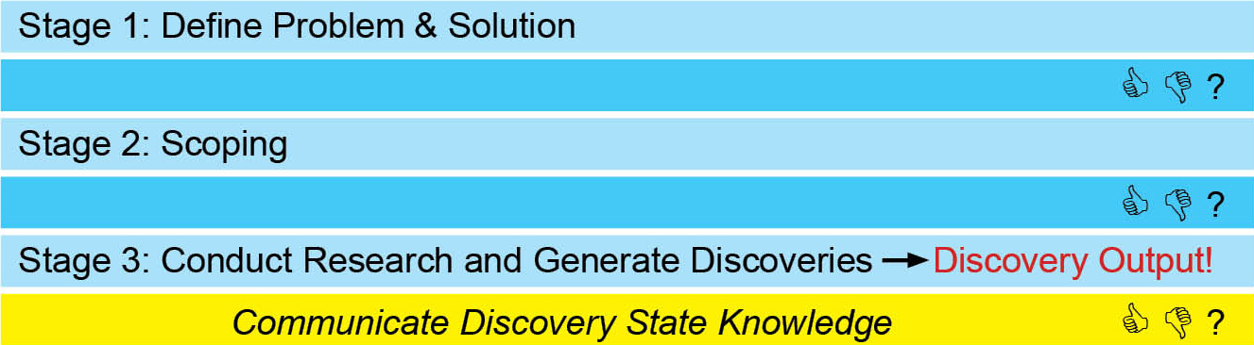
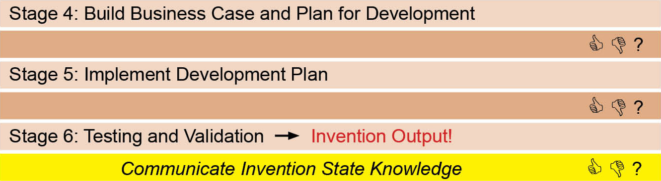
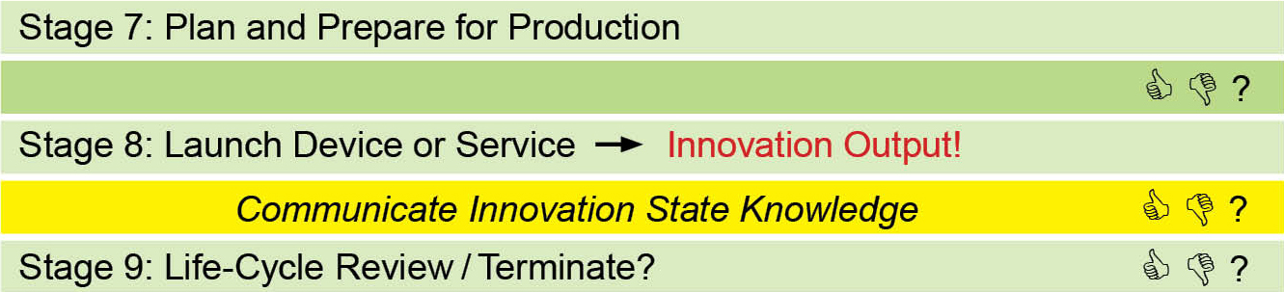
Need to Knowledge (NtK) Model for Technological Innovations

Slide 18
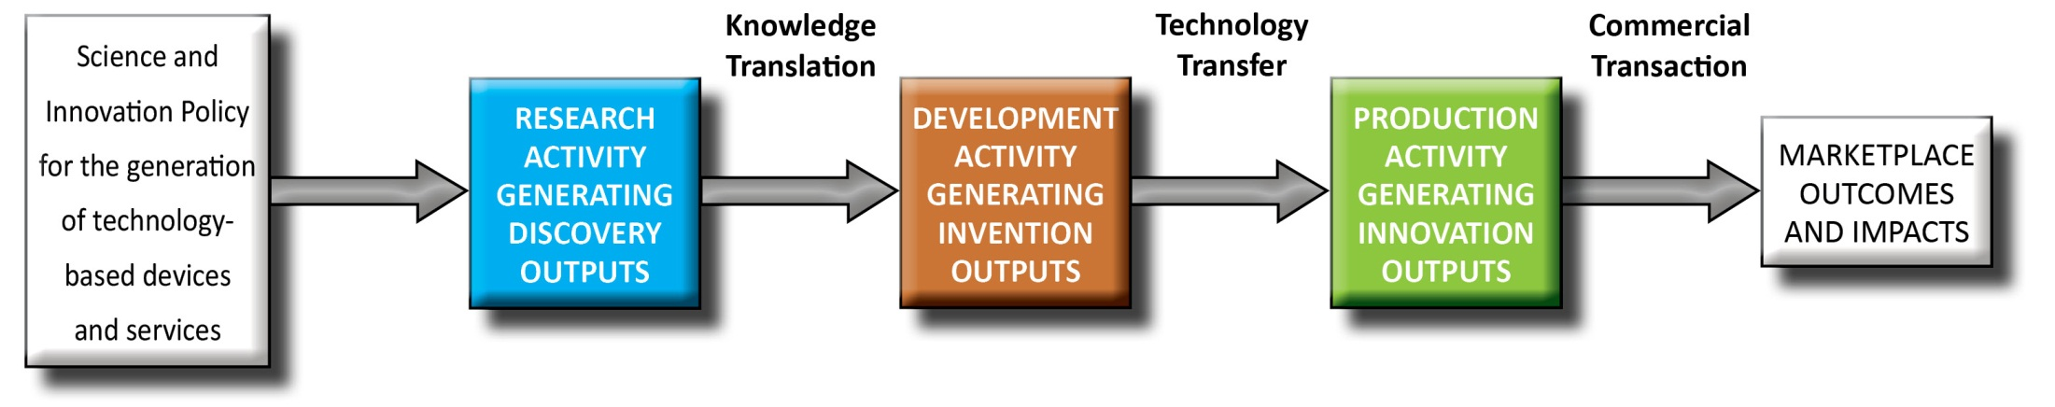
Knowledge Communication –
3 Strategies for 3 States

Slide 19
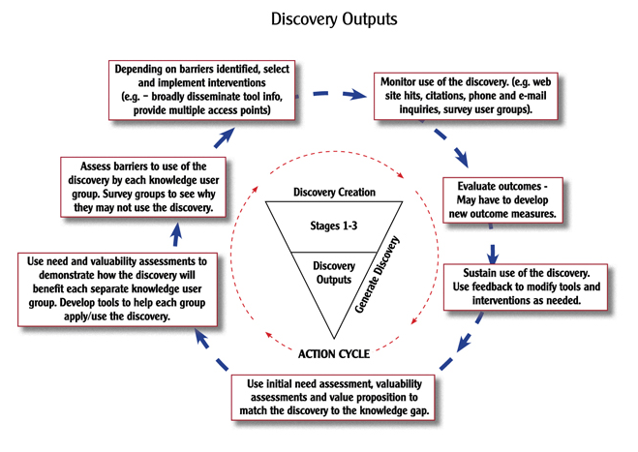
KT for Discovery Outputs

Slide 20
Opportunities for KT
1.1 Assess needs with input from stakeholders.
2.2 Perform preliminary valuability assessments with input from stakeholders.
3.1 Identify expertise needs and assemble transdisciplinary research team.
4.6 Initiate key co-development practices.
6.3 Test refined beta prototype with consumers in field.

Slide 21
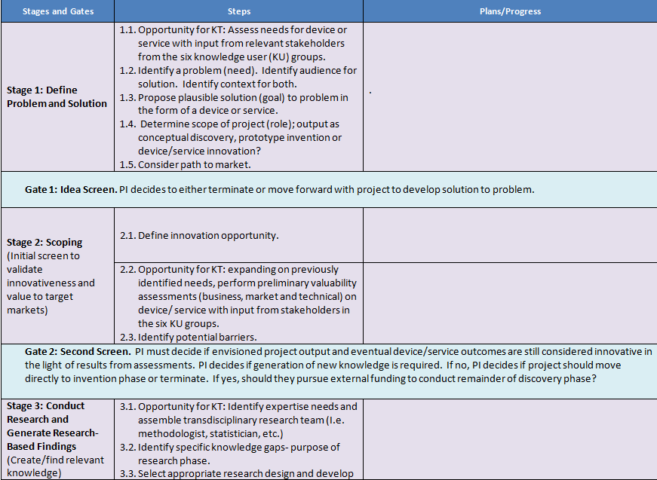
Practical Tool
TT Planning Template http://kt4tt.buffalo.edu/knowledgebase

Slide 22
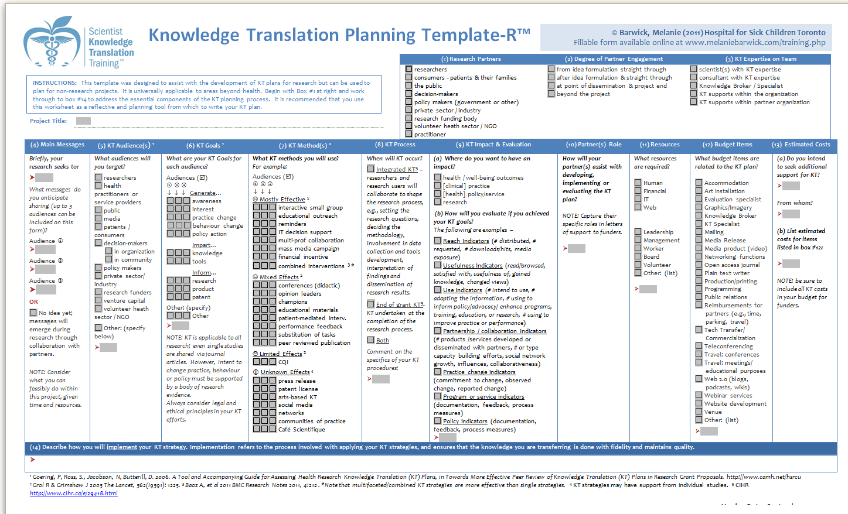
Practical Tool
KT Planning Template
Available at: http://www.melaniebarwick.com/training.php
Consider:
  Research partners
  Level of partner engagement
  KT expertise on team
  Messages
  Audiences
  KT goals
  KT methods & processes
  Intended impact & evaluation
  Role of partners
  Resources & budget → Estimated costs
  Implementation Plan

Slide 23
Resources
NCDDR KT Library
  http://www.ncddr.org/ktinfocenter/
KT Training Programs
  Scientist KT Training
  Knowledge Translation Professional Certificate

Slide 24
Key Take Aways
Involve Knowledge Users:
  Identifying research topics, questions and hypotheses
  Designing and implementing study methods
Pay attention to context
Tailor dissemination strategies
  Critical information, formats and channels
Use planning tools

Slide 25
Questions

Slide 26

ACKNOWLEDGEMENT
This is a presentation of the Center on Knowledge Translation for Technology Transfer, which is funded by the National Institute on Disability and Rehabilitation Research, U.S. Department of Education, under grant #H133A080050.
The opinions contained in this presentation are those of the grantee and do not necessarily reflect those of the
U.S. Department of Education.

