Slide 1


Best Practices in
Technology Transfer
Jennifer L Flagg
Center on Knowledge Translation for Technology Transfer
University at Buffalo

Slide 2

ACKNOWLEDGEMENT
The contents of this presentation were developed under a grant from the U.S. Department of Education
National Institute on Disability and Rehabilitation Research grant #H133A130014.
The opinions contained in this presentation are those of the grantee, and do not necessarily represent the policy of the U.S. Department of Education, and you should not assume endorsement by the Federal Government.

Slide 3
Learning Objectives
Identify 9 stages of activity involved in NPD and TT
Describe 7 universal design tools
Use online NtK Model to access best practices and tools
Notes:
What is most critical to understand here? What can I share with you that has a chance of sticking beyond this presentation?
I don’t expect you to remember the names of the 9 stages. But, you can always look those up online. But, there are a few key points that I may be able to help you keep in mind so that when you’re online looking at the model and remembering those 9 activity stages, you’ll get a bit more about how they actually work in practice.
We’ll do a deep dive into tools for universal design, and in doing so, you’ll get a glimpse of the online version of the NtK model, and be exposed to the ways that I will be accessing information from that model.
I’m going to briefly show you the model and the tools, then we’ll go into a few examples that illustrate key points… Need to put these upfront “here’s the NtK Model” slides up front, then lead into the stories.

Slide 4
History
Center’s core team funded since 1993
  1993-98: Supply push (technology driven)
  1998-2003: Demand pull (market driven)
  2003-08: Corporate collaboration
  2008-13: Generate models, methods, metrics
  2013-18: New! Tools and technical assistance
Notes:
Center’s history and my background… During the time this work was conducted, our team recognized that there were no operational models to guide technology transfer activities. In 2008 we were funded to fill this important gap by establishing the models, methods, and metrics that lead to quality of life impacts for people with disabilities via successful technology transfer. From this work, the Need to Knowledge Model- a guide to best practices in R&D for TT- was established.

Slide 5
What is Technology Transfer (TT)?
The process of changing ownership and control over an invention from the creator to a party intending to generate a commercial product or service.
When does TT happen?
The actual transfer of intellectual property is typically an intermediate step between development activity that generates invention outputs and production activity where commercial innovations are formed. However, market and business viability should be explored prior to initiating projects intended to produce innovations.
Notes:
Note the word “process” in this definition. Like many activities in our daily lives, TT is not just a one time event that fits into a neat little space in time. Instead, TT is often a long and winding journey that is most successful when preceded by certain actions.

Slide 6
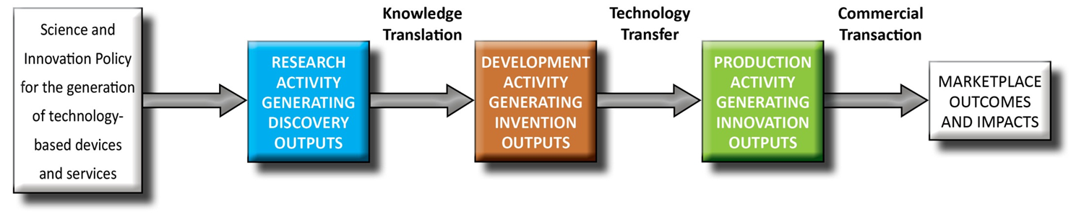
Three Methods & States
Notes:
We see TT here in the context of R&D projects that have begun with federal funding, and end with marketplace outcomes and impacts (i.e. improvements in quality of life for people with disabilities, that are resulting from the introduction of new products and services into the marketplace.) In this model, TT appears to be an activity that takes place in one set point in time. However, this simple diagram is simply representing TT as the point in time where the transfer of ownership and a change in the focus of activities takes place. Best practices in TT actually begin much earlier, and are a part of all preceding and some subsequent activities. In fact, the model we will be discussing today- the Need to Knowledge model- posits that TT should begin PRIOR to receiving funding to initiate a project.
It may help to think of TT as baking a cake. The time spent “baking” it will be just a fraction of the whole effort. In TT the “transfer” is just one of many points in the process. Thinking more about the cake example, we can see that a great deal of planning and infrastructure is needed to bake a cake. Even more so if you want to do it well! You’ll not only have to ensure that you have the necessary ingredients on hand, but you also need the right tools, such as an oven, a cake pan, a bowl for mixing ingredients, and of course a good recipe. I am going to share a model with you today that is your recipe to successful TT. It contains not only the details (tools) related to the actual TT event, but importantly, the ingredients that should be on hand preceding the actual transfer event.

Slide 7
The Need to Knowledge Model
Stage gate model for generating and commercializing technology based innovations.
Represents all stages and steps from initial conception through launch, maturity and decline of a product.
  3 phases (Research, Development, Production)
  9 stages/gates
  58 steps
  3 transitions between stakeholders
    Knowledge Translation (KT)
    Technology Transfer (TT)
    Commercial Transaction (CT)
Notes:
The NtK is focused on describing the tools and techniques that are relevant to entities that are trying to generate commercial products and services for the assistive technology marketplace.

Slide 8
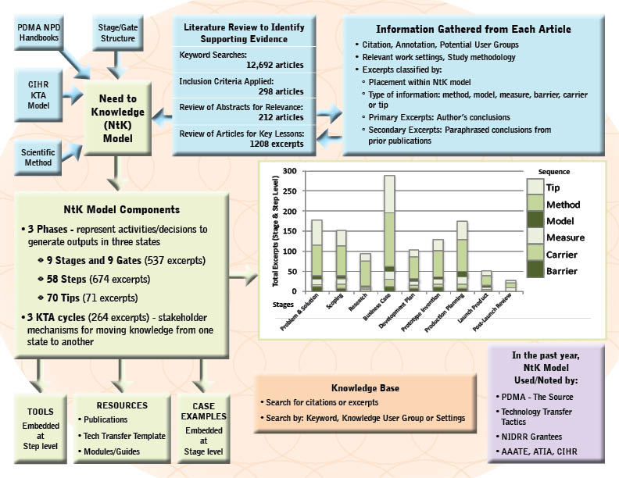
Schematic
Notes:
Orientation – Actors engaged in innovation “need to know”: Problem/Solution; Methods/Outputs; Stakeholder roles; and Goal in context of beneficial socio-economic impacts.
Integration – Product Development Managers Association (PDMA) New Product Development practices (implementation); Canadian Institutes of Health Research (CIHR) Knowledge to Action Model (communication).
Validation – Stage-Gate structure populated with supporting evidence (1,000+ excerpts) from scoping review of academic and industry literature, along with links to tools for completing recommended technical and market analyses .

Slide 9
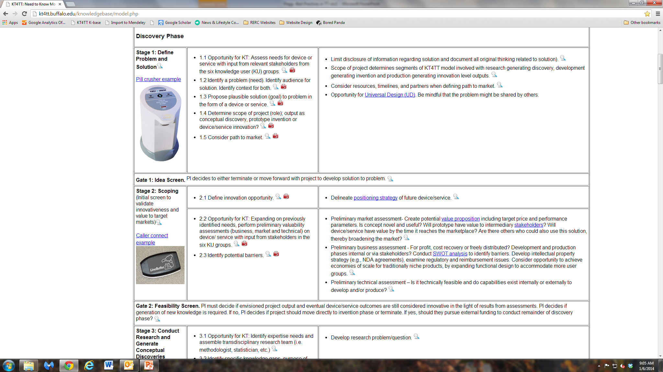
Screen Shot of NtK

Slide 10
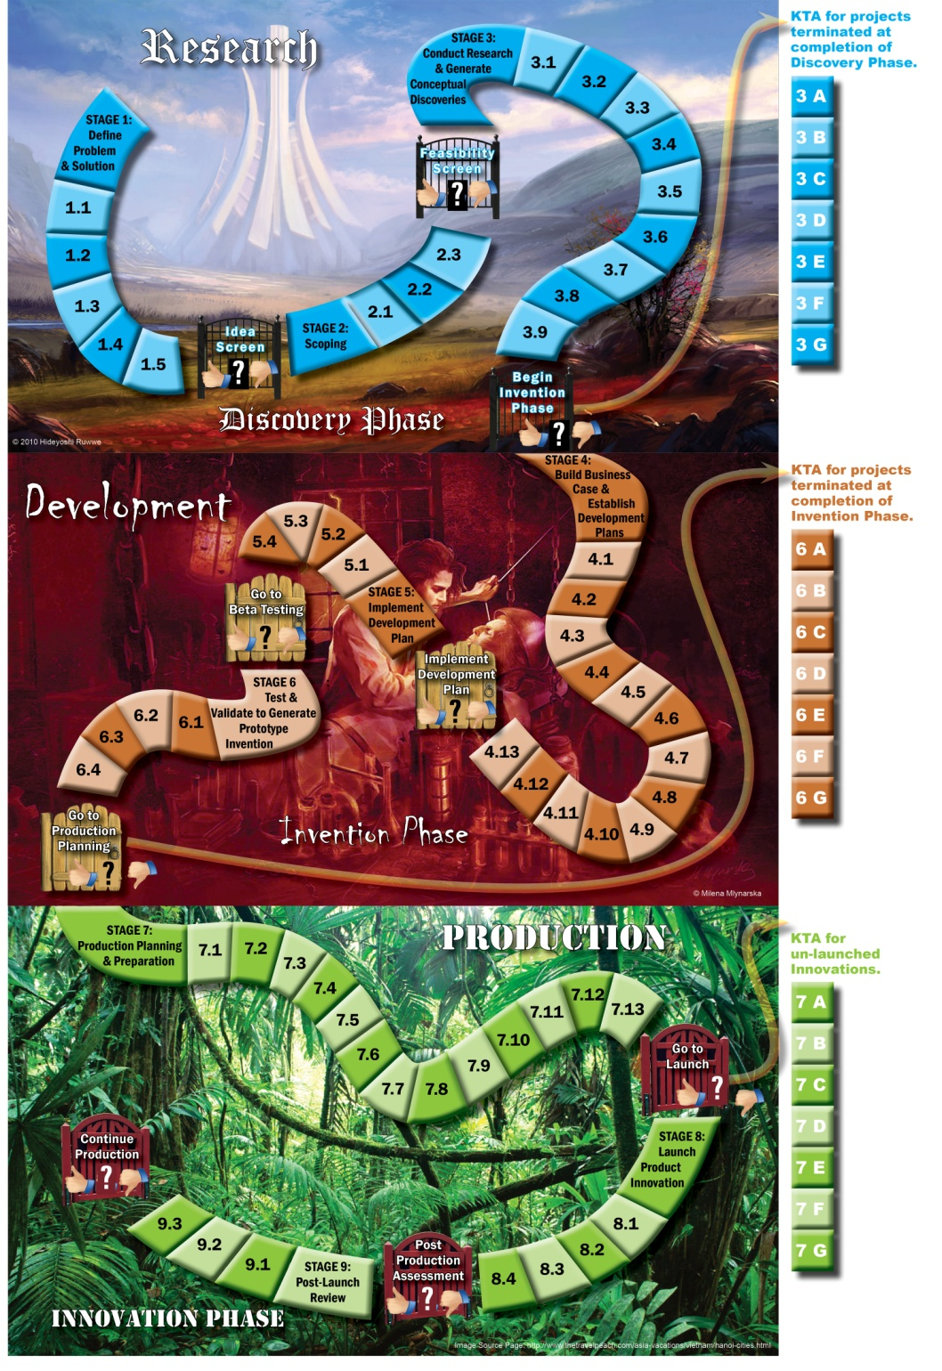
“Gamification” of Technological Innovation
~~~
Click on the path to reveal step names and links to more information
Notes:
Progress through three Methods of Knowledge Generation, and the effective Communication of three Knowledge States, may be circuitous and iterative, punctuated and prolonged, risky and unpredictable, yet still be planned, implemented and accomplished through the deliberate and systematic efforts of key stakeholders.

Slide 11

Where are the Best Practices?
NtK combines PDMA, KTA, and scientific research processes
Supporting evidence associated with each stage, step, and tip offer best practices as defined by academic and practice literature
Effective practices derived from real life case examples for each stage
Notes:
BP’s are represented on many levels throughout the model.
First, the model is based upon other BP models that have been combined.
Second, the model is supported by literature from academia and practice, which details BP’s in an array of contexts using varied methods.
Lastly, case examples from the KT4TT’s own experience are found throughout the model- one for each stage.

Slide 12

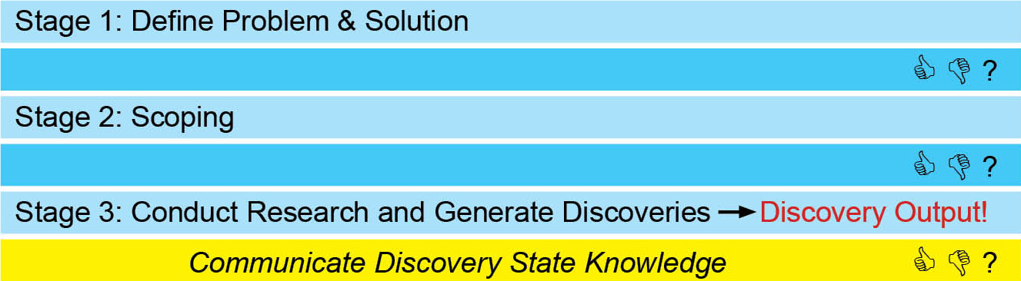
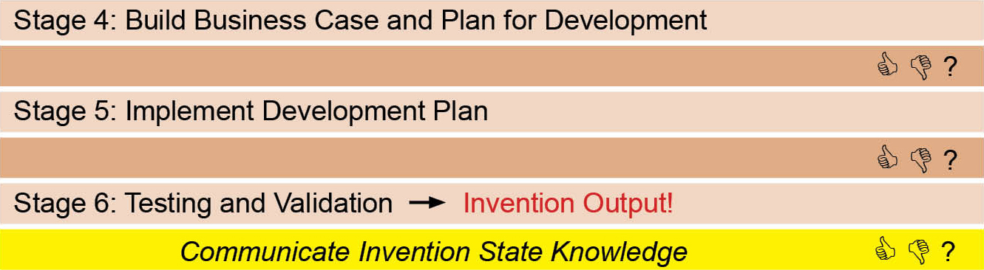
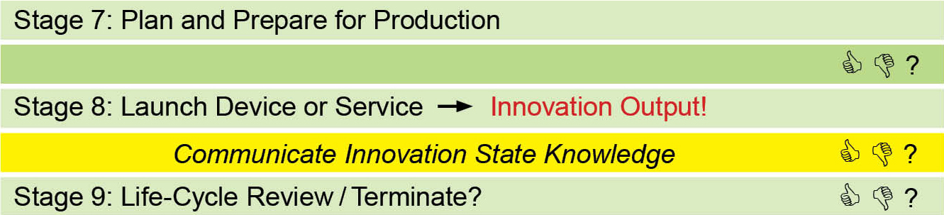
Need to Knowledge (NtK) Model for Technological Innovations
Notes:
As we see in this slide, on the left, we have three phases of activity aligned with the three types of outputs I just mentioned…
What I want to you to pick up from this slide is that the generation of each type of output requires a distinct set of activities. Similarly, the transfer of knowledge from producers to users will be distinct for knowledge in each state.
Give examples of the type of activity that would happen during each phase.

Slide 13
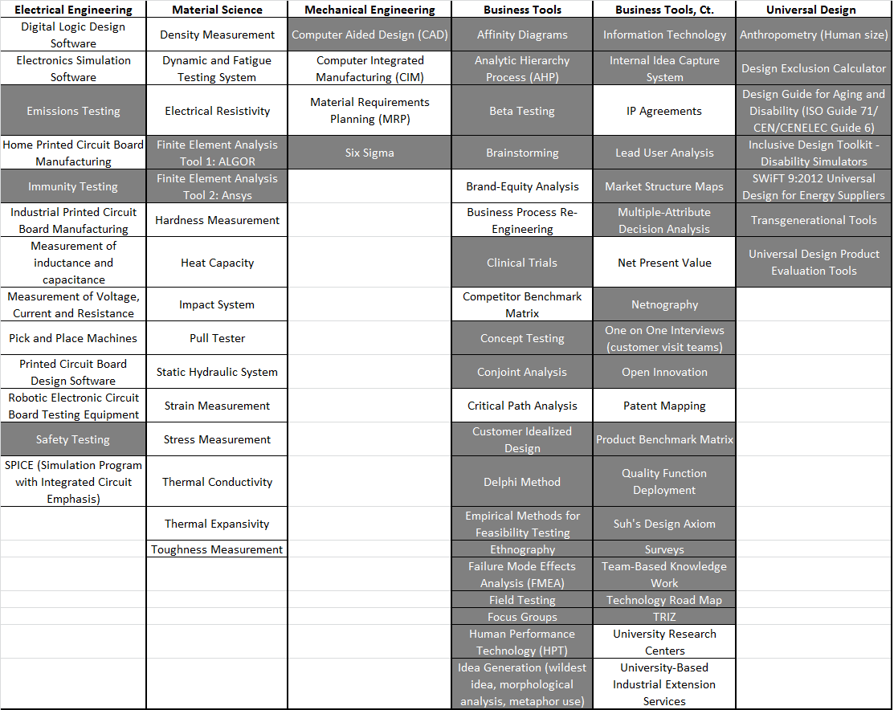
NtK Model Tools
Notes:
79 tools in 5 categories
Electrical/Electronic (13)
Material Science (15)
Mechanical Engineering (4)
Business (40)
Universal Design (7)
Note: Many non-UD tools have some relevance to the practice/philosophy of UD (shaded are relevant to UD)

Slide 14
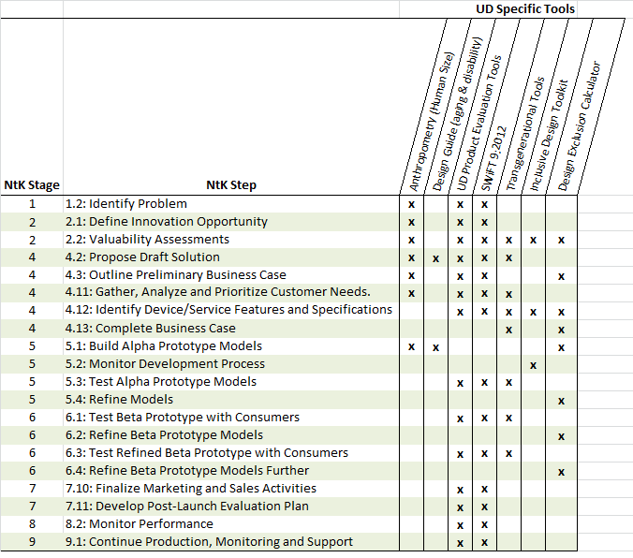
UD Tools within the NtK

Slide 15
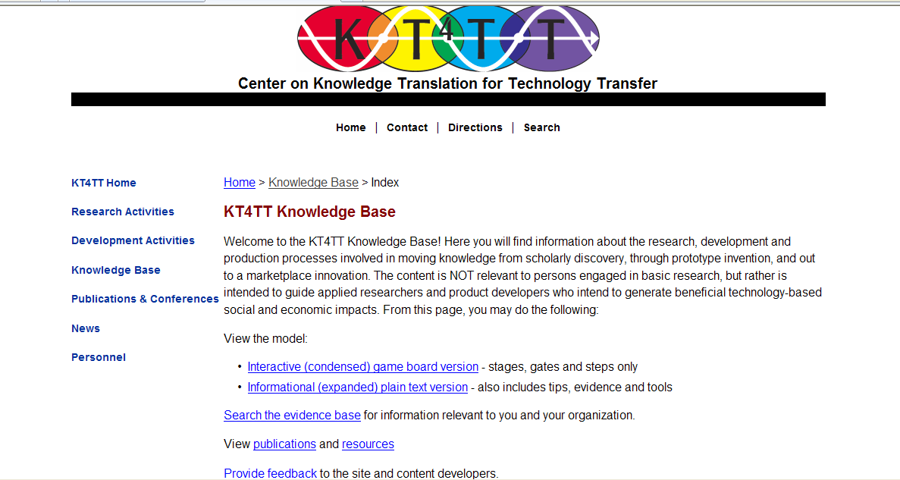
Accessing the NtK and Tools
Visit http://kt4tt.buffalo.edu/knowledgebase
Notes:
Visit http://kt4tt.buffalo.edu/knowledgebase

Slide 16
2 versions of the NtK

Slide 17
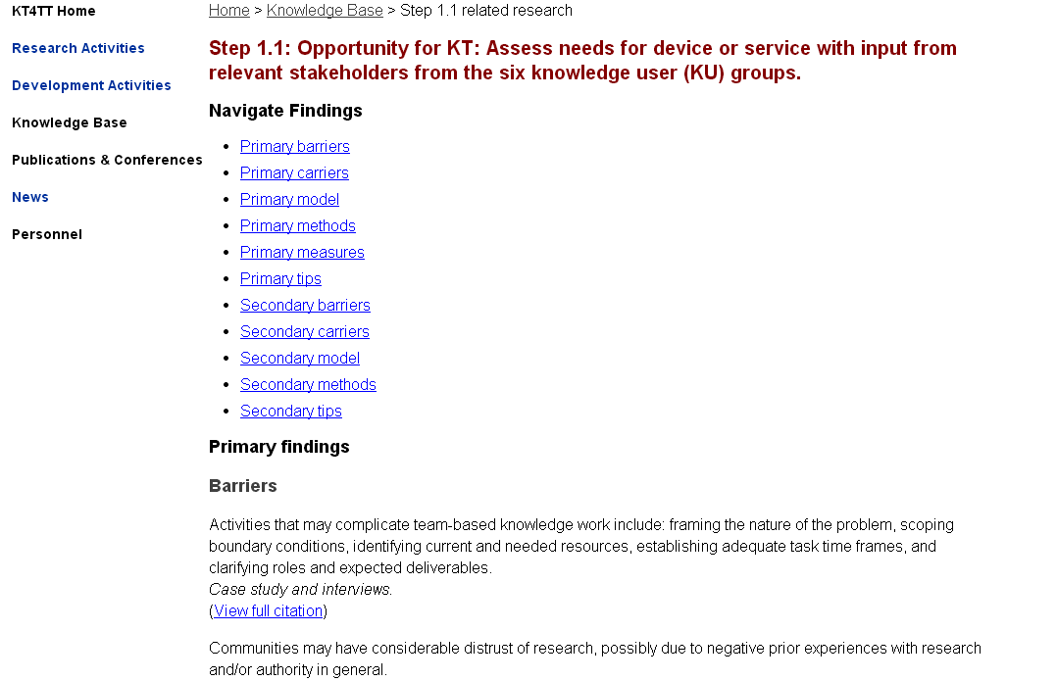
Supporting Evidence

Slide 18
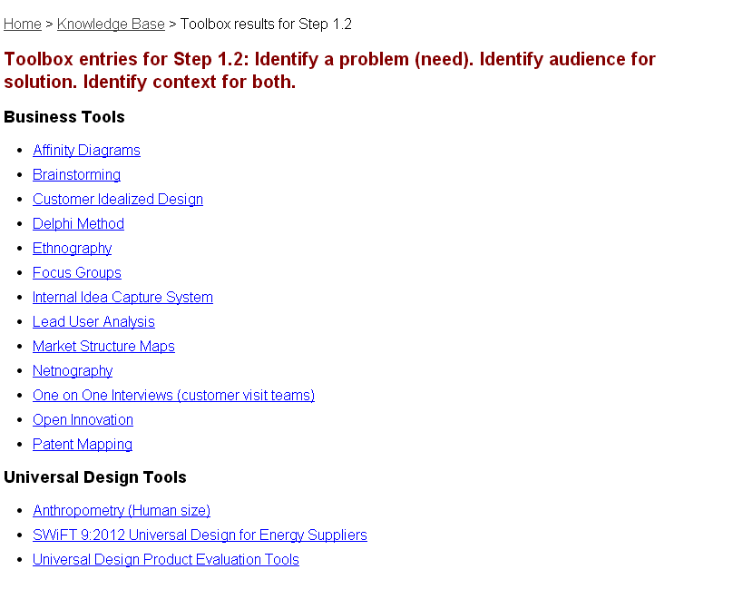
Tools

Slide 19
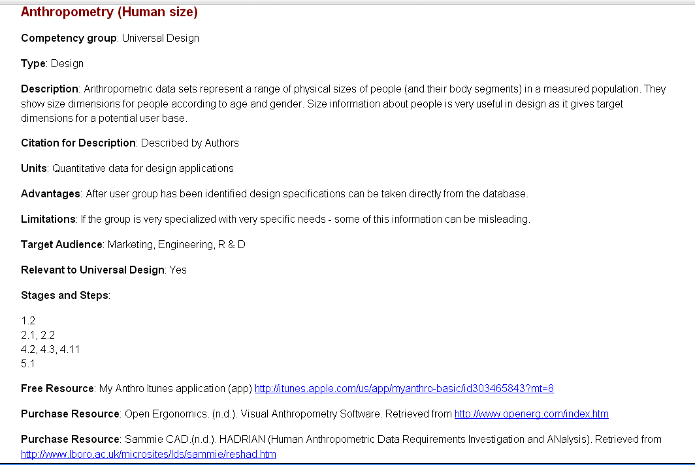
Detailed Tool Listing

Slide 20
Case Examples
Caller Connect (Stage 2)
Lids Off Jar Opener (Stage 4)
Wheelchair Braking System (Stage 7)
Notes:
W/C Braking System- Give them the back-story that you can’t read online. Tell them about the nursing home contacting us, Homer, and his needs. Tell about the fact that with those needs in hand, we conducted due diligence to see if a solution existed- and we found one. Without having first done that research we could have easily wasted tens of thousands + creating a new solution when there was already one that was patented.

Slide 21
Key Takeaways
Due diligence saves money and time
Reduction to practice is a necessary part of the process, but ideas are often adopted more readily than hard forms
Manufacturing partners expect industry standard methods
Broaden the target market when possible
Notes:
Due diligence saves money and time- If we hadn’t done our due diligence with the w/c braking system, we would have reinvented an already patented invention.
Reduction to practice is a necessary evil, but ideas are often adopted more readily than hard forms- true for both the braking system and jar opener (and others– pill crusher…). We had to prove technical feasibility, but in both cases the company then took the core concepts and developed something else that utilized their own resources and capabilities. In the jar opener case, giving away ideas rather than specs eliminated any concern from the manufacturer that we might make intellectual property claims later on… And from our perspective, gave us the ability to help the company wouldn’t have to worry about royalties.
Manufacturing partners expect industry standard methods- Whirlpool appreciated our ability to deliver marketing info that was gathered using techniques they felt were valid.

Slide 22
Recap on Accessing the NtK Model and Tools
Visit: http://kt4tt.buffalo.edu/knowledgebase/index.php
Click link for Informational (expanded) plain text version of model.
Scroll down page to review stages, gates, steps and tips.
Click magnifying glass icons for supporting evidence.
Click toolbox icons for tools.
Case example links found on left side of each stage.

Slide 23
Resources
Need to Knowledge Model: http://kt4tt.buffalo.edu/knowledgebase/model.php
Publications Page on Website: http://kt4tt.buffalo.edu/publications
Website Resources: http://kt4tt.buffalo.edu/publications/ResourceMaterials/index.php
  Primary Market Research Training Module
  Intellectual Property Training Module
  Inventor’s Guide
  Evaluation Resource Guide
Focus Technical Briefs
  KTDRR’s KT Library- Technology Transfer section: http://www.ktdrr.org/ktlibrary/articles_pubs/tt.html
Notes:
Primary Market Research Training Module- Sampling and recruitment; Focus groups & surveys; Outsourcing considerations
Evaluation Resource Guide- Basic concepts; Case studies; Sample Instruments
23

Slide 24
Session Evaluation Reminder
Go To:
“Session Evaluation” Tab in ATIA Mobile Phone App to evaluate this session.
Session:
RSCH – 11
“Best Practices in Technology Transfer”

Slide 25
Continuing Education Credits
ACV-RSCH-11
Code for Academy for Certification of Vision Rehabilitation & Education Professionals

Slide 26
Thank you!
Any Questions?

