Slide 1


Technology Transfer for KT Practitioners
Jennifer L Flagg
Center on Knowledge Translation for Technology Transfer
University at Buffalo

Slide 2

ACKNOWLEDGEMENT
The contents of this presentation were developed under a grant from the U.S. Department of Education
National Institute on Disability and Rehabilitation Research grant #H133A130014.
The opinions contained in this presentation are those of the grantee, and do not necessarily represent the policy of the U.S. Department of Education, and you should not assume endorsement by the Federal Government.

Slide 3
Learning Objectives
Understand the activities involved in generating and translating/transferring knowledge to external parties.
Identify the major phases of the new product development process.
Describe various forms of intellectual property protection and when they would be used.
Articulate how the Knowledge to Action model can be used to define TT activities.
Notes:
What is most critical to understand here? What can I share with you that has a chance of sticking beyond this presentation?
I don’t expect you to remember the names of the 9 stages. But, you can always look those up online. But, there are a few key points that I may be able to help you keep in mind so that when you’re online looking at the model and remembering those 9 activity stages, you’ll get a bit more about how they actually work in practice.
We’ll do a deep dive into tools for universal design, and in doing so, you’ll get a glimpse of the online version of the NtK model, and be exposed to the ways that I will be accessing information from that model.
I’m going to briefly show you the model and the tools, then we’ll go into a few examples that illustrate key points… Need to put these upfront “here’s the NtK Model” slides up front, then lead into the stories.

Slide 4

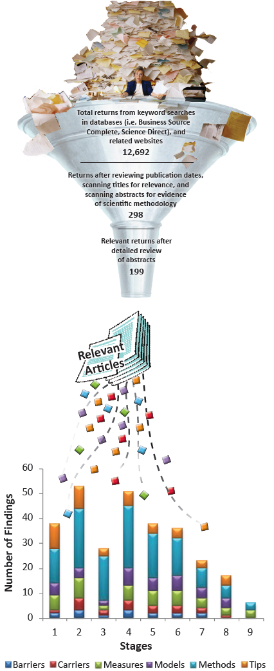
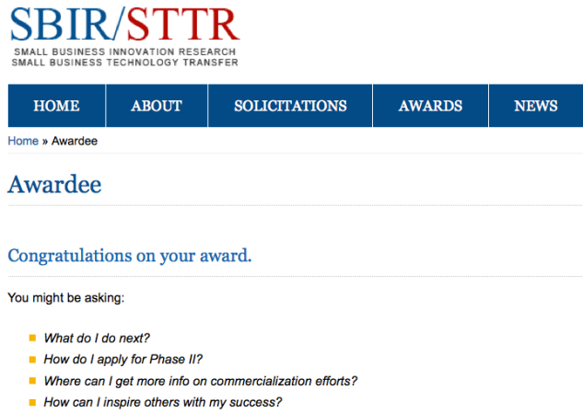
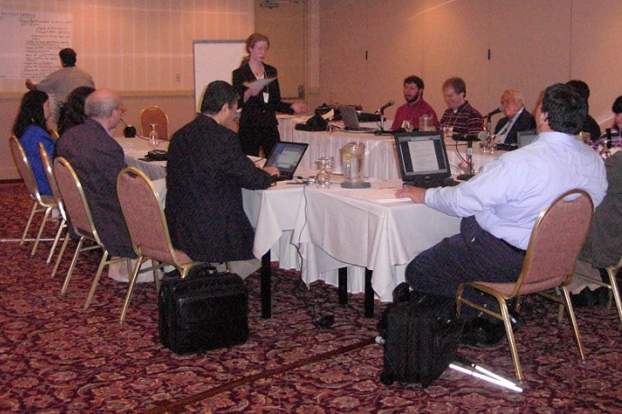
My Background

Slide 5
Organizational History
Tech Transfer Rehab Engineering Research Center
  1993-1998: Supply push (technology driven)
  1998- 2003: Demand pull (market driven)
  2003-2008: Corporate collaboration
Center on Knowledge Translation for Tech Transfer
  2008-13: Generate models, methods, metrics
  2013-18: New! Tools and technical assistance
Notes:
Center’s history and my background… During the time this work was conducted, our team recognized that there were no operational models to guide technology transfer activities. In 2008 we were funded to fill this important gap by establishing the models, methods, and metrics that lead to quality of life impacts for people with disabilities via successful technology transfer. From this work, the Need to Knowledge Model- a guide to best practices in R&D for TT- was established.
Last cycle-
NtK Model established
Value mapping study
RCT- 2 interventions, targeted KDU, targeted and tailored KT
Targeting made difference in awareness, but increases in use were not significant
This cycle-
Variant models
Success factors (prospective study to complement prior retrospective)
TTPT

Slide 6
TT and its Relation to KT
Tech Transfer (TT) involves communicating information regarding a knowledge output to stakeholders who operate in unique contexts according to their particular values and incentives.
As KT professionals, we can help knowledge producers to better communicate with knowledge users in all circumstances- including those where a device or service may eventually be produced.

Slide 7
You are probably somewhat familiar with the Research Process…
Stage 3: Conduct Research and Generate Research-Based Findings
Opportunity for KT: Identify expertise needs and assemble transdisciplinary research team (I.e. methodologist, statistician, etc.)
Identify specific knowledge gaps- purpose of research phase.
Select appropriate research design and develop research plan (action research, grounded theory, cooperative research, clinical research, etc).
Secure funding.
Conduct research.
Monitor and track quality.
Refine process and optimize quality of results.
Results - integrate findings.
Conclusion – evaluate discovery in light of solution.
Notes:
The first step in this research process is intended to encourage the use of an integrated KT process- that is, beginning a project in collaboration with a variety of stakeholders, including potential knowledge users.
Mention similarities to the larger process at hand. We’ll see later on that a lot of what is happening in the formal research process is mirrored on a larger scale through NPD- it’s just in a different context. From the need identification to selecting appropriate design. But what happens is that reseaarchers think of all of their R&D as happening here- they pigeonhole all D and testing into the Conduct research step, when they really should be calling for entirely different sets of methods to do the D work. This is only a piece of the process.
As KT professionals, perhaps we can help researchers to see what is missing from their process outlines.

Slide 8
Two Paths for Research Output
Path 1 – Communicate Conceptual Knowledge through Publication.
Path 2 – Transform Conceptual to Practical through further effort.
  Development effort to create and test Prototype, followed by:
  Production effort to create and launch Device/Service.

Slide 9
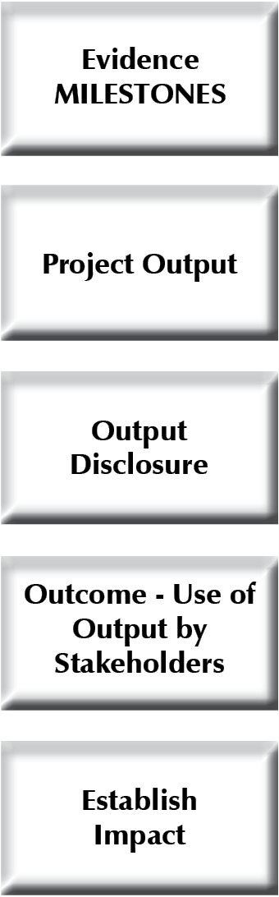





Outputs and outcomes
Notes:
This slide helps us to see just how different the outputs and outcomes from research, development and production can be. The grantees that I work with are typically trying to get to the final green square- they want to advance that state of the practice by generating technological innovations that will improve quality of life for people with disabilities. But, they are often using research methods in an attempt to get there. That’s akin to using the boat that you used to sail across Lake Ontario to get through city traffic on land. The boat will not travel on land, just as research activities will not result in invention outputs. We need another method- feet or a car- to travel on land. And we need another method- engineering development- to create invention and innovation outputs and outcomes.
So, we can think of generating innovations as requiring three distinct processes- each of which generates a different type of output. There are often different actors involved in each process, and KT can help improve communication between those actors to create a seamless “new product development” process.
One of the biggest problems that we have in helping grantees with their TT is akin to the saying “to a hammer, everything looks like a nail.” Similarly, to a traditional researcher, everything looks like a research problem that can be solved with research methods. So, when a researcher is describing a project that is actually developing a prototype invention, they will still characterize it all as research. The big problem is that in doing so, they skip many process steps that are necessary to generating an output that has commercial potential- for example, market assessments, competing product searches, prior art searches within the patent and trademark offices. Frequently these projects end up reinventing the wheel, or creating an invention that is too expensive for consumers to afford, or has too small a market size for a manufacturer to justify the expense of producing the product. There is also this “build it and they will come” mentality that does not reflect reality.
When we think of research outputs, we know that you can publish a paper and it will automatically be put in front of numerous stakeholders who have an interest in that topic area. The journal is doing the marketing for you- they have identified the target market for a specific topic area, and have subscribers who are seeking new knowledge in that domain. They distribute the information to the potential end users, and even provide the mechanism for an interested party to contact the original researcher (corresponding author information). But, when we have a prototype invention, the dissemination tactics have to be very different. It is not enough to “publish” a patent and expect that an interested manufacturer will find it and then contact you to discuss licensing it. (Not that it can’t happen- wheelchair braking system story- it’s just not likely.)
So, why don’t we disseminate information about prototypes in the same way that we do discoveries- Through print and web publications, conference presentations, and online venues? 1) Rarely are people looking for the knowledge that you have generated. Most of the time, manufacturers will develop their own solutions in house, rather than seek external sources- this happens for many reasons. There is truth to the “not invented here syndrome”- this is where someone would rather push forward their own idea instead of developing someone else’s. (You’ll treat your child with more care than your neighbor’s child.) Another reason is that company funds get committed to ongoing projects, and rarely is there a great deal of slack resources just waiting for some new product idea to pop up that is worthy of investment. And you never know where the current project ideas came from- your concept may be directly competing for resources with a project that was the brainchild of the company owner’s son. Whose idea will they invest in? If it’s going to be yours, you would have to make quite a compelling case regarding the business opportunity at stake with your invention.
The point of all of this is, Research is different than development, which is different than production. Each method has its own steps, its own rigor, and its own particular output. And each must be communicated to the stakeholders who can advance the output in a unique way.

Slide 10
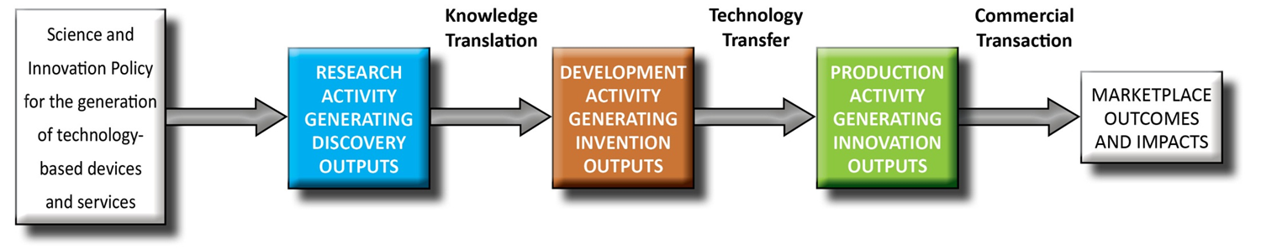
When does TT happen?
What is Technology Transfer?
The process of changing ownership and control over an invention, from the creator, to a party intending to generate a commercial product or service.
Best Practices in TT
Notes:
The actual transfer of intellectual property is typically an intermediate step between development activity that generates invention outputs and production activity where commercial innovations are formed. However, market and business viability should be explored prior to initiating projects intended to produce innovations.
We see TT here in the context of R&D projects that have begun with federal funding, and end with marketplace outcomes and impacts (i.e. improvements in quality of life for people with disabilities, that are resulting from the introduction of new products and services into the marketplace.) In this model, TT appears to be an activity that takes place in one set point in time. However, this simple diagram is simply representing TT as the point in time where the transfer of ownership and a change in the focus of activities takes place. Best practices in TT actually begin much earlier, and are a part of all preceding and some subsequent activities. In fact, the model we will be discussing today- the Need to Knowledge model- posits that TT should begin PRIOR to receiving funding to initiate a project.
It may help to think of TT as baking a cake. The time spent “baking” it will be just a fraction of the whole effort. In TT the “transfer” is just one of many points in the process. Thinking more about the cake example, we can see that a great deal of planning and infrastructure is needed to bake a cake. Even more so if you want to do it well! You’ll not only have to ensure that you have the necessary ingredients on hand, but you also need the right tools, such as an oven, a cake pan, a bowl for mixing ingredients, and of course a good recipe. I am going to share a model with you today that is your recipe to successful TT. It contains not only the details (tools) related to the actual TT event, but importantly, the ingredients that should be on hand preceding the actual transfer event.

Slide 11
A Closer Look at the Process
The Need to Knowledge Model
Stage gate “best practices” model for generating and commercializing technology based innovations.
  3 phases (Research, Development, Production)
  9 stages/gates
  58 steps
  3 transitions between stakeholders
    Knowledge Translation (KT)
    Technology Transfer (TT)
    Commercial Transaction (CT)
Notes:
Throughout the years, our organization had great success transferring more than 50 assistive technology products to the marketplace. We were aware that other grantees had a great deal of difficulty in accomplishing transfers and set out a project to explore the reasons why that was the case. We conducted a retrospective study of 78 recent development projects from 13 RERC’s and sought evidence of progress towards a transfer outcome. As it turned out, nearly half of all projects were plagued by issues related to project management and resource allocation. That is to say that the research projects and research components of development projects were all very well specified, staff was allocated in such a way as to allow for slack where needed, and specialists (think statisticians) were brought in to the project team when necessary. Development projects however, lacked these elements- process planning was vague or undefined entirely, and money was typically not allocated to gain expertise in the areas of marketing, finance or product design.
These findings led us to a better understanding of what was missing from the grantees’ “bag of tricks”. That is, they lacked the experience and training in business that could have helped them to properly plan their development and transfer projects. Without a roadmap of sorts to guide these activities, researchers were stumbling down a dimly lit path where marketplace success was elusive to say the least. With this unmet need in mind, our team set out to generate a solution.
First, we have already discussed the three phases of activity- research, development and production. Each process is unique, and each generates its own type of outputs.
Next, we began by thinking about the importance of knowing when to stop a project in its tracks. Businesses often “kill” projects when it appears that sufficient revenues will not be able to be captured from the market. That is to say, businesses know that they must profit from sales of a product or service- which means that they must be able to produce a product, market and distribute it, and service it after the sale is completed- for less money than the consumer is willing to pay for it. Otherwise, there would be no room for profit. In business, “gates” are often used as check points where managers review the work of their staff to evaluate opportunities and threats, to ensure that only profitable projects are pursued. As increasing levels of investment are required to harden a product for production, the concept passes through increasing levels of scrutiny. Grantees have never had such a check imposed. Once the funding is allocated, most projects proceed unchecked. And in fact, we have seen many cases where a competing product arrives in the marketplace, or market conditions change (perhaps a funding level for a type of device is reduced) during the development process. In that case, a company would reevaluate the situation to ensure their product concept will remain viable in the marketplace, while their grantee counterparts typically continue pushing forward anyway, because they were already funded to do it. I think we can all agree that when a concept no longer has a chance of commercial success, it may make more sense to reinvest the project’s funding to other more potentially fruitful activities. This is where the stage/gate notion of the model comes into play. The NtK is divided into 9 stages and 9 gates. Each stage requires an increased level of financial investment for completion. The gates offer an opportunity to reconsider a project’s viability before continuing investments are made.
In order to lay out a best practices model for technology transfer we turned to the experts- new product developers have been effectively and efficiently bringing new products and services to the marketplace for many years. The field of new product development has been growing by leaps and bounds, and a great deal of information regarding best practices has been explored and documented in scholarly publications. Among those are the three handbooks and three tool books compiled by the PDMA. A through review of these books gave shape to the basic structure of the NtK model- with multiple researchers scouring the books for key process steps. After the basic framework was erected, we confirmed our findings by reviewing approximately 230 articles regarding NPD. A team of three researchers read these articles, and pulled salient points that were collected in a database. We used these excerpts to ensure that the NtK framework was not missing any steps, and structured the database such that all information is freely accessible to interested practitioners and researchers.
We also took a look at the key differences between standard NPD and technology transfer. First, the NPD literature rarely (if ever) discusses research in the same context that an academic would understand research. In industry, research is lumped in with R&D in a way that emphasizes development and market potential (often called the fuzzy front end). In academia, research is much more focused on pure or basic research that employs rigorous methodology to answer some pressing research questions. To reconcile these differences, we embedded the research process that is recognized by academics into the larger NPD process. Importantly, this set of activities- the whole research process- was embedded AFTER a problem and solution have been defined, and some preliminary scoping reviews have taken place. This placement is very deliberate, and is intended to demonstrate the critical importance of beginning with the end in mind. When we are conducting research that is intended to be leveraged in a new product or service, we must ensure that the proposed product or service is feasible to produce, and that there will be a market of buyers once it is created.
A few other key differences that are relevant to TT were also included in the NtK, such as finding a transfer partner and initiating key co-development practices; and evaluating the potential path to market, which will likely involve a technology transfer office.
Finally, we considered best practices for communicating knowledge between stakeholder groups, and how and where that communication might occur depending on a person’s intended goals and the role they have specified for themselves in a project. We reviewed a range of KT models, and found that the KTA – Knowledge to Action model’s action cycle- was an excellent representation of the processes used by businesses for marketing and selling products to consumers. So we created new versions of the KTA that are specifically relevant to tech transfer. They include (1) an opportunity to communicate a research output to someone who can then begin technology development activities; (2) tech trasnfer communication that highlights the market potential and value of a new invention that is in need of a licensee; and (3) an opportunity to create a scholarly work from a less than fruitful project, where a product that did not successfully pass through test marketing (i.e. consumer’s didn’t like it). The thinking here is that some value can be realized even from a failed project, by sharing lessons learned with others.
Now, let’s take a look at the NtK Model printouts that I have provided to you, and review some key steps.

Slide 12

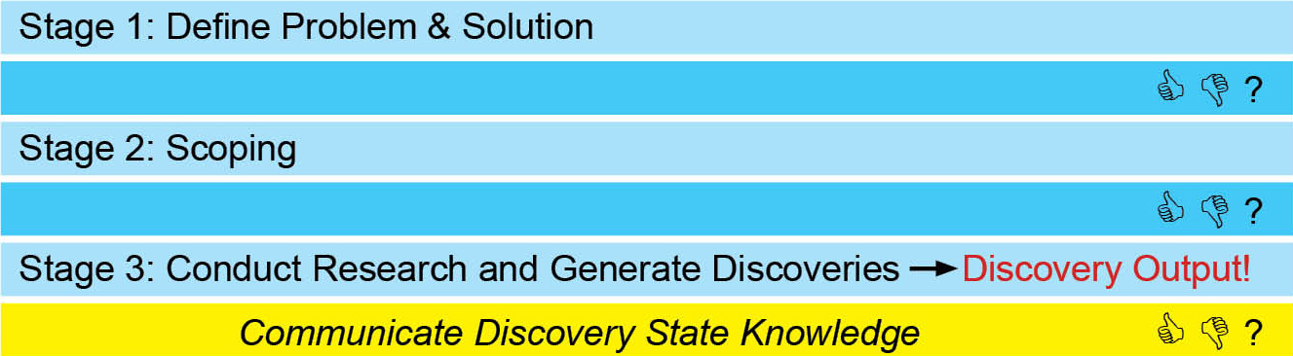
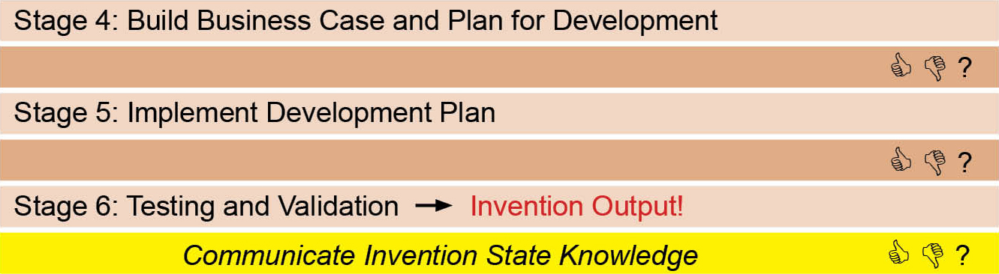
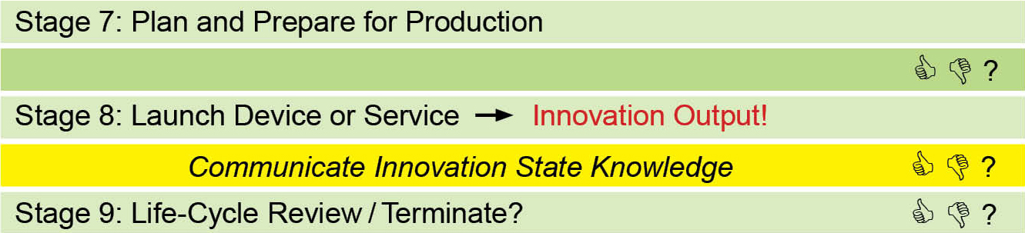
Need to Knowledge (NtK) Model Outline
Notes:
As we see in this slide, on the left, we have three phases of activity aligned with the three types of outputs I just mentioned…
What I want to you to pick up from this slide is that the generation of each type of output requires a distinct set of activities. Similarly, the transfer of knowledge from producers to users will be distinct for knowledge in each state.
Give examples of the type of activity that would happen during each phase.

Slide 13
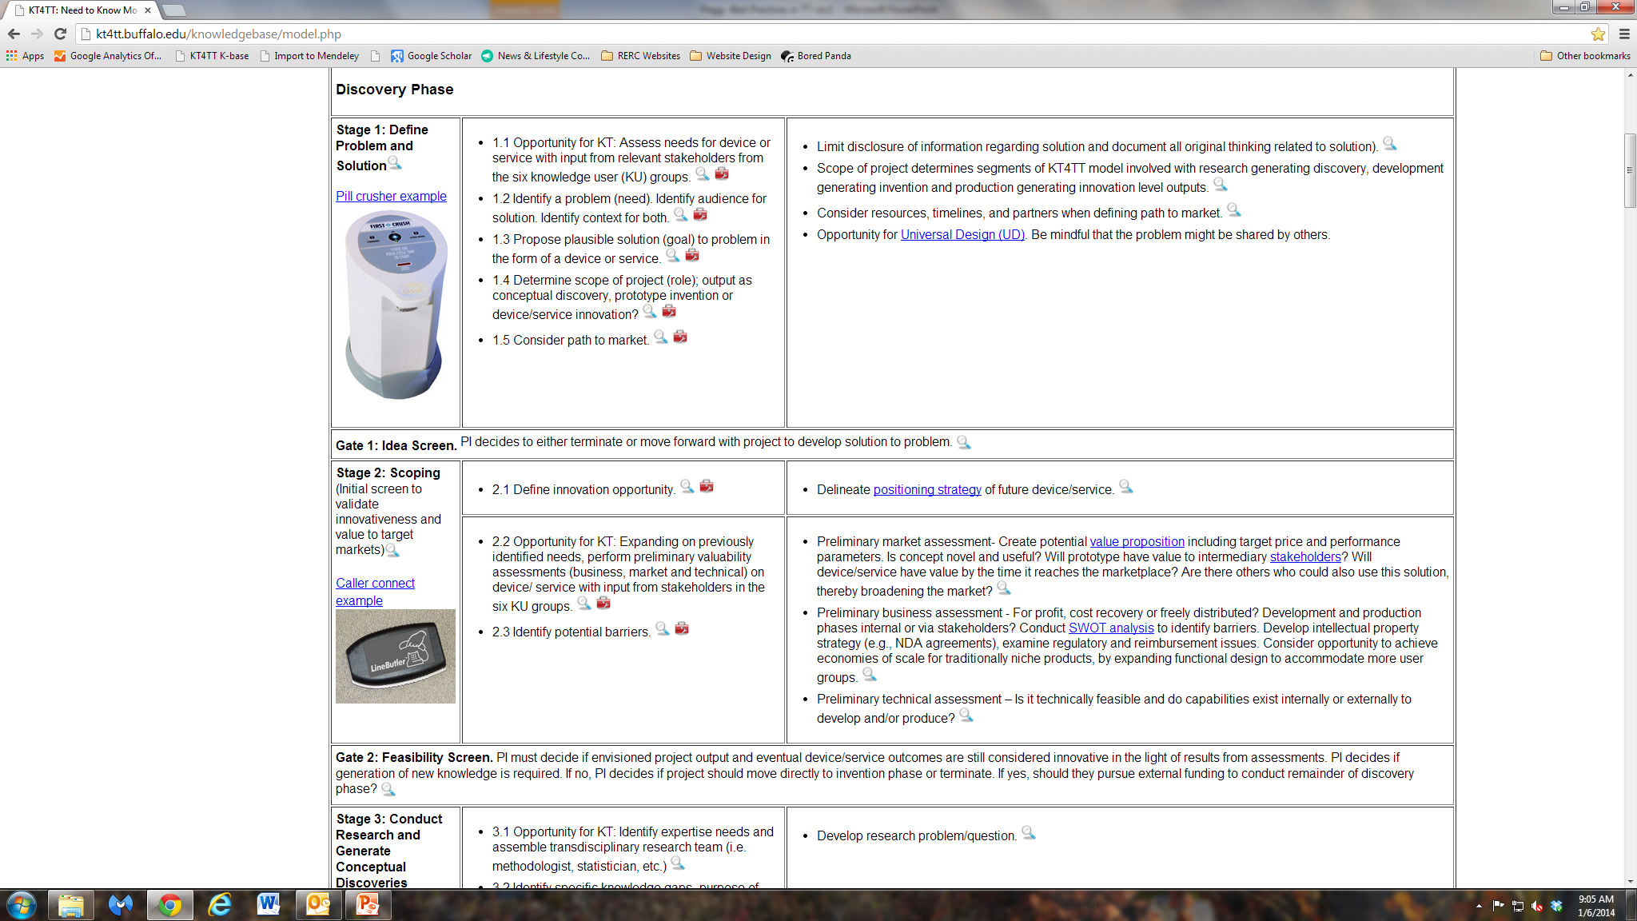
Screen Shot of NtK
Notes:
Go through the major components shown here. Supporting evidence, tools, and glossary.
Show the case examples and talk briefly about each and the lesson it imparts.
Stage 1: Pill crusher- example of a patented invention being licensed to a manufacturer.
Stage 2: Caller connect- Early examination of market resulted in a decision to expand the target market to include other segments of the mainstream population. Project ultimately killed due to new disruptive technology entering the marketplace, because the disruptive tech would have rendered the product obsolete.
3: Fridge door opener- Project killed because market was too small to justify tooling and production expense. However, results from research regarding the amount of force required to break fridge door seal were forwarded to manufacturers for use in new designs.
4: Lids off jar opener- Lessons in working with a company to get buy-in early on; providing them what was missing – in this case validating the need, defining the features and functions (but let them figure out how to integrate them), and defining the price point and purchase intent (hidden lesson in buyer not always being the end user came out here).
5: Tuppeware healthy eating system- Expanded a company’s market by showing them an unmet need by way of focus groups.
6: White Rodgers thermostat- Example of successful and rigorous beta testing in the lab and within consumer’s homes.
7: Wheelchair braking system- Got all the way through trial selling, but technical challenges wound up killing the project.
8: Pointsmart- Tracking of consumer complaints and bugs used for V2.
9: Coin-U-Lator – After sales service and reviews led to multiple spin off products

Slide 14
TT Best Practices
NtK combines PDMA, KTA, and scientific research processes.
Supporting evidence associated with each stage, step, and tip offer best practices as defined by academic and practice literature.
Effective practices derived from real life case examples for each stage.
Notes:
BP’s are represented on many levels throughout the model.
First, the model is based upon other BP models that have been combined.
Second, the model is supported by literature from academia and practice, which details BP’s in an array of contexts using varied methods.
Lastly, case examples from the KT4TT’s own experience are found throughout the model- one for each stage.

Slide 15
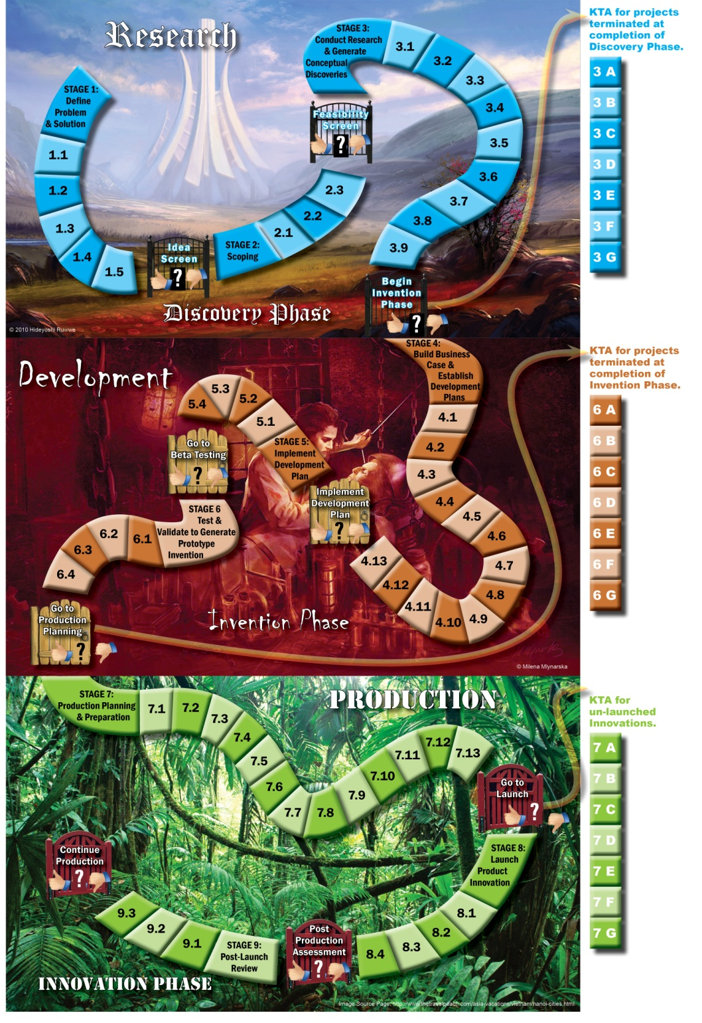
KT4TT in Action!
-----
“Gamification” of Technological Innovation
Notes:
Progress through three Methods of Knowledge Generation, and the effective Communication of three Knowledge States, may be circuitous and iterative, punctuated and prolonged, risky and unpredictable, yet still be planned, implemented and accomplished through the deliberate and systematic efforts of key stakeholders.
Untouchable ivory tower of academia
Frankenstein's lab where development activity is occurring
Jungle- teeming with resources, but you have to know where to find them.
Also, survival of the fittest-

Slide 16
Intellectual Property
“Creations of the mind – creative works or ideas embodied in a form that can be shared or can enable others to recreate, emulate, or manufacture them” (USPTO)
Four primary types of IP protection:
  Patent
  Copyright
  Trademark
  Trade Secret

Slide 17
Copyright
Protection of original works of authorship including literary, dramatic, musical, and artistic works, such as poetry, novels, movies, songs, computer software, and architecture.
Copyright does not protect facts, ideas, systems, or methods of operation, although it may protect the way these things are expressed.
Copyright protection is automatically afforded to the author of the materials listed above upon creation.
U.S. Copyright Office: http://www.copyright.gov/help/faq/faq-general.html#what
Notes:
It’s important to consider copyright ownership when you are publishing information through outside parties. For example, traditionally, journals typically owned the copyright to your work once they published it. This may or may not be the case for open access publications. Just because a publisher is willing to make your work “freely available” to others does not automatically mean that you have maintained ownership of your copyright.
For example, BioMed Central has a very open policy that uses the Creative Commons License, which states, You are free to:
Share — copy and redistribute the material in any medium or format
Adapt — remix, transform, and build upon the material
for any purpose, even commercially.
The licensor cannot revoke these freedoms as long as you follow the license terms.
Under the following terms:
Attribution — You must give appropriate credit, provide a link to the license, andindicate if changes were made. You may do so in any reasonable manner, but not in any way that suggests the licensor endorses you or your use.
No additional restrictions — You may not apply legal terms or technological measures that legally restrict others from doing anything the license permits.
Contrasting that, one of our research studies wanted to distribute copies of an article to study participants. We had to pay for each copy of the article, even though the author of that article was part of our research team. Had the article been published open source, we would have been able to distribute it in its originally published form for free- and may or may not have been allowed to repackage the article, depending on the journal’s copyright rules.
The points is here that you want to pay attention to copyright ownership- and know who will own the copyright once your work is published.

Slide 18
Trademark
A trademark- or service mark- includes any word, name, symbol, device, or any combination, used or intended to be used to identify and distinguish the goods/services of one seller or provider from those of others, and to indicate the source of the goods/services.
US Patent and Trademark Office: http://www.uspto.gov/trademarks/basics/index.jsp
Notes:
Obtaining one involves searching for prior art, making sure that the name and marks have not been previously claimed. Often this work is performed by an attorney.

Slide 19
Patents
Patents are property rights granted to an inventor to exclude others from:
  Making
  Using
  Offering for sale
Patents are granted for a limited time, and in exchange for public disclosure of the invention when the patent is granted.
Notes:
Differences between US and Canada??

Slide 20
Types of Patents
Utility Patents
  Essentially protects how the invention works. New and useful processes, machine, article of mfg. or any new or useful improvement, thereof.
Design Patents
  Granted to inventors that create a novel and nonobvious ornamental design for an article of manufacture.
  Only protects how the invention looks, not how the invention works.
Plant Patents
  Protects the development of new varieties of both sexually and asexually produced plants.

Slide 21
What a Patent Does Not Do!
Patent does not ensure overall functional uniqueness of your device.
Patent does not ensure marketability.
Patent does not ensure someone won’t steal your invention.
Patent does not automatically cover ancillary products.

Slide 22
Patent Facts
50-65% of invention disclosures from U.S. universities are converted into U.S. patent applications. (AUTM 2008)
30-50% of U.S. Patent applications are converted into Utility patents. (AUTM 2008)
99.8% of inventions fail. Only 3,000 patents out of 1.5 million are commercially viable. (Richard Maulsby, Director of Public Affairs USPTO)

Slide 23
Early Steps to Protect Ownership of An Invention
Non-disclosure Agreements
  Legal document that states the person signing the agreement will not disclose or use any of the information that is shared for any reason.
  Anyone who is not a co-inventor should sign a non-disclosure agreement before you share any information with them.
  If you are a university-based researcher, check with your University Technology Transfer office for approved agreements for you to use.
  If you are an independent inventor, you should contact an intellectual property attorney to have an agreement drafted for specifically for your invention and your situation.

Slide 24
Early Steps to Protect Ownership of An Invention
Provisional Patent
  Relatively low-cost way of postponing the cost and effort of drafting and filing a non-provisional patent application.
    $250 is the application fee for large organizations and it’s $125 for small entities or an individual.
  Provides the applicant one-year to determine whether they wish to proceed with the non-provisional application.
  The 20-year utility patent term also does not begin with the filing of a provisional application for patent.

Slide 25
What’s it Worth?
Intellectual property protection is only valuable if you are able to enforce your rights.
Litigation is costly!
Notes:
Patent troll legislation abounds in the US right now. Trying to make it easier for “scammers” to get away with large settlements that shouldn’t even be required.

Slide 26
Where do KT Professionals
Fit In to TT?
Educate colleagues about best practices in TT.
Define important stakeholder groups.
Reconcile values and needs of different stakeholder groups.
Help researchers consider how best to communicate with each group.

Slide 27
Communication Breakdown
Key Differences | Academia | Industry
Timeframes | Long- typically structured based on academic calendar | Short- three month window of opportunity
Critical Considerations | Generalizability of results and ability to replicate | Specificity of results and ability to protect
Methods | Small samples due to lack of resources | Large samples include mix of end users
Values | Tenure and promotion driven by publication | Longevity driven by market success
Consequences | No publication = No promotion | No sale = business failure and job loss

Slide 28
Role Playing Exercise
4 stakeholder groups
  Private sector product manufacturer
  Academic inventor
  Technology Transfer Office
  KT Professional
Let’s see if we can come to agreeable terms…
Notes:
KT Professional should have enough information to try and help the other groups to bridge their communication gaps. Include jargon and give the KT person definitions; prevent the other groups from speaking “out of character” (I.e. they can only talk in ways that would represent their group’s values and should not recognize uncommon jargon that the other groups are using).
Let’s talk it out- if we were working with a research team who was thinking about commercializing their invention. What questions would we ask?

Slide 29
How Did It Go?
Debrief on the role playing exercise and lessons learned.
Let’s explore a few KT tools that can be used to help these stakeholder groups to better understand one another.

Slide 30
KT for TT Tools
Knowledge to Action Model- offers a useful framework that can be modified to reflect the translation of invention and innovation outputs.
KT Tables- define what to share and how to share information with six stakeholder groups. Considers anticipated outcomes.
Contextualized Knowledge Packages (CKP)- provides a framework for putting information into a form that can be easily recognized and valued by a particular stakeholder group.

Slide 31
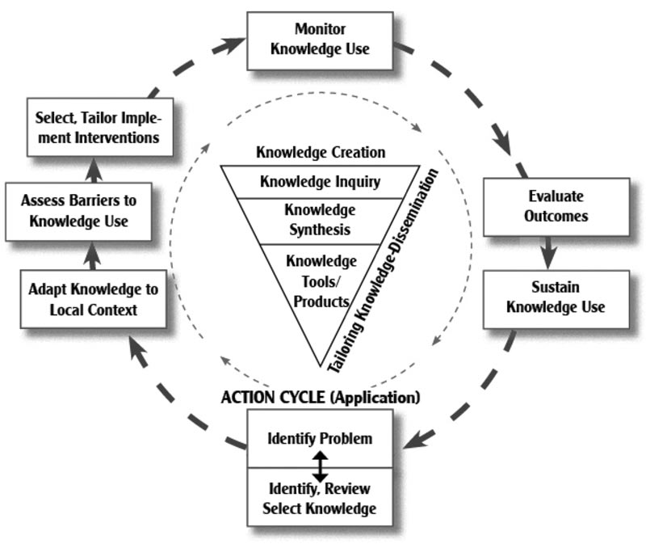
Graham’s KTA Model

Slide 32
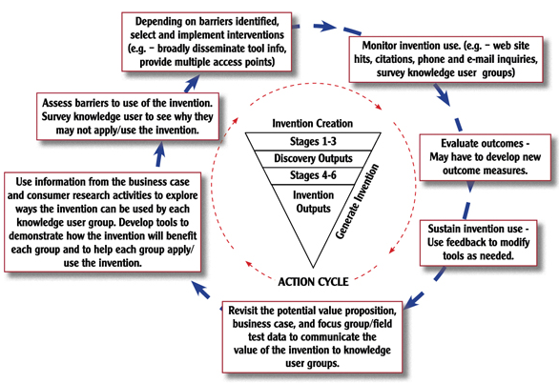
Translating Invention Outputs

Slide 33
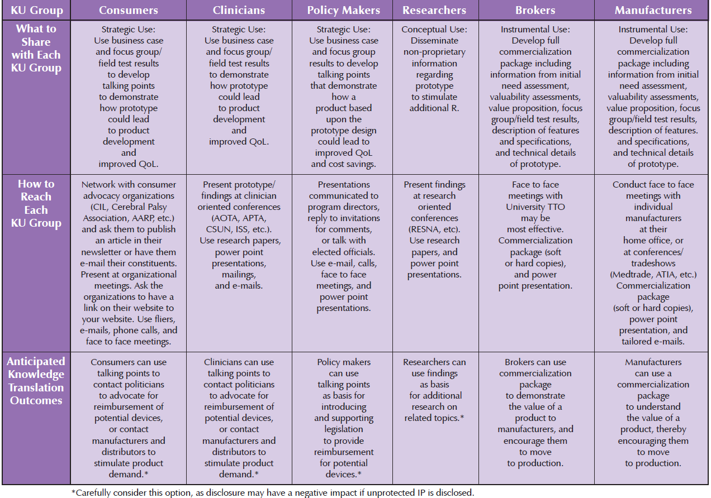
KT Tables
Notes:
Define strategic, conceptual and instrumental use of knowledge.

Slide 34
Contextualized Knowledge Packages
First and foremost a CKP is NOT a Business Plan.
CKP is a tailored presentation of new research findings, a development output, or a new device or concept.
Formulated to meet the specific context requirements of a particular audience or stakeholder group.
  Different material needed to communicate with different stakeholder groups!
Researcher translates features / functions of his / her research discovery or prototype invention into a vision for a marketable consumer product.

Slide 35
CKP Key Points
Experience has shown that researchers only have 5 minutes of a key licensing individual’s time for review of research findings.
5 Key elements of a Manufacturer CKP
  Executive Summary
  Background / Current Situation Section
  Technical
  Marketing Section including IP position
  Consumer Involvement / Testing / Input

Slide 36
Putting It All Together
Real life project to explore.
Let’s consider:
  Who are the key stakeholders
  What do they need to know
  How should it be communicated
  Who should do the communication
  What outcomes do we expect to result from the communication
Notes:
Findings were consistent for the RCT’s on AAC and environmental access. Results for WM are still pending…
(1) Both TTDK and TDK interventions were effective as disseminating strategies for the chosen new K (innovation) in Environmental Access. Both strategies in- creased awareness and use levels in their targeted stakeholders more effectively than passive diffusion.
(2) The TTDK intervention appeared slightly more effective than TDK, but statisti- cally, they were not different from each other.
(3) Within TTDK, the tailoring component CKP was effective, but the tailored webi- nar did not make much difference in raising awareness or use.
(4) In terms of frequencies, the strategies did better in raising awareness than they were at getting non users to use.

Slide 37
Key Takeaways
Best practices in TT (ideally) begin BEFORE a project is initiated.
KT Practitioners can help to improve TT outcomes by:
  Bridging communication gaps between academia and industry.
  Helping researchers present the right information in the right format.
Many tools are available to help!
Notes:
Due diligence saves money and time- If we hadn’t done our due diligence with the w/c braking system, we would have reinvented an already patented invention.
Reduction to practice is a necessary evil, but ideas are often adopted more readily than hard forms- true for both the braking system and jar opener (and others– pill crusher…). We had to prove technical feasibility, but in both cases the company then took the core concepts and developed something else that utilized their own resources and capabilities. In the jar opener case, giving away ideas rather than specs eliminated any concern from the manufacturer that we might make intellectual property claims later on… And from our perspective, gave us the ability to help the company wouldn’t have to worry about royalties.
Manufacturing partners expect industry standard methods- Whirlpool appreciated our ability to deliver marketing info that was gathered using techniques they felt were valid.

Slide 38
Recap on Accessing the
NtK Model and Tools
Visit: http://kt4tt.buffalo.edu/knowledgebase/index.php
Click link for Informational (expanded) plain text version of model.
Scroll down page to review stages, gates, steps and tips.
Click magnifying glass icons for supporting evidence.
Click toolbox icons for tools.
Case example links found on left side of each stage.

Slide 39
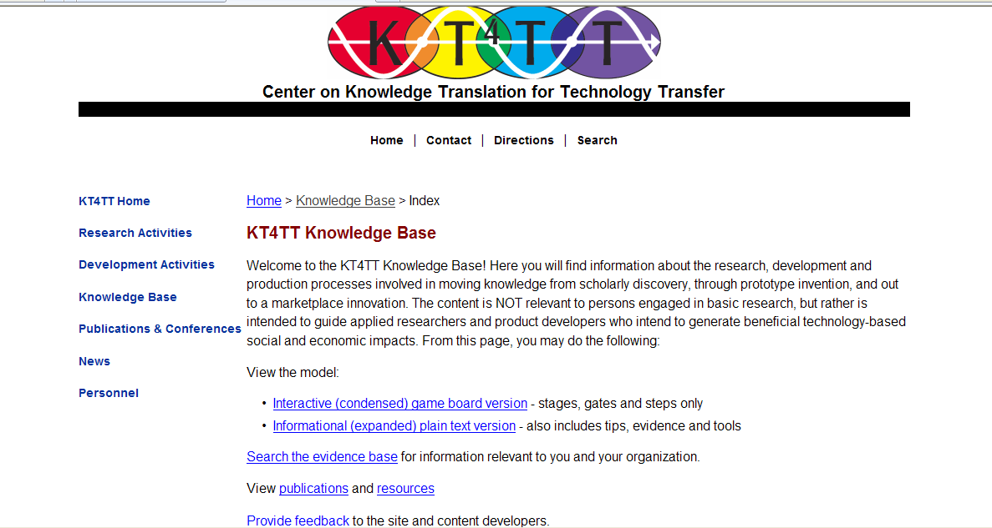
Accessing the NtK and Tools
Visit http://kt4tt.buffalo.edu/knowledgebase
Notes:
Visit http://kt4tt.buffalo.edu/knowledgebase

Slide 40
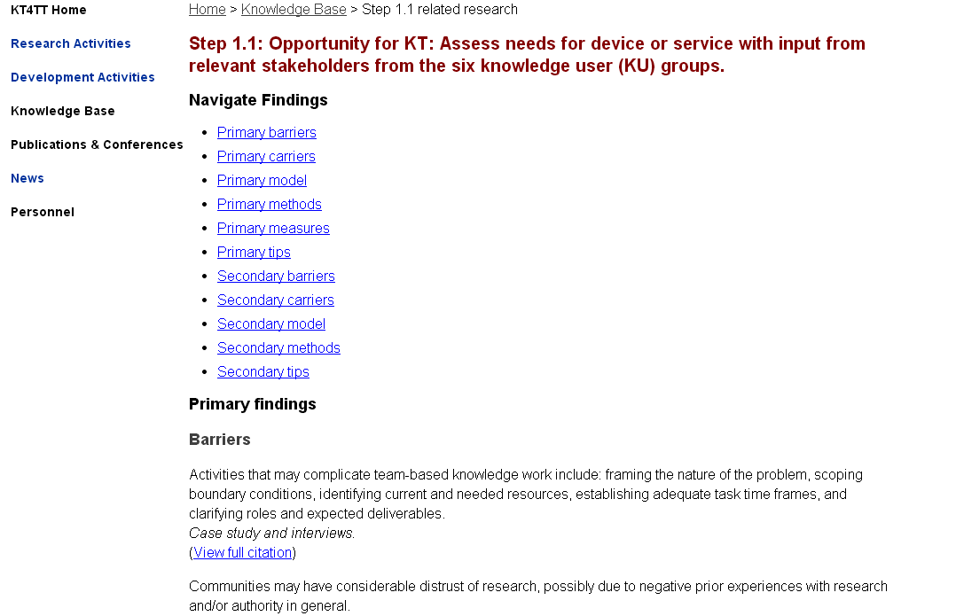
Supporting Evidence

Slide 41
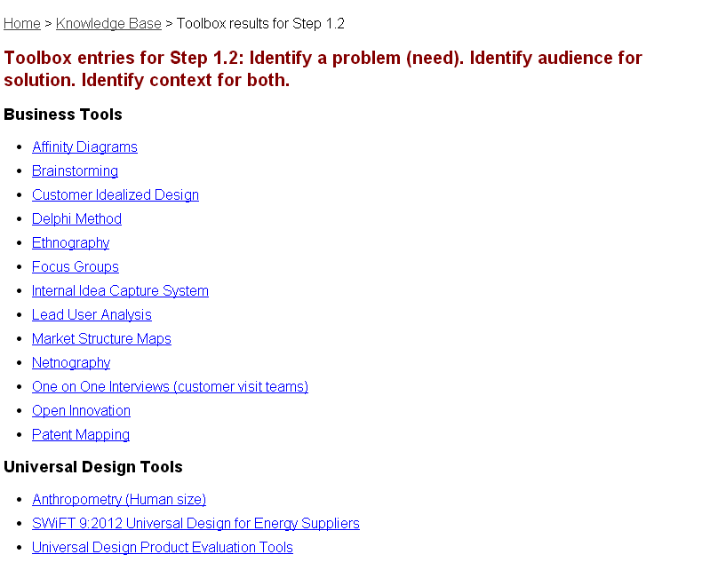
Tools

Slide 42
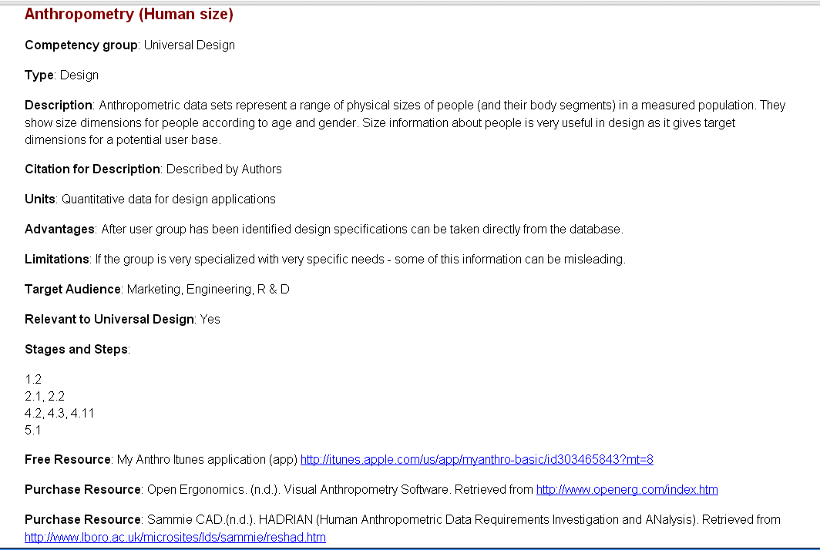
Detailed Tool Listing

Slide 43
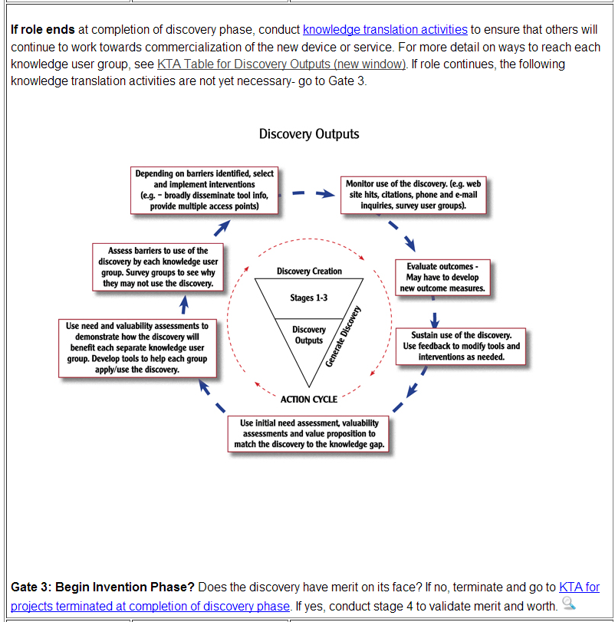
KTA and KT Tables
KTA Diagrams and accompanying KT Tables are available for each type of output (discoveries, inventions, and innovations)

Slide 44
Resources
Need to Knowledge Model: http://kt4tt.buffalo.edu/knowledgebase/model.php
Publications Page on Website: http://kt4tt.buffalo.edu/publications
Website Resources: http://kt4tt.buffalo.edu/publications/ResourceMaterials/index.php
  Primary Market Research Training Module
  Intellectual Property Training Module
  Inventor’s Guide
  Evaluation Resource Guide
Focus Technical Briefs
  KTDRR’s KT Library- Technology Transfer section: http://www.ktdrr.org/ktlibrary/articles_pubs/tt.html
Notes:
Primary Market Research Training Module- Sampling and recruitment; Focus groups & surveys; Outsourcing considerations
Evaluation Resource Guide- Basic concepts; Case studies; Sample Instruments
44

Slide 45
Thank you!
Any Questions?

