Slide 1
Industry – The missing link between S&T Policy and Societal Benefit.
Joseph P. Lane
Center on Knowledge Translation for Technology Transfer
University at Buffalo

Slide 2
Center on KT4TT
Promote parity between research and development in NIDRR/USDE programs.
Apply standard product development practices to academic R&D projects.
Collectively improve quality and quantity of outcomes to fulfill mission of U.S. Rehabilitation Act of 1973 (as amended).

Slide 3
Role of KT4TT Program
Apply what we know about TT and KT to create an operational model of KT4TT.
“Begin with end in mind” – both models lead to knowledge application and use to generate innovations.
Collect supporting evidence from research to speak to academic values.
Collect supporting evidence from development to speak to industry values.
Link both forms of evidence to change funding, process and evaluation of government innovation programs.

Slide 4
“Translating Three States of Knowledge: Discovery, Invention & Innovation”
Lane & Flagg (2010) Implementation Science
http://www.implementationscience.com/content/5/1/9

Slide 5
Historical Note
Convergence of Science and Technology
Technology, Medicine & Rehabilitation (Medical Model) → Federal Funding for Basic Research to generate repository of science-based knowledge.
Convergence of Science and Society
Empowerment & Independent Living (Social Model) → Federal Funding for Applied Research and Development to generate prototypes within Linear Model of innovation.
Where is Industry in all of this?

Slide 6
3 Methods = 3 States
Research methods generate knowledge in state of conceptual discoveries.
Development methods generate knowledge in state of tangible proof-of-concept prototypes.
Production methods generate knowledge in state of market-ready devices or service innovations.

Slide 7
Progression through all three states is necessary to generate technology-based innovations for society.
Linear Model of Innovation is discredited, yet . . .

Slide 8
Trajectories linked between Research, Development & Production Domains
Research → Discovery →Translation → Utilization
Development→ Prototype→ Transfer→ Integration
* *
Production → Innovation → Release → Life Cycle
“R is not D; R about D is not D” - E. Linsenmeyer, FLC

Slide 9
Evidence milestones; research discovery; development invention; production innovation.
Evidence Milestones | Research Discovery | Development Invention | Production Innovation
Identify Opportunity | Knowledge gap in literature | Supply Push or Demand Pull | Feature/function gap in device or service
Establish Scope | Volume of topic discussion in lit | Inventor described or Analysis defined | Statement of need by Users or Vendors
Propose Solution | Experimental Hypothesis | Champion’s vision or Stakeholder defined | Value Proposition
Validate Originality | Literature Review | Assumed or State of Market Survey | Prior Art and State of Practice Search
Conduct Process | Scientific Method – Control variables for objective results | Experimental Method – manipulate variables for subjective results | Product method – optimize function within constraints
Conclude Results | Discovery noted | Innovation noted | Product Specified
Internal Delivery of Output | Scholarly manuscript | Proof of Concept Prototype | Market Ready Good or Service

Slide 10
Issues for Three Domains
Each domain has own rigor and jargon.
Actors are trained and operate in one domain, and over-value that domain.
Academic & Government dominate policy at expense of Industry.
Domains are actually inter-dependent.

Slide 11
Perspective shapes Framework
Mode 1 Research – Goal is expand knowledge base, so framework is “end of grant” KT or supply push.
Mode 2 Research – Goal to involve stakeholders in conduct of research, so framework is “integrated” KT or Maslow’s Hammer.
Mode X RDP - Goal to generate technology – based innovations, so framework requires “prior to grant” KT or demand pull.

Slide 12
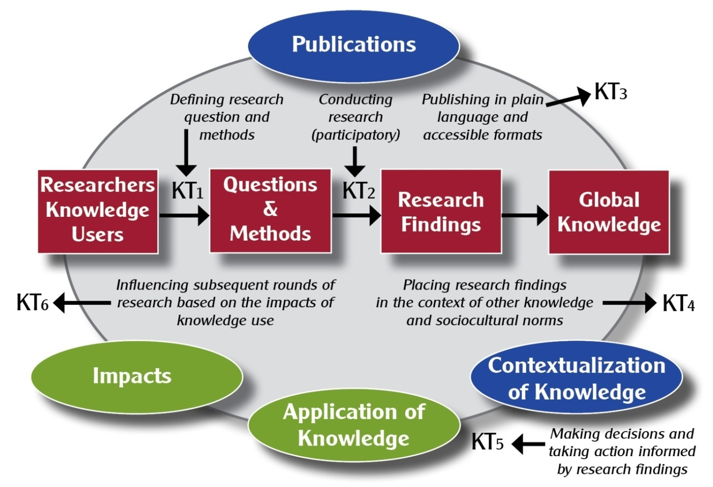
Research Models “Black Box” Downstream Domains

Slide 13
Observations
Research Model has two arcs – Publication vs. Contextualization.
Publication arc has one KT opportunity and lacks Application & Impact (Mode 1).
Contextualization arc has two KT opportunities, both preceding Application and Impacts (Mode 2).

Slide 14
Breakthrough to Impact?
Use the terms, express intent and look inside the black boxes of R/D/P process.
How do Research, Development and Production activity differ?
How do they equate according to logic model milestones?
Alignment of all three aids program planning, implementation and evaluation.

Slide 15
Confounds
Presenting both paths within a “research model” subsumes a separate and equally rigorous process.
Researchers know, infer and apply scientific methods on both R and D.
Academia & Government lack appreciation for Industry role, precluding systematic knowledge preparation for absorption.

Slide 16
Why do these confounds matter?

Slide 17
Think Hockey vs. Golf

Slide 18
Should Golfers Play Hockey?
Milestones | Research | Development | Production
Input
Process
Output
Outcome
Impact
GOLF HOCKEY

Slide 19
Goal determines Role
For projects intending to benefit society, research activity should be subsumed under a broader innovation framework.
All three states of knowledge contribute, but some states may already exist in research literature or patent claims.
Where to apply public funds to achieve the intended impact for society?

Slide 20
Need to Knowledge
Based on CIHR KTA Model (Thanks!)
Technology-based efforts intending impact MUST begin with a problem and potential solution validated by stakeholders.
Validation - Actors “need to know” stakeholders, their need and its context prior to initiating any project – “prior to grant” perspective.

Slide 21
Elements of NtK Model
Full range of activities, including 3 Phases, 9 Stages, Steps, Tasks and Tips.
Supported by primary/secondary findings from a scoping review of 250+ research and practice articles.
http://kt4tt.buffalo.edu/knowledgebase/model.php

Slide 22
NtL Model
Phases | Stages and Gates
Discovery (Research) | Stage 1: Define Problem & Solution
 | Stage 2: Scoping
 | Stage 3: Conduct Research and Generate Discoveries – Discovery Output
Invention (Development) | KTA – Knowledge in Discovery State
 | Stage 4: Build Business Case and Plan for Development
 | Stage 5: Implement Development Plan
 | Stage 6: Testing and Validation – Invention Output
Innovation (Production) | KTA – Knowledge in Invention State (Proprietary & Non-Proprietary)
 | Stage 7: Plan and for Production
 | Stage 8: Launch Device or Service – Innovation Output
 | KTA – Knowledge in Innovation State (Sales & Marketing)
 | Stage 9: Life-Cycle Review / Terminate?

Slide 23
Discovery State of Knowledge
Research Knowledge Creation.
Process - New knowledge discovery results from empirical exploration.
Value – Novelty in first articulation and contribution to knowledge base.
Output – Conceptual idea embodied as publication.

Slide 24
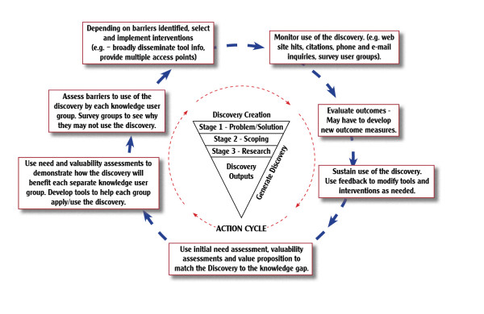
Discovery creation.

Slide 25
Invention State of Knowledge
Development Knowledge Application.
Process - Invention results from trial and error experimentation.
Value – Novelty + Feasibility embodied proof of concept.
Output – Embodied as tangible proof-of concept prototype.

Slide 26
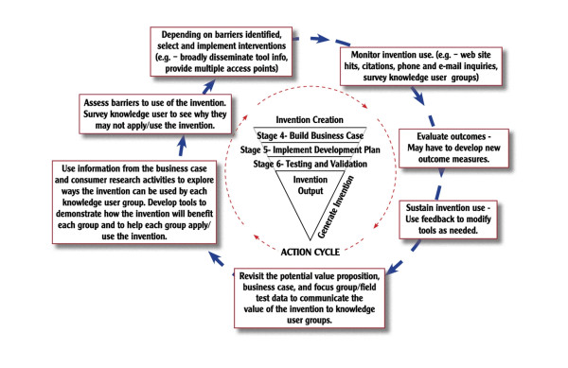
Invention creation

Slide 27
Innovation State of Knowledge
Production Knowledge Codification.
Process – Innovation results from systematic specification of attributes.
Value – Novelty and Feasibility + Utility to producers and consumers.
Output – Embodied as functional device or service.

Slide 28
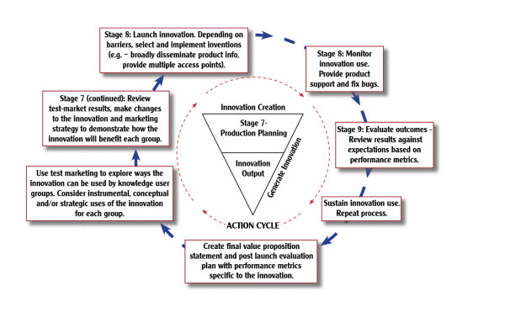
Innovation creation

Slide 29
Market Pull completes dynamic KT cycle.
Technology-oriented research projects must consider downstream development and production – the GOAL.
The successive knowledge outputs must ultimately demonstrate innovativeness:
Novelty in marketplace.
Feasibility in design.
Utility to function.
Actors define ROLE in context of GOAL.

Slide 30
Where we go from here?
Governments should change policies to link Science and Technology R&D to Production Outcomes → IMPACTS.
KT is academia’s approach to applying good business marketing practices. This is an important step but is building bridge from one side only (supply push).
Now we need to add market pull from industry, to ensure Science and Technology investments return innovations that benefit society.

Slide 31
Key Points:
We have an operational model for the Innovation Process validated by research and practice literature.
Recognizing knowledge in three states has implications for policy, practice and for communication.
Industry is missing but critical link for achieving technology-based innovations to benefit society.

Slide 32
Acknowledgement
This is a presentation of the Center on Knowledge Translation for Technology Transfer, which is funded by the National Institute on Disability and Rehabilitation Research, U.S. Department of Education under grant #H133A080050.
The opinions contained in this presentation are those of the grantee, and do not necessarily reflect those of the U.S. Department of Education.

