Slide 1
The Social Model for A/T Technology Transfer – AAATE 2010 “From Problem Identification to Social Validation: An Operational Model”
Joseph P. Lane, Center on Knowledge Translation for Technology Transfer, University at Buffalo

Slide 2
Historical Trends
Convergence of Science and Technology
Technology & Rehabilitation (Medical Model)
Public funding for Basic Research generates a repository of conceptual knowledge;
Innovation expected via Diffusion Model.
Convergence of Science and Society
Empowerment & Independent Living (Social Model)
Public funding for Applied R&D generates a repository of prototype devices/services;
Innovation expected via Linear Model.

Slide 3
Convergence of Science & Industry:
Knowledge embodied in three distinct states: generated by Research, Development and Production methods respectively.
Industry is critical missing partner: Government and academia projects intended to benefit society fail to cross gaps to becoming market innovations.
Evidence-based framework exists: Links three methods, communicates knowledge in three states, and integrates key stakeholder.

Slide 4
3 Methods = 3 Knowledge States
Research methods generate knowledge in gas state of Conceptual Discoveries.
Development methods create knowledge in liquid state of Tangible Inventions.
Production methods formulate knowledge in solid state of Market Innovations.

Slide 5
1) Discovery State of Knowledge
Research methods create new knowledge.
Process – Empirical analysis reveals novel insights regarding key variables.
Output – Conceptual Discovery expressed as manuscript or presentation.
Value – Novelty as first articulation of new concept as contributed to knowledge base.

Slide 6
2) Invention State of Knowledge
Development methods apply knowledge.
Process – Trial and error experimentation and testing demonstrates proof-of-concept.
Output – Tangible Invention embodied as operational prototype.
Value – Novelty of conceptual discovery + Feasibility of tangible invention.

Slide 7
3) Innovation State of Knowledge
Production methods codify knowledge.
Process – Systematic specification of components and attributes yields final form.
Output – Market Innovation embodied as viable device or service in a defined context.
Value – Novelty, Feasibility + Utility defined as revenue to company and function to customers.

Slide 8
Delivering Solutions to Problems involves progress across three Knowledge States
Research → Discovery →Translation → Utilization ↓
Development→ Invention→ Transfer→ Integration ↓
Production → Innovation → Release → Lifecycle ↓

Slide 9
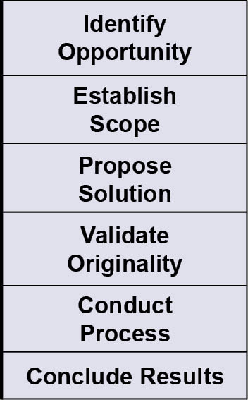
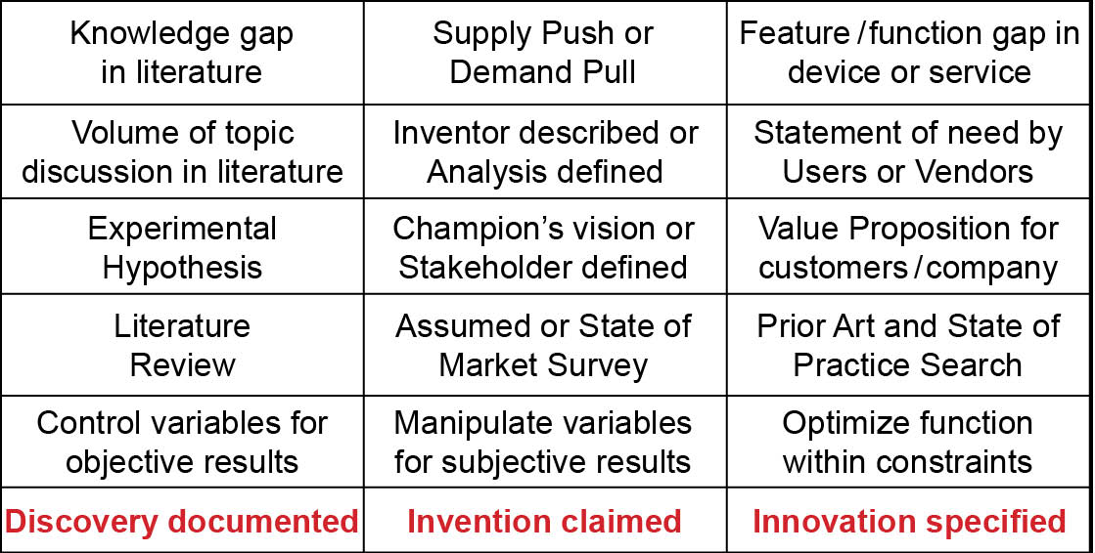
Milestones align three Methods to improve project planning, implementation and evaluation.

Slide 10
Issues & Confounds
Each Method has own rigor and jargon.
Actors over-value the method in which they are trained and operate.
Academia & Government focus on “R&D” fails to connect actors, methods & goals.
Lack of policy/program foresight precludes adequate preparation of knowledge for successful Industry absorption.

Slide 11
Why should these confounds matter to A/T Technology Transfer?

Slide 12
Think Golf versus Hockey

Slide 13
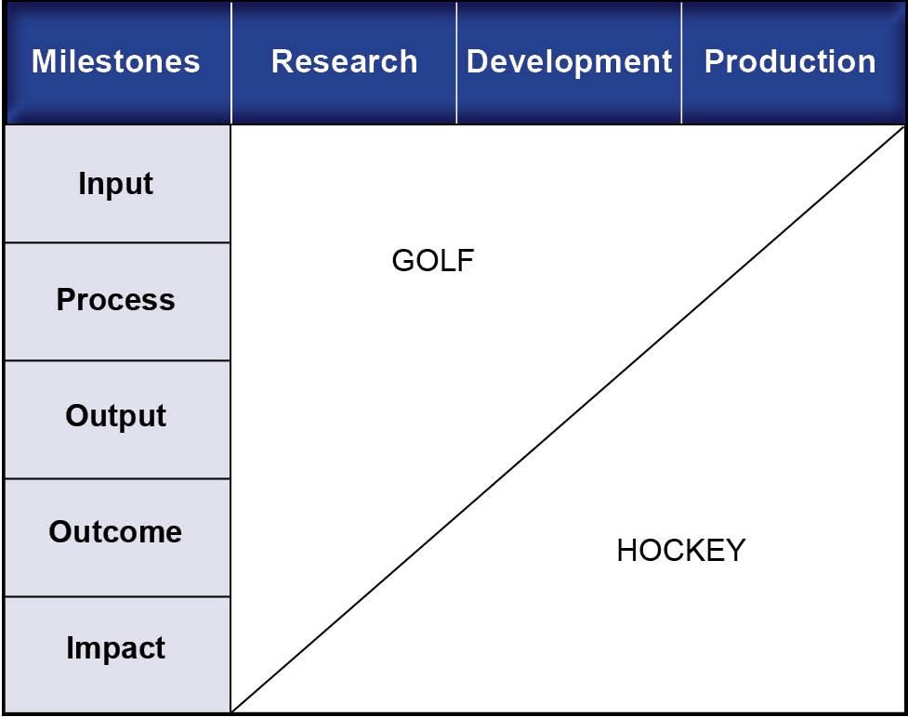
Should Golfers play Hockey?

Slide 14
“Translating Three States of Knowledge: Discovery, Invention & Innovation”
Lane & Flagg (2010)
Implementation Science
http://www.implementationscience.com/content/5/1/9

Slide 15
Need to Knowledge (NtK) Model
Integration – PDMA’s NPD practices with CIHR’s KTA Model.
Validation – All R&D projects intending impact must start with a real problem and potential solution validated by stakeholders.
Orientation – Actors need to know problem, stakeholders, methods and role in advancing process toward the Goal.

Slide 16
Elements of NtK Model
Full range of activities includes 3 Phases, 9 Stages & Gates, Steps, Tasks and Tips.
Supported by primary/secondary findings (scoping review of 250+ research and practice articles), and A/T case examples.
Logic Model orientation – “Begin with the end in mind” (Stephen Covey), and work backwards through process to achieve it.

Slide 17
NtL Model

Slide 18
Let’s take a look!
http://kt4tt.buffalo.edu/knowledgebase/model.php

Slide 19
AT-TT Recommendations
Change governments policies – directly link Science and Technology R&D to Production Outcomes.
End “Rush to Research” – Subsume applied research under a broader innovation framework, to verify if new research will add value, is relevant or even necessary.
Require technology-oriented research projects to address downstream development and production plans.
Add voices of Stakeholders (particularly Industry & Customers) to ensure public S&T investments generate innovations that benefit society – The GOAL!

Slide 20
Review three key points
Knowledge embodied in three distinct states: generated by Research, Development and Production methods respectively.
Industry is critical missing partner: Government and academia projects to benefit society fail to cross gaps to become market innovations.
Evidence-based framework exists: Links three methods, communicates knowledge in three states, and integrates key stakeholder.

Slide 21
Acknowledgement
This is a presentation of the Center on Knowledge Translation for Technology Transfer, which is funded by the National Institute on Disability and Rehabilitation Research, U.S. Department of Education under grant #H133A080050.
The opinions contained in this presentation are those of the grantee, and do not necessarily reflect those of the U.S. Department of Education.

