Slide 1
From Concept to Market: Linking Research, Development and Production Activities
Joseph P. Lane
Center on Knowledge Translation for Technology Transfer
http://kt4tt.buffalo.edu
School of Public Health & Health Professions
University at Buffalo (SUNY)
Funded by NIDRR, US Department of Education, PR# H133A060028

Slide 2
Learning Objectives
1. Participants will be able to distinguish between three Methodologies (scientific research, engineering development, industrial production), and contrast the three States of Knowledge they generate.
2. Participants will be able to discuss examples of literature supporting each of the nine Activity Stages and nine Decision gates, and explain why Stages have multiple steps.
3. Participants will be able to name and describe at least one technical analysis tool and one market analysis tool relevant to each of the three Phases of activity.

Slide 3
Need to Knowledge Model*
A Prior to Grant Perspective for S&E R&D and Technological Innovation
*Learning Objective 1

Slide 4
Range of Public Support for S&E Activity
Grant-based Scientific Research – Exploration to discover new knowledge about physical world (NSF/NIH) – Works well!
Sponsored R&D for Innovation – Application of S&E outputs for commercial exploitation intended to generate socio-economic impacts – Lots of Problems!
Contract R&D for Production – Application of S&E outputs to deliver specified products with national value (DoD/DoE) – Works well!

Slide 5
Sponsored R&D Programs with Innovation/Impact intent
All US Agencies: SBIR/STTR Programs.
NSF – Engineering Research Centers (ERC); Industry/University Cooperative Research Centers (I/U CRC); Innovation Corps (I-Corp).
NIH – Program on Public/Private Partnerships.
NIST – Technology Innovation Program (TIP).
USDE – Rehabilitation Engineering Research Centers (RERC); Field Initiated Development (FID).
Canada – Natural Science and Engineering Research Council (NSERC); Canadian Institutes for Health Research (CIHR).
European Union – Research Framework Programme; Competiveness & Innovation Framework Programme.

Slide 6
Innovation & Impact
Traditionally, each sector defined terms in own narrow context, unconcerned with downstream market activities or broader societal benefits, comfortable in status quo budgets and paradigms. But that applecart is tipping . . .
National Science Board (2012) – “Innovation is defined as the introduction of new or significantly improved products (goods or services), processes organizational methods, and marketing methods, in internal business practices or in the open marketplace.” (OECD/Eurostat, 2005).

Slide 7
“Translating Three States of Knowledge: Discovery, Invention & Innovation”
Lane & Flagg (2010)
Implementation Science
http://www.implementationscience.com/content/5/1/9

Slide 8
Clarification: 3 States of Knowledge
Scientific Research methodology ►
Conceptual Discovery
Engineering Development methodology ►
Prototype Invention
Industrial Production Methodology ►
Market Innovation

Slide 9
Discovery State
Scientific Research methods create new to the world knowledge.
Process – Empirical analysis reveals novel insights regarding key variables, precipitated by push/pull.
Output – Conceptual Discovery expressed as manuscript or presentation.
Legal IP Status – Copyright protection.
Value – Novelty as first articulation of new concept as contributed to knowledge base.

Slide 10
Invention State
Engineering Development methods combine and apply knowledge as functional artifacts.
Process – Trial and error experimentation and testing demonstrates proof-of-concept, initiated through supply/demand forces.
Output – Prototype Invention claimed and embodied as operational prototype.
Legal IP Status – Patent protection.
Value – Novelty of conceptual discovery + Feasibility of tangible invention.

Slide 11
Innovation State
Industrial Production methods codify knowledge in products/components positioned as new/improved.
Process – Systematic specification of components and attributes yields final form.
Output – Market Innovation embodied as viable device or service in a defined context, initiated through a commercial market opportunity.
Legal IP Status – Trademark protection.
Value – Novelty + Feasibility + Utility defined as revenue to company and function to customers.

Slide 12
Importance of Untangling Terms
Each Method has own rigor and jargon.
Actors are trained and operate in one method and tend to over-value that method.
Academic & Government sectors dominate “STI” policy at the expense of Industry – the only sector with time and money constraints. . .
Methods are actually inter-dependent, while traditional dichotomies are all complementary factors supporting innovation outcomes.

Slide 13
Blind men and Elephant.

Slide 14
Way Forward: Integrate Conceptual but Differentiate Operational
Consider three distinct states: Know role of Research, Development and Production methods in context of each project – plan and budget accordingly.
Engage Industry early: Government/Academic projects intended to benefit society fail to cross gaps (death valley vs. Darwinian sea) to business & open markets.
Apply evidence-based framework: Link three methods; Communicate knowledge in three states; Integrate key stakeholder who will determine eventual success.

Slide 15
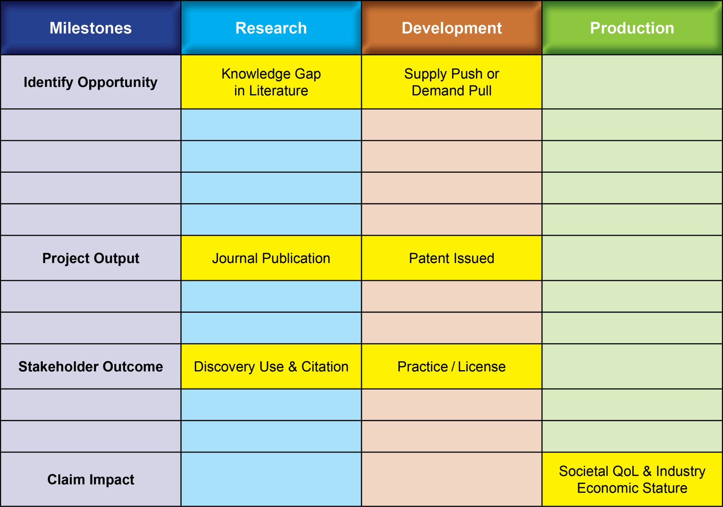
Outputs/Outcomes/Impacts from R or D Methods are distant from Socio-Economic Impacts

Slide 16
“Modeling Technology Innovation: How the integration of science, engineering and industry methods combine to generate beneficial socio-economic impacts.”
Stone & Lane (2012).
Implementation Science
http://www.implementationscience.com/content/7/1/44/

Slide 17
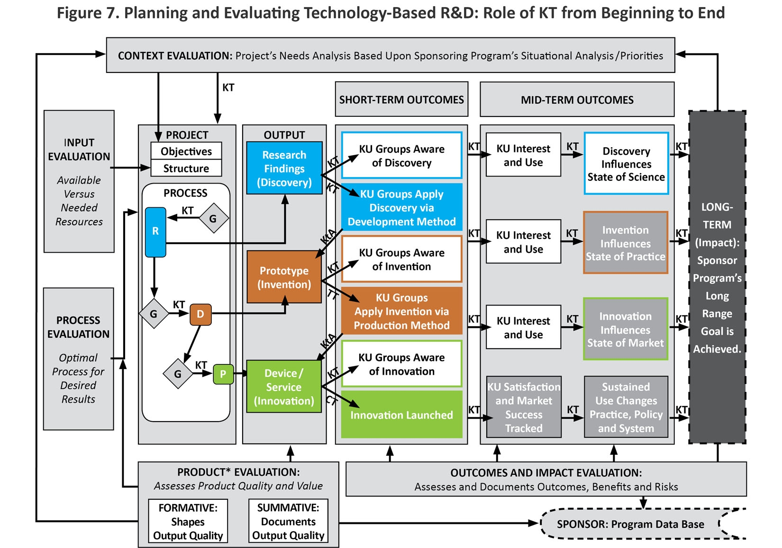
Figure 7

Slide 18
Elements of NtK Model
Full range of activities includes 3 Phases, 9 Stages & Gates, Steps, Tasks and Tips.
Supported by primary/secondary findings (scoping review of 250+ research and practice articles), and A/T case examples.
Logic Model orientation – “Begin with the end in mind” (Stephen Covey), and work backwards through process to achieve it.

Slide 19
Evidence milestones, research discovery, development invention and production innovation.

Slide 20
Need to Knowledge Model for Technological Innovation
Need to Knowledge (NtK) Model for Technological Innovations

Slide 21
Need to Knowledge (NtK) Model
Orientation – Actors engaged in innovation “need to know”: Problem/Solution; Methods/Outputs; Stakeholder roles; and Goal in context of beneficial socio-economic impacts.
Integration – Product Development Managers Association (PDMA) New Product Development practices (implementation); Canadian Institutes of Health Research (CIHR) Knowledge to Action Model (communication).
Validation – Stage-Gate structure populated with supporting evidence (1,000+ excerpts) from scoping review of academic and industry literature , along with links to tools for completing recommended technical and market analyses .

Slide 22
Need to Knowledge Model
http://kt4tt.buffalo.edu/knowledgebase/model.php

Slide 23
NtK Model Key Findings
Evidence base of Academic and Industrial Literature since 1985
Learning Objective #2

Slide 24
Objective 2: Lessons from Literature
Literature from both Industry and Academia converge on “Best Practices” in New Product Development, where due diligence supplants ad hoc approaches and tests assumptions.
Steps/Activities/Tips all point toward Best Practices validated through numerous iterations under a variety of field conditions.
Stage/Step level activity do not require a linear progression, but Decision Gates cannot be properly addressed without them.

Slide 25
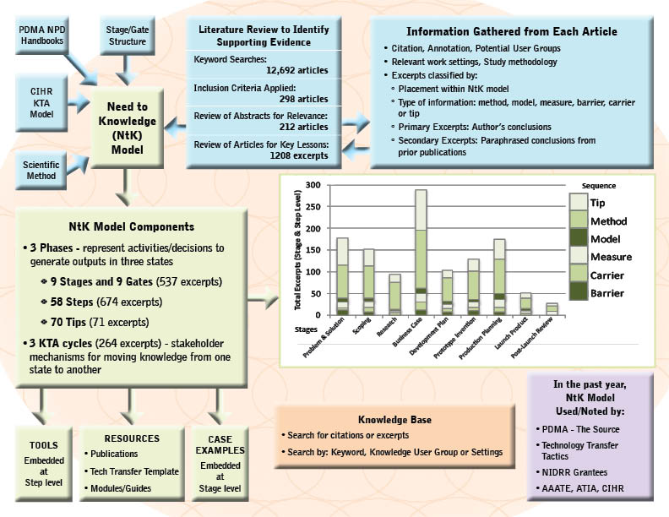
Schematic

Slide 26
Knowledge Communication – 3 Strategies for 3 States

Slide 27
Delivering Solutions to Problems involves progress across three Knowledge States
Research → Discovery →Translation → Utilization ↓
Development→ Invention→ Transfer→ Integration ↓
Production → Innovation → Transaction → Lifecycle ↓

Slide 28
Evidence from Scoping Review
Literature Search; Scoping Review & Narrative Synthesis.
Over 800 excerpts from over 200 academic and industry journal articles substantiate stage/gate model.
Excerpts cluster differently for each Phase of R/D/P.
Review aggregated findings: http://kt4tt.buffalo.edu/knowledgebase/research.php?model=3

Slide 29
Search Evidence Base
Search evidence base by keyword:
http://kt4tt.buffalo.edu/knowledgebase/search.php

Slide 30
Number of Excerpts by code in research/discovery phase

Slide 31
Number of excerpts by code in the development /invention phase

Slide 32
Number of excerpts by code in the production/innovation phase

Slide 33
NtK Model’s Toolbox
Tools for Technical, Marketing
and Customer Analyses
Learning Objective #3

Slide 34
Objective 3: Requirements for Technical & Marketing Analysis
Analyses are required throughout all three Phases, while Grantees are only familiar with a sub-set of them.
Technical, market and customer analyses address three different yet equally critical issues for technological innovation.
Knowing what you don’t know but need to do is critical to creating a successful team.

Slide 35
“Gamification” of Technological Innovation
Progress through three Methods of Knowledge Generation, and the effective Communication of three Knowledge States, may be circuitous and iterative, punctuated and prolonged, risky and unpredictable, yet still be planned, implemented and accomplished through the deliberate and systematic efforts of key stakeholders.

Slide 36
NtK Model’s Toolbox
Go to tools for Technical, Marketing
and Customer Analyses
http://kt4tt.buffalo.edu/knowledgebase/model.php

Slide 37
Summary: NtK Model Utility
Clarifies processes and mechanisms underlying technology-based Innovation, by integrating academic & industry literature.
Establishes linkages between three distinct methods and their respective knowledge outputs for implementation/communication.
Offers structure to sponsors & grantees for program/project planning, implementation, monitoring and evaluation.

Slide 38
Summary: NtK Model Value
Technology Grantees:
Proposal structure – Review Panel liked.
RERC Tech Transfer/ SBIR Phase III Plans.
Program Sponsors:
Assess proposals; Track progress.
Compliance enforced – Funding continuation?
Organizations:
PDMA’s “The Source”; Tech Transfer Tactics;
CIHR; CEUD; DIT; ATIA; AAATE.

Slide 39
ACKNOWLEDGEMENT This is a presentation of the Center on Knowledge Translation for Technology Transfer, which is funded by the National Institute on Disability and Rehabilitation Research, U.S. Department of Education, under grant #H133A080050.
The opinions contained in this presentation are those of the grantee and do not necessarily reflect those of the
U.S. Department of Education.

