Slide 1
The Case for Industry Leadership in STI Policy Implementation.
Joseph P. Lane
Center on Knowledge Translation for Technology Transfer
http://sphhp.buffalo.edu/cat/kt4tt.html
School of Public Health & Health Professions
University at Buffalo (SUNY)
Funded by NIDILRR, ACL/DHHS PR# 90DP0054

Slide 2
What’s this session about?
It’s about narrowing the gap between government funding for R&D and society’s need for beneficial deliverables:
The free market forces of industry address most societal needs for technological innovation, except those too large, too small, too late or premature . . .
Government’s address some of these “market failures” by investing public funds, but success requires proper alignment between investment, value chain and results.
STI Policies based on linear model of university-led R&D is generally ineffective; requiring sector realignment to deliver intended beneficial socio-economic impacts.

Slide 3
Commercial Innovation Markets
Industry delivers technological innovations to society when they meet standard commercial market requirements (market size; customer affluence; high profit margin; low entry barriers):
Market Opportunity
ê
Industry R&D&P
ê
Deliver Product

Slide 4
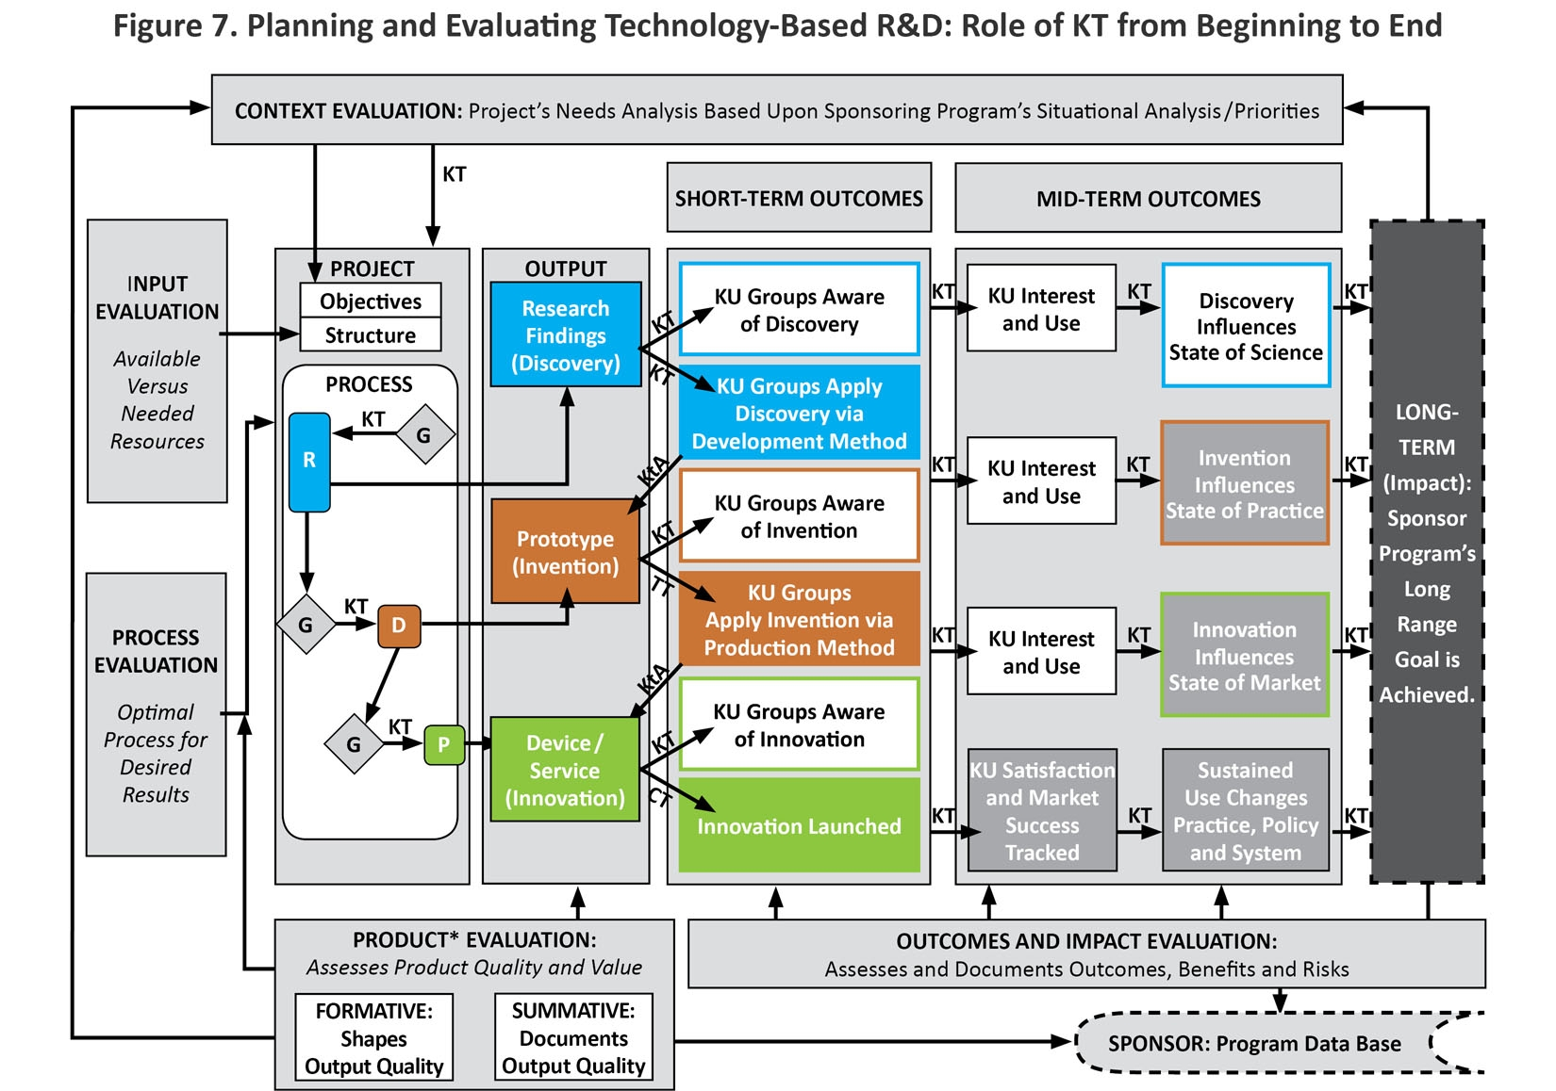
Figure 7. Planning and Evaluating Technology-Based R&D: Role of KT from Beginning to End

Slide 5
Conditions of Market Failure
When standard business conditions are not met -- but need is deemed important to society -- government’s supply resources to fill market gaps.
STI Policies address societal needs for new knowledge under conditions of market failure.
Problems arise when ‘new knowledge’ is defined only in the long-term and indefinite context of university-based scholarship and publications.
New knowledge is not limited to scientific findings.

Slide 6
Government R&D Laboratories
Public tax dollars are allocated to generate new knowledge outputs embodied in 3 different states:
Scientific research ➔ Conceptual Discovery Output (know what ?)
Engineering Development ➔ Tangible Invention Output (know how ?)
Industrial Production ➔ Commercial Innovation Output (know why ?)
Each state follows its own trajectory, outcome, impact.

Slide 7
CONCEPTUAL DISCOVERY STATE
Labs conduct scientific research (basic, fundamental, curiosity-driven)
to expand the base of fundamental knowledge.
Need for fundamental knowledge
ê
$$ to Agency Laboratory/Team
ê
Scientific Research (Basic)
ê
Conceptual Discoveries
ê
Agency Use & Journal Publication
ê
Socio-Economic Impact ???

Slide 8
TANGIBLE INVENTION STATE
Labs conduct scientific research (applied, oriented)
AND engineering development to transform conceptual discoveries into operational prototypes – ‘proof of concept’.
Need for breakthrough prototypes
ê
$$ to Agency Laboratory/Team
ê
Applied SR & Experimental ED
ê
Proof of Concept Prototypes
ê
Agency Use & IP Claims
ê
Socio-Economic Impact ???

Slide 9
COMMERCIAL INNOVATION STATE
Laboratories design, build, test and deliver next generation products – according to performance specifications – while governments serve as primary customer for resulting products.
Product performance requirements
ê
Government
ê
Industry
í î
Universities & Government Labs
ê
Functional Product
ê
Government & Aftermarkets

Slide 10
Let’s Consider Reality!
Market innovations come from a combination of all of the above factors.
Current “STI” policies result from a status quo Academic/Bureaucratic complex.
ROI from public investment – both social benefit and tax revenues -- comes from private sector delivery of products.
Society’s bottom line is the creation of new net wealth at some boundary.

Slide 11
Delivering Solutions to Problems involves progress across all three Knowledge States
Scientific Research → Discovery →
Knowledge Translation → Utilization ↓
Development → Invention →
Technology Transfer → Integration ↓
Industrial Production → Innovation →
Commercial Transaction → Lifecycle ↓

Slide 12
Innovation & Impact
Traditionally, each sector defined terms in own narrow context, unconcerned with downstream market activities or broader societal benefits, comfortable in status quo budgets and paradigms. But that applecart is tipping . . .
National Science Board (2012) – “Innovation is defined as the introduction of new or significantly improved products (goods or services), processes organizational methods, and marketing methods, in internal business practices or in the open marketplace.” (OECD/Eurostat, 2005).

Slide 13
Respective Roles in the STI System

Slide 14
“Innovation” Impact implies Utility
Public support for investment in technology-based innovations grounded in 3 expectations:
New/improved devices/services with economies of scale that contribute to societal quality of life.
Sufficient return on investment through sales to sustain company, pay taxes and compete globally to generate new net wealth.
✓ Benefits realized in short-term (5–10 yrs).
Innovation’s context is Societal Impact via Commercial Marketplace.

Slide 15
Commercial Market is path to Utility
Industry survives in competitive system by translating knowledge into market utility through Production methods (beyond R&D).
Utility = Money to Seller / Function to Buyer.
No $ale – Research discoveries are freely published and globally disseminated, while Development prototypes lack commercial hardening or economies of scale.
R and D outputs ≠ Market Innovation.

Slide 16
So what am I saying?
Time to return to successful practices!
Industry leads R&D efforts intending to generate innovations.
Industry has incentive, expertise and structure to create, retain and exploit new knowledge.

Slide 17
Related Publications
Lane,JP, Godin, B. (2013) Methodology Trumps Mythology, Bridges, Office of Science & Technology, Embassy of Austria, Washington, DC, 36. http://ostaustria.org/programs-projects-english/event-management/2013-04-23-10-55-57/2003-2001/382-categories-all/magazine/volume-36-december-14-2012/opeds-a-commentaries/6002-methodology-trumps-mythology
Lane, JP, Godin, B, (2012) Is America’s Science, Technology, and Innovation Policy Open for Business? Science Progress, June 12, 2012, http://scienceprogress.org/2012/06/is-america%E2%80%99s-science-technology-and-innovation-policy-open-for-business/
Flagg, J, Lane, J., & Lockett M. (2013) Need to Knowledge (NtK) Model: An Evidence-based Framework for Generating Technology-based Innovations. Implementation Science, 8, 21, http://www.implementationscience.com/content/8/1/21
Stone, V. & Lane J (2012). Modeling the Technology Innovation Process: How the implementation of science, engineering and industry methods combine to generate beneficial socio-economic impacts. Implementation Science, 7, 1, 44. http://www.implementationscience.com/content/7/1/44.
Lane, J & Flagg, J. (2010). Translating 3 States of Knowledge: Discovery, Invention & Innovation. Implementation Science, 5, 1, 9. http://www.implementationscience.com/content/5/1/9.
Edquist, C, et al (2015). Public Procurement for Innovation. Cheltenham, UK: Elgar Publishing Inc. http://www.e-elgar.com/shop/public-procurement-for-innovation.

Slide 18
Issues in Science, Technology & Innovation Policies.
Three States of Knowledge – Origins, Relationships & Transitions.
Comprehensive Model of Technological Innovation.
Tools for Effective Knowledge Translation.
Tools for Successful Technology Transfer.
Tools for Achieving Invention Commercialization.
Market Research Resources.

Slide 19
ACKNOWLEDGEMENT The contents were created under a cooperative agreement from the National Institute on Disability, Independent Living, and Rehabilitation Research (#90DP0054). NIDILRR is a Center within the Administration for Community Living (ACL), Department of Health and Human Services (HHS).
The contents do not necessarily represent the policy of NIDILRR, ACL, HHS, and you should not assume endorsement by the Federal Government.

