Slide 1
Need to Knowledge Model: A framework for achieving market Innovations through sponsored R&D
Joseph P. Lane
Center on Knowledge Translation for Technology Transfer,
Center on Technology Transfer
School of Public Health & Health Professions
University at Buffalo (SUNY), USA
Funded by NIDRR, US Department of Education, PR# H133A060028

Slide 2
NtK Model Utility
Clarifies mechanisms and processes underlying technology-based Innovation, by integrating academic & industry literature.
Establishes linkages between three distinct methods and their respective knowledge outputs.
Offers structure to sponsors/grantees for program/project planning, implementation, monitoring and evaluation.

Slide 3
Recurring Themes
Science, Engineering, Industry.
Research, Development, Production.
Discovery, Technology, Product.
Know what, Know how, Know why.
Long term, Medium term, Short Term.
Conceptual, Prototype, Commercial.
Translation, Transfer, Transaction.
Discovery, Invention, Innovation.

Slide 4
Falcon Hypersonic Technology Vehicle 2 "It is a marvelous research and development exercise, we've learned a lot about hypersonic speeds, et cetera. But I just don't see the practicality in it." Lt. General Tom McInerney

Slide 5
Focus of Need to Knowledge Model The NtK Model is relevant to government sponsors and grantees conducting Research & Development projects which are expected to create beneficial socio-economic impacts in short-term through technology-based Innovations.
The NtK Model is not relevant to government sponsors or grantees conducting basic or inquiry-driven “R&D” projects, which have no explicit intent to generate socio-economic impacts, nor any expectations for application in any specific field or in any defined timeframe.

Slide 6
“Innovation” implies Utility
Calls for public investment in technology-based Innovations set 3 expectations:
1. New/improved devices/services with EoS that contribute to societal Quality of Life.
2. Sufficient ROI through sales to sustain company, pay taxes and compete globally.
3. Benefits realized in short-term (5–10 yrs).
Innovation’s Context is Commerce.

Slide 7
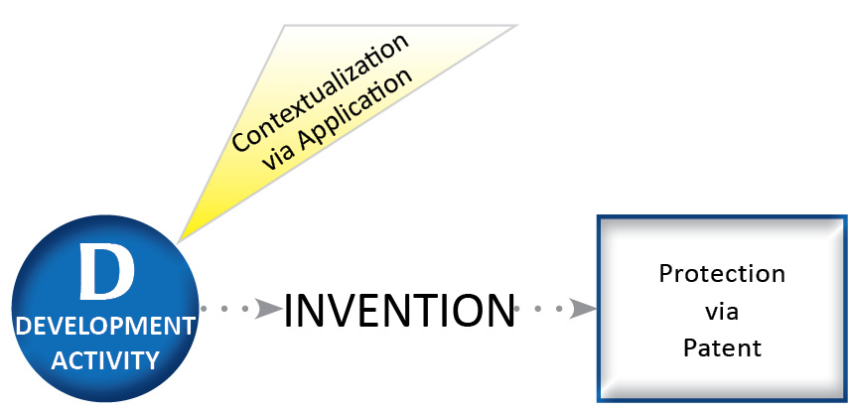
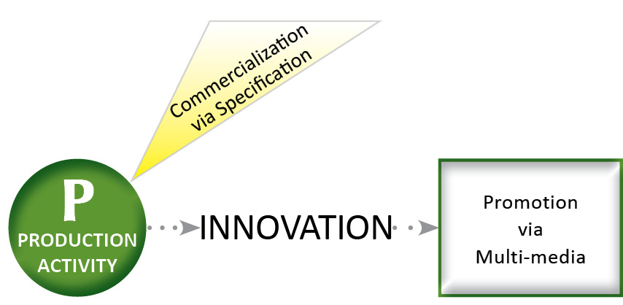
Market Innovation = Socio-Economic Impact

Slide 8
Need to Knowledge (NtK) Model
Orientation – Actors in innovation process “need to know” the problem, the decision makers, the appropriate methods, and their respective roles in advancing toward the goal of socio-economic impacts.
Integration – Product Development Managers Association (PDMA) New Product Development practices for implementation; with the Canadian Institutes of Health (CIHR) Knowledge to Action Model for dissemination.
Validation – Supporting evidence of over 1,000 excerpts drawn from a scoping review of relevant academic and industry literature published in past 25 years.

Slide 9
NtK Model

Slide 10
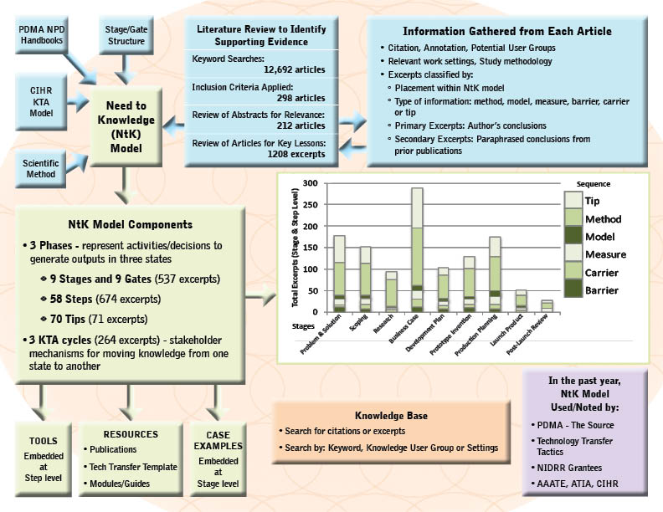
schematic

Slide 11
Go to NtK Model
http://kt4tt.buffalo.edu/knowledgebase/model.php

Slide 12
Discussion of NtK Model

Slide 13
NtK Applications in Enterprise Ireland?

Slide 14
NtK Model Assumptions
Socio-economic impacts start with a validated need, recognized by stakeholders, addressed through delivery of innovations via market mechanisms.
Industry is customer for R&D outputs due to ability to design & deploy market innovations in short term.
Three different methods (R/D/P) create knowledge outputs in three different states (discovery, invention, innovation), each with unique value.
Decision to adopt/implement knowledge rests with recipient stakeholders not with the producers.

Slide 15
NtK Model in Use
Technology Grantees (actual):
Structure proposal content.
Plan Tech Transfer / Commercialization.
Organizations (actual):
PDMA’s “The Source”; Tech Transfer Tactics; ATIA.
DoEd, NIH, NSF, NIST; CIHR; EU Framework (Cardiac).
Program Sponsors (potential):
Frame RFP; Assess proposals; Monitor progress; Collect outcome/impact evidence.

Slide 16
EI follows many paths to Innovation
Basic (Mode 1) vs. Applied (Mode 2) Research – Moot issue.
Supply Push – Solutions in search of problems.
Demand Pull – Academia serving Industry as customer.
Corporate Collaboration – Partnerships for progress can enrich all.

Slide 17
Demand Pull/Collaboration
Competence Centers & Industry-led Research Network Programme (ILRP)
Targeted technology-based efforts to direct Research towards Development in the context of Corporate needs = NtK Model.
Leverages publicly supported expertise and infrastructure – Domestic constraint?
Q/A on Faculty contributions (FTE)?
Leverage R&D outputs into non-targeted applications via translation/transfer?

Slide 18
Industry Needs
Fundamental discoveries and Prototype inventions from Academia for:
Tools, Processes and Products/Services.
Building knowledge base is necessary but not sufficient support for Industry.
Absorptive Capacity vs Knowledge Absorbability
Valley of Death vs. Darwinian Sea – critical market validation beyond technical proof.

Slide 19
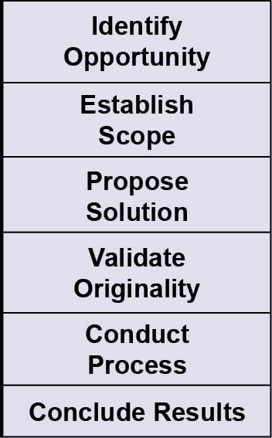
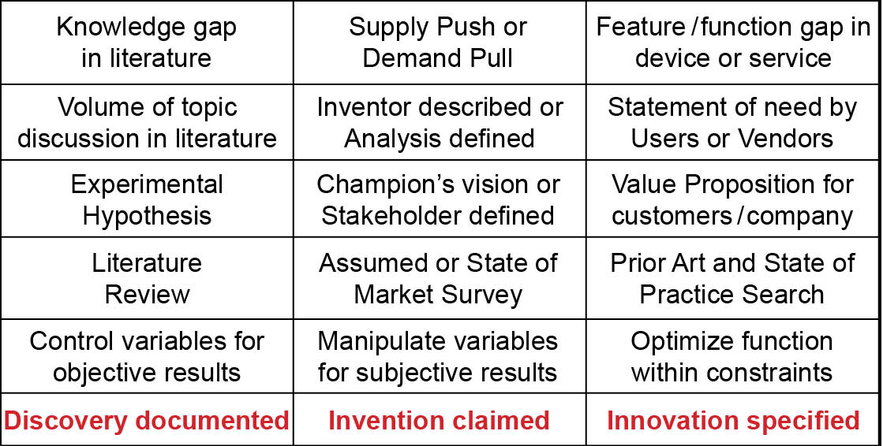
Milestones inside the Black Box of Innovation
19

Slide 20
Milestones inside the Black Box of Innovation (cont.)
Evidence Milestones | Research Discovery | Development Invention | Product Innovation
Claim/Protect Intellectual Property | Copyright (automatic) | Invention Disclosure/ Patent Application | Patent Family/Fencing Continuous Improvement
External Quality Examination | Peer Review of method rigor and contribution | USPTO examines claimed novelty and feasibility | Government certification or Industry standard
External Quality Verification | Manuscript accepted/ In press | Patent issued | Device/Service approved
Output Disclosure & Dissemination | Discovery disclosed in Journal paper by external publisher | Invention disclosed in Patent issues by U.S. Government | Innovation disclosed in press release by Manufacturer

Slide 21
Milestones inside the Black Box of Innovation (cont.)
Evidence Milestones | Research Discovery | Development Invention | Production Innovation
Stakeholder Awareness (STO1) | Subscriber base, web hits, queries | IP Office inquiries, hits on disclosure | Press releases, web hits, industry chatter
Stakeholder Interest (STO2) | Letters to editor, email queries | Request for package confidentiality forms | Vendor, customer, distributor queries
Stakeholder Adoption (STO3) | Author citation, quotations, plagiary | Negotiations for sale or lease, emulation | Advanced orders, licenses, corporate espionage
Intermediate Outcome – Use by Stakeholder | Attributions and citations in literature, or plagiarism | IP transferred via license or practiced illegally via infringement | Innovation purchased & promoted in marketplace, or reverse engineered
Establish Merit | Acclaim, Promotion, Invitations, Rebuttals | Related Collaborations and new funding | Ramp-up, Spin-off products, Competition
Establish Worth | Textbook references, International honors | License royalties, sponsors, partners | Sales revenues, ROI, market share, efficacy
Establish Impact | Advance state of science within scholarly discipline | Advance state of art for field of engineering application | Advance state of Industry & Societal Quality of Life

Slide 22
R and D paths distant from desired Impacts
Milestones | Research | Development | Production
Identify Opportunity | Knowledge Gap in Literature | Supply Push or Demand Pull
Project Output | Journal Publication | Patent Issued
Stakeholder Outcome | Discovery Use & Citation | Practice/License
Claim Impact |  |  | Societal QoL & Industry Economic Stature

Slide 23
Formula for S&T = Innovation
Identify and scope problem/solution in context of stakeholders in marketplace.
Scientific Research → Conceptual Discovery [translate]
Engineering Development → Prototype Invention [transfer]
Industry Production → Commercial Product [transact].
Support Industry application of R & D knowledge outputs; Deploy in market to achieve Impact.
UD = Design for more = Market Broadening.

Slide 24
ACKNOWLEDGEMENT This is a presentation of the Center on Knowledge Translation for Technology Transfer, which is funded by the National Institute on Disability and Rehabilitation Research, U.S. Department of Education, under grant #H133A080050.
The opinions contained in this presentation are those of the grantee and do not necessarily reflect those of the
U.S. Department of Education.

