Slide 1
Reconciling Government Policies and Programs with Public Expectations: The Case of Innovation in AT
Joseph P. Lane
Center on Knowledge Translation for Technology Transfer,
School of Public Health & Health Professions
University at Buffalo (SUNY)
Funded by NIDRR, US Department of Education, PR# H133A060028

Slide 2
“Innovation” implies Utility
Calls for public investment in technology-based Innovations set 3 expectations:
1. New/improved devices/services with EoS that contribute to societal Quality of Life.
2. Sufficient ROI through sales to sustain company, pay taxes and compete globally.
3. Benefits realized in short-term (5–10 yrs).
Innovation’s Context is Commerce.

Slide 3
Market Utility via Innovation
Industry survives in competitive system by translating knowledge into market utility through Production methods (beyond R&D).
Utility = Money to Seller / Function to Buyer.
No $ale – Research discoveries are freely published & Development prototypes lack commercial hardening/economies of scale.
R and D outputs ≠ Market Innovation.

Slide 4
Formula for S&T = Innovation
Identify and scope problem/solution in context of stakeholders in marketplace.
Scientific Research → Conceptual Discovery [translate]
Engineering Development → Prototype Invention [transfer]
Industry Production → Commercial Product [transact].
Support Industry application of R & D knowledge outputs; Deploy in market to achieve Impact.
“Need to Knowledge Model” – AAATE 2010

Slide 5
Recurring Themes
Science, Engineering, Industry.
Research, Development, Production.
Discovery, Technology, Product.
Know what, Know how, Know why.
Long term, Medium term, Short Term.
Conceptual, Prototype, Commercial.
Translation, Transfer, Transaction.
Discovery, Invention, Innovation.

Slide 6
Phases, Stages and Gates

Slide 7
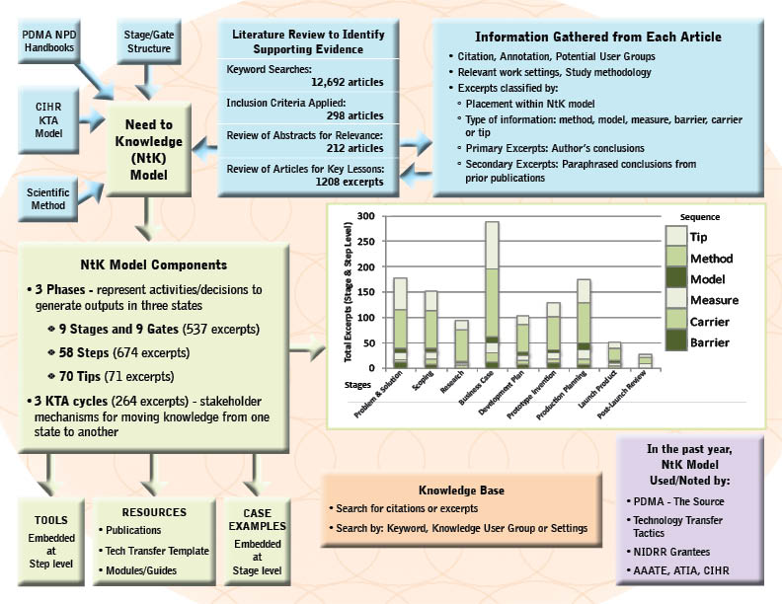
schematic

Slide 8
Go to Need to Knowledge Model
http://kt4tt.buffalo.edu/knowledgebase/model.php

Slide 9
ACKNOWLEDGEMENT This is a presentation of the Center on Knowledge Translation for Technology Transfer, which is funded by the National Institute on Disability and Rehabilitation Research, U.S. Department of Education, under grant #H133A080050.
The opinions contained in this presentation are those of the grantee and do not necessarily reflect those of the
U.S. Department of Education.

