Slide 1
Getting from Knowledge to Action: Effectively communicating Research & Development value to multiple Stakeholder Groups.
Joseph Lane & John Westbrook
RESNA - 2010

Slide 2
Presenter Background
Joe Lane, MBPA
Center for Assistive Technology; UB/SUNY
From RERC on Technology Transfer to Center on KT for TT
Stakeholder: Researcher; Broker; Consumer
John Westbrook, PhD
SEDL; Austin, TX
National Center for Dissemination of Disability Research
Shift from KDU to KT
Stakeholder: Researcher; Broker

Slide 3
Historical Note
Convergence of Science and Technology
Technology, Medicine & Rehabilitation (Medical Model) → Federal Funding for Basic Research to generate repository of science-based knowledge.
Convergence of Science and Society
Empowerment & Independent Living (Social Model) → Federal Funding for Applied Research and Development to generate prototypes within Linear Model of innovation.
This workshop focuses on the latter – Science and Technology – and their link to Industry.

Slide 4
Getting from Knowledge to Action
Knowledge Translation - Definition
How has KT been Defined in Disability Contexts?
From the NIDRR LRP 2005-2009
For NIDRR, the definition of Knowledge Translation (KT) refers to the multidimensional, active process of ensuring that new knowledge gained through the course of research ultimately improves the lives of people with disabilities, and furthers their participation in society.

Slide 5
How has KT been Defined in Disability Contexts? From the NIDRR LRP 2005-2009
The process is active, as it not only accumulates information, but it also filters the information for relevance and appropriateness, and recasts that information in language useful and accessible for the intended audience.

Slide 6
How has KT been Defined in Disability Contexts? From the NIDRR LRP 2005-2009
KT includes transfer of technology, particularly products and devices, from the research and development setting to the commercial marketplace to make possible widespread utilization of the products or devices.

Slide 7
How has KT been Defined in Disability Contexts? From the NIDRR LRP 2005-2009
Knowledge translation is a process of ensuring that new knowledge and products gained through research and development will ultimately be used to improve the lives of individuals with disabilities and further their participation in society.

Slide 8
How has KT been Defined in Disability Contexts? From the NIDRR LRP 2005-2009
Knowledge translation is built upon and sustained by ongoing interactions, partnerships, and collaborations among various stakeholders, including researchers, practitioners, policy-makers, persons with disabilities, and others, in the production and use of such knowledge and products.

Slide 9
How has KT been Defined in Disability Contexts? From the NIDRR LRP 2005-2009
The collaborative and systematic review, assessment, identification, aggregation, and practical application of high-quality disability and rehabilitation research by key stakeholders (i.e., consumers, researchers, practitioners, and policymakers) for the purpose of improving the lives of individuals with disabilities.

Slide 10
Knowledge Translation What is it Exactly?
Is it new? Is it different?
Began to be used in NIDRR community in the Long Range Plan of 2005-2009
Is it substitute language for “dissemination and utilization”?

Slide 11
Knowledge Translation - What is it Exactly? (continued)
KT encompasses all steps between the creation of knowledge and its application.
KT is not a linear process
KT initiates from research knowledge that may appropriately be added to by expert practitioner and professional opinion, and expert consumer opinion

Slide 12
Confusing Terminology
knowledge transfer
knowledge to action
knowledge dissemination
knowledge utilization
knowledge mobilization
research utilization
evidence based practices
evidence based guidelines
evidence based outcomes

Slide 13
KT is a Process
As a process, changes are expected – in our case we do expect the “K” (knowledge) to change and we expect the “T” (translation) to change, with different audiences and intended types of impact
Changes are prompted by: increased knowledge, changing needs/questions, changes in the user groups, changes in the environment (e.g., recession)

Slide 14
So What are Key Characteristics of KT
Knowledge is connected to research
Actively connected to user/beneficiary group(s)
Inclusive of all activities from generation of new knowledge to its use
KT helps identify what we know and what we don’t know – useful in planning future research

Slide 15
So What are Key Characteristics of KT (continued)
Applies knowledge from research to solve/address practical issues or problems
KT encourages the interaction of knowledge creators (researchers, experts, and others) with knowledge users/beneficiaries (consumers, policymakers, and others); Participatory Action Research concepts and KT are very compatible
KT aggregates knowledge combining old concepts with new concepts in order to try and define “what we know”

Slide 16
So What are Key Characteristics of KT (continued)
KT includes all the steps from the creation of knowledge to its application
KT requires ongoing communication and collaboration between knowledge producers and knowledge users
KT initiates by establishing a specific question and context for answering that question – tied to a specific sample and a specific context for application
Effective KT is interdisciplinary and multi-modal

Slide 17
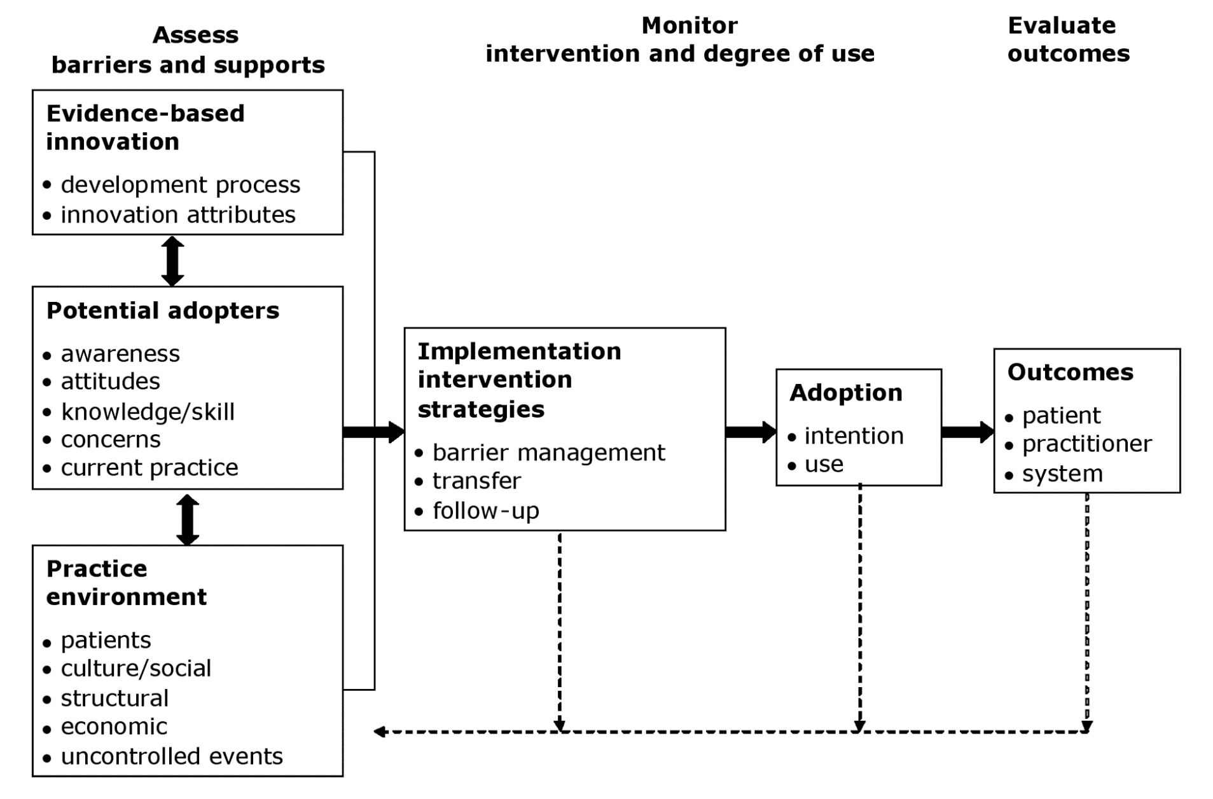
The Revised Ottawa Model of Research Use (Graham & Logan 2004)

Slide 18
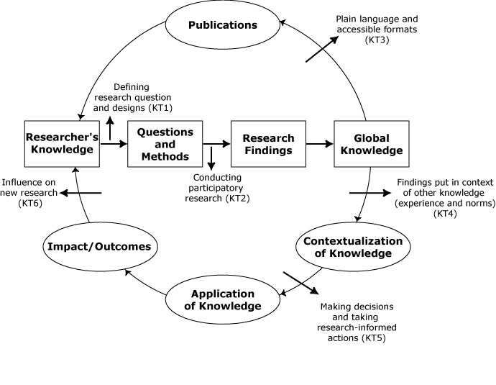
Canadian Institutes of Health Research (CIHR) Model of KT

Slide 19
Limitation of KT Models
All KT Models currently focus on “knowledge” as an output from scientific research.
RESNA activity also address technology-based development and device production.
RESNA represents stakeholders beyond researchers.

Slide 20
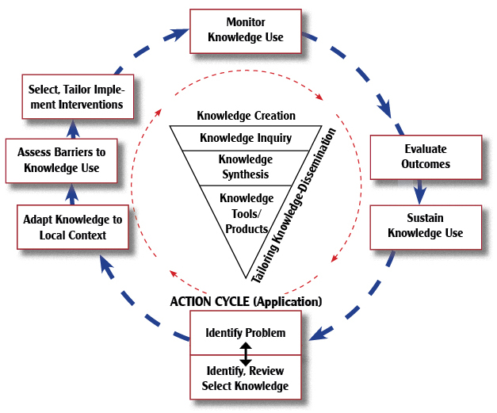
KTA Model - CIHR

Slide 21
KTA Model - CIHR
Knowledge to Action (KTA) Model addresses both creation of knowledge (funnel) and its application for multiple stakeholders (cycle).
KTA Model offers flexibility to adapt for both development and production activity.

Slide 22
Current Challenge: Moving Technology-based knowledge into action requires a broader framework.

Slide 23
RESNA’s Stakeholders in Workshop?
Researchers (Scientists & Engineers)?
Clinicians (Therapists/Educators/Counselors)?
Consumers (PWD’s & Family Members)?
Manufacturers (OEM & VAR)?
Policy Makers (government/agency)?
Brokers (attorneys/consultants)?

Slide 24
Three different but related methods transform knowledge into three difference but related states, involving all stakeholders as both knowledge producers and as knowledge consumers.

Slide 25
3 Methods = 3 States
Research methods generate knowledge in state of conceptual discoveries.
Development methods generate knowledge in state of tangible proof-of-concept prototypes.
Production methods generate knowledge in state of market-ready devices or service innovations.

Slide 26
Discovery State of Knowledge
Research Knowledge Creation.
Process - New knowledge discovery results from empirical exploration.
Value – Novelty in first articulation and contribution to knowledge base.
Output – Conceptual idea embodied as publication.

Slide 27
Invention State of Knowledge
Development Knowledge Application.
Process - Invention results from trial and error experimentation.
Value – Novelty + Feasibility embodied proof of concept.
Output – Embodied as tangible proof-of concept prototype.

Slide 28
Innovation State of Knowledge
Production Knowledge Codification.
Process – Innovation results from systematic specification of attributes.
Value – Novelty and Feasibility + Utility to producers and consumers.
Output – Embodied as functional device or service.

Slide 29
Trajectories linked between Research, Development & Production Domains
Research → Discovery →Translation → Utilization
Development→ Prototype→ Transfer→ Integration
* *
Production → Innovation → Release → Life Cycle
“R is not D; R about D is not D” - E. Linsenmeyer, FLC

Slide 30
Evidence milestones; research discovery; development invention; production innovation.
Evidence Milestones | Research Discovery | Development Invention | Production Innovation
Identify Opportunity | Knowledge gap in literature | Supply Push or Demand Pull | Feature/function gap in device or service
Establish Scope | Volume of topic discussion in lit | Inventor described or Analysis defined | Statement of need by Users or Vendors
Propose Solution | Experimental Hypothesis | Champion’s vision or Stakeholder defined | Value Proposition
Validate Originality | Literature Review | Assumed or State of Market Survey | Prior Art and State of Practice Search
Conduct Process | Scientific Method – Control variables for objective results | Experimental Method – manipulate variables for subjective results | Product method – optimize function within constraints
Conclude Results | Discovery noted | Innovation noted | Product Specified
Internal Delivery of Output | Scholarly manuscript | Proof of Concept Prototype | Market Ready Good or Service

Slide 31
Progression through all three states is necessary to generate technology-based innovations for society.
The passive “Linear Model of Innovation” is discredited, yet there are no operational active models – until now!

Slide 32
“Translating Three States of Knowledge: Discovery, Invention & Innovation”
Lane & Flagg (2010) Implementation Science
http://www.implementationscience.com/content/5/1/9

Slide 33
Need to Knowledge (NtK) Model
Based on CIHR KTA Model.
Technology-based efforts intending impact MUST begin with a validated problem (need) and a feasible solution.
Actors “need to know” stakeholders and context prior to initiating any project.
Solution integrate Discovery, Invention and Innovation outputs.

Slide 34
NtL Model
Phases | Stages and Gates
Discovery (Research) | Stage 1: Define Problem & Solution
 | Stage 2: Scoping
 | Stage 3: Conduct Research and Generate Discoveries – Discovery Output
Prototype (Development) | KTA – Knowledge in Discovery State
 | Stage 4: Build Business Case and Plan for Development
 | Stage 5: Implement Development Plan
 | Stage 6: Testing and Validation – Invention Output
Innovation (Production) | KTA – Knowledge in Invention State (Proprietary & Non-Proprietary)
 | Stage 7: Plan and for Production
 | Stage 8: Launch Device or Service – Innovation Output
 | KTA – Knowledge in Innovation State (Sales & Marketing)
 | Stage 9: Life-Cycle Review / Terminate?

Slide 35
Need to Knowledge (NtK) Model
Model shows Phases, Stages, Steps, Tasks and Tips.
Supported by primary/secondary findings from a scoping review of 250+ research and practice articles.
http://kt4tt.buffalo.edu/knowledgebase/model.php

Slide 36
Key Points:
We have an operational model for the Innovation Process validated by research and practice literature.
Recognizing knowledge in three states has implications for policy, practice and for communication.
Effective communication requires:
Knowing Knowledge State;
Tailoring Message to Target Stakeholder.

Slide 37
Acknowledgement
This is a presentation of the Center on Knowledge Translation for Technology Transfer, which is funded by the National Institute on Disability and Rehabilitation Research, U.S. Department of Education under grant #H133A080050.
The opinions contained in this presentation are those of the grantee, and do not necessarily reflect those of the U.S. Department of Education.

