Slide 1
Where do Market Innovations come from? Not the Stork!
Joseph P. Lane
Center on Knowledge Translation for Technology Transfer
http://kt4tt.buffalo.edu
School of Public Health & Health Professions
University at Buffalo (SUNY)
Funded by NIDRR, US Department of Education, PR# H133A060028

Slide 2
What’s this Session about?
It’s about allocation of public monies to R&D programs which are supposed to generate socio-economic benefits – it’s not about the merit of basic science.
It’s about achieving the publification of technology-based outputs from government sponsored R&D activity – it’s not about the red herrings of publication or privatization.
It’s about realetical induction from 25 years of doing and observing others doing – it’s not about theoretical deductions about innovation by armchair scholars.
It’s about clarification of terms and constructs underling innovation by grounding them in logic and methods – it’s not about obfuscation through rhetoric and reflexivity.

Slide 3
Public Support for Knowledge Creation
Grant-based Scientific Research Programs – Exploration to discover new knowledge about physical world (science/medicine). Grant-based Scholarship → Peer System → Publish for Tenure.
Contract R&D for Production Programs – Application of S&E to deliver specified products with national value (defense/energy): Contract Production → Performance Specs → Sell for Profit.
- BOTH of these programs work well - because their respective expectations, systems and incentives are closely and properly aligned.
Sponsored “R&D” for “S&T” Innovation – Generate S&E outputs for commercial exploitation to generate beneficial socio-economic impacts. Scholarly outputs for tenure ≠ Corporate requirements for profit
HYBRID programs have many problems because their expectations, systems and incentives are misaligned or even incongruent!

Slide 4
Hybrid Programs intending Impact
United States –
All SBIR & STTR Programs; NSF – Engineering Research Centers (ERC); Industry/University Cooperative Research Centers (I/U CRC); Innovation Corps (I-Corp); NIH – Program on Public/Private Partnerships; NIST – Technology Innovation Program (TIP); DoEd – Rehabilitation Engineering Research Centers (RERC); Field Initiated Development (FID).
Canada –
Natural Science and Engineering Research Council (NSERC); Canadian Institutes for Health Research (CIHR).
European Union –
Research Framework Programme; Innovation Framework Programme.
Brazil –
Ministry of Science, Technology & Innovation.
Brazil

Slide 5
What are these Hybrid programs saying?
That tenured/career employees should dictate the rules of innovation for the private sector?
That students and small businesses have the primary insight into societal needs?
That part-time effort by faculty can delivery more value for money than full-time industry staff?
That corporations are devoid of ideas for new products and services?
Yet these absurd premises remain unchallenged.

Slide 6
Image of elephant and blind men.

Slide 7
Let’s get real!
Market innovations come from a combination of all of the above factors.
Current “STI” policies result from a status quo Academic/Bureaucratic complex.
ROI from public investment should focus on the ‘I’ rather than on the ‘R’.
Society’s bottom line is the creation of new net wealth at some boundary.

Slide 8
Innovation & Impact
Traditionally, each sector defined terms in own narrow context, unconcerned with downstream market activities or broader societal benefits, comfortable in status quo budgets and paradigms. But that applecart is tipping . . .
National Science Board (2012) – “Innovation is defined as the introduction of new or significantly improved products (goods or services), processes organizational methods, and marketing methods, in internal business practices or in the open marketplace.” (OECD/Eurostat, 2005).

Slide 9
“Translating Three States of Knowledge: Discovery, Invention & Innovation”
Lane & Flagg (2010)
Implementation Science
http://www.implementationscience.com/content/5/1/9

Slide 10
Three Methodologies are each designed to generate new knowledge in different “States”
Scientific Research methodology ► Conceptual Discovery – state of gas (diffuse).
Engineering Development methodology ► Prototype Invention – state of liquid (malleable).
Industrial Production Methodology ► Market Innovation – state of solid (fixed).

Slide 11
Discovery State of Knowledge
Purpose: Scientific Research methods create new to the world knowledge.
Process: Empirical analysis reveals novel insights regarding key variables, precipitated by push of curiosity or pull of gap in field.
Output: Conceptual Discovery expressed as manuscript or presentation – the ‘know what.’
Legal IP Status: Copyright protection only.
Value: Novelty as first articulation of a new relationship/effect contributed to knowledge base.

Slide 12
Invention State of Knowledge
Purpose: Engineering Development methods combine/apply knowledge as functional artifacts.
Process: Trial and error experimentation/testing demonstrates proof-of-concept, initiated through opportunity supply or operational demand forces.
Output: Prototype Invention claimed and embodied as functional prototype - the ‘know how.’
Legal IP Status: Patent protection.
Value: Feasibility of tangible invention as a demonstration of the Novelty of concept.

Slide 13
Innovation State of Knowledge
Purpose: Industrial Production methods codify knowledge in products/components positioned as new/improved products/services in the marketplace.
Process: Systematic specification of components and attributes yields final form.
Output: Market Innovation embodied as viable device/service in a defined context, initiated through a commercial market opportunity – ‘know why.’
Legal IP Status: Trademark protection.
Value: Utility defined as revenue to company and function to customers + Novelty + Feasibility

Slide 14
Importance of Untangling Terms
Each Method has own rigor and jargon.
Actors are trained and operate in one method and tend to over-value that method.
Academic & Government sectors dominate “STI” policy at the expense of Industry – the only sector with time and money constraints. . .
Methods are actually inter-dependent, while traditional dichotomies are all complementary factors supporting innovation outcomes.

Slide 15
“Modeling Technology Innovation: How the integration of science, engineering and industry methods combine to generate beneficial socio-economic impacts.”
Stone & Lane (2012).
Implementation Science
http://www.implementationscience.com/content/7/1/44/

Slide 16
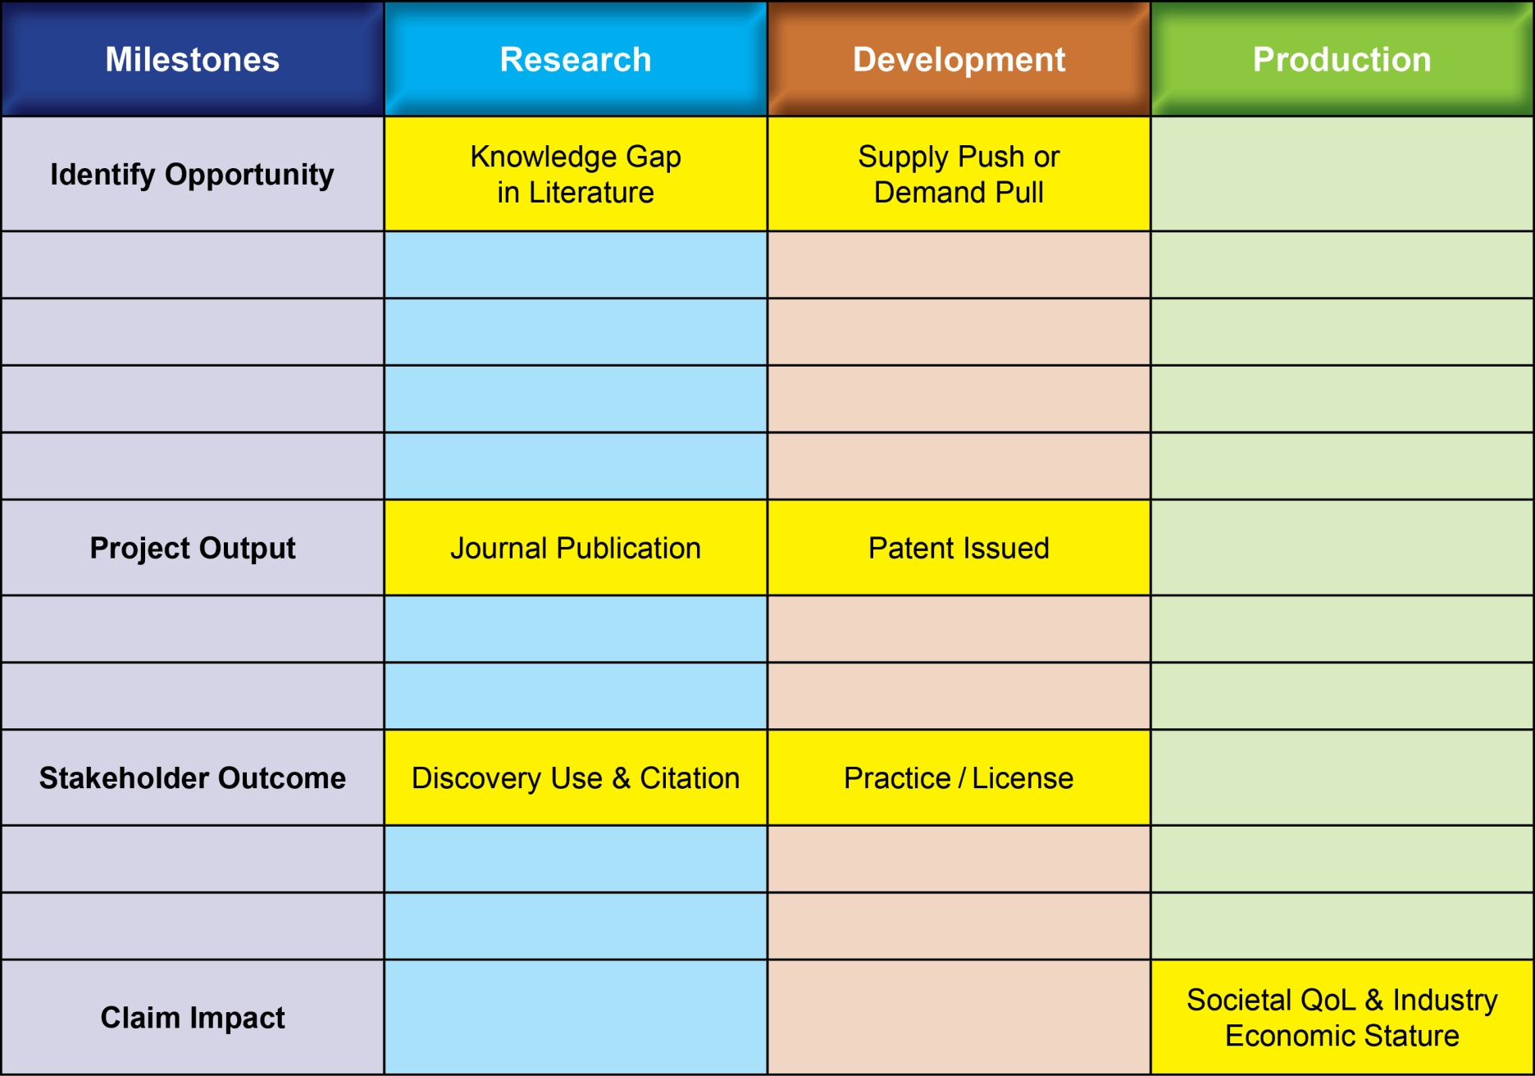
Outputs/Outcomes/Impacts from R or D Methods are distant from Socio-Economic Impacts

Slide 17
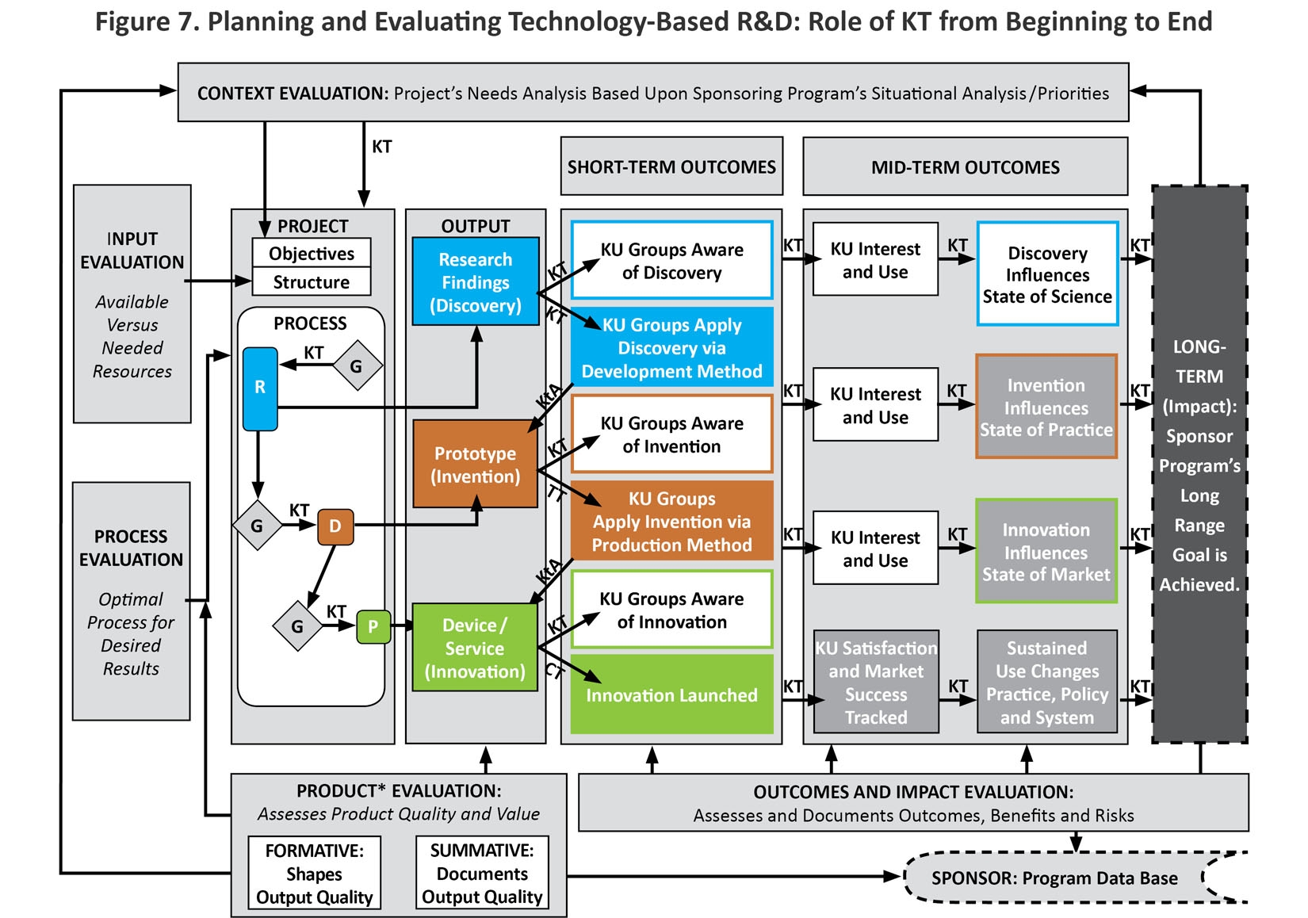
Figure 7

Slide 18
Delivering Solutions to Problems involves progress across all three Knowledge States
Scientific Research → Discovery →
Knowledge Translation → Utilization ↓
Development → Invention →
Technology Transfer → Integration ↓
Industrial Production → Innovation →
Commercial Transaction → Lifecycle ↓

Slide 19
Knowledge Communication – 3 Strategies for 3 States

Slide 20
“Need to Knowledge (NtK) Model: an evidence-based framework for generating technological innovations with socio-economic impacts.”
Flagg, Lane & Lockett (2013)
Implementation Science
http://www.implementationscience.com/content/8/1/21

Slide 21
Elements of NtK Model
Full range of activities includes 3 Phases, 9 Stages & Gates, Steps, Tasks and Tips.
Supported by primary/secondary findings (scoping review of 250+ research and practice articles), and A/T case examples.
Logic Model orientation – “Begin with the end in mind” (Stephen Covey), and work backwards through process to achieve it.

Slide 22
Evidence milestones; research discovery; development invention; production innovation.

Slide 23
Need to Knowledge (NtK) Model for Technological Innovations

Slide 24
Need to Knowledge (NtK) Model
Orientation – Actors engaged in innovation “need to know”: Problem/Solution; Methods/Outputs; Stakeholder roles; and Goal in context of beneficial socio-economic impacts.
Integration – Product Development Managers Association (PDMA) New Product Development practices (implementation); Canadian Institutes of Health Research (CIHR) Knowledge to Action Model (communication).
Validation – Stage-Gate structure populated with supporting evidence (1,000+ excerpts) from scoping review of academic and industry literature , along with links to tools for completing recommended technical and market analyses .

Slide 25
Need to Knowledge Model
http://kt4tt.buffalo.edu/knowledgebase/model.php

Slide 26
What do Publications say?
Literature from both Industry and Academia converge on “Best Practices” in New Product Development, where due diligence supplants ad hoc approaches and tests assumptions.
Steps/Activities/Tips all point toward Best Practices validated through numerous iterations under a variety of field conditions.
Stage/Step level activity do not require a linear progression, but Decision Gates cannot be properly addressed without them.

Slide 27
Evidence from Scoping Review
Literature Search; Scoping Review & Narrative Synthesis for Scholarly and Industry publications from 1985 - 2010.
Over 800 excerpts from over 200 journal articles – out of 1,500 screened -- substantiate stage/gate model.
Excerpts cluster differently for each Phase of R/D/P.
Review aggregated findings: http://kt4tt.buffalo.edu/knowledgebase/research.php?model=3

Slide 28
Number of Excerpts by Code in the Research/Discovery Phase

Slide 29
Number of Excerpts by Code in the Development/Invention Phase

Slide 30
Number of Excerpts by Code in the Production/Innovation Phase

Slide 31
NtK Model’s Toolbox
Go to tools for Technical, Marketing
and Customer Analyses
http://kt4tt.buffalo.edu/knowledgebase/model.php

Slide 32
Requirements for Technical, Business & Marketing Analysis
Analyses are required throughout all three Phases, while Grantees are only familiar with a sub-set of them.
Technical, market and customer analyses address three different yet equally critical issues for technological innovation.
Knowing what you don’t know but need to do is critical to creating a successful team.

Slide 33
“Gamification” of Technological Innovation
Progress through three Methods of Knowledge Generation, and the effective Communication of three Knowledge States, may be circuitous and iterative, punctuated and prolonged, risky and unpredictable, yet still be planned, implemented and accomplished through the deliberate and systematic efforts of key stakeholders.

Slide 34
Understanding where Market Innovations come from:
Clarifies processes and mechanisms underlying technology-based Innovation, by integrating academic & industry literature.
Establishes linkages between three distinct methods and their respective knowledge outputs for implementation/communication.
Offers structure to sponsors & grantees for program/project planning, implementation, monitoring and evaluation.

Slide 35
ACKNOWLEDGEMENT The contents of this presentation were developed under a grant from the Department of Education, NIDRR grant number H133A130014.
However, those contents do not necessarily represent the policy of the Department of Education, and you should not assume endorsement by the Federal Government.

Slide 36
ATIA Closing Slide
Go To:
“Session Evaluation” Tab in ATIA Mobile Phone App to evaluate this session.
Session:
RSCH – 09
“Where do market innovations come from?”

