Slide 1
How to Translate Knowledge in Three States: Discovery, Invention, Innovation
Joseph P. Lane
Center on Knowledge Translation for Technology Transfer
University at Buffalo

Slide 2
“Translating Three States of Knowledge: Discovery, Invention & Innovation”
Lane & Flagg (2010) Implementation Science
http://www.implementationscience.com/content/5/1/9

Slide 3
Need to Knowledge (NtK) Model
Based on CIHR KTA Model.
Technology-based efforts intending impact MUST begin with a validated problem (need) and a feasible solution.
Actors “need to know” stakeholders and context prior to initiating any project.
Solution integrate Discovery, Invention and Innovation outputs.

Slide 4
Need to Knowledge (NtK) Model
Model shows Phases, Stages, Steps, Tasks and Tips.
Supported by primary/secondary findings from a scoping review of 250+ research and practice articles.
http://kt4tt.buffalo.edu/knowledgebase/model.php

Slide 5
Three States of Knowledge
Knowledge in each state requires a different approach to Knowledge Translation.
Translating knowledge in all three states increases stakeholder opportunities for knowledge awareness, interest and use.
Use may occur in short or long term.

Slide 6
NtK Model
Phases | Stages and Gates
Discovery (Research) | Stage 1: Define Problem & Solution
 | Stage 2: Scoping
 | Stage 3: Conduct Research and Generate Discoveries – Discovery Output
Prototype (Development) | KTA – Knowledge in Discovery State
 | Stage 4: Build Business Case and Plan for Development
 | Stage 5: Implement Development Plan
 | Stage 6: Testing and Validation – Invention Output
Innovation (Production) | KTA – Knowledge in Invention State (Proprietary & Non-Proprietary)
 | Stage 7: Plan and for Production
 | Stage 8: Launch Device or Service – Innovation Output
 | KTA – Knowledge in Innovation State (Sales & Marketing)
 | Stage 9: Life-Cycle Review / Terminate?

Slide 7
Discovery State of Knowledge
Research = Knowledge Creation.
Process - New knowledge discovery results from empirical exploration.
Value – Novelty in first articulation and contribution to knowledge base.
Output – Discovery State – conceptual idea embodied as publication.

Slide 8
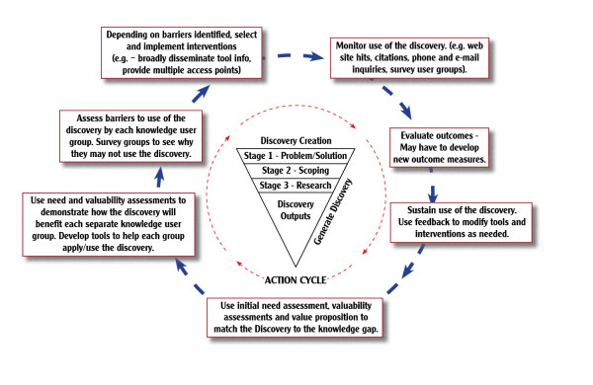
Discovery creation

Slide 9
Invention State of Knowledge
Development = Knowledge Application.
Process - Invention results from trial and error experimentation.
Value – Novelty + Feasibility embodied proof of concept.
Output – Invention State - embodied as tangible proof-of concept prototype.

Slide 10
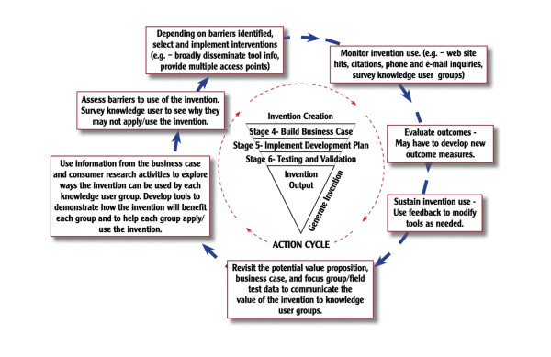
Invention creation

Slide 11
Innovation State of Knowledge
Production = Knowledge Codification.
Process – Innovation results from systematic specification of attributes.
Value – Novelty and Feasibility + Utility to producers and consumers.
Output – Innovation State - embodied as functional device or service.

Slide 12
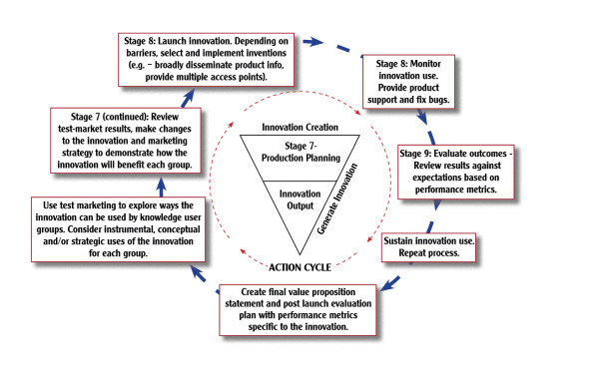
Innovation creation

Slide 13
Takeaway Points: *There is now an operational model for the Innovation Process validated by research and practice literature.
* Considering knowledge in three states has implications for practice, policy and communication.

Slide 14
Acknowledgement
This is a presentation of the Center on Knowledge Translation for Technology Transfer, which is funded by the National Institute on Disability and Rehabilitation Research, U.S. Department of Education under grant #H133A080050.
The opinions contained in this presentation are those of the grantee, and do not necessarily reflect those of the U.S. Department of Education.

