Slide 1
The Need to Knowledge (NtK) Model: Orienting Scholar “Technology Grantees” to Best Practices in Transfer & Commercialization
Joseph P. Lane, Director
Center on Knowledge Translation for Technology Transfer
http://kt4tt.buffalo.edu
University at Buffalo, SUNY, USA

Slide 2
NtK Model addresses persistent challenge: Focusing Technology Grantee’s on NIDRR’s Mission
Improve the Quality of Life for Persons with Disabilities.
Although deliberately not housed in NIH or NSF, NIDRR adopted the “science” procedures and metrics common to both agencies.
NIDRR competition criteria and review panels are designed for academic scholars, despite the range of activities authorized.
Grantees oriented toward scholarly peers and faculty career goals (publications), despite the range of stakeholder audiences.
Project outputs overwhelmingly reflect a culture of Scholarship rather than one of Service to Society.

Slide 3
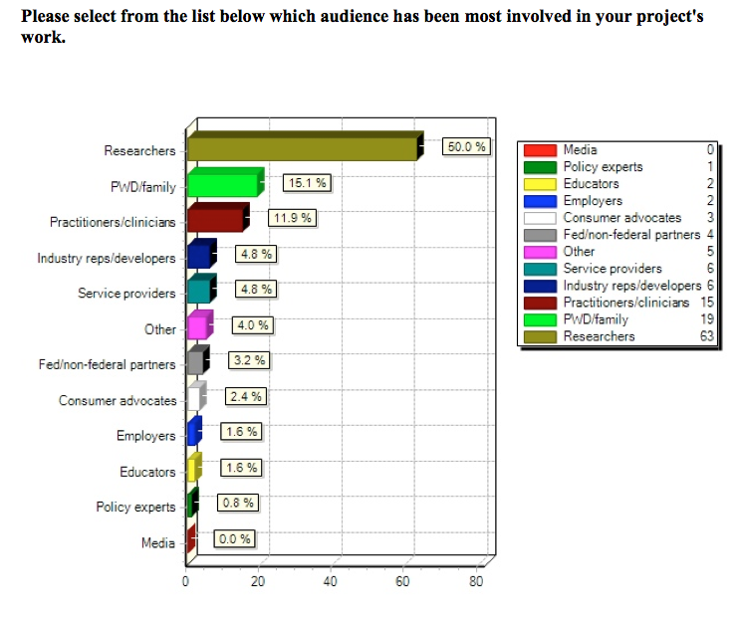
Grantee’s Primary Audience: Peer Researchers (KTDRR 2013)

Slide 4
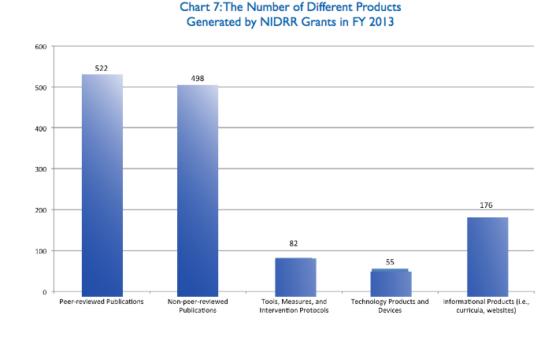
Grantee Outputs = 80% papers vs. 5% products

Slide 5
Purpose of NtK Model Project
Re-orient NIDRR’s “Technology Grantees” – those funded projects intending to generate product & service outcomes.
Place scholarly activity in proper context of broader Transfer & Commercialization process.
Provide a “cook-book” approach to designing, implementing and managing such projects to optimize probability of eventual success.

Slide 6
KT Principle
NtK Model links values & goals of project sponsors, grantees and stakeholders;
Who are all critical to successful delivery and deployment of project outcomes;
Highlighting where their respective models, methods and metrics intersect, and how to communicate state of knowledge for active application and passive diffusion.

Slide 7
KT Principle
NtK Model’s Stage/Gate and Logic Model constructs provided both a common reference and a unifying structure for all stakeholder;
-- Regardless of their training, language, culture and values –
Allowing users to find their own perspective within the broader model, and thereby identify their own role within the shared goal.

Slide 8
KT Principle
Given scholarly orientation of decision makers (Government and Academia);
Grounded NtK Model in evidence-base of all relevant literature published since 1985;
Evidence base designed to overcome objections to applying a structured process in general, and challenges to unfamiliar specific Stage activities and decision Gates.

Slide 9
NtK Model Value
Technology Grantees:
Proposal structure – Review Panel liked.
RERC Tech Transfer & SBIR Phase III Plans.
NIDRR & Other Program Sponsors:
Assess proposals; Track progress.
Compliance enforced – Funding continuation?
International Organizations:
PDMA’s “The Source”; Tech Transfer Tactics;
NSF; CIHR; AITA; AAATE; CNRTA.

Slide 10
Related Publications
Lane, JP (2008). “Delivering on the D in R&D: Recommendations for Increasing Transfer Outcomes from Development Projects,” Assistive Technology Outcomes and Benefits, Fall Special Issue. http://www.atia.org/files/public/ATOBSIF2008.pdf
Lane,JP, Godin, B. (2013). “Methodology Trumps Mythology,” Bridges, The Translatlantic STI Policy Quarterly from the Office of Science & Technology, Embassy of Austria, Washington, DC, 36, December 2012/OpEds & Commentaries.
Lane, JP, Godin, B, (2012). “Is America’s Science, Technology, and Innovation Policy Open for Business?” Science Progress, June 12, 2012, http://scienceprogress.org/2012/06/is-america%E2%80%99s-science-technology-and-innovation-policy-open-for-business/
Flagg, J, Lane, J., & Lockett M. (2013). “Need to Knowledge (NtK) Model: An Evidence-based Framework for Generating Technology-based Innovations.” Implementation Science, 8, 21, http://www.implementationscience.com/content/8/1/21
Stone, V. & Lane J (2012). “Modeling the Technology Innovation Process: How the implementation of science, engineering and industry methods combine to generate beneficial socio-economic impacts.” Implementation Science, 7, 1, 44. http://www.implementationscience.com/content/7/1/44.
Lane, J & Flagg, J. (2010). “Translating 3 States of Knowledge: Discovery, Invention & Innovation.” Implementation Science, 5, 1, 9. http://www.implementationscience.com/content/5/1/9.

Slide 11
ACKNOWLEDGEMENT The contents of this presentation were developed under a grant from the U.S. Department of Education, NIDRR grant #H133A130014.
However, the contents do not necessarily represent the policy of the Department of Education, and you should not assume endorsement by the Federal Government.

