Slide 1
Accomplishing Technological Innovation in AT: How the outputs from three methods can combine to generate beneficial socio-economic impacts.
Joseph P. Lane, Director
Center on Knowledge Translation for Technology Transfer
http://kt4tt.buffalo.edu
University at Buffalo, SUNY, USA
Dr. Maria de Mello, President
Technocare Inc.
www.technocare.net.br
São Luís, Brazil

Slide 2
Workshop Objectives
Participants will be able to distinguish between three methodologies (scientific research; engineering development; industrial production), and compare the states of knowledge they generate.
Participants will be able to discuss examples of literature supporting each of the nine Stages of activity and nine Decision Gates, and explain their importance.
Participants will be able to describe and discuss at least one technical and one marketing tools relevant to each of the three Stages of activity.

Slide 3
Workshop Schedule
Hours | Topics | Presenter(s) | Objectives
9 - 10 | Overview of STI Policy Problems and Solutions | Lane & de Mello | 1 - 3
10 – 11:30 | NtK Model – Rationale and Components | Lane | 1
1 - 2:30 | Evidence from Academic and Industry Literature | de Mello | 2
3 - 4 | Tools for Performing Required Analyses | Lane | 3
4 - 5 | Discussion of Utility to AT Stakeholders | Participants | 1 - 3

Slide 4
PART 1: 9 – 10am
STI Policy Overview

Slide 5
What’s this talk about?
It’s about spending public monies in R&D programs which are supposed to generate socio-economic benefits – it’s not about the merit of basic science.
It’s about achieving the publification of technology-based outputs from government sponsored R&D activity – it’s not about the red herrings of publication or privatization.
It’s about realetical induction from 25 years of doing and observing others doing – it’s not about theoretical deductions about innovation by armchair scholars.
It’s about clarification of terms and constructs underling innovation by grounding them in logic and methods – it’s not about obfuscation through rhetoric and reflexivity.

Slide 6
Public Support for Knowledge Creation
Grant-based Scientific Research Programs – Exploration to discover new knowledge about physical world (science/medicine). Grant-based Scholarship → Peer System → Publish for Tenure.
Contract R&D for Production Programs – Application of S&E to deliver specified products with national value (defense/energy): Contract Production → Performance Specs → Sell for Profit.
- BOTH of these programs work well - because their respective expectations, systems and incentives are closely and properly aligned.
Sponsored “R&D” for “S&T” Innovation – Generate S&E outputs for commercial exploitation to generate beneficial socio-economic impacts. Scholarly outputs for tenure ≠ Corporate requirements for profit
HYBRID programs have many problems because their expectations, systems and incentives are misaligned or even incongruent!

Slide 7
Hybrid Programs intending Impact
United States –
All SBIR & STTR Programs; NSF – Engineering Research Centers (ERC); Industry/University Cooperative Research Centers (I/U CRC); Innovation Corps (I-Corp); NIH – Program on Public/Private Partnerships; NIST – Technology Innovation Program (TIP); DoEd – Rehabilitation Engineering Research Centers (RERC); Field Initiated Development (FID).
Canada –
Natural Science and Engineering Research Council (NSERC); Canadian Institutes for Health Research (CIHR).
European Union –
Research Framework Programme; Competiveness; Innovation Framework Programme.
Latin America & Southeast Asia - ????

Slide 8
What are these Hybrid programs saying?
That academia is better equipped than industry to deliver value for money?
That tenured/career employees should dictate the rules of innovation for the private sector?
That corporations are devoid of ideas for new products and services?
That students and small businesses have the primary insight into societal needs?
Yet these absurd premises remain unchallenged.

Slide 9
Why?
(Mis)Alignment of Funder Expectations, Processes and Actor Incentives:
Grant-based Scholarship → Peer System → Publish for Tenure.
Mixed Model = Mixed Message?
Contract-based Production → Performance Delivery System → Sell for Profit.
You can’t get there from here!

Slide 10
Even newest government models lack utility (description, explanation, prediction, control). (http://www.ott.nih.gov/PDFs/NIH-TT-Plan-2013.pdf)

Slide 11
Silly Metrics based on Vague Models
∑ (R + D) / GDP = Innovation
∑ (95%R + 5%D) ≠ ∑ (5%R + 95%D)
∑ (X%R + Y%D) ≠ Products/Services
Such measures co-mingle inputs, ignore key factors, and ignore causal links.

Slide 12
False Dichotomies/Erroneous Contractions
Supply/Science/Technology Push vs.
Demand/Market/Society Pull
Research & Development (R&D)
Science & Technology (S&T)
Discovery/Insight/Invention/Innovation
Scholarly vs. Societal: Outputs/Outcomes/Impacts
Expenditures & Bibliometrics vs. New Net Wealth
Counting what is countable vs. Counting what matters.

Slide 13
So why do they persist?
The largesse of public funding since the 1940’s shifted power and influence over budgets from corporate to non-corporate sectors.
The distortion of V. Bush’s national R&D proposal by entrenched agency interests.
The perpetuation of false paradigms by beneficiaries in government and academia.
The lack of appreciation for unintended consequences by corporations and public:
Military/Industrial vs. Academic/Bureaucratic Complex

Slide 14
Innovation & Impact
Traditionally, each sector defined terms in own narrow context, unconcerned with downstream market activities or broader societal benefits, comfortable in status quo budgets and paradigms. But that applecart is tipping . . .
National Science Board (2012) – “Innovation is defined as the introduction of new or significantly improved products (goods or services), processes organizational methods, and marketing methods, in internal business practices or in the open marketplace.” (OECD/Eurostat, 2005).

Slide 15
“Innovation” Impact implies Utility
Public support for investment in technology-based innovations grounded in 3 expectations:
1. New/improved devices/services with economies of scale that contribute to societal quality of life.
2. Sufficient return on investment through sales to sustain company, pay taxes and compete globally to generate new net wealth.
3. Benefits realized in short-term (5–10 yrs).
Innovation’s context is Commercial Impact.

Slide 16
Commercial Market is path to Utility
Industry survives in competitive system by translating knowledge into market utility through Production methods (beyond R&D).
Utility = Money to Seller / Function to Buyer.
No $ale – Research discoveries are freely published and globally disseminated, while Development prototypes lack commercial hardening or economies of scale.
R and D outputs ≠ Market Innovation.

Slide 17
Importance of Untangling Terms
Each Method has own rigor and jargon.
Actors are trained and operate in one method and tend to over-value that method.
Academic & Government sectors dominate “STI” policy at the expense of Industry – the only sector with time and money constraints. . .
Methods are actually inter-dependent, while traditional dichotomies are all complementary factors supporting innovation outcomes.

Slide 18
Image of elephant and blind men.

Slide 19
Relational Attributes from Literature
Episteme | Techne | Phronesis
Know what | Know how | Know why
Science | Engineering | Industry
Research | Development | Production
Intellectual | Technological | Commercial
Long term | Mid term | Short term
Concept | Prototype | Product
Novelty | Feasibility | Utility
Translation | Transfer | Transaction
DISCOVERY | INVENTION | INNOVATION

Slide 20
Substituting Methods for Madness
Establish Terms, Definitions & Proofs: These are essential yet currently absent from STI Policy.
Acknowledge Knowledge States & Transitions: Methods of knowledge creation and output state attributes dictate opportunity and constraints for knowledge kernel.
Apply proper strategies to transitions between Knowledge States: Ensure that models, methods and metrics underlying Knowledge Management systems are congruent and designed to communicate information based on rigor and relevance, not on rhetoric.
Apply the scholarly values of demonstration, replication, skepticism and peer review to all elements and actors.

Slide 21
Way Forward: Integrate Conceptual but Differentiate Operational
Consider three distinct states: Know role of Research, Development and Production methods in context of each project – plan and budget accordingly.
Engage Industry early: Government/Academic projects intended to benefit society fail to cross gaps (death valley vs. Darwinian sea) to business & open markets.
Apply evidence-based framework: Link three methods; Communicate knowledge in three states; Integrate key stakeholder who will determine eventual success.

Slide 22
Part II: 10 – 11:30am
NTK Model Elements
Stage/Gate Model
3 Phases, 9 Stages & 9 Gates
Steps, Activities, Tips
Literature & Tools

Slide 23
“Translating Three States of Knowledge: Discovery, Invention & Innovation”
Lane & Flagg (2010)
Implementation Science
http://www.implementationscience.com/content/5/1/9

Slide 24
Socio-Economic Impacts via Innovation
R&D projects intending to benefit society need to broaden definition of knowledge beyond traditional academic perspective.
3 related methods (R, D & P) generate knowledge in 3 different states; discoveries, inventions & innovations.
Challenge: Justify investment of declining public funding under shorter timeframes, by delivering intended impacts!

Slide 25
Three Methodologies are each designed to generate new knowledge in different “States”
Scientific Research methodology ► Conceptual Discovery – state of gas (diffuse).
Engineering Development methodology ► Prototype Invention – state of liquid (malleable).
Industrial Production Methodology ► Market Innovation – state of solid (fixed).

Slide 26
Discovery State of Knowledge
Purpose: Scientific Research methods create new to the world knowledge.
Process: Empirical analysis reveals novel insights regarding key variables, precipitated by push of curiosity or pull of gap in field.
Output: Conceptual Discovery expressed as manuscript or presentation – the ‘know what.’
Legal IP Status: Copyright protection only.
Value: Novelty as first articulation of a new relationship/effect contributed to knowledge base.

Slide 27
Invention State of Knowledge
Purpose: Engineering Development methods combine/apply knowledge as functional artifacts.
Process: Trial and error experimentation/testing demonstrates proof-of-concept, initiated through opportunity supply or operational demand forces.
Output: Prototype Invention claimed and embodied as functional prototype - the ‘know how.’
Legal IP Status: Patent protection.
Value: Feasibility of tangible invention as a demonstration of the Novelty of concept.

Slide 28
Innovation State of Knowledge
Purpose: Industrial Production methods codify knowledge in products/components positioned as new/improved products/services in the marketplace.
Process: Systematic specification of components and attributes yields final form.
Output: Market Innovation embodied as viable device/service in a defined context, initiated through a commercial market opportunity – ‘know why.’
Legal IP Status: Trademark protection.
Value: Utility defined as revenue to company and function to customers + Novelty + Feasibility

Slide 29
3 Strategies for Communicating/ Transforming Knowledge across 3 States ✓ Knowledge Translation – From SR to ED ✓ Technology Transfer – From ED to IP ✓ Commercial Transaction – From IP to Public

Slide 30
Why are these Methods & States important to STI Policy?
National policies and programs are increasingly focused on generating socio-economic benefits; Yet economies and budgets are contracting.
These benefits are seen as chiefly arising from technological innovations; Yet we lack accurate models of knowledge creation, transition, implementation.
Dominant theories and practices are seriously flawed in most nations – Only China is explicitly positioning R&D investment as business oriented and market driven.
L. Yonxiang, Science & technology in China: a roadmap to 2050. Strategic General Report of the Chinese Academy of Sciences, (Beijing: Springer/ Science Press, 2011)

Slide 31
“Modeling Technology Innovation: How the integration of science, engineering and industry methods combine to generate beneficial socio-economic impacts.”
Stone & Lane (2012).
Implementation Science
http://www.implementationscience.com/content/7/1/44/

Slide 32
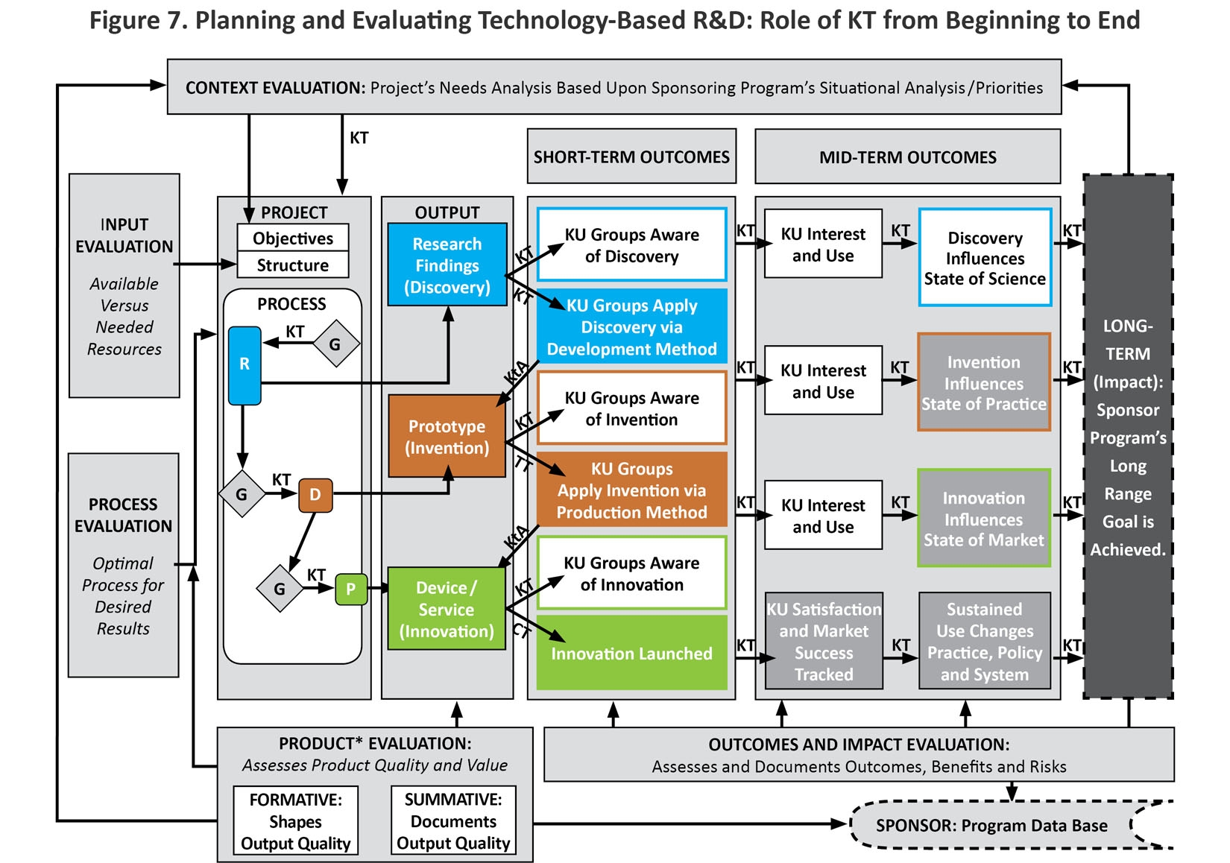
Figure 7

Slide 33
“Need to Knowledge (NtK) Model: an evidence-based framework for generating technological innovations with socio-economic impacts.”
Flagg, Lane & Lockett (2013).
Implementation Science
www.implementationscience.com/content/8/1/21/

Slide 34
Need to Knowledge (NtK) Model
Orientation – Actors engaged in innovation “need to know”: Problem/Solution; Methods/Outputs; Stakeholder roles; and Goal in context of beneficial socio-economic impacts.
Integration – Product Development Managers Association (PDMA) New Product Development practices (implementation); Canadian Institutes of Health Research (CIHR) Knowledge to Action Model (communication).
Validation – Stage-Gate structure populated with:
Supporting evidence (1,000+ excerpts) from scoping review of academic and industry literature ,
along with links to tools for completing recommended technical and market analyses .

Slide 35
Elements of NtK Model
Full range of activities includes 3 Phases, 9 Stages & Gates, Steps, Tasks and Tips.
Supported by primary/secondary findings (scoping review of 250+ research and practice articles), and A/T case examples.
Logic Model orientation – “Begin with the end in mind” (Stephen Covey), and work backwards through process to achieve it.

Slide 36
Evidence milestones; research discovery; development invention; production innovation.

Slide 37
Need to Knowledge (NtK) Model for Technological Innovations

Slide 38
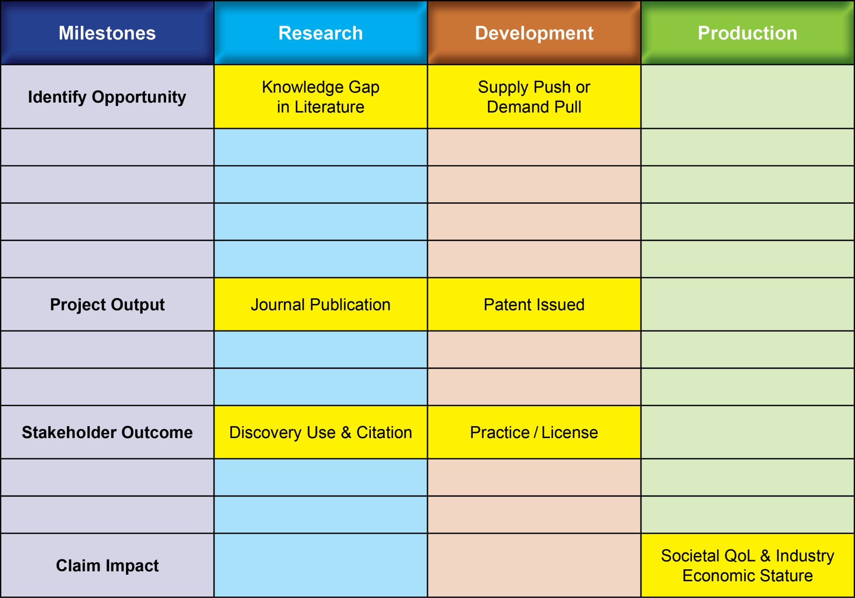
Outputs/Outcomes/Impacts from R or D Methods are distant from Socio-Economic Impacts

Slide 39
“Gamification” of Technological Innovation
Progress through three Methods of Knowledge Generation, and the effective Communication of three Knowledge States, may be circuitous and iterative, punctuated and prolonged, risky and unpredictable, yet still be planned, implemented and accomplished through the deliberate and systematic efforts of key stakeholders.

Slide 40
NtK Model Utility
Clarifies processes and mechanisms underlying technology-based Innovation, by integrating academic & industry literature and analytic tools.
Establishes linkages between three distinct methods and their respective knowledge outputs for implementation/communication.
Offers a structure to sponsors & grantees for program/project planning, proposal submission & review, project implementation, progress monitoring and summative evaluation.

Slide 41
Need to Knowledge Model
http://kt4tt.buffalo.edu/knowledgebase/model.php

Slide 42
Part III: 1 – 2:30 pm
Review of Academic and Industry
literature supporting elements
of the NtK Model

Slide 43
Lessons from Literature
Literature from both Industry and Academia converge on “Best Practices” in New Product Development, where due diligence supplants ad hoc approaches and tests assumptions.
Steps/Activities/Tips all point toward Best Practices validated through numerous iterations under a variety of field conditions.
Stage/Step level activity do not require a linear progression, but Decision Gates cannot be properly addressed without them.

Slide 44
NtK Model Key Findings
Evidence base of Academic and
Industrial Literature since 1985

Slide 45
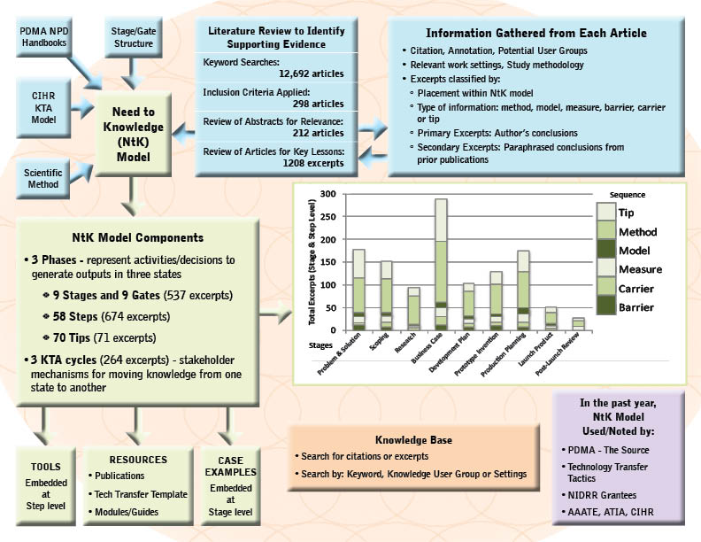
Schematic

Slide 46
Knowledge Communication – 3 Strategies for 3 States

Slide 47
Delivering Solutions to Problems involves progress across three Knowledge States
Research → Discovery →Translation → Utilization ↓
Development→ Invention→ Transfer→ Integration ↓
Production → Innovation → Transaction → Lifecycle ↓

Slide 48
Evidence from Scoping Review
Literature Search; Scoping Review & Narrative Synthesis.
Over 800 excerpts from over 200 academic and industry journal articles substantiate stage/gate model.
Excerpts cluster differently for each Phase of R/D/P.
Review aggregated findings: http://kt4tt.buffalo.edu/knowledgebase/research.php?model=3

Slide 49
Search Evidence Base
Search evidence base by keyword:
http://kt4tt.buffalo.edu/knowledgebase/search.php

Slide 50
Number of Excerpts by Code in the Research/Discovery Phase

Slide 51
Number of Excerpts by Code in the Development/Invention Phase

Slide 52
Number of Excerpts by Code in the Production/Innovation Phase

Slide 53
Part IV: 3 – 4 pm
Tools for Technical,
Business and
Marketing Analysis

Slide 54
NtK Model’s Toolbox
Tools for Technical, Marketing
and Customer Analyses

Slide 55
Requirements for Technical & Marketing Analysis
Analyses are required throughout all three Phases, while Grantees are only familiar with a sub-set of them.
Technical, market and customer analyses address three different yet equally critical issues for technological innovation.
Knowing what you don’t know but need to do is critical to creating a successful team.

Slide 56
NtK Model’s Toolbox
Go to tools for Technical, Marketing
and Customer Analyses
http://kt4tt.buffalo.edu/knowledgebase/model.php

Slide 57
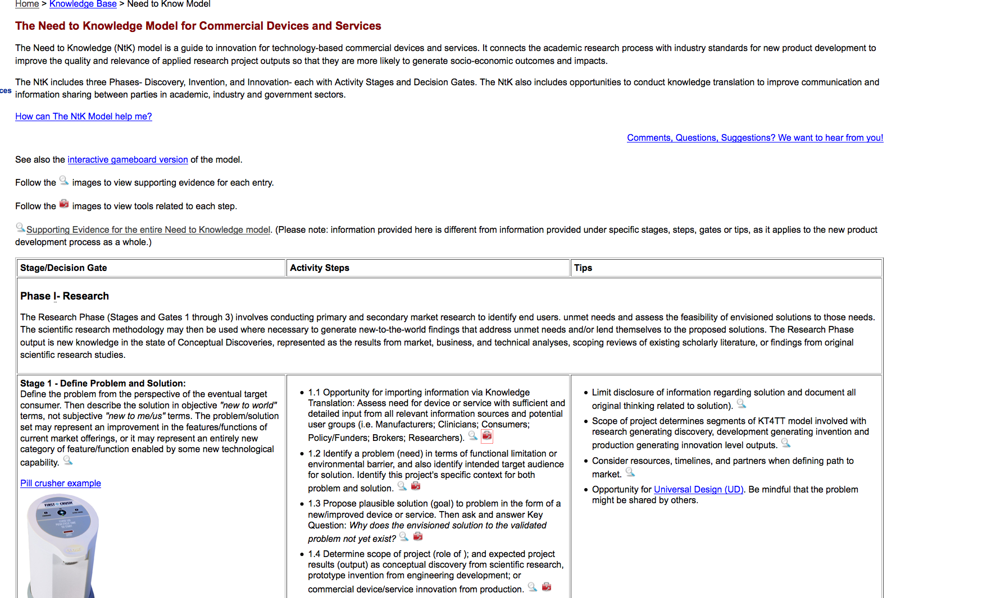
The Need to Knowledge Model for Commercial Devices and Services

Slide 58
The Need to Knowledge Model

Slide 59
Toolbox entries for Step 1.1

Slide 60
Affinity Diagrams

Slide 61
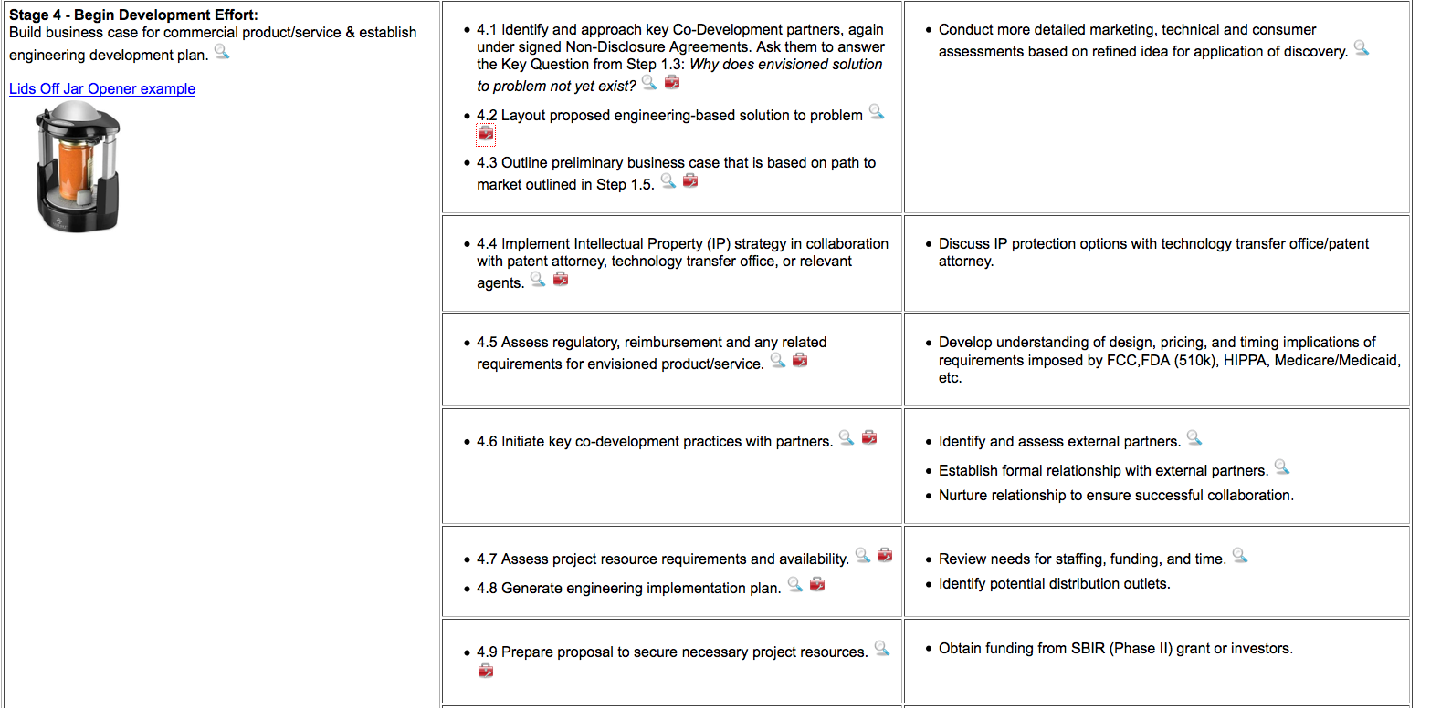
Stage 4 Begin Development Effort

Slide 62
Toolbox entries for Step 4.2

Slide 63
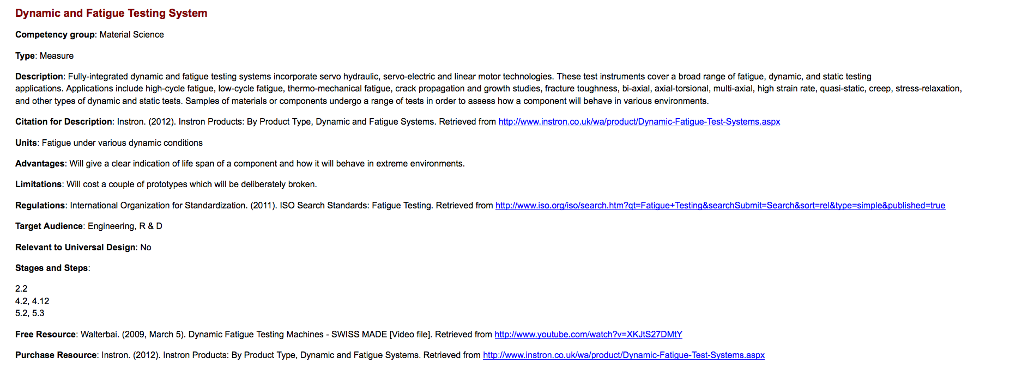
Dynamic and Fatigue Testing System

Slide 64
Stage 4 – Begin Development Effort

Slide 65
Design guide for aging and disability

Slide 66
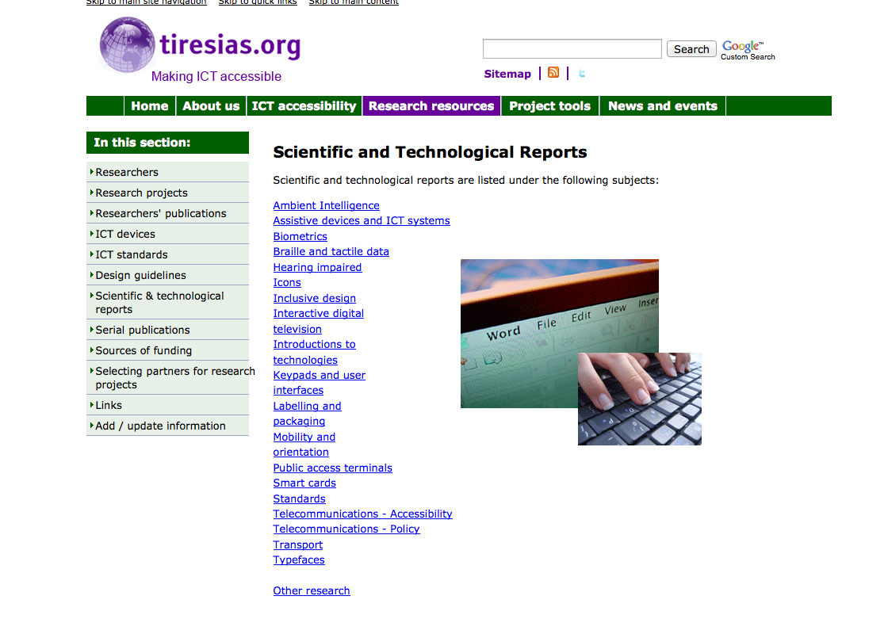
Scientific and technological reports

Slide 67
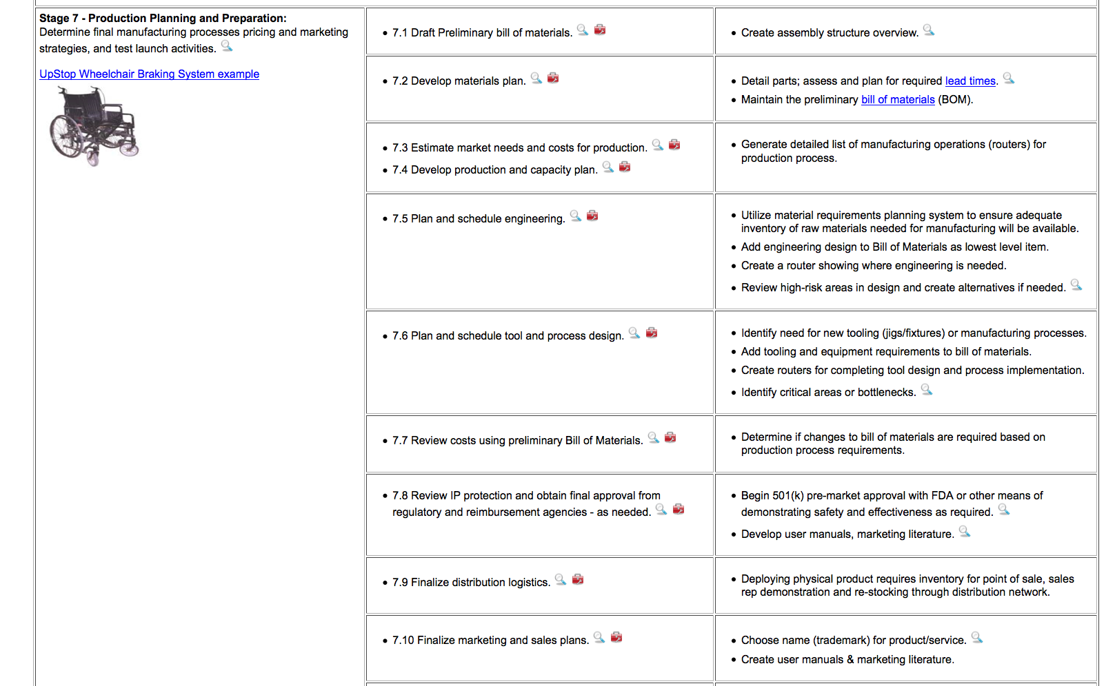
Stage 7 – Production Planning and Preparation

Slide 68
Toolbox entries for Step 7.10

Slide 69
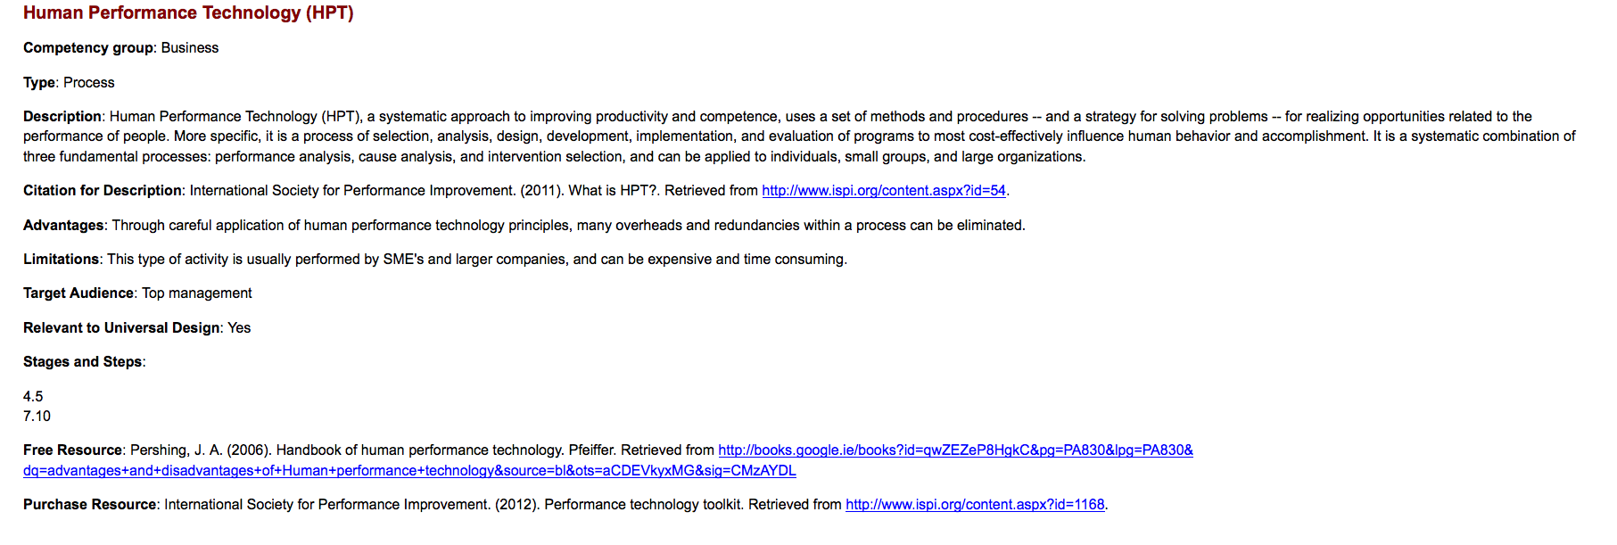
Human Performance Technology (HPT)

Slide 70
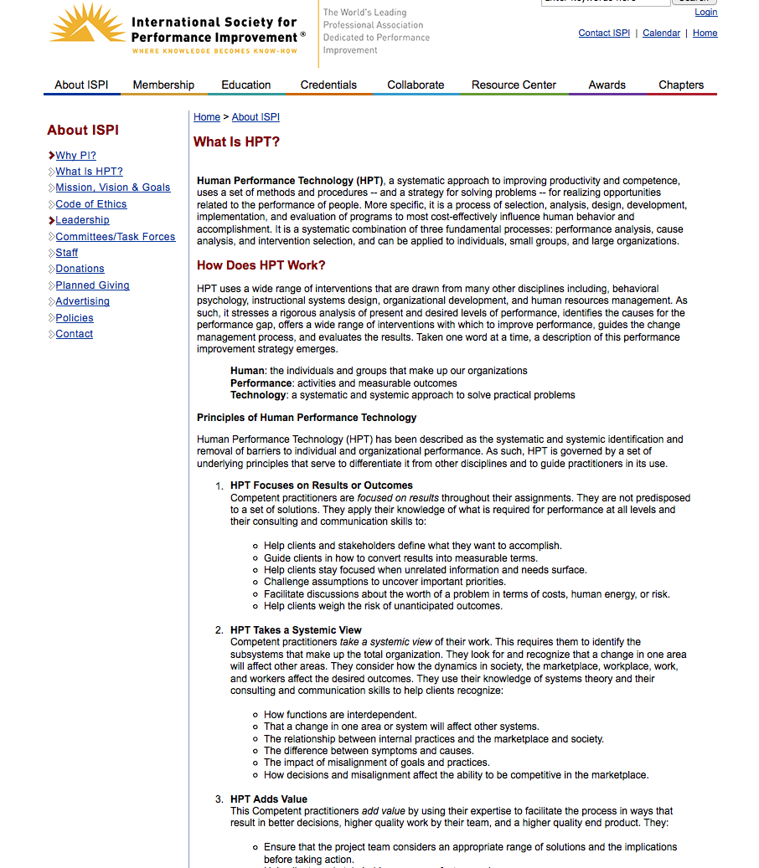
What is HPT?

Slide 71
Summary: NtK Model Utility
Clarifies processes and mechanisms underlying technology-based Innovation, by integrating academic & industry literature.
Establishes linkages between three distinct methods and their respective knowledge outputs for implementation/communication.
Offers structure to sponsors & grantees for program/project planning, implementation, monitoring and evaluation.

Slide 72
Summary: NtK Model Value
Technology Grantees:
Proposal structure – Review Panel liked.
RERC Tech Transfer/ SBIR Phase III Plans.
Program Sponsors:
Assess proposals; Track progress.
Compliance enforced – Funding continuation?
Organizations:
PDMA’s “The Source”; Tech Transfer Tactics;
CIHR; CEUD; DIT; ATIA; AAATE.

Slide 73
ACKNOWLEDGEMENT The contents of this presentation were developed under a grant from the U.S. Department of Education, NIDRR grant #H133A130014.
However, the contents do not necessarily represent the policy of the Department of Education, and you should not assume endorsement by the Federal Government.

Slide 74
Part V: 4 – 5pm
Group discussion:
NTK Model’s utility for AT field;
Utility for STI Policy in general.

