Slide 1
Winning your next proposal: “Buzz Tactics” to increase the chances of success
Joseph Lane, Jennifer Flagg, James Leahy
Center on Knowledge Translation for Technology Transfer, University at Buffalo

Slide 2
Session Objectives
Introduce key concepts and buzz words.
Understand federal funding sponsor needs for increased uptake and use of R&D outputs.
Identify where you are now and where you’re going with your technology-based R&D projects.
Secure valid “Voice of the Customer” through proper focus group methods.

Slide 3
Objective 1. Key Concepts and Buzz Words
Know what to do and what to avoid.

Slide 4
Knowledge Translation (KT)
A process for moving knowledge generated through research into implementation and application by various stakeholders.
Key definition – Canadian Institutes for Health Research (CIHR).
Origins – Systematic reviews to vet literature, and evidence-based practice to achieve efficacy.
Current KT focus on linear model of research diffusion, and assume conduct of grant-based scholarly activity. Not sufficient for R&D proposals!

Slide 5
Technology Transfer (TT)
A process for moving technology-based prototypes generated through development into application and exploitation by stakeholders.
Key definition – Wikipedia’s is as good as any.
Origins – Shifting control over invention from one sector to another, or from one application to another, to generate additional value.
TT process focused on the Path to Market (PtM) where outputs from Research and Development become valid inputs to Production (R/D/P).

Slide 6
Path to Market
Supply Push (SP) – Where R&D generates a discovery or invention independent of target application. Underlies “linear model” where scientific outputs are assumed to eventually and somehow lead to innovations.
“Message in a Bottle”
Governments fund such exploratory or inquiry-driven activity in universities. Their Technology Transfer Offices (TTO’s) are saddled with the efforts to match the “solution” to a problem.

Slide 7
Path to Market
Demand Pull (DP) – R&D is initiated in response to identified problem in society, unmeet need in the marketplace, or fundamental requirement by industry.
“Lassie rescues Timmy”
Only pre-competitive needs can be addressed publicly due to competitive nature of industry. Solutions lack recipient input for customization.

Slide 8
Relevant “Buzz Words”
Corporate Collaboration (CC) - R&D projects conceived, implemented and operated in full partnership with company or industry. Partnership rather than passing solution from one party to another.
“Hand-tailored Suit”
Corporate Collaborations focus on the optimal creation of innovative technology-based devices for the marketplace.

Slide 9
Analogies between KT and TT
“End of Grant” KT = Supply Push. Open-ended search for a way to apply conceptual discovery output from basic inquiry-driven science.
“Integrated KT” ≈ Demand Pull TT. Emphasis on research prolongs timeframe and typically generates a sub-optimal discovery/invention.
“Prior to Grant” KT = Corporate Collaboration. Validate need and design solution in partnership to complete optimal path for market success.
Science Rigor + Industry Relevance = Impact!

Slide 10
“Translating Three States of Knowledge: Discovery, Invention & Innovation”
Lane & Flagg (2010)
Implementation Science
http://www.implementationscience.com/content/5/1/9

Slide 11
Delivering Solutions to Problems Involves Progress Across Three Knowledge States
Research → Discovery →Translation → Utilization ↓
Development→ Invention→ Transfer→ Integration ↓
Production → Innovation → Release → Lifecycle ↓

Slide 12
Integrate Concepts
Knowledge embodied in three distinct states: Know role of Research, Development and Production methods in context of project – plan and budget accordingly.
Initiate with industry engagement: Government and academia projects intended to benefit society fail to cross gaps to becoming market innovations.
Apply evidence-based framework: Links three methods, communicates knowledge in three states, and integrates key stakeholder who will determine eventual success.

Slide 13
Objective 2: Understanding Federal Funding Sponsor Needs for Increased Uptake and Use of Funded Research by All Stakeholders
James A. Leahy
Center on Knowledge Translation for Technology Transfer
University at Buffalo
http://kt4tt.buffalo.edu/

Slide 14
Federal Sponsor Needs
Using NIDRR of the US Department of Education as an example …..
In NIDRR RFP’s for RERC’s the following requirement appears:
“Increased transfer of RERC developed technologies to the marketplace. RERCs' must contribute to this outcome by developing and implementing a plan for ensuring that all technologies developed by the RERC are made available to the public.” Hence the need for a technology transfer plan.
- Why?

Slide 15
Federal Sponsor Needs
NIDRR intends to improve "marketplace" outcomes from RERC's.
NIDRR has set specific goals to increase such outcomes by 20% by the year 2013.
NIDRR needs to meet this goal to demonstrate results to the Office of Management and Budget. This is a serious program level mandate, with NIDRR's future funding in question if the performance goals are not met.

Slide 16
Federal Sponsor Needs
KT4TT in the context of NIDRR Technology grantees means the application of KT theory & practice in R&D to more effectively apply TT processes and generate TT outputs.
Goal is to have NIDRR technology grantees increase the application of their outputs by manufacturers, clinicians, researchers, policy makers, brokers, and consumers.
University researchers, interested in having their research culminate in consumer products, must become skilled in translating their research findings into a format and language used by product manufacturers, clinicians, consumers and others.

Slide 17
Federal Sponsor Needs
Grant proposal differentiates between research projects and research and development projects generating new prototypes.
For projects that intend to conduct research and generate knowledge that is intended strictly for publication and scholarly application, this message is not relevant.
This message is meant for projects that involve technologies and generate outputs intended for use by others, who in turn will generate outcomes with beneficial impacts for, in the NIDRR case, people with disabilities.

Slide 18
Federal Sponsor Needs
For example:
Projects that intend to generate draft or final industry standards, clinical protocols or practice guidelines.
Projects that intend to generate instruments or tools for use by others in research or practice.
Projects that intend to generate hardware devices or software systems that will be made available for free access by request or direct download.
Projects that intend to generate a device or service intended for release into the commercial marketplace.

Slide 19
Federal Sponsor Needs
So what are federal funding sponsors, such as NIDRR, looking for in proposals?
Concrete evidence of an intent to transfer.
Any project that intends to involve technology transfer requires articulation of a Technology Transfer Plan.
We recognize that one might consider the expressed intent to transfer to be equivalent to a plan for transfer. But, it’s not!!!

Slide 20
Federal Sponsor Needs
In your proposal for each Research and Development project you need to generate an operational framework describing:
The stages/steps/tasks involved;
The monetary and staff resources dedicated to each;
The timeline and resource loading by the grantee and expected by others;
Anticipated milestones for tracking and evaluating progress through the process.

Slide 21
Federal Sponsor Needs
Need access to a template or framework for this effort?
Refer you to the NtK model at our website.
Stage/gate framework articulates nine stages (three each for Research, Development and Production activity) and the steps and tasks for each stage.
In cases where stages were completed in a prior funding cycle or completed by others, that information needs to be stated and shown on the project timeline.

Slide 22
Federal Sponsor Needs
In cases where the proposed work may require the full grant cycle, with transfer to external stakeholders beyond the end of the grant cycle, this information should be stated and shown in timeline.
Level of detail you provide should permit an independent external reviewer, to assess the quality and comprehensiveness of your R&D efforts.
Level of detail you provide should allow sponsor to feel confident you will reach your stated goals.

Slide 23
Objective 3: Identifying Where You are Now and Where You are Going
Jennifer L Flagg
Center on Knowledge Translation for Technology Transfer
University at Buffalo
http://kt4tt.buffalo.edu/
Notes:
Identifying where you are now and where you’re going. This learning objective is focused not only on helping you to clarify your own goals and define an appropriate path to market, but also to help you convey that information to potential collaborators, grant reviewers, and funding agencies.

Slide 24
Objective 3 Outline
Need to Knowledge Model
Template for Commercialization or TT Plans
Gaant Charts
Key Take-Aways
Notes:
First, I will show you the Need to Knowledge model, which can be found on our website at http://kt4tt.buffalo.edu/knowledgebase/model.php
Next, I will show you how the model can be used as a template for developing commercialization and technology transfer plans- one a requirement for SBIR funding, the other needed for projects funded by NIDRR that have the intention of transferring technology-based products and services to the marketplace.
I will then offer a version of a Gaant chart that helps to document timelines and key players.
Finally, we will conclude this section of the presentation with a few key take aways

Slide 25
The Need to Knowledge Model
Outline path to market
Begin with the end in mind!
Early identification of important downstream considerations
Early involvement of partners
Stages and gates
Notes:
The Need to Knowledge model was developed to connect the formal research, development and production processes, using best practices from each of those areas of activity. Knowledge translation techniques are woven into the steps in order to ensure that information is transferred from one party to another in formats that are useful to a project’s stakeholders. The goal of using the model is to increase the number of federally funded R&D project outputs resulting in impacts in the marketplace. One of the most important features of the NtK model is that it helps one to clearly outline their project output’s path to market.
In order to do so, the model requires an investigator to begin with the end in mind. To reach a desirable end-point, it is very helpful to have an idea of what the intended end point is at the onset of the project. The model helps PI’s to develop their path to market by connecting the dots from the research they intend to conduct to the embodiment of their discoveries as prototype inventions, to the manufacturing floor where product innovations are generated. Without such planning, R&D efforts may be uncoordinated and unguided. It is also very difficult to obtain buy-in (from a sponsor or partners) when one cannot articulate the process of getting from here (idea/prototype) to there (product/improved QoL). The Need to Knowledge model helps organizations to overcome this barrier through clear identification of the necessary steps to achieve desired impacts. The planning process is also particularly helpful for creating awareness of possible pitfalls and problems that may arise later in the process. Early planning helps a PI to prepare for such obstacles and ideally, to obviate them.
The model encourages investigators to consider relevant stakeholder groups from the onset of the project. Stakeholders may include people with disabilities, caregivers, product purchasers, manufacturing partners, or subject matter experts in the field. Their input can then be used to shape a product or service that will have value and meet the needs of not only the end users, but also of any intermediate stakeholders who can influence the success of a project.
In terms of structure, the NtK model uses a stage-gate format. This format was popularized by Cooper and Edgett, who are well-known in the fields of new product development and project management. Note that stage-gate models can (and should!) be customized to match an organization’s goals and capabilities- for example, many stages and steps may take place concurrently, and some steps are performed earlier than others in a stage.
A special note on gates- to paraphrase the famous rapper, Ice Cube, “You better check yourself before you wreck yourself.” Gates represent important opportunities for self-checks where an investigator can reflect upon progress and identify any internal or external changes that may make it wise to tweak a project’s path or discontinue a project altogether. Though it may be difficult for any investigator to abandon a project into which they have poured a great deal of effort, throwing good money after bad rarely produces desirable results. Particularly when involved in long-term projects, an investigator is wise to keep abreast of environmental changes- depending on the product or service being developed, the relevant environment may include laws and regulations; standards; changes in target market segments such as new buying habits or the increase or decrease of a population; or the introduction of new technology that renders the on-going project obsolete before it is completed. Ideally, an organization is keeping pace with such changes as they happen. However, gates present an opportunity to reflect upon what has been going on before making commitments to make increasingly larger investments as a project continues on.

Slide 26
Knowledge Base Main Page
6
Notes:
Now I would like to introduce you to the material you will find on the KT4TT knowledgebase website. On this slide, I have placed a screenshot of the webpage that is available at the following address: http://kt4tt.buffalo.edu/knowledgebase
The Knowledge base content is located in the middle of the page, and begins with a welcome paragraph. Under this text, there are three links, which I have highlighted in a yellow box. From this page, you can view the model, search the evidence base, or provide feedback to us regarding the website, model or findings.
We are always interested in improving our tools so that they may better serve our target audience. Please let us know if you encounter any problems in using the Knowledge base or if you have suggestions for improving upon it!
Moving on from here, let’s say we’ve clicked the link for “View the model”.

Slide 27
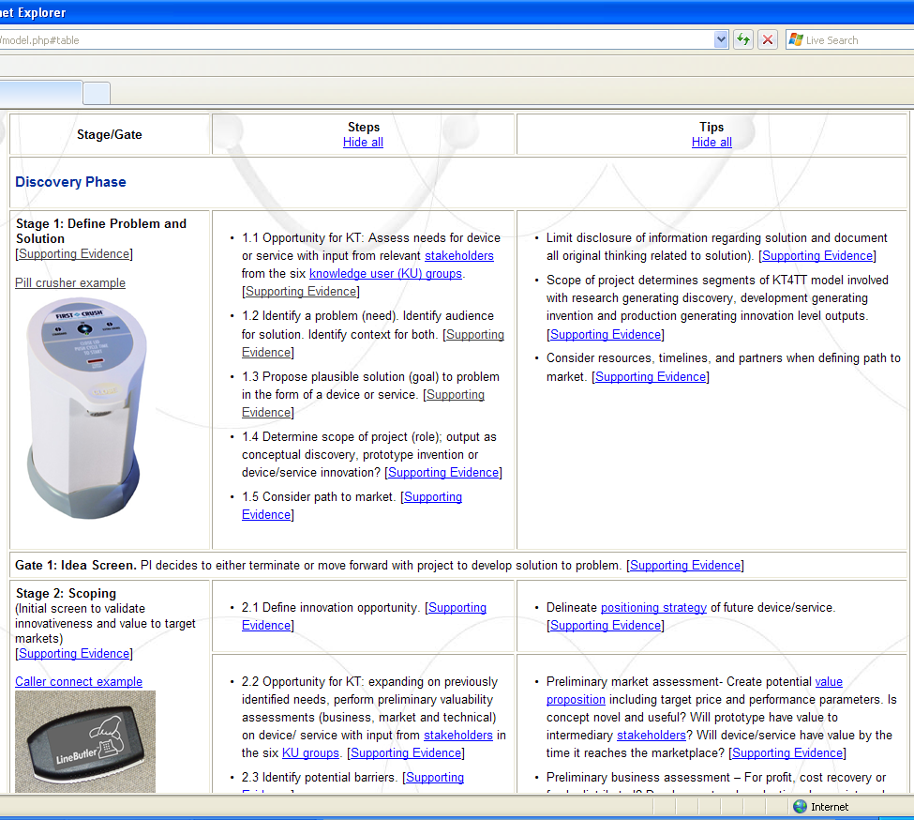
Links Everywhere- What to click?
Link to Example
Supporting Evidence Link
Link to Glossary Definitions
3
8
Notes:
When you arrive at the model page steps and tips will not be visible.
Click links at the top of those columns for view all steps and tips. Once you do so, the table now contains much more information, and many, many more links! Where do we go from here? It depends. Let’s review the different types of links on this page, then we will explore each one in more detail.
I have placed a yellow arrow on the upper left portion of the table. It points to linked text just above the picture of a device that says: “Pill crusher example”. Click on the words to review examples related to the stages. At this time, we have only completed examples for the first three stages. However, more examples are under development and will be posted to the model as they become available.
Moving downward in the stages column, I have placed a blue arrow pointing to a link for Supporting Evidence. Supporting evidence links are present for all stages, gates, steps and tips that have associated findings. You’ll notice that some steps and tips do not currently have any supporting evidence. These areas have been noted and will be explored in future work.
Finally, there is a red arrow pointing to a hyperlinked word that has been defined in a glossary. Click on the word to view a pop up window containing the full glossary.

Slide 28
Supporting Evidence Links
Supporting evidence links for stages and steps/tips/gates
Stages
Key themes
Citations related to each theme
All findings
Steps/Tips/Gates
Tools
Citations related to the step
All findings
10
Notes:
The example and glossary links are relatively straight-forward. However, you may be wondering what you will find on the supporting evidence links.
In order to substantiate and give operational detail to the NtK model, we have conducted a literature review of approximately 200 pieces of literature relate to new product development. Over 1000 individual findings were extracted from these papers, and classified by their most appropriate placement within the model. The links for supporting evidence contain the raw data extracted from each piece of literature, as well as data resulting from a secondary analysis of those findings.
Knowledge base users should be aware that the content available through the links for supporting evidence differs from one category to another. All findings for each stage are being sorted and grouped according to themes that emerge as the data is reviewed. A listing of citations related to each theme is provided, along wish a summary of all findings.
Early attempts to identify themes for steps and tips were not fruitful because there simply was not enough data to create meaningful groupings of findings. However, when reviewing findings at the step and tip level, a number of tools that could aid with step and tip implementation were identified. Tools are the first item detailed in the supporting evidence links for steps and tips, followed by citations, and then findings.
New information is presently being posted as it becomes available, and a side project has been initiated to expand the tools section of the supporting evidence.

Slide 29
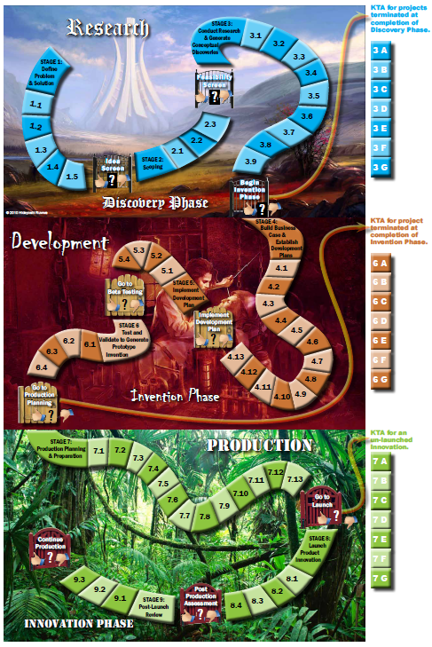
New Interface- Coming Soon!
Notes:
Here we have a screen shot of our interactive game board version of the NtK model. In this colorful version of the model, you can clearly see the distinction between activities in the research phase, development phase, and production phase.
This version of the model also highlights three instances where knowledge translation techniques can be used to facilitate handoffs of projects to other stakeholders. For example, after completing the research phase an investigator may hand off their work to other stakeholders who will carry it through the remaining phases. Knowledge translation steps based upon Ian Graham’s Knowledge to Action model have been used to describe the actions needed at these hand-off points. Additional details about types of information and formats can be found on the NtK model webpage by clicking on links for KT tables.

Slide 30
KT Table
Notes:
When you click on the KT table link at the end of Stage 3, a window opens which contains the table shown on this slide. I have highlighted the column of information related to manufacturers. In this case, we can see that the table recommends using the work developed in stages 1, 2, and 3 to communicate the value of the discovery output to a manufacturer. 5 other groups of stakeholders are also discussed in this table, as discoveries outputs can often be used in other ways by different groups. For example, consumers and clinicians may appreciate information that helps them to advocate for product availability or changes in reimbursement standards that enable manufacturers to profitably provide needed devices and services.

Slide 31
Now…
How can YOU use this model for planning purposes?
Notes:
Now, the question is how do you use this information to go about making a commercialization plan or technology transfer plan?

Slide 32
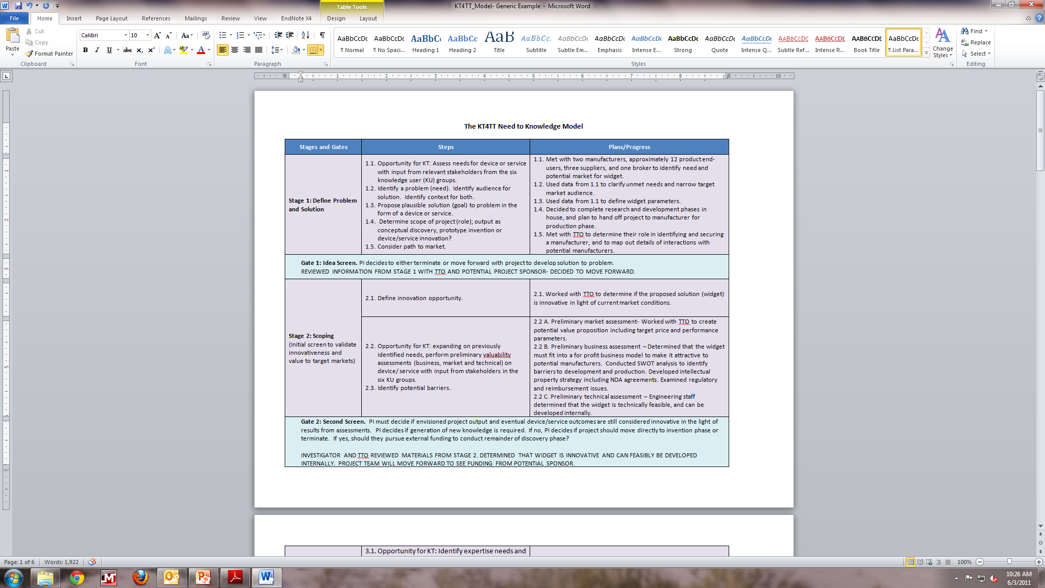
Using the Model as a Template
Notes:
In the example provided on this slide, you can see that the investigator has completed all tasks in Stages 1 and 2 in collaboration with their TTO. They are now at Gate 2 and ready to submit a proposal to fund the work proposed in the remainder of the plan.
Based on experience with NIDRR grantees, we recommend detailing current progress and future plans for each step of the process. A downloadable template will be available on the website within the coming weeks. In the meantime, please feel free to email me for a copy of the template that you see on this slide. Once future plans are laid out in this way, key and supporting staff can be identified, and a timeline can be plotted to determine what will happen when. We have seen SBIR and RERC grantees employ Gaant charts for this purpose with great success.

Slide 33
Gaant Chart Example
Objective and Task | Oct 06 | Nov 06 | Dec 06 | Jan 07 | Feb 07 | Mar 07 | Apr 07 | May 07 | Jun 07 | Jul 07 | Aug 07 | Sept 07
O1: T1 | JD | JD | JD/LJ | LJ
O1: T2 | AF
O1: T3 | JD
O1: T4 | AF | LJ
O1: T5 | JD | JD | LJ |  |  |  |  | LJ
O1: T6 |  |  |  |  | AF
O1: T7 |  |  |  |  | LJ | LJ
O2: T1 |  |  |  |  |  |  | SUB
O3: T1 |  |  |  |  |  |  |  | AF
O3: T2 |  |  |  |  |  |  |  |  | SUB
O4: T1 |  |  |  |  |  |  |  | JD | LJ | LJ
O4: T2 |  |  |  |  |  |  |  |  |  | SUB | SUB | JD
O5: T1
O6: T1
O7: T1
O7: T2 | JD
O7: T3 | LJ
O7: T4 | LJ
O8: T1
Notes:
This example is about as basic as a gaant chart gets. If you google the term, you’ll find a wide variety of formats and programs that can be used to create much more stylish gaant charts. For our purposes, Excel works just fine. The important items to take note of are 1) there is an outline of all tasks (in this case, tasks are connected to specific objectives that will be completed during the project). In other models, the first column might list the NtK stages and steps. 2) The month by month timeline shows when activities will be happening simultaneously as well as when they are sequential. 3) initials have been added to each box to indicate the key staff person responsible for the completion of each piece. This can be helpful in project planning to ensure that no one person ends up overbooked with too many concurrent activities at once.
In this example, a number of boxes are labeled with “SUB” to indicate that a sub-contractor will lead those activities. This tool helps the subcontractor to see exactly how and where their work fits into the bigger picture, as well as what must be completed before their work can proceed.
We have received numerous positive comments from grant reviewers when using such planning tools in grant proposals. Though it may appear as though a table takes up quite a bit of space in a proposal which is often limited in number of pages, the chart actually conveys a great deal of information concisely and in a standard format that is easy to follow… A key when requesting funds!

Slide 34
Key Take-Aways
Think Prior to Grant KT.
Involve stakeholders early- ideally before project funding is obtained!
Needs of end users are not the only consideration.
Your Path to Market will define your key stakeholders.
Do you need a manufacturer to achieve impacts?
Contingency Plans are crucial!
Plan for the “what ifs.”
Notes:
In summary, the NtK model is intended to get researchers and new product developers thiking about downstream activities early in their process. Communicating with key stakeholders including manufacturing partners, and University TTO’s early in the process is critical to obtaining buy-in and a commitment to results. Further, collaboration early and often helps to ensure that all parties’ concerns are addressed before they become show-stoppers. I cannot stress enough that if you are seeking to hand off your invention to someone else for manufacturing- THEY are your customer. Yes, you must be mindful of the needs of end-users, but the manufacturer will be the one communicating with that audience. It is your job to sell your discovery or invention to the manufacturer- not the consumer!
Use your TTO- we recently worked with one grantee who had thought that spending time with their TTO would be wasteful. However, after a few early conversations with their TTO they found that the TTO was willing to take on the brunt of the market research and manufacturing partner cultivation activities. This not only saves the researcher time for working on their discoveries and inventions, but also allows the TTO experts to do what they do best!
Something we did not discuss earlier is the importance of contingency plans. In my experience, back-up plans were particularly important in one particular NIH fast-track proposal that I worked on. In this case, funding was awarded for Phase I and II simultaneously. Therefore, the proposal had to consider a multitude of possible scenarios that could potentially impact progress. By considering these possible problems early in the planning process, the PI was able to easily maneuver around problems as they arose, using the pre-defined plans.
In another case, during a two year project timeframe the contact at one particular manufacturing company changed multiple times. Fortunately, the investigator had anticipated such turnover and established contact with a number of individuals in the organization. Doing so prevented the project from being halted once the key contact left the company, as others who had interest in being project champions stepped up to the plate to ensure it continued moving forward.
Now Jim is going to move on to objective 4, where you will learn the nuts and bolts of a small, but important part of the new product development process- obtaining consumer input with Voice of the Customer techniques.

Slide 35
Objective 4: Identify and Articulate Appropriate Uses of Voice of the Customer
James A. Leahy
Center on Knowledge Translation for Technology Transfer
University at Buffalo
http://kt4tt.buffalo.edu/

Slide 36
Voice of the Customer in Funded Research and Development Projects
Inclusion of consumer input early on in funded researchers proposal shows reviewers increased likelihood of successful product outcome.
Historically, manufacturers of consumer products have made product design decisions without factoring in the needs, wants, and expectations of the full range of end consumers.
This process leads to ineffective products in the marketplace, new product failures, and product abandonment. Failure rates for new product introductions vary by industry but range from 30% to 90%.
The primary cause of these failures can be traced back to a point early in the product design process where significant consumer or device user information failed to be collected and analyzed prior to the initial fabrication of the device (aka prototype).

Slide 37
Voice of the Customer in Funded Research and Development Projects
Method of inclusion of consumer input – Targeted Focus Groups!
Targeted focus groups employ purposive sampling, rigorous primary and secondary recruitment screens, and state of the art product and feature demonstrations early in the design process.
Focus groups allow new product developers to obtain specific design functions and features for the product being developed directly from the product’s targeted end users.
Farther on in the product development process these same targeted, educated, end users are reconvened to review functional prototypes of the new product prior to its initial production run.

Slide 38
Focus Group Methodology
Steps Prior to the Focus Groups
Step 1: Identification of product target area.
Have you identified an unmet need in the consumer marketplace?
Step 2: Identification of focus group participants and the use of purposive sampling.
With purposive sampling you are seeking a predefined group of consumers not a random selection of the general population.
Step 3: Use of general media outlets to recruit potential focus group participants.
This includes newspaper, television or radio ads, and targeted placement of recruitment flyers.
Step 4: Rigorous primary and secondary screens administered to potential focus group participants.

Slide 39
Focus Group Methodology
Focus Group Process
Step 5: Decision point.
If this is a product refinement focus group, does the group have to be educated on the current state of the science through information or product demonstrations prior to the focus group so that the participants are not just identifying design functions and features of products currently available in the marketplace? If yes, see Step 6. If not, skip to Step 7.
Step 6: Prepare state of the art product demonstrations.
Demonstrations will be performed prior to the start of the actual focus group. Or prepare a listing of the state of the art features currently available in products in the marketplace and discuss them with participants prior to the focus groups.
Notes:
Need to make this flow – or look like it is a flow chart of sorts…

Slide 40
Focus Group Methodology
Step 7: Run the alpha focus groups or concept definition focus groups which involve consumers in defining product requirements and setting priorities for product design.
To determine the current status and consumer satisfaction levels with their product function techniques and devices, the participants will be asked to provide background information on a variety of topics involving the product.
On the topic of ideal product, participants will be asked to provide the attributes of what they perceive to be the ideal device to perform the function.
The focus group participants undertake an evaluation of static product concept models prepared in advance for the groups.
Purchase intent and price point questions are asked of the participants for both the conceptualized ideal product and for the concept models shown.
Notes:
Lots of info – try to shorten. Don’t forget to add footnote below to the formatting:
Merges, Robert Patrick, et al. Patent Law and Policy: Cases and Materials. Newark: LexisNexis, 2002 (p. 644)

Slide 41
Focus Group Methodology
Step 8: Beta Focus Groups.
Primarily allow the refinement of a product’s appearance by the manufacturer through a critique of key design features of a prototype. They provide an opportunity to rank a product’s function and design features previously identified in concept definition focus groups.
Beta focus group participants are a representative sample of the alpha focus group participants.
Two beta groups of twelve participants each are usually sufficient.
Beta groups provide the ability to score how well a prototype meets consumer expectations and gauge consumer desire or intent to purchase the product.

Slide 42
Focus Group Methodology
Step 8: Beta Focus Groups.
Beta groups provide the ability to obtain quantitative data on the previously collected qualitative information and allows that data to be applied to the prototype being evaluated. They answer the question as to whether or not a prototype addresses the top function and design features a product must have to be deemed desirable by the consumer.

Slide 43
Voice of the Customer in Funded Research and Development Projects
Resources:
On the T2RERC web site is a Primary and Secondary Marketing Research Training Module which covers focus groups in detail and can be referenced at:
http://www.t2rerc.buffalo.edu/pubs/training/mod4/PMR%20Module-%202009-%20Sept%2022.pdf
Also on the KT4TT web site is a Resource Guide on Evaluation for New Product Development and that can be referenced at:
http://kt4tt.buffalo.edu/publications/Eval%20Trg%20Module%20-%20a%20resource%20guide.pdf
Notes:
Play with the formatting – this slide is too cluttered

Slide 44
ACKNOWLEDGEMENT This is a presentation of the Center on Knowledge Translation for Technology Transfer, which is funded by the National Institute on Disability and Rehabilitation Research, U.S. Department of Education under grant #H133A080050.
The opinions contained in this presentation are those of the grantee, and do not necessarily reflect those of the
U.S. Department of Education.

