Slide 1
From Theory to Practice: Operationalizing Knowledge Translation for Successful AT Commercialization
Joseph P. Lane
Center on Knowledge Translation for Technology Transfer, University at Buffalo

Slide 2
Outline
Overview of Knowledge Translation (KT)
Definition
Knowledge to Action Model
Need to Knowledge Model
Structure and Supporting Evidence
Three Opportunities for KT
KTA Diagrams & Tables
KT Resources

Slide 3
What is Knowledge Translation?
A process for moving research-based knowledge into stakeholder action.
Definition – Canadian Institutes for Health Research
Origins – Evidence-based Medicine to justify Federal & Public investment.
Current models focus on linear model, and assume conduct of research activity.

Slide 4
KTA Model – CIHR

Slide 5
Analogies between KT and TT
“End of Grant” KT = Supply Push TT – Applying discovery from basic inquiry (Mode 1 science).
“Integrated KT” = Collaborative TT – Creating discovery from validated need (Mode 2 science).
“Prior to Grant” KT = Demand Pull TT – Identify Problem for which Knowledge offers Solution.
Science Rigor + Industry Relevance = Impact!

Slide 6
Successive Trends
Convergence of Science & Technology
Public funding for Basic Research generates a repository of conceptual knowledge;
Innovation expected via Diffusion Model.
Convergence of Science, Technology & Society
Public funding for Applied R&D generates a repository of prototype devices/services;
Innovation expected via Linear Model.
Convergence of Government, Academia, Industry
Integrate three sectors in Problem Solution.
“Open” innovation and “Challenge” orientation.
Notes:
6

Slide 7
Convergence of Science & Industry:
Knowledge embodied in three distinct states: generated by Research, Development and Production methods respectively.
Industry is critical missing partner: Government and academia projects intended to benefit society fail to cross gaps to becoming market innovations.
Evidence-based framework exists: Links three methods, communicates knowledge in three states, and integrates key stakeholder.

Slide 8
“Translating Three States of Knowledge: Discovery, Invention & Innovation”
Lane & Flagg (2010)
Implementation Science
http://www.implementationscience.com/content/5/1/9

Slide 9
3 Methods = 3 Knowledge States
Research methods generate knowledge in gas state of Conceptual Discoveries.
Development methods create knowledge in liquid state of Tangible Inventions.
Production methods formulate knowledge in solid state of Market Innovations.

Slide 10
1) Discovery State of Knowledge
Research methods create new knowledge.
Process – Empirical analysis reveals novel insights regarding key variables.
Output – Conceptual Discovery expressed as manuscript or presentation.
Value – Novelty as first articulation of new concept as contributed to knowledge base.

Slide 11
2) Invention State of Knowledge
Development methods apply knowledge.
Process – Trial and error experimentation and testing demonstrates proof-of-concept.
Output – Tangible Invention embodied as operational prototype.
Value – Novelty of conceptual discovery + Feasibility of tangible invention.

Slide 12
3) Innovation State of Knowledge
Production methods codify knowledge.
Process – Systematic specification of components and attributes yields final form.
Output – Market Innovation embodied as viable device or service in a defined context.
Value – Novelty, Feasibility + Utility defined as revenue to company and function to customers.

Slide 13
Delivering Solutions to Problems involves progress across three Knowledge States
Research → Discovery →Translation → Utilization ↓
Development→ Invention→ Transfer→ Integration ↓
Production → Innovation → Release → Lifecycle ↓

Slide 14
Need to Knowledge (NtK) Model http://kt4tt.buffalo.edu/knowledgebase/model.php
Integration – PDMA’s NPD practices with CIHR’s KTA Model.
Validation – All R&D projects intending impact must start with a real problem and potential solution validated by stakeholders.
Orientation – Actors need to know problem, stakeholders, methods and role in advancing process toward the Goal.

Slide 15
Elements of NtK Model
Full range of activities includes 3 Phases, 9 Stages & Gates, Steps, Tasks and Tips.
Supported by primary/secondary findings (scoping review of 250+ research and practice articles), and A/T case examples.
Logic Model orientation – “Begin with the end in mind” (Stephen Covey), and work backwards through process to achieve it.

Slide 16
NtK Model

Slide 17
Game board version of NtK Model

Slide 18
webpage
Notes:
Be sure to note the supporting evidence links here!

Slide 19
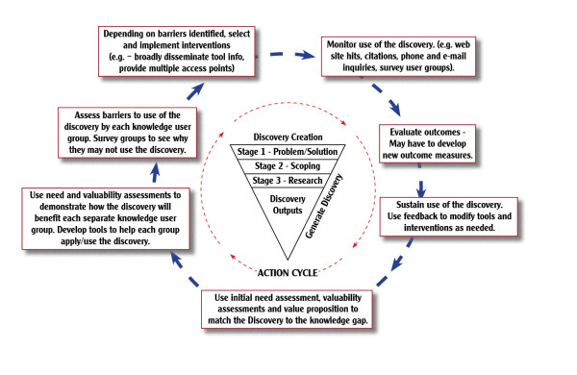
Discovery Creation

Slide 20
Discovery Outputs.
KU Group | Consumers | Clinicians | Policy Makers | Researchers | Brokers | Manufacturers
What to Share with Each KU Group | Strategic Use: Use initial needs assessment paired with research findings to develop talking points that demonstrate how knowledge (K) could lead to product development and improved Quality of Life (QoL) | Strategic Use: Use initial needs assessment paired with research findings to develop talking points that demonstrate how K could lead to product development and improved QoL. | Strategic Use: Use initial needs assessment paired with research findings to develop talking points that demonstrate how K could lead to cost savings and improved QoL. | Conceptual Use: Disseminate non-proprietary K to stimulate additional research (R). | Instrumental Use: Use needs assessment, valuability assessments and value proposition to demonstrate value of K. Develop preliminary commercialization package to promote benefits (financial and otherwise) to brokers and their clients. | Instrumental Use: Use needs assessment, valuability assessments and value proposition to demonstrate value of K. Develop preliminary commercialization package to promote benefits (financial and otherwise) to manufacturers.
How to Reach Each KU Group | Network with consumer advocacy organizations (CIL, Cerebral Palsy Association, AARP, etc.) and ask them to publish an article in their newsletter or have them email their constituents. Present at organizational meetings. Ask the organizations to have a link on their website to your website. Use fliers, emails, phone calls and face to face meetings. | Present findings at clinician oriented conferences (AOTA, APTA, CSUN, ISS, etc.). Use research papers, power point presentations, mailings, emails, presentations at conferences. | Presentations communicated to program directors, reply to invitations for comments or talk with elected officials. Use email, calls, face to face meetings, power point presentations. | Present findings at research oriented conferences (RESNA, etc.); publish in clinical and in AT research journals. Use research papers and power point presentations. | Face to face meetings with University TTO may be most effective. Utilize their invention disclosure processes. Develop a preliminary commercialization package (soft or hard copies) and use power point presentations. | Conduct face to face meetings with individual manufacturers at their home office, or at conferences/tradeshows (Medtrade, ATIA, etc.). Develop preliminary commercialization package (soft or hard copies) and use power point presentations and tailored emails.
Anticipated Knowledge Translation Outcomes | Consumers can use talking points to contact politicians to advocate for reimbursement of potential devices, or contact manufacturers and distributors to stimulate product demand.* | Clinicians can use talking points to contact politicians to advocate for reimbursement of potential devices, or contact manufacturers and distributors to stimulate product demand.* | Policy makers can use talking points as a basis for introducing and supporting legislation to provide reimbursement for potential devices.* | Researchers can use findings as a basis for additional research on related topics.* | Brokers can use preliminary commercialization package to stimulate discussions between manufacturers and researchers pertaining to application of research findings.* | Manufacturers can use preliminary commercialization package to engage in discussions with brokers and researchers pertaining to application of research findings.*

Slide 21
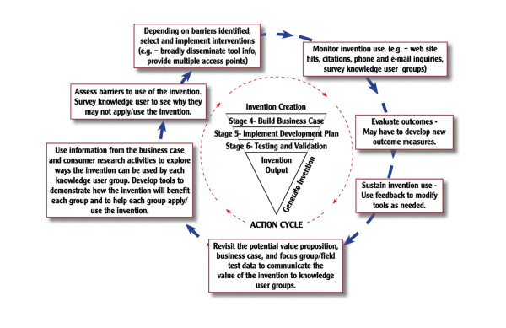
Invention creation.

Slide 22
Invention outputs.
KU Group | Consumers | Clinicians | Policy Makers | Researchers | Brokers | Manufacturers
What to Share with Each KU Group | Strategic Use: Use business case and focus group/field test results to develop talking points to demonstrate how prototype could lead to product development and improved Quality of Life (QoL). | Strategic Use: Use business case and focus group/field test results to demonstrate how prototype could lead to product development and improved QoL. | Strategic Use: Use business case and focus group results to develop talking points that demonstrate how a product based upon the prototype design could lead to improved QoL and cost savings. | Conceptual Use: Disseminate non-proprietary information regarding prototype to stimulate additional R. | Instrumental Use: Develop full commercialization package including information from initial need assessment, valuability assessments, value proposition, focus group/field test results, description of features and specifications and technical details of prototype.* | Instrumental Use: Develop full commercialization package including information from initial need assessment, valuability assessments, value proposition, focus group/field test results, description of features and specifications and technical details of prototype.*
How to Reach Each KU Group | Network with consumer advocacy organizations (CIL, Cerebral Palsy Association, AARP, etc.) and ask them to publish an article in their newsletter or have them email their constituents. Present at organizational meetings. Ask the organizations to have a link on their website to your website. Use fliers, emails, phone calls and face to face meetings. | Present prototype/findings at clinician oriented conferences (AOTA, APTA, CSUN, ISS, etc.). Use research papers, power point presentations, mailings and emails. | Presentations communicated to program directors, reply to invitations for comments or talk with elected officials. Use email, calls, face to face meetings and power point presentations. | Present findings at research oriented conferences (RESNA, etc.). Use research papers and power point presentations. | Face to face meetings with University TTO may be most effective. Commercialization package (soft or hard copies) and power point presentations.* | Conduct face to face meetings with individual manufacturers at their home offices or at conferences/tradeshows (Medtrade, ATIA, etc.). Commercialization package (soft or hard copies), power point presentations and tailored emails.*
Anticipated Knowledge Translation Outcomes | Consumers can use talking points to contact politicians to advocate for reimbursement of potential devices, or contact manufacturers and distributors to stimulate product demand.* | Clinicians can use talking points to contact politicians to advocate for reimbursement of potential devices, or contact manufacturers and distributors to stimulate product demand.* | Policy makers can use talking points as basis for introducing and supporting legislation to provide reimbursement for potential devices.* | Researchers can use findings as basis for additional research on related topics.* | Brokers can use a commercialization package to demonstrate the value of a product to manufacturers and encourage them to move to production.* | Manufacturers can use a commercialization package to understand the value of a product, thereby encouraging them to move to production.*

Slide 23
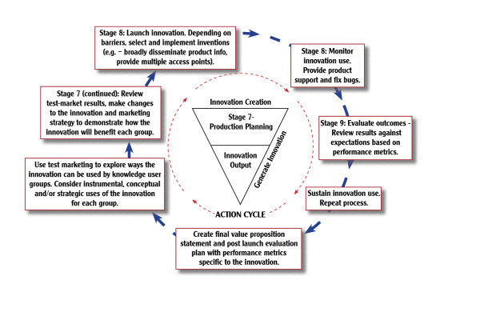
Innovation Creation.

Slide 24
Innovation Outputs.
KU Group | Consumers | Clinicians | Policy Makers | Researchers | Brokers | Manufacturers
What to Share with Each KU Group | Instrumental Use: Must demonstrate value of product to end users via product packaging and marketing efforts. | Instrumental Use: Must demonstrate value of product to end users (clinician or their clients) via informational literature, conference presentations and marketing efforts. | Strategic Use: If public funds were used for product development, demonstrate return on investment (ROI). | Conceptual Use: Provide information on path to market, barriers encountered and carriers used to overcome barriers to provide product development insights to other researchers. | Conceptual Use: Demonstrate ROI (financial, university publicity, student training, etc.). | Strategic Use: Demonstrate ROI and identify partnering opportunities with companies producing complementary products.
How to Reach Each Group | Use news media (targeted print, broadcast and internet based forms); product placement in stores; demonstration packages and trial use of product. | Use sales representatives, product training sessions, news media (print, broadcast and internet based forms); product placement in stores. Offer product demonstrations at conferences and tradeshows. Offer assessment tools that help determine if a product is appropriate for a client, or the ideal configuration, accessories, etc. for product. Provide demonstration packages and trial use of product. | Use email, phone calls and web links to news stories regarding the product. Report in formal annual performance report. | Present findings at research oriented conferences (RESNA, etc.). Use research papers and power point presentations. | Use formal reports, email, phone calls and face to face meetings. | Face to face meetings may be most effective. Seek out manufacturers at offices, conferences and tradeshows.
Anticipated Knowledge Translation Outcomes | Consumers can use products, leading to a better QoL. | Clinicians may use products directly or recommend products, leading to improved QoL. | Policy makers can share ROI information with oversight organizations (ex. Office of Management and Budget). | Researchers will gain a greater appreciation and understanding of the Knowledge to Axtion (KTA) process, leading to an increased liklihood that new research will be conducted using the Need to Knowledge and KTA models. | Brokers can use ROI information to justify future investments in similar products. | Manufacturers can increase ROI by teaming up with companies selling complementary products.

Slide 25
Review three key points
Knowledge embodied in three distinct states: generated by Research, Development and Production methods respectively.
Industry is critical missing partner: Government and academia projects to benefit society fail to cross gaps to become market innovations.
Evidence-based framework available: Links three methods, communicates knowledge in three states, and integrates key stakeholder.

Slide 26
KT Resources
KT4TT’s Publications and News Pages: http://kt4tt.buffalo.edu/publications/index.php
Training modules
Journal articles
Conference Presentations

Slide 27
KT Resources
National Center for the Dissemination of Disability Research
FOCUS Technical Briefs
Webcasts
KT Library
Articles
Guidelines
Models
Organizations
Research Registries

Slide 28
KT Resources
Agency for Healthcare Research and Quality
Innovations Exchange
Canadian Institutes of Health Research
Definitions; Strategies; News.
Canadian Health Services Research Foundation
Resources & Tools
Acquisition, Assessment, Adaptation, and Application

Slide 29
ACKNOWLEDGEMENT This is a presentation of the Center on Knowledge Translation for Technology Transfer, which is funded by the National Institute on Disability and Rehabilitation Research, U.S. Department of Education under grant #H133A080050.
The opinions contained in this presentation are those of the grantee, and do not necessarily reflect those of the
U.S. Department of Education.

