Slide 1
Tools for Technical, Business & Consumer Analysis in AT Product Development:
Expanding the Need to Knowledge Model
Joseph P. Lane, Center on KT4TT
University at Buffalo (SUNY), USA
www.kt4tt.buffalo.edu

Slide 2

Need to Knowledge (NtK) Model
Orientation – Actors in innovation process “need to know”: Problem/Solution; Methods/Outputs; Stakeholder’s roles; Goal in context of technology for socio-economic impacts.
Integration – Product Development Managers Association (PDMA) New Product Development practices (implementation); Canadian Institutes of Health Research (CIHR) Knowledge to Action Model (communication).
Validation – Stage-Gate structure populated with supporting evidence (1,000+) excerpts drawn from a scoping review of relevant academic and industry literature published since 1985.

Slide 3
NtK Model Utility
Clarifies processes and mechanisms underlying technology-based Innovation, by integrating academic & industry literature.
Establishes linkages between three distinct methods and their respective knowledge outputs for implementation/communication.
Offers structure to sponsors & grantees for program/project planning, implementation, monitoring and evaluation.

Slide 4

Users requested more details on
Technical & Business Analyses
NtK Steps call for various types of analyses across all three Phases (R, D &P) and in all nine Stages, while Grantees are typically familiar with only a sub-set of them.
Technical, Market and Customer analyses address three different yet equally critical issues for technological innovation so they must be planned and conducted.
Time to supplement “what to do” Literature with “how to do” Tools .

Slide 5
Ireland/USA Partnership
Dr. James Condron – Biomedical Engineer, Dublin Institutes of Technology.
Professor Eugene Coyle, School of Engineering, DIT.
Dr. Gerald Craddock & James Hubbard, National Disability Association, Ireland.
Jennifer Flagg & Michelle Lockett, University at Buffalo, USA.

Slide 6
Five Competency Categories
Electrical/electronic engineering tools: measurement systems, design and testing systems and mass manufacturing tools.
Material science tools: required to make the choice for a particular manufacturing material or to examine the characteristics of a potential material.
Mechanical engineering tools: encompasses the generation and application of heat and mechanical power and the design, production, and use of machines and tools.
Business tools: such as quantifying customer requirements, benchmarking, marketing tools, business feasibility, process improvement and return on investment.
Inclusive/Universal Design tools: to ensure that the widest possible audience will be considered in the design process, regardless of age, size, ability or disability.

Slide 7
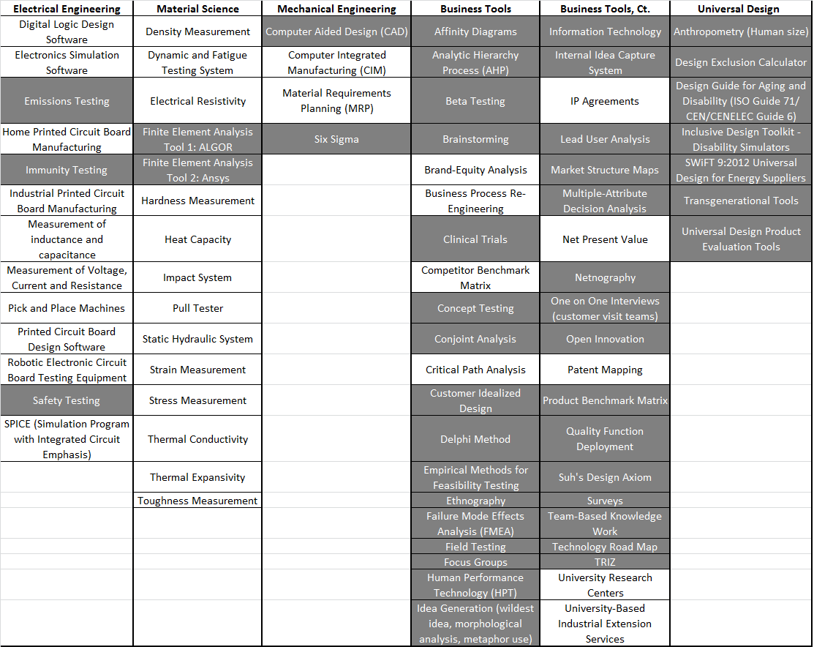
Type/Range of Tools

Slide 8
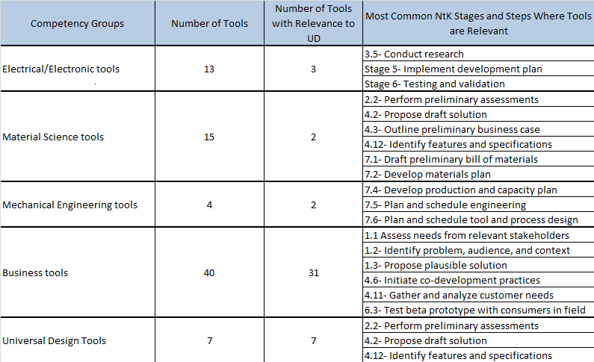
Distribution of 79 Tools by Group

Slide 9
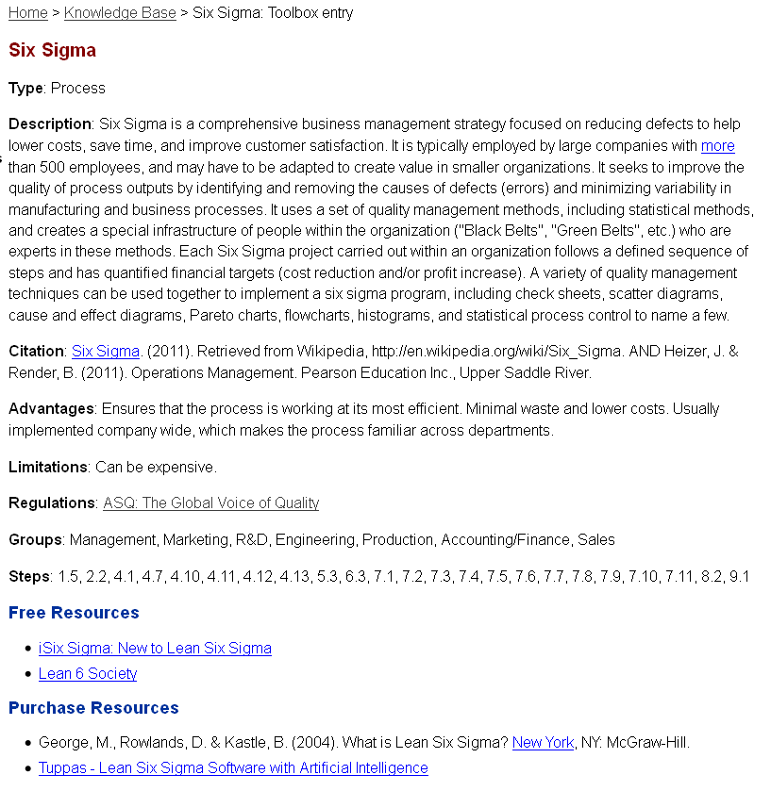
Screen Image of Tool Summary

Slide 10
NtK Model’s Toolbox
Go to tools for Technical, Marketing
and Customer Analyses
http://kt4tt.buffalo.edu/knowledgebase/model.php

Slide 11
NtK Model Publications
Lane, J & Flagg, J. (2010) “Translating 3 States of Knowledge: Discovery, Invention & Innovation.” Implementation Science, 5, 1, 9. http://www.implementationscience.com/content/5/1/9
Stone, V. & Lane J (2012). “Modeling the Technology Innovation Process: How the implementation of science, engineering and industry methods combine to generate beneficial socio-economic impacts.” Implementation Science, 7, 1, 44. http://www.implementationscience.com/content/7/1/44.
Lane, JP (2012). The Need to Knowledge Model: An operational framework for knowledge translation and technology transfer. Technology and Disability, 24,187–192. http://iospress.metapress.com/content/f384n4gp042732gx/fulltext.html
Flagg, J, Lane, J., & Lockett M. (2013) “Need to Knowledge (NtK) Model: An Evidence-based Framework for Generating Technology-based Innovations.” Implementation Science, 8, 21, http://www.implementationscience.com/content/8/1/21

Slide 12

ACKNOWLEDGEMENT
This is a presentation of the Center on Knowledge Translation for Technology Transfer, which is funded by the National Institute on Disability and Rehabilitation Research, U.S. Department of Education, under grant #H133A080050.
The opinions contained in this presentation are those of the grantee and do not necessarily reflect those of the
U.S. Department of Education.

