Slide 1
Three States of Knowledge in Technological Innovation
Joseph P. Lane
Center on Knowledge Translation for Technology Transfer
http://kt4tt.buffalo.edu
School of Public Health & Health Professions
University at Buffalo (SUNY)
Funded by NIDRR, US Department of Education, PR# H133A060028

Slide 2
Socio-Economic Impacts via Innovation
R&D projects intending to benefit society need to broaden definition of knowledge beyond traditional academic perspective.
3 related methods (R, D & P) generate knowledge in 3 different states; discoveries, inventions & innovations.
Challenge: Justify investment of declining public funding under shorter timeframes, by delivering intended impacts!

Slide 3
Range of Public Support for S&E Activity
Grant-based Scientific Research – Exploration to discover new knowledge about physical world (NSF/NIH) – Works well!
Sponsored R&D for Innovation – Application of S&E outputs for commercial exploitation intended to generate socio-economic impacts – Lots of Problems!
Contract R&D for Production – Application of S&E outputs to deliver specified products with national value (DoD/DoE) – Works well!

Slide 4
Why?
(Mis)Alignment of Funder Expectations, Processes and Actor Incentives:
  Grant-based Scholarship → Peer System → Publish for Tenure.
  Mixed Model = Mixed Message?
  Contract-based Production → Performance Delivery System → Sell for Profit.
  You can’t get there from here!

Slide 5
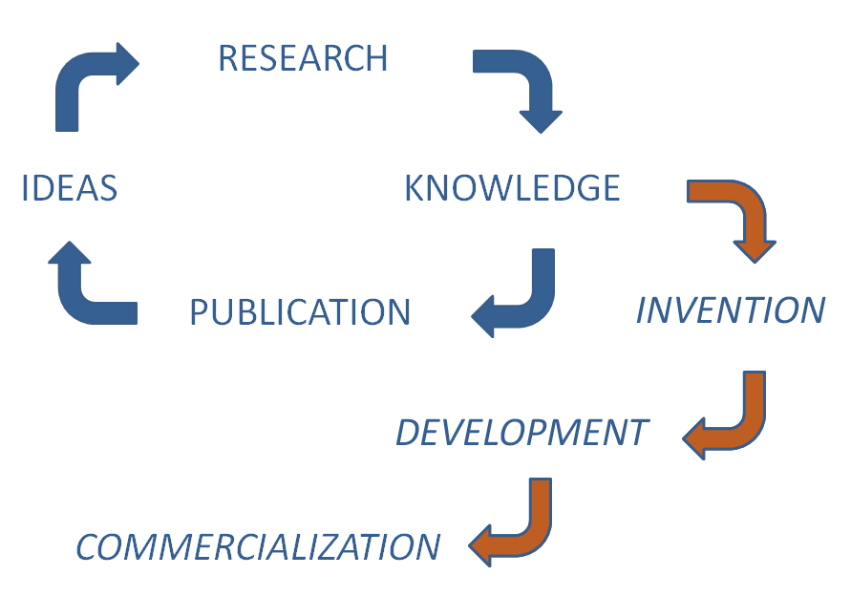
Even newest government models lack utility (description, explanation, prediction, control). (http://www.ott.nih.gov/PDFs/NIH-TT-Plan-2013.pdf)

Slide 6
Silly Metrics based on Silly Models
∑ (R + D) / GDP = Innovation
∑ (95%R + 5%D) ≠ ∑ (5%R + 95%D)
∑ (X%R + Y%D) ≠ Products/Services
Measures co-mingle inputs and ignore causal links in chain to outcomes!

Slide 7
Sponsored R&D Programs with Innovation/Impact intent
All US Agencies: SBIR/STTR Programs.
NSF – Engineering Research Centers (ERC); Industry/University Cooperative Research Centers (I/U CRC); Innovation Corps (I-Corp).
NIH – Program on Public/Private Partnerships.
NIST – Technology Innovation Program (TIP).
USDE – Rehabilitation Engineering Research Centers (RERC); Field Initiated Development (FID).
Canada – Natural Science and Engineering Research Council (NSERC); Canadian Institutes for Health Research (CIHR).
European Union – Research Framework Programme; Competiveness & Innovation Framework Programme.

Slide 8
Innovation & Impact
Traditionally, each sector defined terms in own narrow context, unconcerned with downstream market activities or broader societal benefits, comfortable in status quo budgets and paradigms. But that applecart is tipping . . .
National Science Board (2012) – “Innovation is defined as the introduction of new or significantly improved products (goods or services), processes organizational methods, and marketing methods, in internal business practices or in the open marketplace.” (OECD/Eurostat, 2005).

Slide 9
“Innovation” Impact implies Utility
Public support for investment in technology-based innovations grounded in 3 expectations:
1. New/improved devices/services with economies of scale that contribute to societal quality of life.
2. Sufficient return on investment through sales to sustain company, pay taxes and compete globally to generate new net wealth.
3. Benefits realized in short-term (5–10 yrs).
Innovation’s context is Commercial Impact.

Slide 10
Commercial Market is path to Utility
Industry survives in competitive system by translating knowledge into market utility through Production methods (beyond R&D).
Utility = Money to Seller / Function to Buyer.
No $ale – Research discoveries are freely published and globally disseminated, while Development prototypes lack commercial hardening or economies of scale.
R and D outputs ≠ Market Innovation.

Slide 11
“Translating Three States of Knowledge: Discovery, Invention & Innovation”
Lane & Flagg (2010)
Implementation Science
http://www.implementationscience.com/content/5/1/9

Slide 12
Importance of Untangling Terms
Each Method has own rigor and jargon.
Actors are trained and operate in one method and tend to over-value that method.
Academic & Government sectors dominate “STI” policy at the expense of Industry – the only sector with time and money constraints. . .
Methods are actually inter-dependent, while traditional dichotomies are all complementary factors supporting innovation outcomes.

Slide 13

Elephant and blind men.

Slide 14
Clarification: 3 States of Knowledge
Scientific Research methodology ►
Conceptual Discovery
Engineering Development methodology ►
Prototype Invention
Industrial Production Methodology ►
Market Innovation

Slide 15
Discovery State
Scientific Research methods create new to the world knowledge.
Process – Empirical analysis reveals novel insights regarding key variables, precipitated by push/pull.
Output – Conceptual Discovery expressed as manuscript or presentation.
Legal IP Status – Copyright protection.
Value – Novelty as first articulation of new concept as contributed to knowledge base.

Slide 16
Invention State
Engineering Development methods combine and apply knowledge as functional artifacts.
Process – Trial and error experimentation and testing demonstrates proof-of-concept, initiated through supply/demand forces.
Output – Prototype Invention claimed and embodied as operational prototype.
Legal IP Status – Patent protection.
Value – Novelty of conceptual discovery + Feasibility of tangible invention.

Slide 17
Innovation State
Industrial Production methods codify knowledge in products/components positioned as new/improved.
Process – Systematic specification of components and attributes yields final form.
Output – Market Innovation embodied as viable device or service in a defined context, initiated through a commercial market opportunity.
Legal IP Status – Trademark protection.
Value – Novelty + Feasibility + Utility defined as revenue to company and function to customers.

Slide 18
Way Forward: Integrate Conceptual but Differentiate Operational
Consider three distinct states: Know role of Research, Development and Production methods in context of each project – plan and budget accordingly.
Engage Industry early: Government/Academic projects intended to benefit society fail to cross gaps (death valley vs. Darwinian sea) to business & open markets.
Apply evidence-based framework: Link three methods; Communicate knowledge in three states; Integrate key stakeholder who will determine eventual success.

Slide 19
“Modeling Technology Innovation:
How the integration of science, engineering and industry methods combine to generate beneficial socio-economic impacts.”
Stone & Lane (2012).
Implementation Science
http://www.implementationscience.com/content/7/1/44/

Slide 20
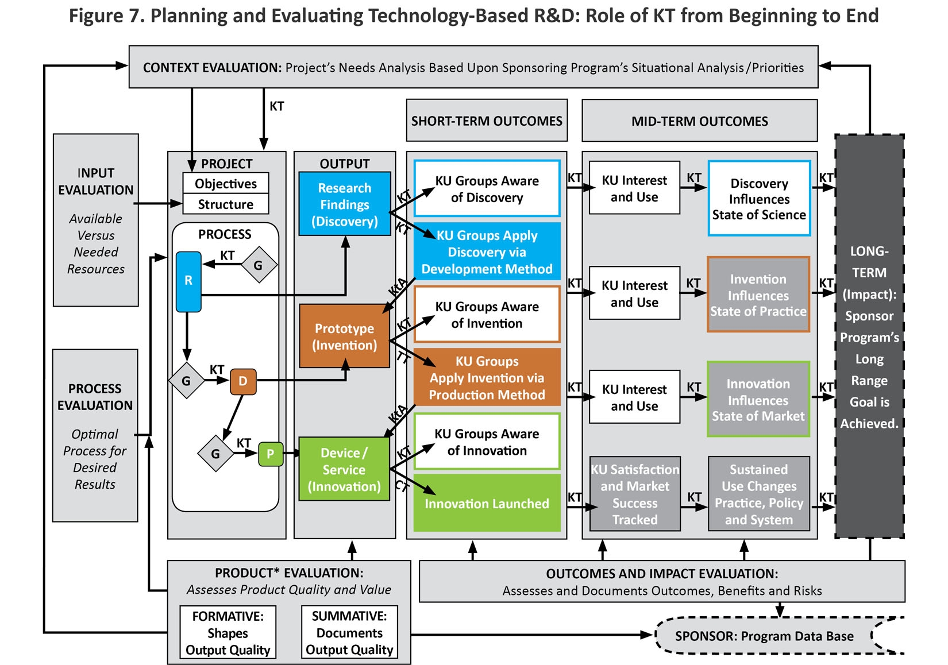
Figure 7. Planning and Evaluating technology-Based R&D: Role of KT from Beginning to End

Slide 21
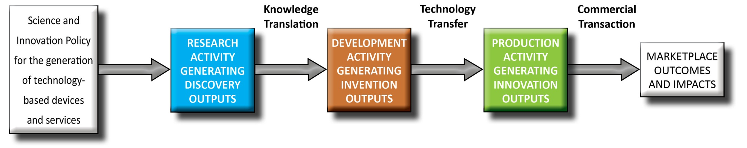
Knowledge Communication –
3 Strategies for 3 States

Slide 22
“Need to Knowledge (NtK) Model: an evidence-based framework for generating technological innovations with socio-economic impacts.”
Flagg, Lane & Lockett (2013).
Implementation Science
www.implementationscience.com/content/8/1/21/

Slide 23


Need to Knowledge (NtK) Model
Orientation – Actors engaged in innovation “need to know”: Problem/Solution; Methods/Outputs; Stakeholder roles; and Goal in context of beneficial socio-economic impacts.
Integration – Product Development Managers Association (PDMA) New Product Development practices (implementation); Canadian Institutes of Health Research (CIHR) Knowledge to Action Model (communication).
Validation – Stage-Gate structure populated with supporting evidence (1,000+ excerpts) from scoping review of academic and industry literature , along with links to tools for completing recommended technical and market analyses.

Slide 24

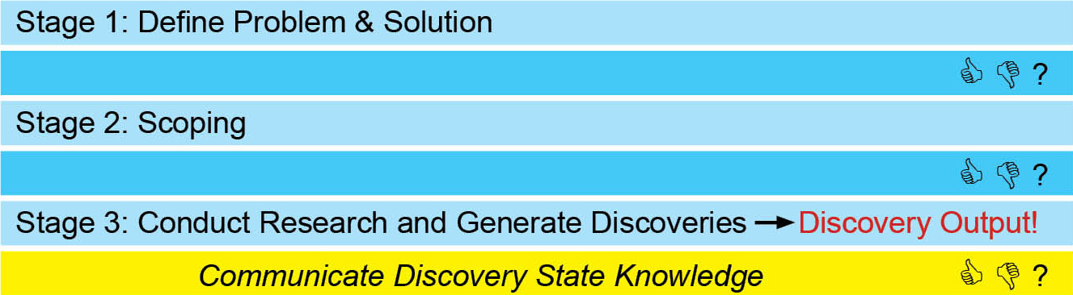
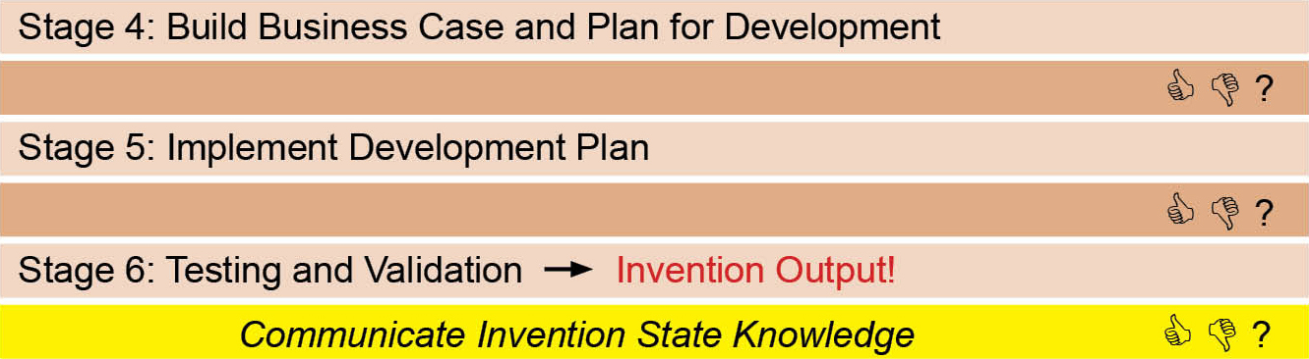
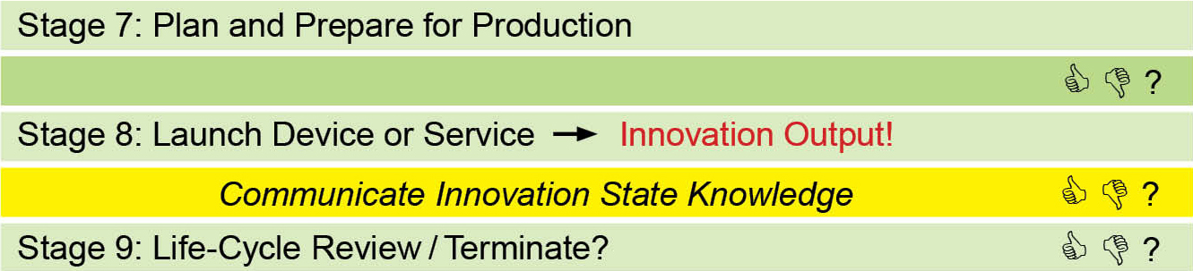
Need to Knowledge (NtK) Model for Technological Innovations

Slide 25
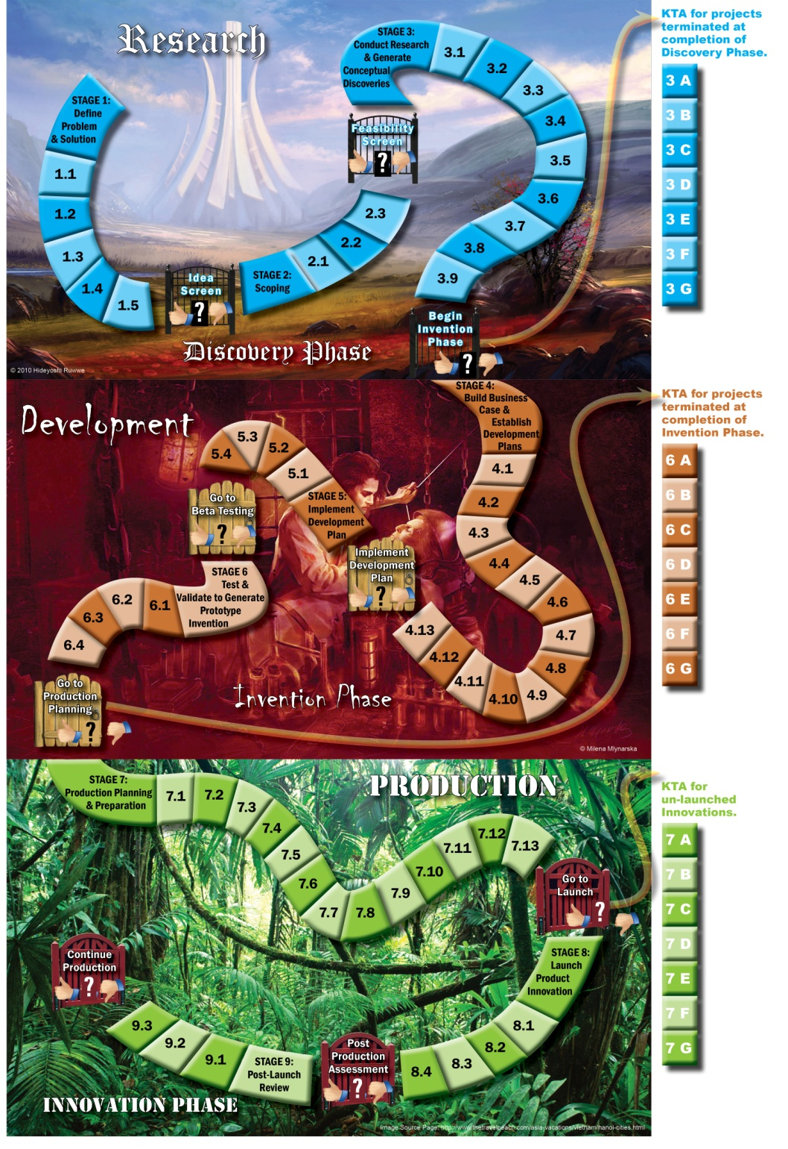
“Gamification” of Technological Innovation
Progress through three Methods of Knowledge Generation, and the effective Communication of three Knowledge States, may be circuitous and iterative, punctuated and prolonged, risky and unpredictable, yet still be planned, implemented and accomplished through the deliberate and systematic efforts of key stakeholders.

Slide 26
NtK Model Utility
Clarifies processes and mechanisms underlying technology-based Innovation, by integrating academic & industry literature and analytic tools.
Establishes linkages between three distinct methods and their respective knowledge outputs for implementation/communication.
Offers a structure to sponsors & grantees for program/project planning, proposal submission & review, project implementation, progress monitoring and summative evaluation.

Slide 27

ACKNOWLEDGEMENT
This is a presentation of the Center on Knowledge Translation for Technology Transfer, which is funded by the National Institute on Disability and Rehabilitation Research, U.S. Department of Education, under grant #H133A080050.
The opinions contained in this presentation are those of the grantee and do not necessarily reflect those of the
U.S. Department of Education.

