Slide 1
KT for TT – Ensuring Technology-based R&D matters to Stakeholders
Center on Knowledge Translation for Technology Transfer
University at Buffalo

Slide 2
Session Objectives
Define KT and describe how Models, Methods and Measures differ from traditional Dissemination and Diffusion Strategies
Present parallels between KT for research projects and KT for development projects; and explain how they link to move from conceptual idea to tangible product.
Present KT for TT Model and its relevance to Stakeholders – particularly intermediaries.

Slide 3
Background
Convergence of Science and Technology
Technology, Medicine & Rehabilitation (Medical Model) → Federal Funding for Basic Research to generate repository of science-based knowledge.
Convergence of Science and Society
Empowerment & Independent Living (Social Model) → Federal Funding for Applied Research to generate prototype technologies with product potential.

Slide 4
Background (cont.)
Mission of NIDRR/USDE
Quality of life for people with disabilities through new knowledge and new products.
Assistive Technology Defined – AT as a class of Devices and Services to benefit PWD’s.
Generate Knowledge from Research and Products from Development – all to improve quality of life for persons with disabilities.

Slide 5
Three Confounds
Academic vs. Industry “R&D“
Scholarly vs. Commercial “Product”
Supply Push vs. Demand Pull “Innovation”

Slide 6
Academic “R&D” - Research and Dissemination
Scientific Method – Systematic Process.
Symbiotic Closed System of Scholars and Publishers.
Knowledge Producers know market requirements (Author guidelines & peer review).
Success defined as contributions to Global Knowledge Base, evidenced via citations.

Slide 7
Industry “R&D” - Product Development and Testing
PDMA Method - Systematic Process
Competitive and Open System of Entrepreneurs, Corporations and Markets.
User requirements and constraints are ill-defined and opportunities are dynamic.
Success defined as sales and market share, evidenced by sales and growth.

Slide 8
PDMA Process – 20 Steps

Slide 9
Keys to Confounds
Know your Goal - Final product/service innovation.
Know your Role – In R/D/P continuum from concept to marketplace.
Know your Customer – Motivations in context of Stakeholder Value Chain.

Slide 10
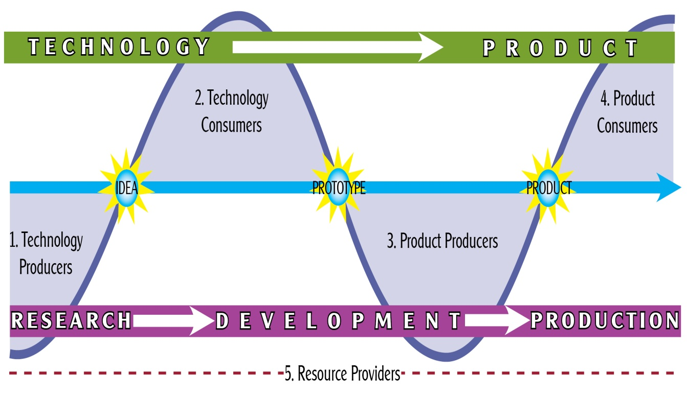
Technology Transfer Domain

Slide 11
Research leads to Development, which leads to Products – RDP Model
Input -> Output -> Outcome -> Impact
Research output becomes Development input;
Development output becomes Production input;
Product outcomes impact Target Populations.

Slide 12
RDP Model

Slide 13
What is Knowledge Translation?
A method for moving academic knowledge into stakeholder action.
Definition – Canadian Institutes for Health Research
Origins – Evidence-based Medicine to justify Federal & Public investment.
Current models focus on supply push.

Slide 14
KTA Model – CIHR

Slide 15
Analogies between KT and TT
End of Grant KT = Supply Push TT – Applying discovery from basic inquiry (Mode 1 science).
Integrated KT = Demand Pull TT – Creating discovery from validated need (Mode 2 science).
Science has rigor = Industry has relevance.
The RDP Model requires both rigor and relevance to optimize chance of success.

Slide 16
NtK Model
Process | Stages and Gates
Research | Stage 1: Discovery
 | GATE 1: Idea Screen
 | Stage 2: Scoping
 | GATE 2: Second Screen
 | Stage 3: Conduct Research and Generate Idea
Development | GATE 3: Go to Build Business Case?
 | Stage 4: Build Business Case and Development Planning
 | GATE 4: Go to Development?
 | Stage 5: Implement Development Plan
 | GATE 5: Go to Testing?
 | Stage 6: Testing and Validation
Production | GATE 6: Go to Production Planning?
 | Stage 7: Production Planning and Preparation
 | GATE 7: Go to Launch?
 | Stage 8: Launch
 | GATE 8: Post Production Assessment
 | Stage 9: Post-Launch Review

Slide 17
Research
Process | Stages | Steps
Research | Stage 1: Discovery | Assess Users’ Needs / Identify Problem Propose Plausible Solutions
 | GATE 1: Idea Screen
 | Stage 2: Scoping | Define Concept Perform Preliminary Assessments (Innovation Screen)
 | GATE 2: Secondary Screen
 | Stage 3: Conduct Research and Generate Idea | Identify Specific Knowledge Gaps Conduct Appropriate Knowledge Inquiries Compile Findings Propose Components Conceptualize Model/Draft Solution Evaluate Research Findings

Slide 18
Development
Process | Stages | Steps
Development
 | GATE 3: Go to Build Business Case?
 | Stage 4: Build Business Case and Development Planning | Build Business Case Implement IP Strategy Initiate Key Co-Development Practices Develop Implementation Plan Allocate Adequate Resources Gather, Analyze and Prioritize Customer Needs Identify Product Features and Specifications
 | GATE 4: Go to Development?
 | Stage 5: Implement Development Plan | Build Alpha Prototype Models Test Alpha Prototype Models Refine Models
 | GATE 5: Go to Testing?
 | Stage 6: Testing and Validation | Test Beta Prototype with Consumers In Lab Refine Beta Prototype Models Test Beta Prototype with Consumers In Field

Slide 19
Production
Process | Stages | Steps
Production
 | GATE 6: Go to Production Planning?
 | Stage 7: Production Planning and Preparation | Refine Beta Prototype Models Further Draft Preliminary Bill of Materials Develop Materials Plan Develop Production and Capacity Plan Plan and Schedule Engineering Plan and Schedule Tool and Process Design Estimate Costs Using Preliminary Bill of Materials Review IP Protection Finalize Marketing and Sales Activities Finalize Distribution Logistics Initiate Trial or Limited Production Runs Test Market or Trial Sell
 | GATE 7: Go to Launch?
 | Stage 8: Launch | Launch Product and Provide Product Support
 | GATE 8: Post Production Assessment
 | Stage 9: Post-Launch Review | Monitor Fix Review Performance Against Expectations

Slide 20
KT for TT Implications of RDP Model
Technology-oriented research projects must consider downstream development and production – the goal.
The expected knowledge output must demonstrate validated innovativeness:
Novelty in marketplace.
Feasibility in design.
Utility to function.
Principal must define goals and roles.

Slide 21
Where to go from here
What should government change?
Model and Method for linking Research and Development to generate Product Outcomes.
Why should it change?
Evidence shows a different approach works better.
Why is government following current approach?
R&D implementation in 1940’s led by academics.

Slide 22
Where to go from here (cont.)
KT is academia’s approach to applying good business marketing practices.
Not sufficient – must go full measure of implementing RDP Model to achieve desired outcomes from R&D – to make R&D matter!

Slide 23
KT4TT Program
Sponsored by NIDRR to increase application of technology-related grantee R&D outputs.
Experiment in small field with large implications.
Cross-walk TT to KT, and link KT to TT, demonstrate and test KT4TT model.
Validate model in context of prior research as well as context of new grantee practices.
Establish “best practices” for Steps & Tasks.

Slide 24
Role of KT4TT Program
Apply what we know about TT and KT to create an operational model of KT4TT.
Begin with end in mind – both models lead to application and use.
Generate evidence from research to speak to academic values.
Generate evidence from development to speak to industry values.
Link both forms of evidence to change funding and evaluation of government grant programs.

Slide 25
TT and KT Resources
Materials on the following slides are useful to all Stakeholders involved in the Research, Development, Production continuum.
Project website under construction will contain all relevant resources:
kt4tt.buffalo.edu

Slide 26
TT Resources
“How to” guides
T²RERC Training modules
Supply push, demand pull, primary and secondary market research, intellectual property, commercialization, and evaluation
Technology Transfer Tactics
Best practices
Free e-zine

Slide 27
TT Resources
Associations and Organizations
Association of University Technology Managers
Intellectual Property Owners Association
Advanced Medical Technology Association
Licensing Executives Society

Slide 28
TT Resources
Market Research Resources
General Disability Statistics
Specific Disability Statistics
Trends
Competing Products
Abledata
Competing Technology
USPTO
Notes:
Key resources for developing business plans, commercialization packages, and grant proposals

Slide 29
General Disability Statistics
International Disability Statistics
World Health Organization- Disability
U.S. and Regional Disability Statistics
Census Bureau – Disability
Notes:
Resources that offer information on a wide range of disabilities and chronic health conditions
Note that these sources will also be very useful for determining market size and segments for both business plans as well as SBIR proposals.
29

Slide 30
Disability-Specific Resources
National Institute of Health (NIH)
T²RERC Publications
Industry Profile on Vision Technologies
Industry Profile on Educational Technologies
Industry Profile on Wheeled Mobility
Coming Soon!
Advocacy Organizations
American Foundation for the Blind
National Federation of the Blind
Administration on Aging
Notes:
There are 27 centers and institutes within the NIH

Slide 31
Understanding Trends and Market Growth
Longitudinal National Surveys
National Health Interview Survey (annual)
Activity limitations, instrumental activities of daily living, work limitations; vision, hearing, and mobility limitations; learning disabilities in children; insurance coverage; standard demographics (age, income, race, etc.)
Current Population Survey (monthly)
Income, employment, occupation, industry; work disability; standard demographics
American Community Survey (annual)
Income, age, housing, journey to work; hearing, vision, and cognitive limitations; standard demographics
Survey of Income and Program Participation (continuous)
Labor force, program participation and eligibility; disability; standard demographics

Slide 32
KT Resources
National Center for the Dissemination of Disability Research
Focus Technical Brief
Webcasts
KT Library
Articles
Guidelines
Models
Organizations
Research Registries

Slide 33
KT Resources
Agency for Healthcare Research and Quality
Innovations Exchange
Canadian Institutes of Health Research
Definitions; Strategies; News.
Canadian Health Services Research Foundation
Resources & Tools
Acquisition, Assessment, Adaptation, and Application

Slide 34
Acknowledgement
This is a presentation of the Center on Knowledge Translation for Technology Transfer, which is funded by the National Institute on Disability and Rehabilitation Research of the U.S. Department of Education under grant number H133A080050. The opinions contained in this presentation are those of the grantee and do not necessarily reflect those of the U.S. Department of Education.

