Slide 1
Researcher-Industry Collaboration: Establishing and Maintaining Trusted Partnerships!
Section Code: RSCH-15
James A. Leahy
KT4TT Center, University at Buffalo
http://sphhp.buffalo.edu/cat/kt4tt.html
Kathleen Hanek
SP Ableware, a Division of SP
http://www.maddak.com/index.php
9:20 – 10:50 a.m.
February 4, 2016
ATIA
Orlando, Florida

Slide 2
Acknowledgement
The contents of this presentation were developed under a grant from the National Institute on Disability, Independent Living, and Rehabilitation Research (NIDILRR grant number 90DP0054-01-00). NIDILRR is a Center within the Administration for Community Living (ACL), Department of Health and Human Services (HHS). The contents of this presentation do not necessarily represent the policy of NIDILRR, ACL, HHS, and you should not assume endorsement by the Federal Government.

Slide 3
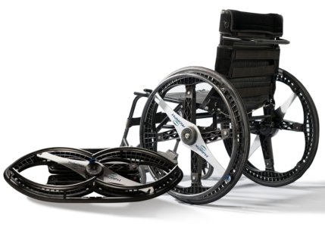
Key Learning Objective
Describe and Discuss a Case Example of Successful Researcher Industry Partnership
Morph Wheels http://morphwheels.com
Foldable 24” manual wheelchair wheel whose dimensions when folded are 32” x 12.5”.

Slide 4
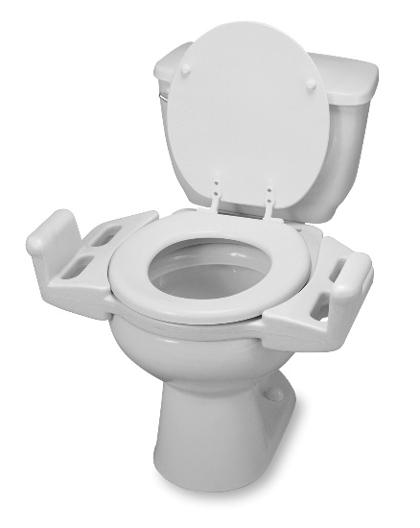
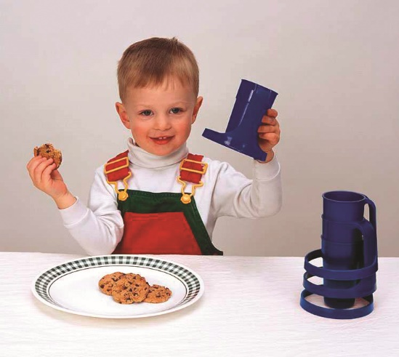
Background
Longstanding Maddak/ KT4TT (T²RERC) Collaboration
Co-sponsored Invention Competitions at AOTA
Licensed ADL products to Maddak ranging from toilet seats to drinking cups

Slide 5
Initiating a Collaboration
How do you institute a collaboration with a company? In some cases it’s through a referral, but in many cases, it’s a cold call. Topic of other presentations I have made on Knowing What to Say, How to Say It, and When to Say It to a company. Bottom line - want to be perceived as a resource by the company.
Need to Become Knowledgeable of the Industry you are Approaching.
Know the Industry, the players, the product development cycles
Who are the companies? What are the trade shows? How do they introduce new products?
What are the mark-ups for products in this industry? 3:1, 4:1, 6:1 or higher (software)
Do they routinely license products?
Will they accept your NDA?
Will they only accept patented products?
NEVER, EVER say anything negative about the company or its products!!!!
Communication - partnering/brokering role is of tantamount importance.

Slide 6
Initiating a Collaboration (cont.)
Previous ATIA Presentation:
Outlined a Process of Industry/University Collaborations.
Discussed the Template Agreements that should be in place.
Discussed the Criteria for Vetting Potential Corporate Collaborators for a Joint R &D Project.

Slide 7
Initiating a Collaboration (cont.)
How to Succeed:
Follow Up. Ask for a specific date and time for the next conversation.
Follow Up. Make the call at that date and time. If progress is made, that’s great. Either way – ask for a specific date and time for the next conversation.
Follow Up. This is a contact sport. If you are asked for anything, deliver it on time. Work on Corporate Schedule, not an Academic Schedule.

Slide 8
Understanding a Manufacturer’s Mindset What affects the decision?
Product Line Focus:
Manufacturers may have many product lines, family/product categories
Typically they will have dedicated focus – inquire about what that focus is
A rejection to a product does not mean it is not a good product
Rejection is not personal, it is ALWAYS a business decision
Build a Relationship
Understand the manufacturer’s focus
Gear submissions towards focus
If possible work with manufacturer during the design process to make the transition to manufacturing easier

Slide 9
Understanding a Manufacturer’s Mindset What affects the decision? (cont.)
Go to Market and Start Up Costs:
Familiarize yourself with the terminology ROI (Return on Investment)
Corporate decisions are based on the projects projected ROI
What can affect ROI?
Market Size
Product Cost vs. Market Price
Distribution methods: Direct to Consumer; Business to Business
Prototyping and Tooling investments can be significant
Investment costs vary depending on manufacturing method, number of parts etc.
R&D budgets and personal resources often require both small and large projects
Does your project fit in the resource allocation for the year?

Slide 10
Understanding a Manufacturer’s Mindset What affects the decision? (cont.)
Product Design Flexibility
Can the design be updated to reach a broader market
Can the design be updated to reduce costs
Is the researcher/inventor flexible
Is there an emotional attachment to the product
Researcher/Inventor Expectations:
Patent ownership
This is dictated by law not the company
Licensing/Royalty (ROI)
Product line extensions

Slide 11
Understanding a Manufacturer’s Mindset What affects the decision? (cont.)
Project Justification (There’s that ROI again)
Project justification can be time consuming (very!)
Decision making can be easier if you have research data to back up product claims, target population market size, estimated costs etc.
Be realistic
Be as thorough as possible
You will gain points for pertinent/useful information!
Balance this with excluding “non-decision” making information
Justification is on-going throughout a projects
Things can change
Stage gate decisions can affect the outcome of the project

Slide 12
Understanding a Manufacturer’s Mindset What affects the decision? (cont.)
Qualities of the successful partnership
Cooperation:
Cooperation is important because the process is most successful when it is collaborative.
Flexibility
Flexibility is necessary since inventions often have to be tweaked or modified in order to increase their change of success
Patience
Patience is critical because doing a good job can take time
Respect
Each party brings a skill set to the table
Playing off of each other’s strength increases the chances for success

Slide 13
Morph Wheels
Foldable Wheel Concept previously reviewed by KT4TT via Invention Submission/Technical Assistance request from a University professor.
In correspondence with inventor and his University TTO, KT4TT brought to their attention a patent out of England on the same concept that they would probably be infringing upon.
University TTO agreed and the project was dropped.
Few years later, Maddak became interested in the foldable wheel concept and licensed the patent.

Slide 14
Morph Wheels (cont.)
After Licensing the patent on the foldable wheel concept, Kathleen Hanek of Maddak contacted the KT4TT to discuss what assistance KT4TT could provide in product development.
Project fit within KT4TT’s Participant/Observer Product Development project.
KT4TT recruited the NIDILRR funded RERC on Wheeled Mobility (WM) at Georgia Tech to assist with meeting wheelchair wheel testing and standard guidelines.
KT4TT, Maddak and RERC on WM possessed a shared vision for designing innovative concepts to provide solutions to the everyday problems faced by manual w/c users.

Slide 15
Morph Wheels (cont.)
Communication among partners of paramount importance. Worked on Corporate schedule, not Academic schedule.
Constant email and telephone conference calls to keep all informed on progress, challenges, etc.
First and foremost – consumer involvement in all stages of new product development is critical. KT4TT scheduled Concept Definition (Alpha) focus groups on the topic area. Maddak attended the focus groups and demonstrated a first generation prototype to focus group participants.

Slide 16
Morph Wheels (cont.)
Maddak engineers and product designers took the needed product functions and features identified in the Alpha Focus groups and incorporated them into their design.
Upon completion of the Alpha prototype, Beta Focus groups were scheduled and held for product refinement.
Modifications groups to the pre-production prototype were made by Maddak engineers based on the consumer feedback from the Beta.
Beneficial Design was enlisted to conduct the final product testing of the Morph Wheels prior to product introduction.

Slide 17
Morph Wheels (cont.) Commercialization Process
Initiated an aggressive PR and Marketing Campaign
Enlisted PR Firm
Brand Ambassadors
Advertised in key publications
Attended key shows and conferences
Innovative collateral material
Targeted key business customers
Grass roots approach to end users
Email blasts and social media

Slide 18
Morph Wheels (cont.) Commercialization Process Highlights and Recognition
Popular Science Best of What’s New
Medtrade Spring New Product Pavilion Innovation Award
London Design Museum’s Product of the Year – Transportation Category
Television Appearances
CNN Blueprint
Fox and Friends
My Fox - Boston
New England News Channel
KTLA
Telemundo
The Daily Buzz
Fox 4 – Kansas City
Newspaper and Magazine Articles
USA Today ( 2 times)
Atlantic Magazine
Wall Street Journal
Quest Magazine
PN Magazine
Sports-n-Spokes
Radio and Internet
Gizmodo
MomRN
Disabled Life Media

Slide 19
Thank You for Attending this Session
CEU’s – Session Code RSCH-15
More info at www.atia.org/CEU
For ACVREP, AOTA, and ASHA CEU’s, hand in completed Attendance Forms to REGISTRATION DESK at the end of the conference. Please note there is a $15 fee for AOTA CEU’s.
For general CEU’s, apply online with THE AAC Institute: www.aacinstitute.org
Session Evaluation: URL
Please help us improve the quality of our conference by completing your evaluation form.
Completed evaluation forms should be submitted as you exit or to staff at the registration desk.
Handouts
Handouts are available at www.atia.org/orlandohandouts
Handout link remains live for 3 months after the conference ends.

