Slide 1
Researcher-Industry Collaboration: Realizing Evidence-Based and Sustainable Products!
Section Code: RSCH-16
James A. Leahy
KT4TT Center University at Buffalo
http://sphhp.buffalo.edu/cat/kt4tt.html
David Arnott
Comforts of Home Companion Services/Black and Decker
http://www.comforts-of-home.net/
9:20 – 10:50 a.m.
February 5, 2016
ATIA
Orlando, Florida

Slide 2
Acknowledgement
The contents of this presentation were developed under a grant from the National Institute on Disability, Independent Living, and Rehabilitation Research (NIDILRR grant number 90DP0054-01-00). NIDILRR is a Center within the Administration for Community Living (ACL), Department of Health and Human Services (HHS). The contents of this presentation do not necessarily represent the policy of NIDILRR, ACL, HHS, and you should not assume endorsement by the Federal Government.

Slide 3
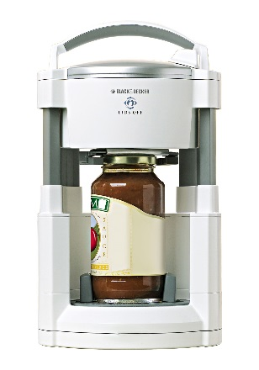
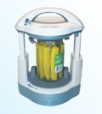
Key Learning Objective
Describe 3 Key Benefits of Effective University-Industry Partnerships
Case Example: Lids Off Jar Opener
Electrically powered automated jar opener; sold over 1 million units in its first year.

Slide 4
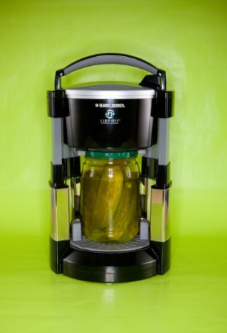
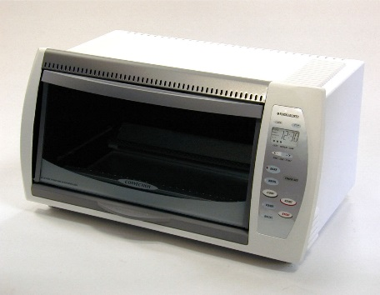
Background
Longstanding Black and Decker / KT4TT (T²RERC) Collaboration

Slide 5
Initiating a Collaboration
How do you institute a collaboration with a company? In some cases it’s through a referral, but in many cases, it’s a cold call. Topic of other presentations I have made on Knowing What to Say, How to Say It, and When to Say It to a company. Bottom line - want to be perceived as a resource by the company.
Need to Become Knowledgeable of the Industry you are Approaching.
Know the Industry, the players, the product development cycles
Who are the companies? What are the trade shows? How do they introduce new products?
What are the mark-ups for products in this industry? 3:1, 4:1, 6:1 or higher (software)
Do they routinely license products?
Will they accept your NDA?
Will they only accept patented products?
NEVER, EVER say anything negative about the company or its products!!!!
Communication- partnering/brokering role is of tantamount importance

Slide 6
Initiating a Collaboration (cont.)
Previous ATIA Presentation:
Outlined a Process of Industry/University Collaborations.
Discussed the Template Agreements that should be in place.
Discussed the Criteria for Vetting Potential Corporate Collaborators for a Joint R &D Project.

Slide 7
Initiating a Collaboration (cont.)
How to Succeed:
Follow Up. Ask for a specific date and time for the next conversation.
Follow Up. Make the call at that date and time. If progress is made, that’s great. Either way – ask for a specific date and time for the next conversation.
Follow Up. This is a contact sport. If you are asked for anything, deliver it on time. Work on Corporate Schedule, not an Academic Schedule.

Slide 8
Lids Off Jar Opener
In 1999 Jen Davis, of Yale University, was a winning team leader at the BF Goodrich Collegiate Inventors Competition for her Twistmaster, automated jar opening device.
T²RERC (KT4TT) knew of the unmet need among older adults for such a device through work done by the RERC on Aging.
T²RERC contacted Ms. Davis and were informed that B&D owned the IP rights. In 1998 B&D had approached Yale after receiving suggestions for student projects to fund from a corporate suggestion box.
T²RERC then cold called Black and Decker to ascertain their plans for the Twistmaster.

Slide 9
Lids Off Jar Opener (cont.)
B&D stated they were not satisfied with the current device design and possessed a hesitant attitude towards the product as they believed the market for the product was unclear and undefined.
In March 2000, the T²RERC went about defining the need and delineating the market for an Automated Jar Opener through primary and secondary marketing.
Marketing Data and price point information was presented to B&D who by October 2000 agreed to take on the project.
Early in 2001, Alpha or Concept definition focus groups were run detailing 29 specific needed functions and features of an Automated jar opener along with specific consumer purchase intent and price point information. This information was presented to B&D product designers and their project team.

Slide 10
Lids Off Jar Opener (cont.)
A functional prototype was fabricated by B&D along with 3 foam models all with different handle and activation button designs.
Two Beta focus groups were held in late 2001 where participants performed a ranking by importance of the previously identified function and design features of the jar opener concept.
Beta focus group participants chose the final overall jar opener shape, activation button location, size, and shape, type of handle and the bottom jaws unlock activator for the device.

Slide 11
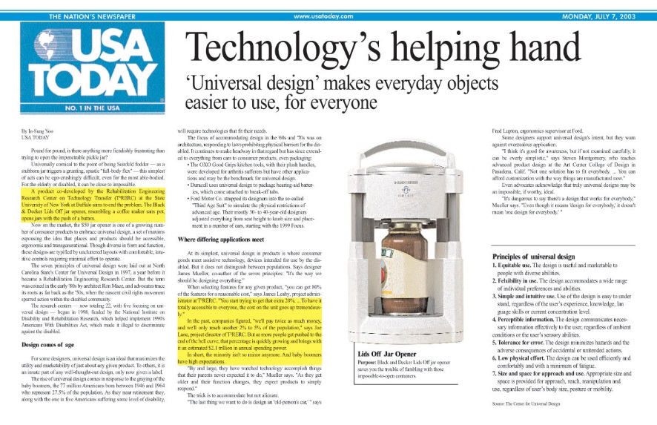
Lids Off Jar Opener (cont.)
Beta focus group participants also identified a selling price of $40 and that it would be well received as a gift item at Holiday time.
Product was introduced and initially sold via the internet and then onto mainstream distribution channels (Wal-Mart, Target, etc.)
T²RERC assisted B&D Public Relations with everything from press releases, to contacting the USA Today for an article on the Jar Opener.

Slide 12
Lids Off Jar Opener (cont.)
Lids Off Jar Opener work led to additional projects in future years on a Toaster/Convection Oven and the Gizmo can opener.
Communication among partners of paramount importance. Worked on Corporate schedule, not Academic schedule.
Constant email and telephone conference calls to keep all informed on progress, challenges, etc.
First and foremost – consumer involvement in all stages of new product development is critical.

Slide 13
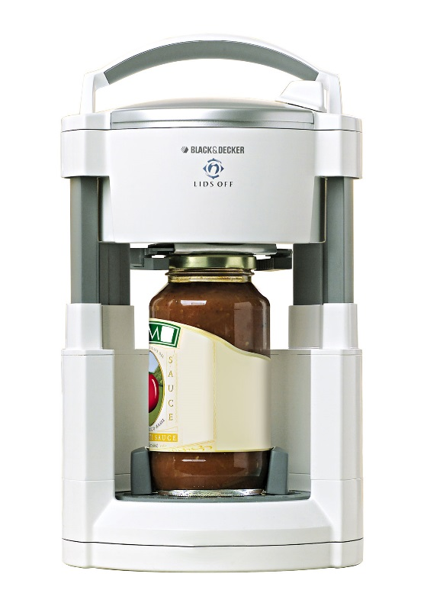
Pix of other B&D projects

Slide 14
Summary
Benefits of Effective University/Industry Partnerships
First, and foremost – delivering products needed by consumers in the marketplace. University Applied Research is focused on solving problems.
Training of University students in not just Academic endeavors but in corporate business. In effect developing a highly skilled workforce for a globally competitive economy.
Corporations ability to leverage and use unique University research capabilities or facilities. Corporations are seeking much less expensive avenues for research and development.

Slide 15
Thank You for Attending this Session
CEU’s – Session Code RSCH-16
More info at www.atia.org/CEU
For ACVREP, AOTA, and ASHA CEU’s, hand in completed Attendance Forms to REGISTRATION DESK at the end of the conference. Please note there is a $15 fee for AOTA CEU’s.
For general CEU’s, apply online with THE AAC Institute: www.aacinstitute.org
Session Evaluation: URL
Please help us improve the quality of our conference by completing your evaluation form.
Completed evaluation forms should be submitted as you exit or to staff at the registration desk.
Handouts
Handouts are available at www.atia.org/orlandohandouts
Handout link remains live for 3 months after the conference ends.

