Slide 1
Knowledge Translation Media Outreach Strategies
KTDRR Online Conference
October 27th, 29th, 31st, 2014
James A. Leahy
Center on Knowledge Translation for Technology Transfer (KT4TT)
University at Buffalo
http://kt4tt.buffalo.edu/

Slide 2
logos

Slide 3
Media Strategies
Broader, Nationwide Audience
Local Media Coverage

Slide 4
Key Requirements
1. Patience
2. Persistence
3. Perseverance

Slide 5
Rules for Connecting with Media
You need them. They do not need you.
Do your due diligence research. Identify:
Relevant media outlets
Individuals working in the media you plan to target
Track individuals and outlets to ensure relevance of material

Slide 6
Patience
Identify Media Target & Cold Call
Make convincing pitch
Leave message OR hang up after leaving 2 messages
Keep trying!
Contact administrative assistant
Make convincing pitch
Schedule a time to call when target is available

Slide 7
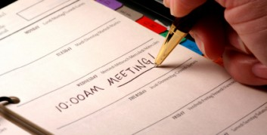
Persistence
Target has heard convincing pitch and is hesitant:
Ask: Is there any additional information the target needs that you can provide?
Follow-up with target at future point in time
Before hanging up, make next callback appointment
Always call back at appointed day and time

Slide 8
Perseverance
Do not give up!
Keep trying until you find a mainstream outlet willing to work with you
Approach media coverage as if your financial livelihood depends on it
“I’m convinced that about half of what separates the successful entrepreneurs from the non-successful ones is pure perseverance.” – Steve Jobs

Slide 9
Broader, Nationwide Audience
Convincing Pitch – Your story will appeal to a vast audience
Must know:
What to say
How to say it
When to say it
What
How
When

Slide 10
Broader, Nationwide Audience (continued)
Research hot buttons
What is the editor seeking?
Piece for all adults, aging baby boomer generation, or their children?
Tie it to your product and perhaps other breakthrough products that serve the same market.
What has been happening in market on national level?
Recent articles publication has been running.

Slide 11
Local Media
Press or TV Coverage
Know what type of story reporter likes to do and tailor pitch to it
Business-oriented: highlight business aspects of product in pitch
Story will only be on your product, service or organization
Do not have to research what is going on nationally

Slide 12
Local Media (continued)
Press Release
Written by you
Tailor it to audience
Ex: Consumer publication
Functions, features, how/why product better for them
Ex: Business publication
Cost, sales, market broadening, product differentiators

Slide 13
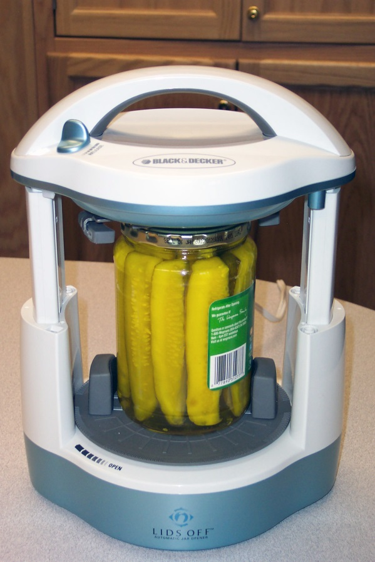
As Seen on TV
wgrz
.com
Products That Can Help the Elderly and People With Disabilities

Slide 14
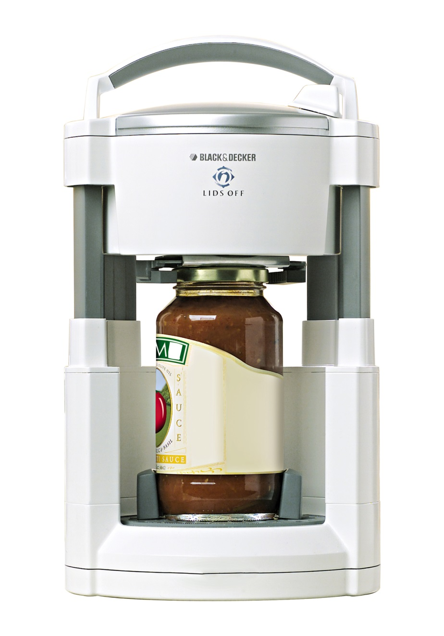
Black & Decker Lids Off Jar Opener
Black & Decker Lids Off Jar Opener
GAINING THE UPPER HAND ON STUBBORN LIDS
Technology’s Helping Hand
‘Universal design’ makes everyday objects easier to use, for everyone

Slide 15
University of Buffalo Pill Crusher Makes Medicine Easier to Swallow

Slide 16
The Media Insights & Engagement Conference

Slide 17
Acknowledgement
The KT4TT is funded by the National Institute on Disability and Rehabilitation Research of the U.S. Department of Education. The contents of this presentation were developed under a grant from the Department of Education, NIDRR grant number H133A130014. However, these contents do not necessarily represent the policy of the Department of Education, and you should not assume endorsement by the Federal Government.

