Slide 1
Role of Focus Groups and Surveys in New AT Technology Product Development
Role of Focus Groups and Surveys in New AT Technology Product Development
James A. Leahy, Jennifer L. Flagg
KT4TT Center, University at Buffalo
http://sphhp.buffalo.edu/cat/kt4tt.html
1:15 – 2:15 p.m.
June 28, 2017
RESNA, New Orleans, Louisiana

Slide 2
Key Learning Objectives
Participants will be able to design surveys and survey questions using a Survey Methodology presented.
Participants will be able to define Purposive Sampling and learn, through the use of examples, how and why it is used.
Participants will learn how to design recruitment screens for focus groups and surveys.
Participants will be able to design a Concept Definition Focus Group using a Focus Group Methodology presented.

Slide 3
Voice of the Customer in Funded Research and Development Projects
Inclusion of consumer input early on in funded researchers proposal shows reviewers increased likelihood of successful product outcome.
Historically, manufacturers of consumer products have made product design decisions without factoring in the needs, wants, and expectations of the full range of end consumers.
This process leads to ineffective products in the marketplace, new product failures, and product abandonment. Failure rates for new product introductions vary by industry but range from 30% to 90%.
The primary cause of these failures can be traced back to a point early in the product design process where significant consumer or device user information failed to be collected and analyzed prior to the initial fabrication of the device (aka prototype).

Slide 4
Voice of the Customer in Funded Research and Development Projects
One method of inclusion of consumer input – Targeted Focus Groups!!!
Targeted focus groups employ purposive sampling, rigorous primary and secondary recruitment screens, and state of the art product and feature demonstrations early in the design process.
Focus groups allow new product developers to obtain specific design functions and features for the product being developed directly from the product’s targeted end users.
Farther on in the product development process these same targeted, educated, end users are reconvened to review functional prototypes of the new product prior to its initial production run.

Slide 5
Purposive Sampling & Recruitment
As compared to Random Sampling, in Purposive Sampling the new product developer or researcher will select individuals for a focus group based on specific human factors, or specific demographic constraints.
First level targeted recruitment is through list servs, newspaper advertisements, descriptive fliers distributed in key locations, tv public service announcements and they target a specific product user group rather than having an ‘all hands on deck’ call for recruitment.
Recruitment screens then become the recruitment subject refinement tool of choice.

Slide 6
Purposive Sampling & Recruitment
Primary recruitment is product dependent. For example, the product being developed may require a prospective participant to be a manual wheelchair user, who independently travels outside the home extensively. Recruitment advertisements will highlight this aspect. (Morph Wheel Example)
Screening questionnaires are administered upon contact with a prospective focus groups participant and it becomes the tool of recruitment refinement.
Potential subjects may be asked if they take public transportation such as airplanes, trains? Do they drive themselves? Do they have quick disconnect wheels for their wheelchairs?

Slide 7
Purposive Sampling & Recruitment
Your sample plan will outline any additional recruiting specific bias (e.g. age or gender) that you may have. (Clinicians, prescribers, 3rd party payers, consumers)
For example, in some cases, you may be developing a product that is predominantly used by women and you will look to skew your recruitment in that direction.
Employment status and income levels may come into play as the product may be an out of pocket purchase by the consumer rather than a 3rd party payer reimbursable product.
Questions about a participant’s knowledge of current state of the art may be asked to ascertain a participant’s ability to add value to the group. (Line Butler example)

Slide 8
Types of Focus Groups
Alpha Focus Groups
Involve consumers defining product requirements and setting priorities for the product design. Three Alpha focus groups, each consisting of fourteen participants, are necessary to identify product requirements. These groups use mixed samples rather than uniform samples so that all participants are exposed to various relevant perspectives.
Participants in these groups are asked to participate in an open forum discussion led by an experienced focus group moderator. The three primary topic areas included: (1) the current status of the participant in regards to the how they address the function being addressed. (2) The description of the attributes of what their ideal product to address that function would be, and (3) an evaluation of product concept designs.
Beta Focus Groups
Primarily allow the refinement of a product’s appearance by the manufacturer through a critique of key design features of a prototype. They provide an opportunity to rank a product’s function and design features previously identified in concept definition focus groups.

Slide 9
Focus Group Methodology
Steps Prior to the Focus Groups
Step 1: Identification of product target area (Morph Wheel Example)
Have you identified an unmet need in the consumer marketplace?
Step 2: Identification of focus group participants and the use of Purposive Sampling.
With Purposive Sampling you are seeking a predefined group of consumers not a random selection of the general population.
Step 3: Use of general media outlets to recruit potential focus group participants
This includes newspaper, television or radio ads, and targeted placement of recruitment flyers
Step 4: Rigorous primary and secondary screens administered to potential focus group participants.

Slide 10
Focus Group Methodology
Focus Group Process
Step 5: Decision point:
If this is a product refinement focus group, does the group have to be educated on the current state of the science through information or product demonstrations prior to the focus group so that the participants are not just identifying design functions and features of products currently available in the marketplace? If yes, see Step 6. If not, skip to Step 7.
Step 6: Prepare state of the art product demonstrations.
Demonstrations will be performed prior to the start of the actual focus group. Or prepare a listing of the state of the art features currently available in products in the marketplace and discuss them with participants prior to the focus groups.

Slide 11
Focus Group Methodology
Step 7: Run the Alpha Focus Groups or Concept Definition Focus Groups which involve consumers in defining product requirements and setting priorities for product design.
To determine the current status and consumer satisfaction levels with their product function techniques and devices, the participants will be asked to provide background information on a variety of topics involving the product.
On the topic of ideal product, participants will be asked to provide the attributes of what they perceive to be the ideal device to perform the function.
The focus group participants undertake an evaluation of static product concept models prepared in advance for the groups.
Individualized paper questionnaires are used to ask the participants their purchase intent and price point for both their Conceptualized Ideal Product and for the concept models shown. (Pill Crusher Example)

Slide 12
Focus Group Methodology
Step 8: Beta Focus Groups.
Primarily allow the refinement of a product’s appearance by the manufacturer through a critique of key design features of a prototype. They provide an opportunity to rank a product’s function and design features previously identified in concept definition focus groups.
Beta focus group participants are a representative sample of the Alpha focus group participants.
Two Beta groups of twelve participants each are usually sufficient.
Beta groups provide the ability to score how well a prototype meets consumer expectations and gauge consumer desire or intent to purchase the product.

Slide 13
Focus Group Methodology
Step 8: Beta Focus Groups
Beta groups provide the ability to obtain quantitative data on the previously collected qualitative information and allows that data to be applied to the prototype being evaluated. They answer the question as to whether or not a prototype addresses the top function and design features a product must have to be deemed desirable by the consumer.

Slide 14
Focus Group Report
Samples of Alpha and Beta Focus group reports can be found on our website.
Reports include:
Executive Summary which includes project goals, recruitment criteria, report description, prototype evaluation, and aspects of design influencing purchase decisions.
Background/Current Situation- how people are currently addressing the function the device addresses
Description of the Ideal Product
Evaluation Results of the Prototype Shown
Strengths and Weaknesses
Participant Purchase Intent/Pricing Responses
Demographic Profile of participants

Slide 15
Designing Surveys and Recruitment Screens

Slide 16
Step 1: Define the Purpose
What is your goal?
Learning about the target market
Understanding consumer needs
Defining product specifications
Comparing alternatives
Determining price point and purchase intent
Designing marketing campaigns
Are you seeking quantitative or qualitative data?

Slide 17
Step 2: Determine How the Survey Will be Conducted
Questionnaires- Participant completes survey on their own
Mail, Email, Web, Targeted distribution
Pros- Inexpensive, easy to reach large audience, participants can respond in privacy
Cons- Low response rate, misinterpretation
Interviews- Trained interviewer administers survey
Telephone, Face to face
Pros- Easy to ask follow up questions, participants might be more inclined to finish a long survey when speaking with a person
Cons-Can be expensive, interviewer bias

Slide 18
Step 3: Choose Survey Format
Word document
Mail printed version, email or download electronic version, or administer via interviews
Form-fillable PDF
Email or post on a website
Online services- Survey monkey, google forms
Email link. Internet connection needed while taking survey

Slide 19
Step 4: Draft Questions
Phrase questions in a neutral way to avoid bias from leading questions.
Ask one question at a time, and avoid compound questions (two questions in one sentence). Participants may want to respond to each differently.
Avoid double-negatives.
Wording is important for avoiding bias. Must be sensitive to the knowledge and experiences of your respondents. People from different socioeconomic circumstances, various parts of the country, and in different age groups may interpret things differently.

Slide 20
Step 5: Create response options
Dichotomous scales- Yes/No; True/False; Agree/Disagree
Rating Scales- Even number of options = “forced choice” with no middle ground
Multiple Choice- Avoid overlap in responses that should be mutually exclusive (Ex. 0-10, 11-20, 21-30)
Consider options for “other” or “none of the above”
Open ended- Opportunity to gain unexpected insights
Notes:
Which response option to choose? Consider goals of the survey, method of administration, burden on the respondent…

Slide 21
Step 6: Create Instructions
Tell participants how to respond to questions.
Check the box that matches your level of agreement with each statement.
Mark all that apply.
Circle/highlight the one response...
Use this space to describe…
Remember to tell participants what to do when they’re done with the survey!

Slide 22
Step 7: Accessibility Check
Does your intended target population include people with functional limitations?
Vision: Size of print, use of images, color/ contrast, compatibility with screen readers;
Hand strength or dexterity: consider format (paper = must hold pen or pencil);
Cognitive decline or impairment: consider burden on participant

Slide 23
Step 8: Pilot Testing and Launch
Ask a small group from your target population to pilot test your survey.
Are questions and response options clear and have they been interpreted as intended?
Are sufficient instructions provided?
How much time is needed to complete the survey?
Use the results to make changes as needed.
Launch into full survey administration.

Slide 24
How to Develop Recruitment Screens
How is recruitment related to sampling?
Sampling defines what and how many specific types of people are desired
Recruitment implements the selection plan by contacting individuals, getting their commitment and including them in the schedule.
How are surveys related to recruitment?
Survey questionnaires are a recruitment tool.

Slide 25
Step 1: Define Participant Characteristics
Consider all stakeholders who may purchase or use your product, or influence purchase decisions.
Buyers, users, caregivers, parents, adult children, therapists, doctors…
Identify the characteristics you are seeking from each stakeholder group.
Experience with products or target populations, type of residence, functional limitations

Slide 26
Participant Characteristics Example New patient transfer lift
Retailers: Durable Medical Equipment Dealers-
Sell lifts to consumers and to institutions
In the DME business for at least 5 years
Buyers: Nursing Home Administrators-
In the business for at least 5 years
Responsible for purchasing decisions
Users: Nursing Home/Assistive Living Aids-
Care for people with transfer needs in an institutional setting
Mix of experience with manual lifting and mechanical lifts to transfer patients
In the business for at least 2 years
Users/Buyers: People with Mobility Limitations who Require Assistance with Transfers-
Even mix of Nursing Home Residents; Assisted Living Facility Residents; People Who Live at Home
50/50 mix of licensed drivers/non-drivers
Users/Buyers: In-Home Care Providers-
Mix of partners/spouses /adult children of people with disabilities; and hired care providers
Mix of experience with manual lifting and mechanical lifts to transfer patients

Slide 27
Step 2: Create a Sampling Frame
Identify how many participants from each stakeholder group are desired.
Assign target numbers to each group/characteristic.
Additional steps for focus groups:
Determine how many focus groups will be run.
Determine how many participants from each stakeholder group should be in each focus group session.

Slide 28
Sampling Frame Example
 | Group 1- Aug 30- AM | Group 2- Aug 30 - PM | Group 3- Aug 31- PM
DME Dealers |  | 2-3
Nursing Home Administrator |  | 2-3
Nursing Home Aide | 2-3 | 3-4 | 2-3
Home Health Care Aide | 2-3 | 3-4 | 2-3
Nursing Home Resident | 2-3 |  | 2-3
Assisted Living Facility Resident | 1-2 |  | 1-2
Residing at Home | 2-3 |  | 2-3
In-Home Care Providers | 1-2 |  | 1-2
Notes:
Sampling Frame Example table.
2-3 DME Dealers, Group 2, Aug. 30, PM.
2-3 Nursing Home Administrator, Group 2, Aug. 30, PM.
2-3 Nursing Home Aide, Group 1, Aug. 30, AM.
3-4 Nursing Home Aide, Group 2, Aug. 30, PM.
2-3 Nursing Home Aide, Group 3, Aug. 31, PM.
2-3 Home Health Care Aide, Group 1, Aug. 30, AM.
3-4 Home Health Care Aide, Group 2, Aug. 30, PM.
2-3 Home Health Care Aide, Group 3, Aug. 31, PM.
2-3 Nursing Home Resident, Group 1, Aug. 30, AM.
2-3 Nursing Home Resident, Group 3, Aug. 31, PM.
1-2 Assisted Living Facility Resident, Group 1, Aug. 30, AM.
1-2 Assisted Living Facility Resident, Group 3, Aug. 31, PM.
2-3 Residing at Home, Group 1, Aug. 30, AM.
2-3 Residing at Home, Group 3, Aug. 31, PM.
1-2 In-Home Care Providers, Group 1, Aug. 30, AM.
1-2 In-Home Care Providers, Group 3, Aug. 31, PM.

Slide 29
Step 3: Create Recruitment Materials that Encourage Self-Selection
Limited self-selection through ads can narrow the pool of potential respondents without disclosing desired participant characteristics.
Adults who use patient lifts for transfers.
Nursing home aids with experience in patient transfers.
Participants visit a website or contact a recruiter for more information.

Slide 30
Step 4: Develop and Administer Screener Questionnaire
Employ the same techniques used in general survey development.
Questions are focused on identifying desired characteristics.
Appropriate response options depend on how each question is asked.
Multiple choice may ease the burden for the recruiter as it can be tied to the sampling frame.

Slide 31
Example Screener Questions DME Dealer
Do you sell lifts and scooters [Yes/No]
If no, terminate; If yes, continue
How long have you been in the DME business? [0-4 years; 5-10 years; 11+]
If 0-4, terminate; If 5-10 or 11+, continue
Do you have experience working directly with consumers? [Yes/No]
If no, terminate; If yes, continue
Can you participate in a 2-hour focus group the evening of August 30? [Yes/No]
If no, terminate; If yes, schedule and collect demographics

Slide 32
Resources
Primary Market Research Training Module
Sampling and recruitment, focus groups, surveys, and considerations when outsourcing.
Evaluation Resource Guide
Evaluation for new product development- from needs assessment to after-sales efficacy evaluations.
Includes example questionnaires from lab testing and home trials.
Center on KT4TT Resources Page
Starting a business, verifying market opportunities, building a prototype, intellectual property, and getting to market.

Slide 33
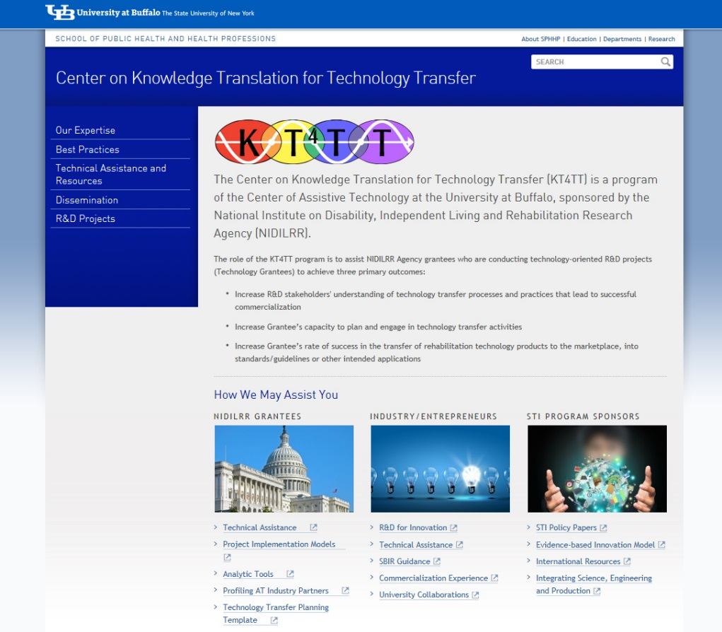
Summary
Visit the KT4TT web site for additional information, more examples, and resources for new product developers, inventors, and federal grantees. http://sphhp.buffalo.edu/cat/kt4tt.html
Thank you!

Slide 34
Acknowledgement
The contents of this presentation were developed under a grant from the National Institute on Disability, Independent Living, and Rehabilitation Research (NIDILRR grant number 90DP0054-01-00). NIDILRR is a Center within the Administration for Community Living (ACL), Department of Health and Human Services (HHS). The contents of this presentation do not necessarily represent the policy of NIDILRR, ACL, HHS, and you should not assume endorsement by the Federal Government.

