Slide 1
Translating New Knowledge from Technology Based Research Projects: an End-of-Grant Intervention Evaluation Study.
Rationale and Methods
Vathsala I. Stone
vstone@buffalo.edu
University at Buffalo
Center on Knowledge Translation for Technology Transfer
http://kt4tt.buffalo.edu
AEA Annual Meeting, Nov. 13, 2010

Slide 2
Background: Knowledge Translation [KT]
Emergent field
Research Utilization - influence public policy
(Weiss, 1979)
Healthcare (CIHR, 2004; 2005; 2009)
Evidence practice impact on beneficiaries
Impact from funded Research [R&D]
(Wholey et al, 2004)

Slide 3
Knowledge Translation for Technology Transfer (KT4TT)
Technology based R&D → K (Output) → TT Market (Outcome) → Benefit users (Impact)
Creation & Strategic Communication of K
  → Through relevant Stakeholders
  → For Products and Services in market (TT)
      → To benefit end users
Examples: New wheelchair cushion, easier household appliances.

Slide 4
Background: Study Context
Funding agency: National Institute for Disability and Rehabilitation Research (NIDRR)
Beneficiaries: Persons with Disabilities
Knowledge Producers: NIDRR’s Technology grantees (R&D projects)
Knowledge Users: (6 stakeholder groups)
  Manufacturers; Clinicians; Transition Brokers; Researchers; Policy makers; Consumers with disabilities

Slide 5
Knowledge Translation [KT] Interventions
Problem: Sub-optimal level of demonstrated impact from R&D investment.
Challenge: Develop an effective KT intervention strategy to increase impact.
What will enhance K use (application) by intermediary and beneficiary stakeholders?
  Knowledge to Action Model - Graham et al, 2006
Formats of communication? Channels of delivery?
What else? Why?

Slide 6
Study Purpose
Overall Purpose:
Develop KT best practice models for (later use by)
K producers (technology grantees)
Research Project:
Conceptualize a KT intervention strategy for a selected K; implement and evaluate effects on relevant Users.
3 technology areas; first study on Augmentative and Alternative Communication (AAC)

Slide 7
Intervention Study: Procedures
Objective: Evaluate effectiveness of KT strategy for a given new K in AAC field; demonstrate what works for NIDRR and grantees (K producers).
Focus: End-of-Grant KT ( completed grantee project)
Approach: Select an Innovation (grantee research study) → “Translate” the study → implement intervention on six
K user populations → measure effects: Awareness, Interest and Use of New Knowledge (AIUNK).

Slide 8
Evaluation Quality
Target stakeholder: NIDRR & Technology Grantees
Utility: Effective KT strategy for use by grantee; specific feedback from K users for strategy refinement.
Feasibility – KT strategy conceptualized from grantee perspective, & replicated for different technology outputs.
Accuracy – RCT design (merit) + follow up (worth).
Propriety – involve K producer (grantee) in translation.

Slide 9
Study Procedures (contd.)
Basic guide: KTA action cycle steps
  Create Intervention Strategy & tools
  Implement and evaluate Intervention

Slide 10
Evaluation Quality (Contd.)
Evaluating knowledge (K) for translation:
Is the K credible?
  Merit (rigor) of evidence
Is the K worthy? (Relevance to K users )
Both are important

Slide 11
Create Intervention
  Grantee Innovation Profile (GIP) for Output [Innovation = Novel, Feasible & Useful]
  2. Knowledge Value Maps (KVM) (Rogers, 2000)
  [User Context & needs of organizations]
  Tools:
    Six “Contextualized Knowledge Packages”
    Six Webinars (training)
    Technical Assistance upon request

Slide 12
Implement Intervention: Design
Design:
Randomized Control Trial (RCT)
3 groups : KT (proposed strategy), KDU (traditional dissemination) and Control
Pre →Int.→ Post 1 → Int. → Post 2
Duration: 8 Months
Sample: 270 = 45 subjects x 6 stake h. groups
(Recruited through national organizations).

Slide 13
Implement Intervention: Measures
Measure:
Awareness, Interest and Use of New Knowledge
Focus: Instrumental Use (Estabrooks, 1999)
Instrument:
AIUNK (based on Halls et al, 2006);
Web-based survey
Items cover 6 categories within 10 levels.

Slide 14
Project Status
Baseline data collected for Current Study in AAC
Expected completion June 2011
Planning next Replication Studies using the KTA action cycle (model validation)

Slide 15
Acknowledgement
This is a presentation of the KT4TT Center which is funded by the National Institute on Disability and Rehabilitation Research of the U.S. Department of Education, under grant number H133E030025. The opinions contained in this presentation are those of the grantee and do not necessarily reflect those of the U.S. Department of Education.

Slide 16
Thank you!!
Contact: vstone@buffalo.edu
http://kt4tt.buffalo.edu
Questions?

Slide 17
Figures and References

Slide 18
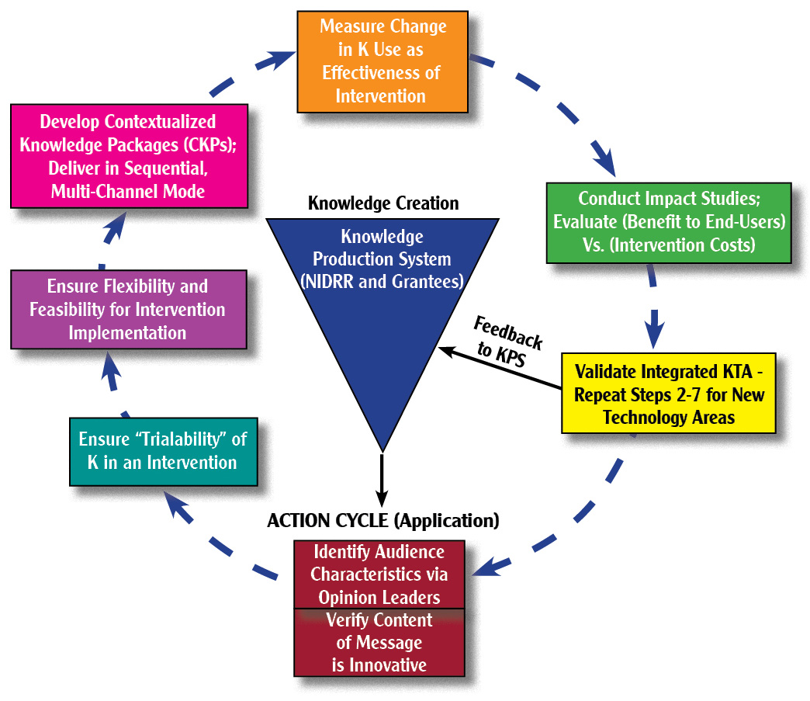
Fig. (i). Implementing the AAC KT Intervention Study via KTA model

Slide 19
Fig.(ii). Research Design for the KT Intervention Study.
 | Baseline Assessment | Intervention Delivery | Post Test 1 | Intervention Delivery | Post Test 2
R T₁ | O _{(1 – 6)} | X₁ | O _{(1 – 6)} | X₁ | O _{(1 – 6)}
R T₂ | O _{(1 – 6)} | X₂ | O _{(1 – 6)} |  | O _{(1 – 6)}
R C | O _{(1 – 6)} |  | O _{(1 – 6)} |  | O _{(1 – 6)}

Slide 20
Fig. (iii). AIUNK Survey Framework (Based on Halls et al, 2006)
 |  | CATEGORIES
 |  | Being Aware | Getting Information | Sharing | Assessing | Planning | Implementing
LEVELS | 0 - NON-AWARENESS
 | 1- AWARENESS:
 | 2 – ORIENTATION:
 | 3 – PREPARATION:
 | 4 - INITIAL USE:
 | 5 - ROUTINE USE:
 | 6 – EXPANSION:
 | 7 –COLLABORATION:
 | 8 – INTEGRATION:
 | 9 – MODIFICATION:

Slide 21
Fig. (iv). A KT Framework for Technology Based Innovations
Need & Envisioned Solution
Need to Knowledge (NtK) Model
(Lane and Flagg, 2010)
http://kt4tt.buffalo.edu/knowledgebase/model.php
R
D
P
Impact on Beneficiary
KtA
KtA
KtA
3 processes; 3 states of K; 3 outputs
Introduces Prior-to-grant KT

Slide 22
Key References
CIHR. About knowledge translation. Retrieved October 25, 2009, from http://www.cihr-irsc.gc.ca/e/29418.html
Graham, I.D., Logan, J., Harrison, M.B., Straus, S.E., Tetroe, J., Caswell, W., & Robinson, N. (2006). Lost in translation: time for a map? The Journal of Continuing Education in the Health Professions, 26(1), 13-24.
Hall, G.E., Dirksen, D.J., and George, A.A. (2006). Measuring Implementation in Schools: Levels of Use. Austin, TX: Southwest Educational Development Laboratory (SEDL).
Lane, J.P. & Flagg, J.L. (2010). Translating three states of knowledge: Discovery, invention & innovation. Implementation Science. http://www.implementationscience.com/content/5/1/9
Rogers, J.D. (2000). Theoretical consideration of collaboration in scientific research. In J.S. Hauger and C.McEnaney (Eds.), Strategies for competitiveness in Academic Research (Chapter 6).
Sudsawad, P 2007. Knowledge Translation: Introduction to Models, Strategies, and Measures. Austin: Southwest Educational Development Laboratory, National Center for the Dissemination of Disability Research. (p.4; 21-22)
Wholey J S., Hatry H P., and Newcomer, K E (eds.) (2004). Handbook of Practical Program Evaluation, San Francisco: Jossey-Bass.

