Slide 1
Targeting Stakeholders and Tailoring Knowledge as Communication Strategies in Assistive Technology: Three Randomized Controlled Case Studies
Presenter: Vathsala Stone
vstone@buffalo.edu
Center on Knowledge Translation for Technology Transfer (KT4TT)
University at Buffalo, NY
http://sphhp.buffalo.edu/cat/kt4tt.html
Presented for the panel - “KT Casebook ”
NARRTC Annual Meeting, March 26, 2018

Slide 2
Why the project?
An Accountability Concern
(GPRA, 1993, 2010; Weiss, 1979; Wholey et al, 2004)
Prior
Knowledge
Base
New Knowledge (K)
(Research-generated)
Beneficial Impacts
(Societal/End-users)
???
Public Funds
(Investment in Innovations)

Slide 3
Obtaining Impact is a Challenge
Multiple stakeholders must
Uptake & Use the New K;
Pass new outputs forward
B. Diverse Stakeholders for Assistive/ RehabTechnology innovations; and
C. Disperse (hard-to-reach) Stakeholders
Need
Effective Knowledge Translation (KT) strategies (including communication)
to move new K through stakeholders to end-users

Slide 4
Objective
For a published Research output (findings/new K) identified as innovative in the Assistive/Rehab Technology field:
A. Identify the diverse groups of potential stakeholders and develop appropriate KT strategies & materials to communicate the new K to these stakeholders; and
B. Evaluate effectiveness of proposed strategies, compared to Passive Diffusion (traditional form), in a randomized controlled study.

Slide 5
Three Randomized Controlled Studies
STUDY/YR | STUDY AREA | Publication (New Knowledge)
Case One: 2009-11 | Alternative and Augmentative Communication (AAC) Technology | Bryen (2008) Vocabulary Set (to support socially-valued adult roles)
Case Two: 2010-12 | Rerc-Environmental Access Technologies | Rimmer et al., (2004) AIMFREE: Accessibility Instruments Measuring Fitness and Recreation Environments.
Case Three: 2011-13 | Wheeled Mobility Technologies | Sonenblum, Sprigle & Maurer (2009) Use of power tilt systems in everyday life. (Consumer use of power tilting technology)

Slide 6
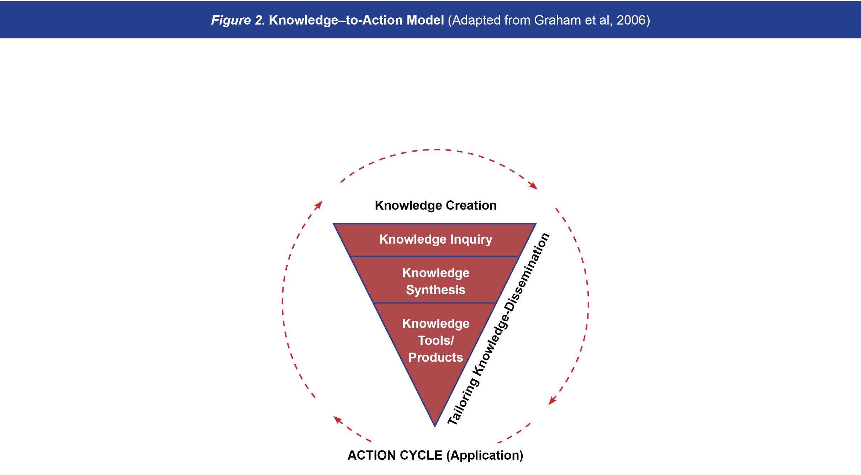
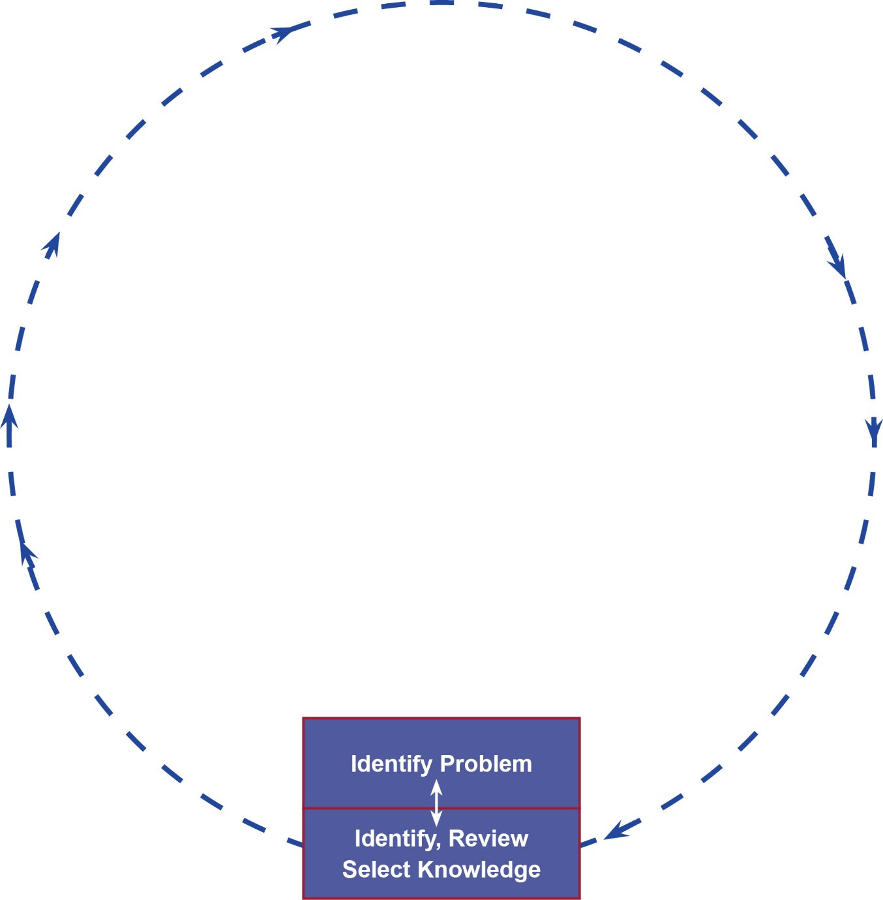
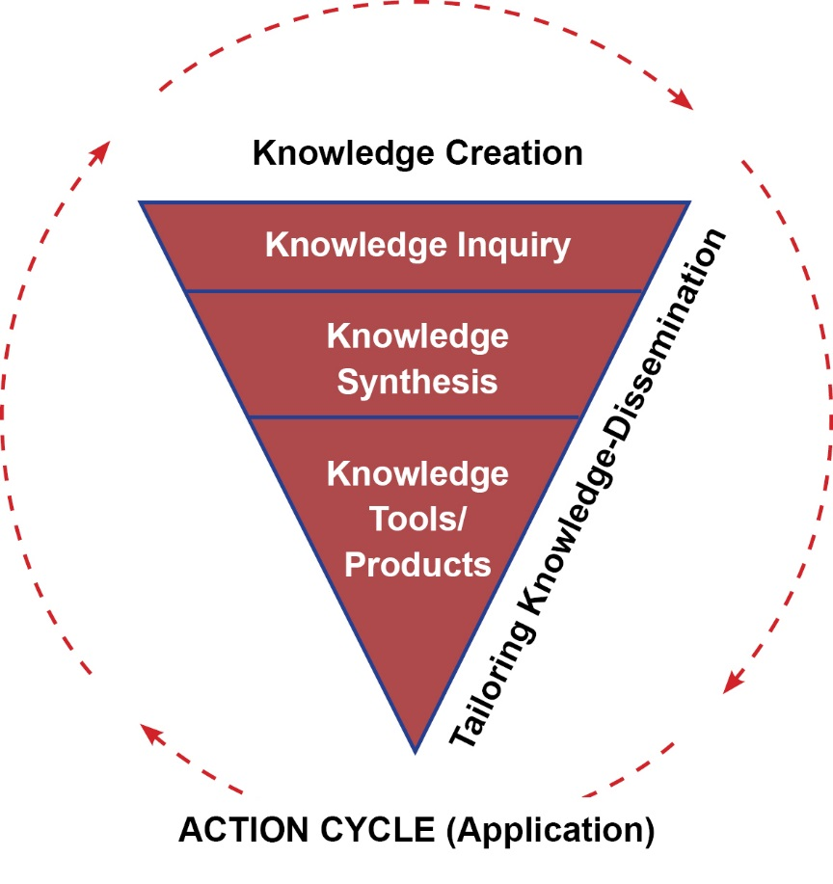
Figure 2: Knowledge-to-Action Model (Adapted from Graham et al, 2006)

Slide 7
Two KT Interventions (Knowledge Communication Strategies)
1. Tailor and Target Strategy (based on Graham, et al, 2006)
Pre-identify (target) relevant stakeholder groups
Tailor the new Knowledge (published Research Findings) to the context of each stakeholder type;
Deliver the tailored information to the Stakeholders using multi modal channels.
2. Target-Only Strategy (based on NCDDR,1996)
a) Pre-identify (target) stakeholders and
b) Deliver the original publication, with no tailoring.

Slide 8
Five Types of Stakeholder Groups participated in Each Study
Five Types of Stakeholder Groups participated in Each Study
Stakeholder Type* |  | Sample Size in the 3 Studies
 | Study 1 (AAC Tech) | Study 2 (Rec Access Tech) | Study 3 (Wh. Mobility Tech)
Brokers (liaison to consumers) | 65 | 40 | 31
Clinicians/Practitioners | 45 | 61 | 59
Industry/Manufacturers | 26 | 58 | 45
Researchers | 21 | 65 | 21
Consumers w/Disabilities | 50 | 64 | 54
(Policy Implementers)** | 50 | 64 | 54
 | N=207 | N=288 | N=210
*Lane & Flagg (2010)
** Excluded due to their limited availability for participation

Slide 9
Intervention Materials – Tailor & Target Strategy
http://sphhp.buffalo.edu/cat/kt4tt/projects/past-projects/kt4tt-2008-2013/research-projects/case-studies-materials.html
Contextualized Knowledge Packages (CKPs)
Five different stakeholder versions (See Example set in display)
Print & electronic formats (for stakeholder accessibility)
C. Enclosures:
Cover letter
The original Research article
Tailored Information package: Highlight relevance/value of new K to Stakeholder’s living and working context
Content : Need/problem addressed; Research findings and potential benefits; Using the new K in specific stakeholder context - opportunities and resources.
4. A CD version of the CKP

Slide 10
Intervention Materials – Tailor & Target Strategy (Contd.)
http://sphhp.buffalo.edu/cat/kt4tt/projects/past-projects/kt4tt-2008-2013/research-projects/case-studies-materials.html
2. Tailored Webcast + optional technical assistance
Five different stakeholder versions;
Similar to CKP in content – present new K, potential benefits, highlight how applied in specific stakeholder context;
Video demonstration of example applications of the new K
Offer of technical assistance for applying the new Knowledge;
Contact Info

Slide 11
Intervention Materials: Target-only Strategy
Direct delivery of published research article to pre-identified (targeted) stakeholders; with no tailoring.
Enclosures:
Cover letter
Copy of research article (obtained with prior author/publisher permission)
Delivered through US mail/ e-mail
11

Slide 12
Developed the Level Of Knowledge Use Survey (LOKUS) Instrument
(Based on Hall et al,1975; Rogers, 1983)
Web-based survey instrument (via the Vovici (2011) software).
http://sphhp.buffalo.edu/cat/kt4tt/projects/past-projects/kt4tt-2008-2013/research-projects/lokus-instrument.html
2. Measures at 4 Levels of Use:
Non-awareness → Awareness→ Interest→ Use.
(covers 10 Dimensions; 37 Activities)
4. Strong validity (Item, content, construct), reliability and responsiveness to change (Stone et al., 2014)

Slide 13
Table 1. Randomized Controlled Pretest-Posttest Design to Evaluate Two Knowledge Communication Strategies
 | Group | Pretest: Level of Use at Baseline | Intervention (4 Mo.) | Post test 1: Level of Use At 4 months | Intervention (4 Mo.) | Post test 2: Level of Use At 8 months
Five Stakeholder Types | (R) T1 | LOKUS | CKP | LOKUS | Webcast + TA offer | LOKUS
 | (R) T2 | LOKUS | R article delivery | LOKUS | --- | LOKUS
 | (R) C | LOKUS | --- | LOKUS | --- | LOKUS
Legend: R = Random assignment to groups; T1 = group exposed to Tailor-and-Target intervention; T2 = group exposed to Target-Only intervention; C = Control group (no intervention);

Slide 14
Data Analysis
Statistics:
Non-parametric, because of Nominal or Ordinal data.
Effectiveness Analysis:
Changes in K Use Level from Pretest to Post test, separately for groups T1, T2 & C
Differences in K Use Level between groups T1, T2 and C (at 4 months & at 8 months)
Guidelines
Consider both Statistical and Practical significance.
Changes in groups T1 and T2 should surpass “testing effect”.
Consider first 4 months important for T2; no intervention reinforcement beyond that period.
Notes:
Chi-square; Kruskal-Wallis One-way ANOVA; Wilcoxon Signed-Rank test; McNemar test

Slide 15
Summary of Findings
In all three studies, both Tailor-and-target and Target-only strategies were:
Effective. For each strategy, Pretest-to-post test changes were significant.
Effective compared to Passive Diffusion (Control)
But there was no significant difference between the two strategies in any study. Neither was better than the other.
[Question: Is tailoring worth the extra effort?]
3. Differentially effective with different stakeholder groups.
4. Effective in raising Awareness of the new K between pre- and post tests.
5. Effective in persuading Non-Users to Use the new K, differently across studies
6. In practical terms, able to persuade too few people to initiate use or sustain it.
[Question: initiating/sustaining Use vs. stakeholder perceived value of the new K?]

Slide 16
Limitations and Lessons
Successful implementation - Seamlessly smooth logistics supported rigor of the RCT Design
Limitation:
LOKUS called for repeated and self-reported responses based on recall. Correction for testing effect, necessary not sufficient.
Design did not provide for follow-up qualitative interviews; missed opportunity for in-depth learning about actual use/non-use of the new K.
Future studies need to focus on:
shorter or longer study periods. How soon after dissemination to expect stakeholder awareness, interest or use?
Qualitative follow-up of stakeholders for barriers and facilitators of K use
Prior-to-grant KT that validates stakeholder need/value for the new K before generating it

Slide 17
REFERENCES:
ACL/NIDILRR (2017). Draft Long-Range Plan for the period 2018-2023. PDF Document for public comments (pp.1-33). Retrieved through NIDILRR-announcements@naric.com, January 19, 2017
Bryen, D.N. (2008). Vocabulary to support socially-valued adult roles. Augmentative and Alternative Communication, 24(4), 294-301. doi: 10.1080/ 07434610802467354
Center on Knowledge Translation for Technology Transfer (KT4TT). Targeting Stakeholders and Tailoring Knowledge as Communication Strategies in Assistive Technology: Three Randomized Controlled Case Studies. KT Casebook (2nd Ed.) (Updated Nov. 2017). http://ktdrr.org/products/ktcasebook/targeting_stakeholers2016.html
Center on Knowledge Translation for Technology Transfer (KT4TT). http://sphhp.buffalo.edu/cat/kt4tt/projects/past-projects/kt4tt-2008-2013/research-projects/case-studies-materials.html
CIHR. About knowledge translation. Retrieved October 25, 2009, from http://www.cihr-irsc.gc.ca/e/29418.html
Flagg, J.L., Lane, J.P., & Lockett M.M. Need to Knowledge (NtK) Model: an evidence-based framework for generating technological innovations with socio-economic impacts, Implementation Science 2013, 8:21.
Graham, I.D., Logan, J., Harrison, M.B., Straus, S.E., Tetroe, J., Caswell, W., & Robinson, N. (2006). Lost in translation: time for a map? The Journal of Continuing Education in the Health Professions, 26(1), 13-24.
Lane, J.P. & Flagg, J.L. (2010). Translating three states of knowledge: Discovery, invention & innovation. Implementation Science. http://www.implementationscience.com/content/5/1/9
Lane, J.P., & Rogers, J.D. (2011). Engaging national organizations for knowledge translation: Comparative case studies in knowledge value mapping. Implementation Science, 6(106), 1-13. doi:10.1186/1748-5908-6-106
National Center for the Dissemination of Disability Research (NCDDR). (1996). Dissemination and knowledge utilization. A review of the literature on dissemination and knowledge utilization. Retrieved from http://www.ncddr.org/du/products/review/index.html
Rimmer, J. H., Riley, B., Wang, E. & Rauworth, A. (2004). Development and validation of AIMFREE: Accessibility Instruments Measuring Fitness and Recreation Environments. Disability and Rehabilitation, 26 (18), 1087-1095.
Sonenblum, S. E., Sprigle, S. & Maurer, C. I. (2009). Use of power tilt systems in everyday life. Disability and Rehabilitation: Assistive Technology, 4(1): 24-30.
Stone, et al. (2014). Development of a measure of knowledge use by stakeholders in rehabilitation technology. Sage Open Medicine, 2014, 2, 1-19. [SA1]
Stone, et al. (2015). Effectively Communicating Knowledge to Assistive Technology Stakeholders: Three Randomized Controlled Case Studies In: Focused Issue: Knowledge Translation and Technology Transfer in Assistive Technology, Assistive Technology Outcomes and Benefits, Winter 2015, 9(1), pp.98-159.
Sudsawad, P 2007. Knowledge Translation: Introduction to Models, Strategies, and Measures. Austin: Southwest Educational Development Laboratory, National Center for the Dissemination of Disability Research. (p.4; 21-22)
University at Buffalo (SUNY) Center on Knowledge Translation for Technology Transfer (KT4TT). Targeting Stakeholders and Tailoring Knowledge as Communication Strategies in Assistive Technology: Three Randomized Controlled Case Studies. KT Casebook (2nd Ed.) (Updated Nov. 2017). http://ktdrr.org/products/ktcasebook/targeting_stakeholers2016.html
USDE (2006). NIDRR Logic Model: Targeted Outcomes Arenas. Federal Register/Vol. No. 31, February 15, 2006.: Appendix 2.
United States Government Printing Office (2011).GPRA modernization act of 2010, PUBLIC LAW 111–352, Retrieved from http://www.gpo.gov/fdsys/pkg/PLAW-111publ352/pdf/PLAW-111publ352.pdf
United States Office of Management and Budget. (1993). Government performance and results act (GPRA) of 1993. Retrieved from http://www.whitehouse.gov/omb/mgmt-gpra/gplaw2m
Wholey J S., Hatry H P., and Newcomer, K E (eds.) (2004). Handbook of Practical Program Evaluation, San Francisco: Jossey-Bass.
Weiss, C H (1979). The Many Meanings of Research Utilization. Public Administration Review, 39(5): 426-431.

Slide 18
ACKNOWLEDGEMENT ACKNOWLEDGEMENT
The contents of this presentation were created under a cooperative agreement with the National Institute on Disability, Independent Living, and Rehabilitation Research (#90DP0054). NIDILRR is an Institute within the Administration for Community Living (ACL) in the U.S. Department of Health and Human Services (HHS). The contents do not necessarily represent the policy of NIDILRR, ACL, DHHS, and endorsement by the U.S. Federal Government should not be assumed.

Slide 19
Thank you!
Questions?
Contact:
Email: vstone@buffalo.edu
Web: http://sphhp.buffalo.edu/cat/kt4tt.html

Slide 20
Appendix Tables

Slide 21
1. Both strategies effective, taken individually
In all three studies, Pretest-to-post test changes were significant
a) Tailor-and-target strategy:
At 4 months (p<.001) and
At 8 months (p<.001)
CKP effective, in particular.
Target-Only Strategy:
At 4 months - Period of active intervention
(p=.001; p<.001; p<.001)
Additionally at 8 months in Studies 1 & 2 (p=.001; p<.001)

Slide 22
Pretest- to- posttest changes within each Group
Group |  | Months 1-4 | Months 5-8 | 8 months
T1 Tailor & Target |  | [CKP] | [Webcast + TA offer]
 | CASE STUDY 1 | yes; p<.001 | No | Yes- p<.001
 | CASE STUDY 2 | Yes; p<.001 | No | Yes; p<.001
 | CASE STUDY 3 | Yes; (p<.001) | Yes; (p<.031); | Yes; (p<.001)
T2 Target-Only |  | [Publication delivery] | _______
 | CASE STUDY 1 | yes; p=.001 | No | Yes- p= .001
 | CASE STUDY 2 | Yes p<.001 | No | Yes; p<.001
 | CASE STUDY 3 | Yes; (p<.001) | No | Yes; (p<.001) -testing eff?
C No intervention | CASE STUDY 1 | No; p=.321 | No | Yes p=.036ª
 | CASE STUDY 2 | Yes; p=.015 ª | No | Yes; p=.011ª
 | CASE STUDY 3 | Yes; (p<.013)ª | No | Yes; (p<.001) ª
NOTE: ª Testing Effect

Slide 23
2. Both strategies effective, compared to Passive Diffusion
In all three studies, both Tailor-and-target and Target-only strategies were effective compared to Passive Diffusion (Control)
Study 1, at 8 mo. (p=.029);
Study 2 at 4mo. (p=.001) & at 8 mo. (p=.001);
Study 3 at 4 mo. (p=.002)
But there was no difference between the two strategies in any study
(p=.086; p=.323; p<.615)
Neither was better than the other
Question: Is tailoring worth the extra effort?
-Ask the stakeholder, maybe?

Slide 24
Between –Group Differences
 | Case Study One |  | Case Study Two |  | Case Study Three
 | After 4 months | After 8 months | After 4 months | After 8 months | After 4 months | After 8 months
Among T1 -T2 -C | No diff. | Yes (p=.029) | Yes (p=.001) | Yes (p=.001) | Yes (p=.002) | No* (p=.603)
Between T1 -T2 | … | No [p=.086] | No (p=.086) | No (p=.323) | No (p=.060) | No (p<.615)
* (See Stone et al, 2015 for details)

Slide 25
3. The strategies were differentially effective with stakeholder groups
3. However, stakeholder type made a difference in the effectiveness of each strategy
Tailor & Target was effective with
Manufacturers, Clinicians and Consumers for all 3 technologies (AAC, RecAccess & WhMobility)
Brokers* for Wheeled Mobility technology
Researchers for Recreational Access technology
Target-only was effective with
Manufacturers, Clinicians, Consumers and Brokers for Wh Mobility technology
Manufacturers and Researchers for RecAccess technology
Consumers for AAC technology
* They were caregivers/nurses

Slide 26
Differential Effectiveness – by Strategy
Intervention | Stakeholder Type | Study 1: AAC | Study 2: Rec. Env Access | Study 3: Wheeled Mobility
Tailor & Target | Practitioner (Clinician/Therapist) | p1=.023 | p2=.016 CKP (p2=.005) | p3= .023
 | Manufacturer (Industry) | p1=.016 | p2=.016 CKP (p2=.010) | P3=.040)
 | Consumer | p1=.024, CKP (p1= .017) | p2=.006 CKP (p2=.026) | p3=.014 CKP (p3= .024)
 | Brokers |  |  | p3=.007; p3=.039
 | Researcher |  | p2=.011; p2=.038
Target Only | Practitioner (Clinician/Therapist) |  |  | p3=.011
 | Manufacturer (Industry) |  | p2=.010; p2=.007 | p3=.011
 | Consumer | p1=.013 |  | p3=.038
 | Brokers |  |  | p3=.034
 | Researcher |  | p2=.038; p2=.014

Slide 27
Differential Effectiveness by Stakeholder Type
Stakeholder Type | Intervention | Study 1: AAC | Study 2: Rec. Env. Access | Study 3: Wh. Mobility
Clinicians/Therapists (Practitioners) | Tailor & Target | p1=.023 | p2=.016 CKP (p2=.005) | p3= .023
 | Target Only |  |  | p3=.011
Industry/Manufacturers | Tailor & Target | p1=.016 | p2=.016 CKP (p2=.010) | P3=.040)
 | Target Only |  | p2=.010; p2=.007 | p3=.011
Consumers | Tailor & Target | p1=.024, CKP (p1= .017) | p2=.006 CKP (p2=.026) | p3=.014 CKP (p3= .024)
 | Target Only | p1=.013 |  | p3=.038
Brokers | Tailor & Target |  |  | p3=.007; p3=.039
 | Target Only |  |  | p3=.034
Researchers | Tailor & Target |  | p2=.011; p2=.038
 | Target Only |  | p2=.038; p2=.014

Slide 28
4. Both strategies raised stakeholder awareness of new knowledge
Both strategies raised Stakeholder Awareness of the new Knowledge.
they did so in all 3 Case Studies.
Between pretest & post test, they effectively moved people
from “Non-awareness” level to “Awareness/Interest/Use” levels.

Slide 29
Both Strategies raised Awareness of the New K in each Group
Pretest- to- posttest changes within each Group in the 3 Studies
Group |  | Months 1-4 | Months 5-8 | 8 months
T1 Tailor & Target | Intervention → | CKP | Webcast + TA offer
 | CASE STUDY 1 | yes; p=.001 | No | Yes- p<.001
 | CASE STUDY 2 | Yes; p<.001 | No | Yes; p<.001
 | CASE STUDY 3 | Yes; (p<.001) | No | Yes; (p<.001)
T2 Target-Only | Intervention→ | Deliver R Publication | _______
 | CASE STUDY 1 | yes; p=.001 | No | Yes- p= .001
 | CASE STUDY 2 | Yes p<.001 | No | Yes; p<.001
 | CASE STUDY 3 | Yes; (p<.001) | No | Yes; (p<.000)
C No intervention | CASE STUDY 1 | No; p=.321 | No | Yes p=.036ª
 | CASE STUDY 2 | Yes; p=.015 ª | No | Yes; p=.011ª
 | CASE STUDY 3 | Yes; (p=.001)ª | No | Yes; (p<.001) ª
NOTE: ª Denotes Testing Effect; the control group had no intervention

Slide 30
5. Both Strategies persuaded Non-users to use the new K, differently across the 3 Studies
Statistically speaking, both strategies persuaded Non-users to use the new K.
There was significant move between pretest and post test:
From “(Non-awareness/Awareness/ Interest)” levels → “Use” level
But….the pattern was different across the 3 studies
Tailor & target - Studies 1 & 2: effective over months 1-4;
Study 3: effective over months 5-8 as well as over months 1-8.
Target-only: Studies 1, 2 & 3: effective over months 1-4;
Study 3: over months 1-8

Slide 31
Both strategies persuaded Non-users to Use the new knowledge: differently across the three studies
Pretest- to- posttest changes within each Group
Group |  | Months 1-4 | Months 5-8 | 8 months
T1 Tailor & Target | Intervention → | CKP | Webcast + TA offer
 | CASE STUDY 1 | yes; p=.039 | No | No
 | CASE STUDY 2 | Yes; p<.001 | No | No
 | CASE STUDY 3 | Yes; (p<.004) – but changes did not surpass testing effect | Yes; p<.041 | Yes; (p<.000)
T2 Target-Only | Intervention → | Deliver R Publication | _______
 | CASE STUDY 1 | yes; p=.022 | No | No
 | CASE STUDY 2 | Yes p<.001 | No | No
 | CASE STUDY 3 | Yes; (p<.001) | No | Yes; (p<.021)
C No intervention | CASE STUDY 1 | No | No | No
 | CASE STUDY 2 | No | No | No
 | CASE STUDY 3 | Yes; (p<.027)ª | No | Yes; (p<.001) ª
NOTE: ª Testing Effect, since the Control group had no intervention.

Slide 32
6. Too few Non-users made the move to Use the new K
Practically speaking:
In the case of both strategies, too few persons
made the move to Use, or
stayed there after moving.
Persuading people to actually apply new K remains a challenge to KT.
Decision to use /not use depends , among other things, on stakeholder perception of value in the new K;
Ensuring stakeholder relevance before generating new K needs consideration.

