Slide 1
A prospective study of the translational process in the technology development and transfer projects of NIDILRR’s technology grantees: a qualitative study in progress
Presenter: Vathsala Stone
vstone@buffalo.edu
Center on Knowledge Translation for Technology Transfer (KT4TT)
University at Buffalo, NY
http://sphhp.buffalo.edu/cat/kt4tt.html
Presented for the panel - “Bench to Bedside and Beyond”
AEA Annual Meeting, November 10, 2017

Slide 2
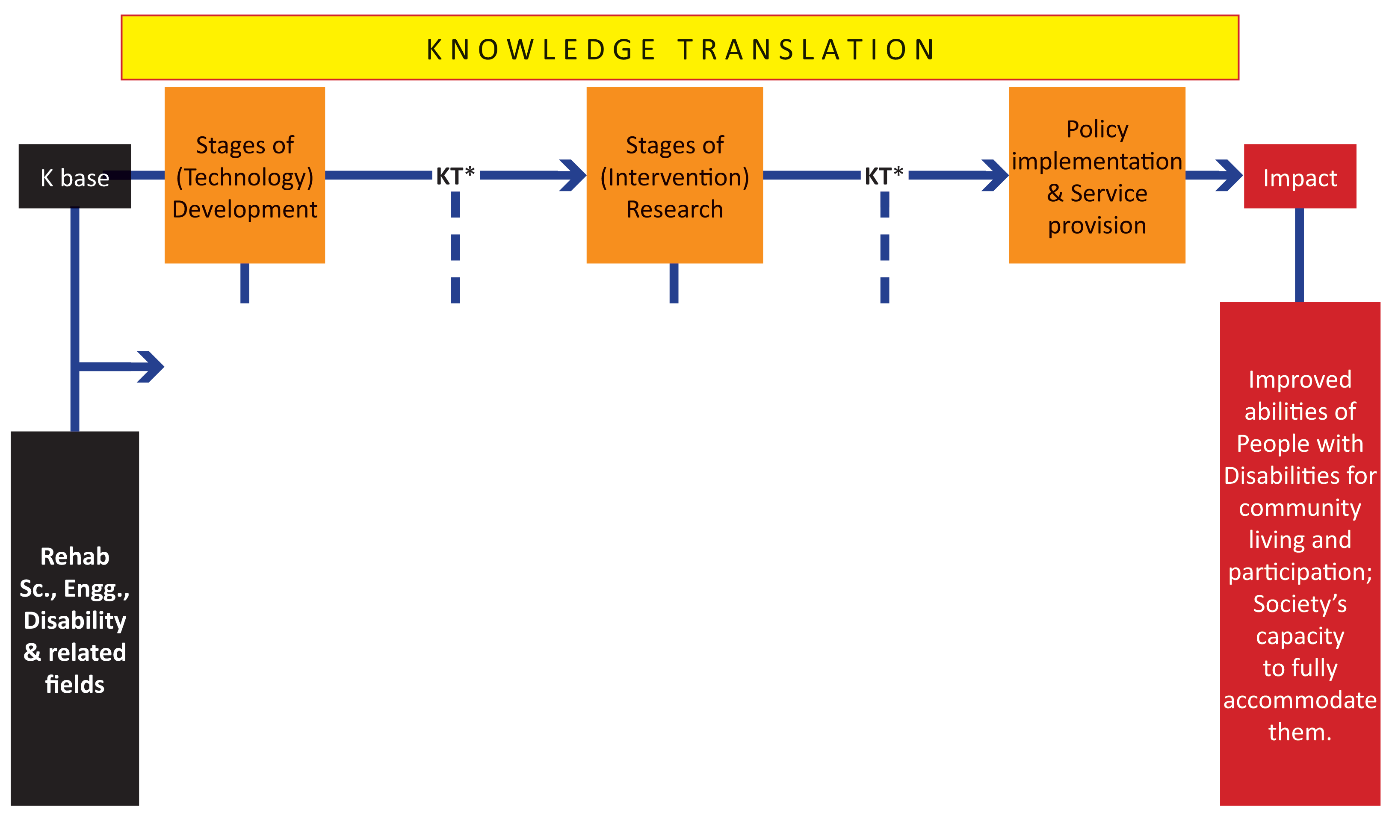
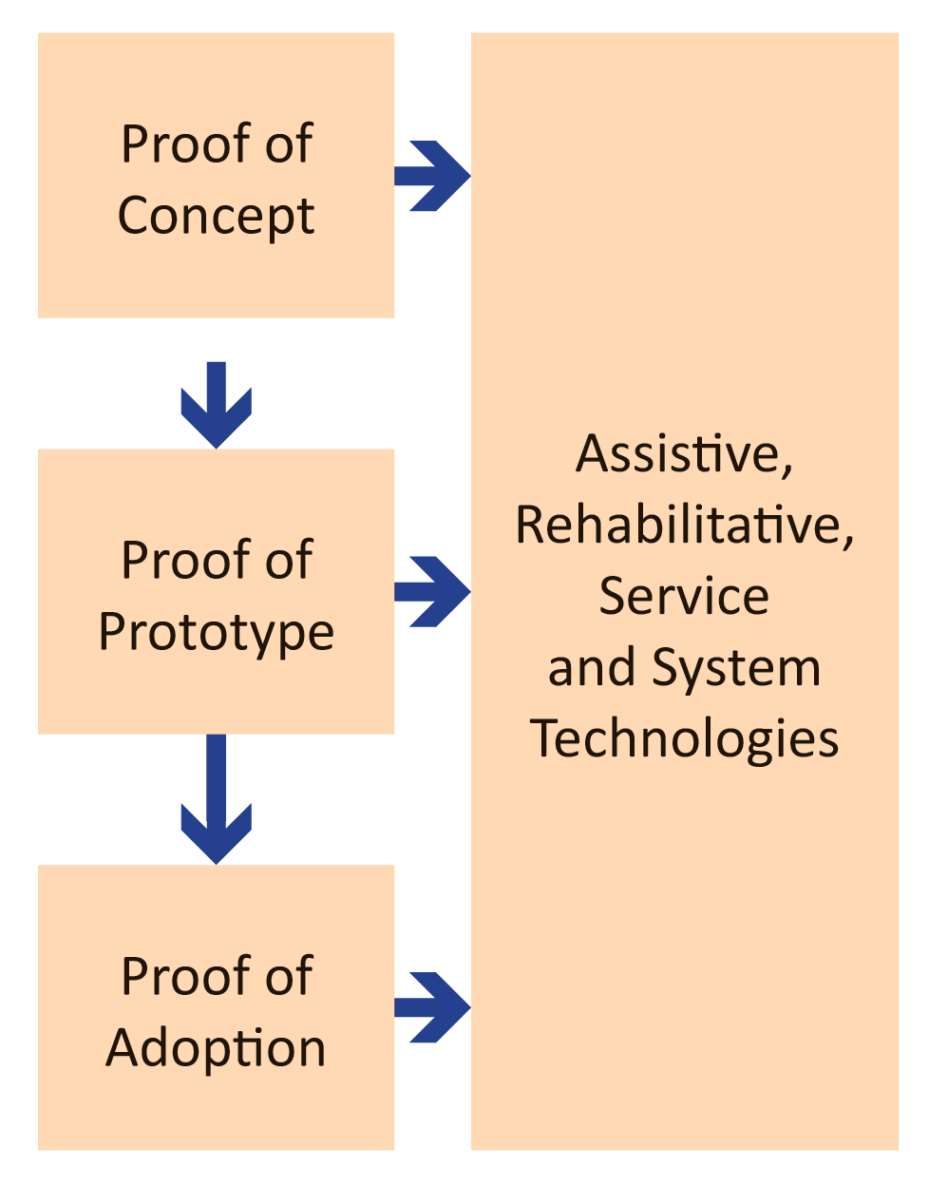
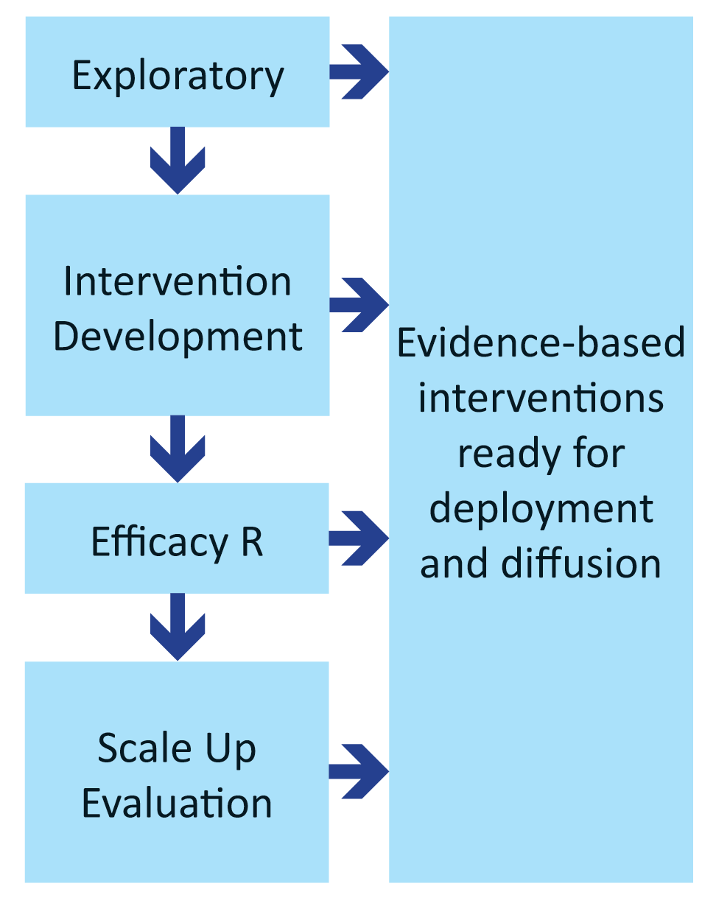

Fig. 1. The Study Context: ACL/NIDILRR’s Knowledge Translation (KT) Framework focused on Technology Innovation and Use (Summary View)

Slide 3
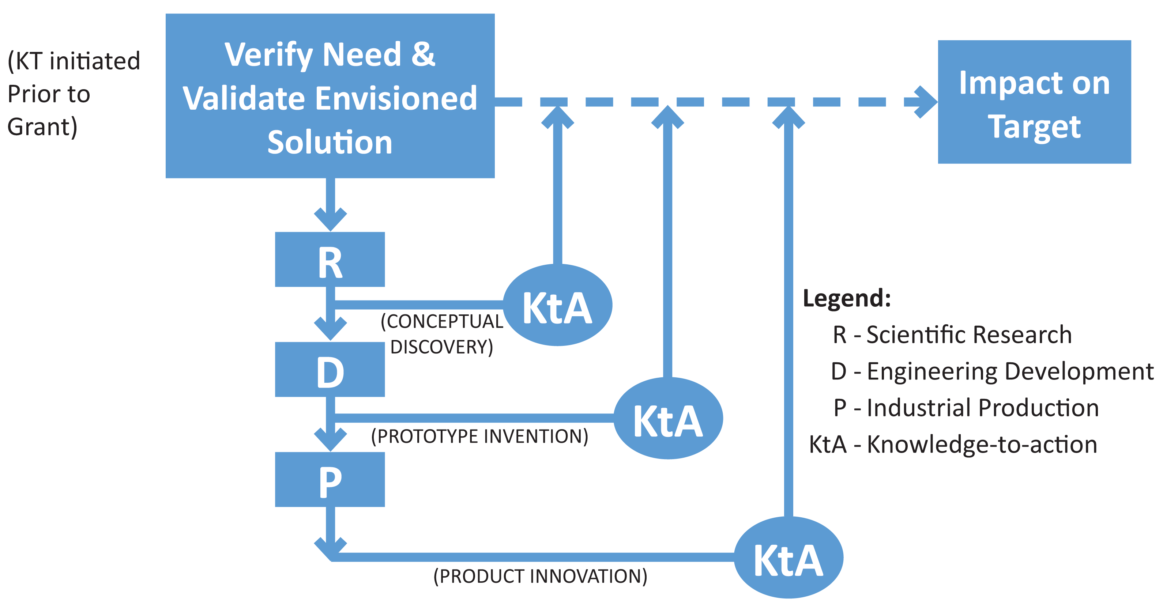
Fig. 2. Need-to-Knowledge (NtK) Model: Three Methods generate Three States of Knowledge (Lane & Flagg, 2010)

Slide 4
An Operational Need-to-Knowledge (NtK) Model An Operational Guide to KT for TT (Lane & Flagg, 2010) Guide to KT for TT (Lane & Flagg, 2010)
Need-to-Knowledge (NtK) Model: An Operational Guide to KT for TT
(Flagg, Lane & Lockett, 2013)
Model description
http://sphhp.buffalo.edu/cat/kt4tt/best-practices/need-to-knowledge-ntk-model.html (also see Fig. 2 - handout)
Two roles in managing the KT4TT process
Tool for planning: Technology Transfer Planning Template (TTPT)
https://sphhp.buffalo.edu/cat/kt4tt/projects/development-projects/technology-transfer-planning-template.html
Tool for assessing/tracking KT4TT process (see Fig. 3 -handout)

Slide 5
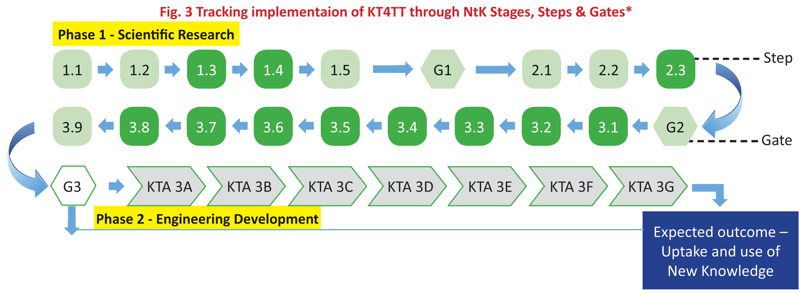
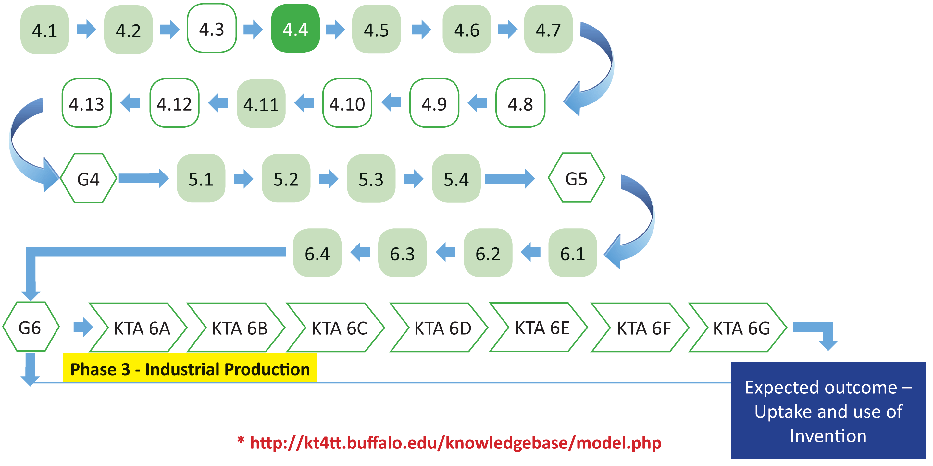
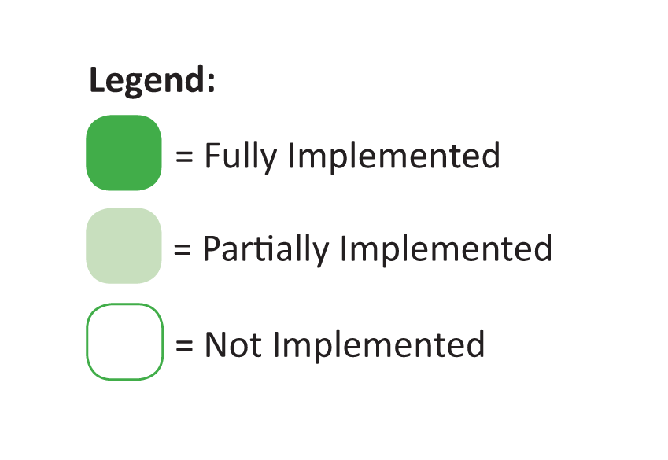
Fig. 3 Tracking implementation of KT4TT through NtK Stages, Steps & Gates*

Slide 6
Longitudinal Qualitative Study at the KT4TT Center
Focus:
NIDILRR Grantees’ technology development and transfer processes
Approach:
Capture Grantees’ translation stories by tracking their project processes from start to end, using the NtK framework as the basis
Objectives:
Uncover and document barriers and facilitators, in Grantee processes.
Refine & contextualize the NtK model using newly identified Best practices.

Slide 7
Longitudinal Study at the KT4TT Center: Study Design
Participants: PI’s of NIDILRR’s (technology)development (D) projects: funded in 2013 & 2014
Design: Prospectively follow the participant D Projects (“Cases”) →
Collective Case Study (Stake, 1995; 2003)
Enrolled Volunteer Participants
Grant Type | Duration | # of Cases (D Projects)
RERC | 5 yrs. | 10
DRRP | 5 yrs. | 1
FI | 3 yrs. | 6
SBIR II | 2 yrs. | 2
TOTAL |  | 19

Slide 8
Method
Baseline: Review grantee proposal & technology transfer (TT) plan – basis: NtK stages, steps and gates
Follow up: Quarterly telephone interviews with PI (beginning to end of grant)
Questionnaires on applicable NtK-steps and gates
PI feedback on transcribed summary
Analysis: Code and analyze data (PI responses) in NVivo 10
Compile findings:
Visual Map of (Grantee process X NtK steps and gates) to compare patterns; (See Fig. 3)
Organize Barriers and facilitators in emerging categories;
Individual Case report → PI feedback → Collective Case Study report

Slide 9
Current Status
Completed:
3 case reports
All data collection for 9 cases
Ongoing:
Data collection (Interviews) for remaining 7 Cases;
Analyze (Code, query, organize) & Compile findings for 9 reports
Project implementation pattern mapped on to Ntk model
Categorize Best Practices, Barriers, and Facilitators
Next Steps:
Follow any remaining project(s) to the end of their grant cycle & complete reports
Collective Case Study Report
Recommendations to Grantees; Inform policy (NIDILLR).

Slide 10
REFERENCES
ACL/NIDILRR (2017). Draft Long-Range Plan for the period 2018-2023. PDF Document for public comments (pp.1-33). Retrieved through NIDILRR-announcements@naric.com, January 19, 2017
CIHR. About knowledge translation. Retrieved October 25, 2009, from http://www.cihr-irsc.gc.ca/e/29418.html
Flagg, J.L., Lane, J.P., & Lockett M.M. Need to Knowledge (NtK) Model: an evidence-based framework for generating technological innovations with socio-economic impacts, Implementation Science 2013, 8:21.
Graham, I.D., Logan, J., Harrison, M.B., Straus, S.E., Tetroe, J., Caswell, W., & Robinson, N. (2006). Lost in translation: time for a map? The Journal of Continuing Education in the Health Professions, 26(1), 13-24.
Lane, J.P. & Flagg, J.L. (2010). Translating three states of knowledge: Discovery, invention & innovation. Implementation Science. http://www.implementationscience.com/content/5/1/9
NCATS/NIH (2015). https://ncats.nih.gov/translation/spectrum
NIEHS (2016). Draft Translational Research Framework for Environmental Health Sciences. retrieved from partners.niehs.nih.gov/assets/docs/draft_translational_research_framework_508.pdf Cached Aug 30, 2016
Stake, R (1995). The art of case study research. (pp. 49-68). Thousand Oaks, CA: Sage
Stake, R (2003). Case Studies. In: Denzin, N. K & Lincoln, Y.(2003) (Eds.) Strategies of Qualitative Inquiry (2nd. Ed.).Thousand Oaks: Sage. (pp.134-164)
Stone, V.I., & Lane, J.P. Modeling technology innovation: How science, engineering, and industry methods can combine to generate beneficial socioeconomic impacts, Implementation Science, 2012, 7:44.
Stone, et al. (2014). Development of a measure of knowledge use by stakeholders in rehabilitation technology. Sage Open Medicine, 2014, 2, 1-19. [SA1]
Stone, et al. (2015). Effectively Communicating Knowledge to Assistive Technology Stakeholders: Three Randomized Controlled Case Studies In: Focused Issue: Knowledge Translation and Technology Transfer in Assistive Technology, Assistive Technology Outcomes and Benefits, Winter 2015, 9(1).
Sudsawad, P 2007. Knowledge Translation: Introduction to Models, Strategies, and Measures. Austin: Southwest Educational Development Laboratory, National Center for the Dissemination of Disability Research. (p.4; 21-22)
USDE (2006). NIDRR Logic Model: Targeted Outcomes Arenas. Federal Register/Vol. No. 31, February 15, 2006.: Appendix 2.
Wholey J S., Hatry H P., and Newcomer, K E (eds.) (2004). Handbook of Practical Program Evaluation, San Francisco: Jossey-Bass.
Weiss, C H (1979). The Many Meanings of Research Utilization. Public Administration Review, 39(5): 426-431.

Slide 11

ACKNOWLEDGEMENT ACKNOWLEDGEMENT
The contents of this presentation were created under a cooperative agreement with the National Institute on Disability, Independent Living, and Rehabilitation Research (#90DP0054). NIDILRR is an Institute within the Administration for Community Living (ACL) in the U.S. Department of Health and Human Services (HHS). The contents do not necessarily represent the policy of NIDILRR, ACL, DHHS, and endorsement by the U.S. Federal Government should not be assumed.

Slide 12
Thank you! Questions?
Contact:
vstone@buffalo.edu
Web: http://sphhp.buffalo.edu/cat/kt4tt.html

