Slide 1
Achieving Knowledge Translation for Technology Transfer: Implications for Evaluation
Presenter:
Vathsala I. Stone
vstone@buffalo.edu
University at Buffalo/ Center on Knowledge Translation for Technology Transfer
UB/KT4TT
AEA Annual Meeting , Nov. 11-15, 2009

Slide 2
ACKNOWLEDGEMENT
This is a work in progress at the KT4TT Center which is funded by the National Institute on Disability and Rehabilitation Research of the U.S. Department of Education, under grant number H133A080050. The opinions contained in this presentation are those of the grantee and do not necessarily reflect those of the U.S. Department of Education.

Slide 3
Why Knowledge Translation [KT]?
NEED
Increase Use of research findings by stakeholders; improve Evidence Based Practice.
PROBLEM
How to increase impact from funded Research?
GPRA, PART and other Fed Gov. initiatives; Systematic review efforts.

Slide 4
Knowledge Translation [KT]
SOLUTION
Strategic Communication (Translation) of Knowledge to stakeholders resulting in application/use.
Various definitions & models of KT
[Sudsawad, 2004]

Slide 5
KT- the CIHR Definition
“Knowledge translation is a dynamic and iterative process that includes synthesis, dissemination, exchange and ethically sound application of knowledge to improve the health of [citizens], provide more effective health services and products and strengthen the health care system”.
Canadian institutes of health research. http://www.cihr-irsc.gc.ca/e/29418.html

Slide 6
Knowledge -to-Action (KTA) Model
Proposed by Graham et al (2006).
Two key components:
Knowledge Creation (K Inquiry → K tools)
Action Cycle (Application: problem identification → use)
End-of-grant Vs. Integrated KT

Slide 7
Knowledge Creation
Relevance Vs. Rigor
Start KT before research
Pro-actively make research outputs relevant to end user contexts.
Systematic KT process

Slide 8
The Path of KT
FLOW OF KNOWLEDGE
KNOWLEDGE | INTERMEDIARIES | END USERS
RESEARCH | INTERMEDIATE STAKEHOLDERS | BENEFICIARIES
IMMEDIATE RESULTS | SHORT/MID TERM CHANGES | LONG TERM BENEFITS
OUTPUT | OUTCOMES | IMPACTS

Slide 9
KT for TT
STRATEGIC COMMUNICATION OF KNOWLEDGE TO STAKEHOLDERS THROUGH TECHNOLOGICAL OUTPUTS RESULTING IN USE
[E.g., Commercial devices/services, freeware…]

Slide 10
Path Of KT4TT
1. An Output chain:
Discovery [Concept]→Invention[Prototype]→ Innovation[Device/Service in market]
2. A Process chain:
Research [R]→Development [D] →Production[P]
KT4TT involves R-D-P project(s)

Slide 11
Impacts from R-D-P Projects
Both Merit (Credibility/Quality) and Worth (Relevance/Value) are important
Sub-optimal use of evaluation

Slide 12
Evaluation enlightens decision-making

Slide 13
Role of Evaluation in KT4TT
The CIPP rationale can be extended from D projects → [R-D-P] projects
Evaluation starts before the R process and continues beyond the P process;
Details in the KT4TT management model [Lane & Flagg, 2009]
http://kt4tt.buffalo.edu/knowledgebase/model.php

Slide 14
KT4TT management
Stage-Gate model
Evaluative information for decisions at gates
R-D-P process continuous but separate R, D, P projects possible
Project Goal: P Output (Vs. R output)

Slide 15
Evaluation, process stages, decision gate and action

Slide 16
Evaluation, process stages, decision gate and action

Slide 17
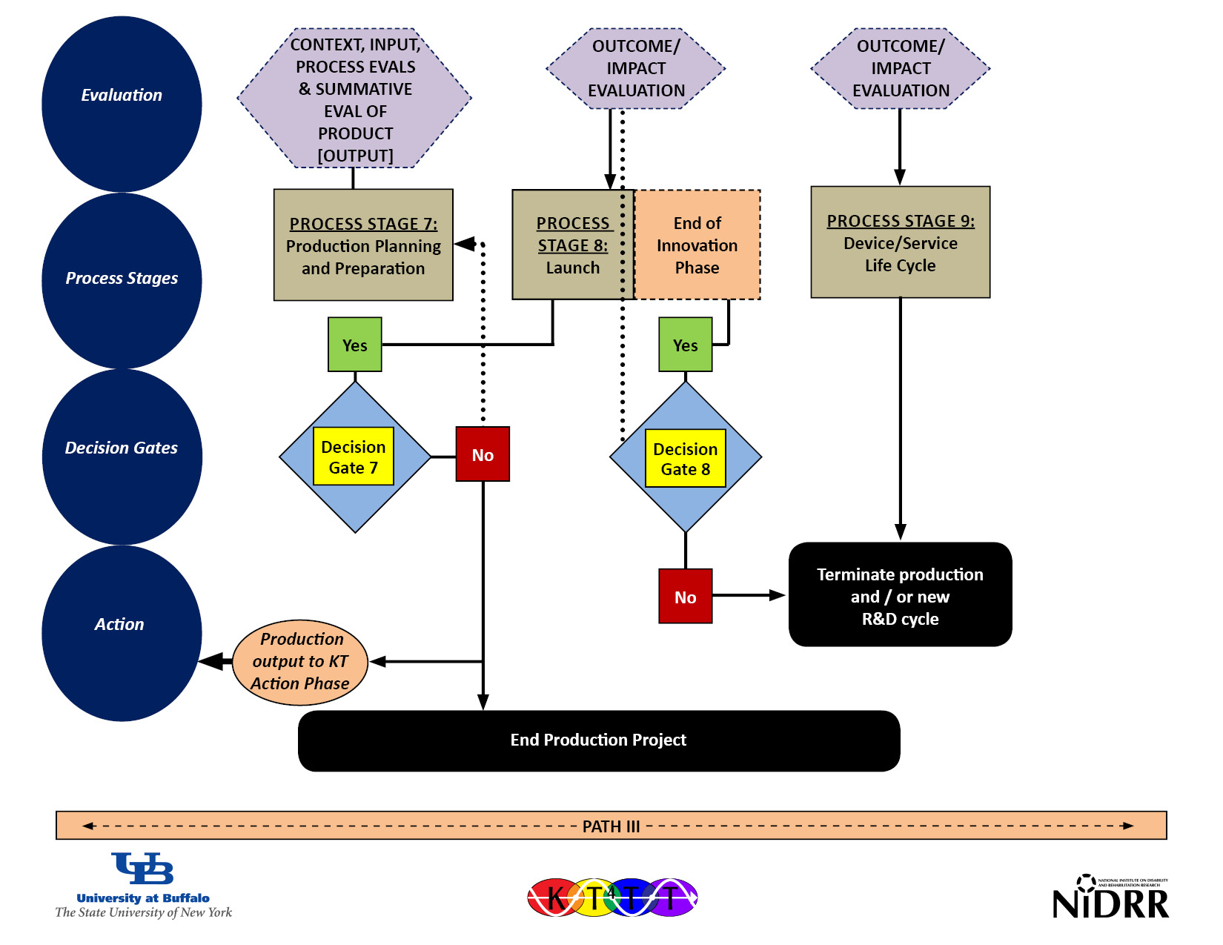
Evaluation, process stages, decision gate and action

Slide 18
Getting outcomes and impacts from R-D-P projects
Accountability: R output Vs. (R-D-P) outputs.
CIPP builds relevance into final output;
Bridge to outcomes and impacts is implicit .
Projects need an additional tool -the logic model (Wholey, 1987, 2004; McLaughlin and Jordan, 1991, 2004)

Slide 19
Implications of KT for the Logic Model

Slide 20
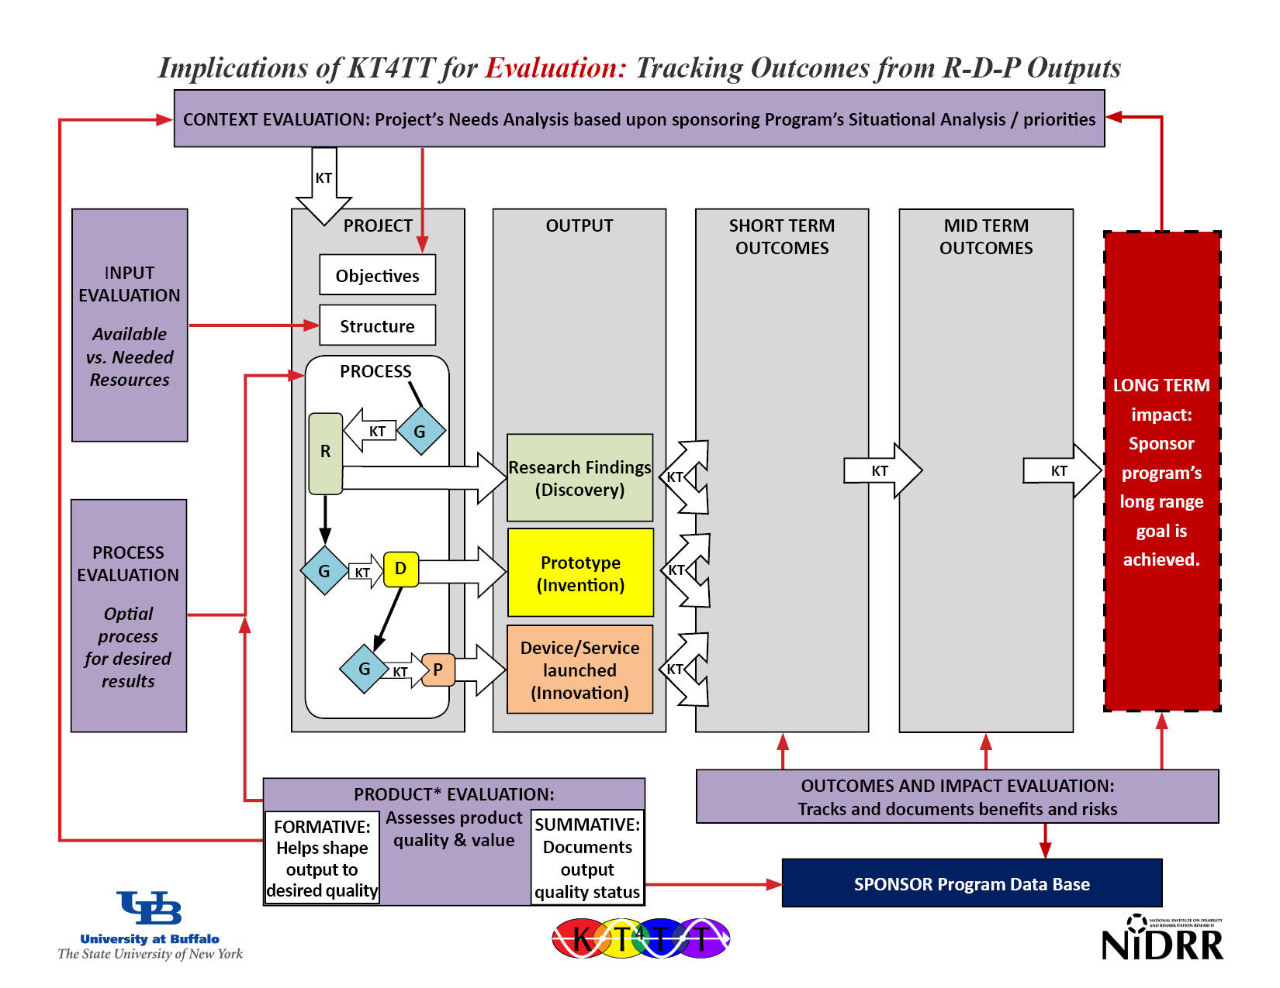
Implications of KT4TT for evaluation

Slide 21
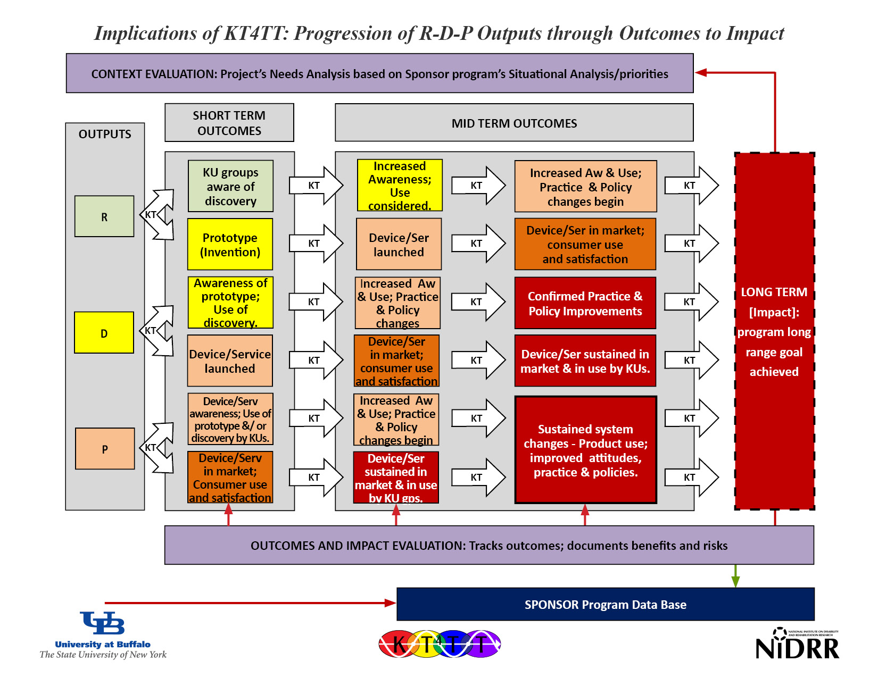
Implications of KT4TT

Slide 22
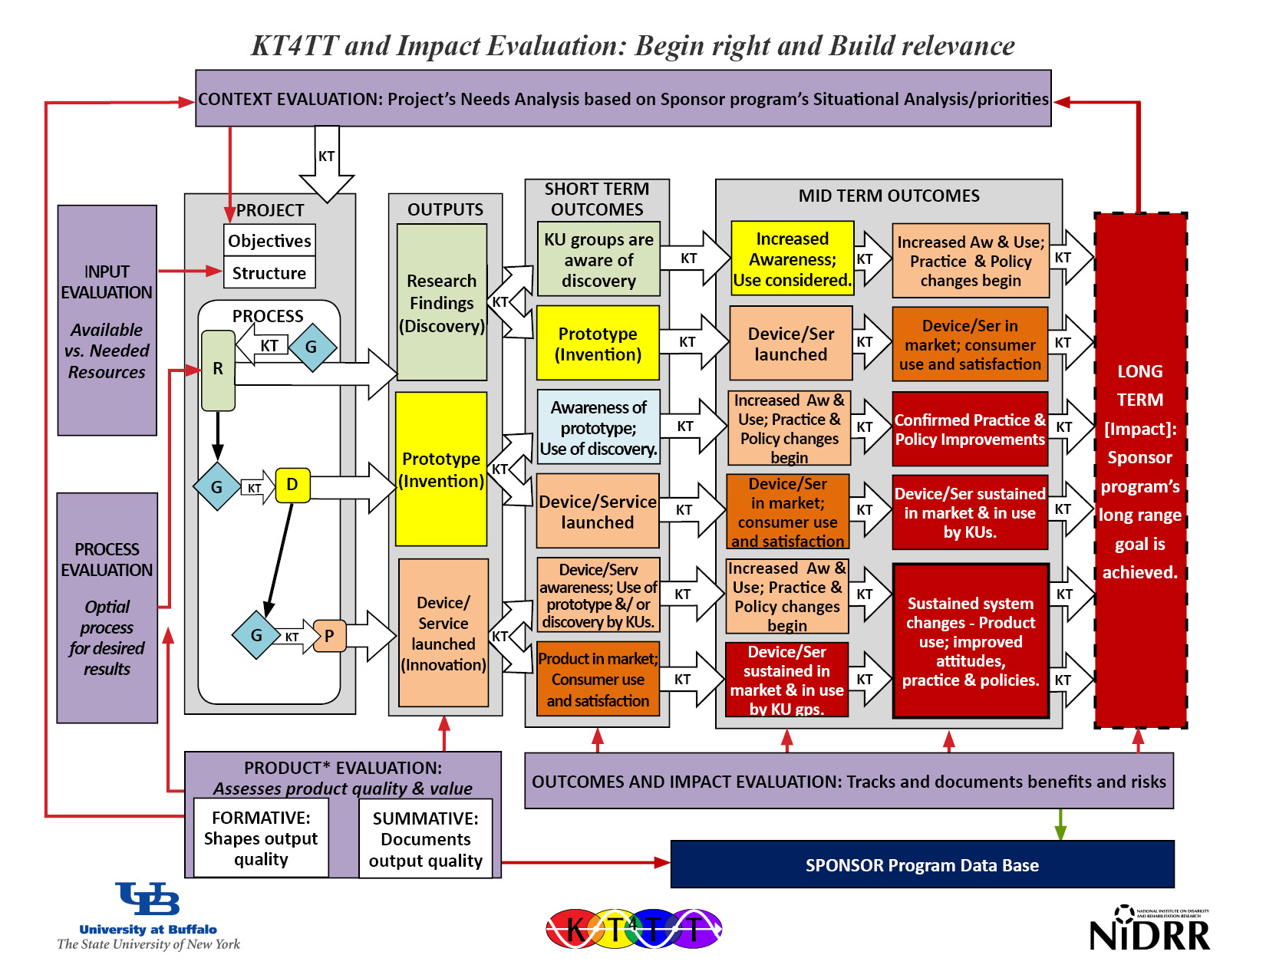
KT4TT and impact

Slide 23
Final Considerations
Funded Project’s Context Evaluation has a significant role:
Point of intersection with Funding Program;
Begin there to ensure relevance;
Beginning right is a big part of achieving impact.

Slide 24
Final Considerations
2. Funding Program’s Situation Analysis has a leading role:
Point of intersection with funded projects;
Evidence base for RFP & Grant review criteria;
Orient grant proposals for relevance
Define Impact Indicators & Collect data from projects

Slide 25
References
http://kt4tt.buffalo.edu/knowledgebase/model.php
CIHR. About knowledge translation. Retrieved October 25, 2009, from http://www.cihr-irsc.gc.ca/e/29418.html
Graham, I.D., Logan, J., Harrison, M.B., Straus, S.E., Tetroe, J., Caswell, W., & Robinson, N. (2006). Lost in translation: time for a map? The Journal of Continuing Education in the Health Professions, 26(1), 13-24.
Lane, J.P. & Flagg, J.L. (2009). Translating three states of knowledge: Discovery, invention & innovation. Manuscript submitted for publication.
Sudsawad, P. (2007). Knowledge Translation: Introduction to Models, Strategies, and Measures. Austin, TX. Southwest Educational Development Laboratory (SEDL), National Center for the Dissemination of Disability Research (NCDDR).

