Slide 1
Talking to Sharks and Angels: What You Need to Know!
Jennifer Flagg
James A. Leahy
Center on Knowledge Translation for Technology Transfer,
University at Buffalo
http://sphhp.buffalo.edu/cat/kt4tt.html
8:00 – 9:00 a.m.
February 3, 2018
ATIA, Orlando Florida

Slide 2
Acknowledgement:
The contents of this presentation were developed under a grant from the National Institute on Disability, Independent Living, and Rehabilitation Research (NIDILRR grant number 90DP0054-01-00). NIDILRR is a Center within the Administration for Community Living (ACL), Department of Health and Human Services (HHS). The contents of this presentation do not necessarily represent the policy of NIDILRR, ACL, HHS, and you should not assume endorsement by the Federal Government.
Speaker Disclosures:
The speakers are employed by the University at Buffalo’s Center on KT4TT, and Ms. Flagg has a non-financial relationship with ATIA’s journal Assistive Technology Outcomes and Benefits.

Slide 3
Key Learning Objectives
1: Learn how to create a project summary and a short product pitch.
2: Access four assistive technology industry profiles.
3: Learn to create a competing products matrix to highlight a product’s advantages over competitors.

Slide 4

Talking to Manufacturers and Investors
Need to know What to Say, How to Say it, and When to Say it.
To answer those questions you must know your audience and what motivates them.
Need to do your due diligence research on your target audience.
Example for the Mfg. group, there are many questions to ask.
Next, what motivates this stakeholder group?

Slide 5

Importance of Terminology
‘What to Say’ ? – what terminology will work in a certain industry or with a certain stakeholder group?
Universal Design – end goal.
Term Transgenerational Design – used to increase accessibility and usability.
Transgenerational Design – market broadening and creating a product that spans the ages from children to older adults.

Slide 6

Key Element in a Pitch or Commercialization Package
Key element is the ‘Hook’.
What is the ‘Hook’ and how do you develop it?
‘Hook’ is something that gets your audience interested, invested, and enthused about what you are presenting.
‘Hook’ is developed with knowledge of your research findings and what will motivate the stakeholder group you are targeting.
Wallpaper77.com

Slide 7
Contextualized Knowledge Translation Packages
CKP examples are available on our web site. Each package had a specialized ‘Hook’ developed for a specific stakeholder group.
Packages were developed for an AAC research finding, a Wheeled Mobility research finding, and an Exercise Technology research finding.
Examples can be found at: http://sphhp.buffalo.edu/cat/kt4tt/projects/past-projects/kt4tt-2008-2013/research-projects/case-studies-materials.html

Slide 8
Knowledge Translation Packages
Do they work?
Yes!!! They do!
AAC Mfg. commented the following when he received a CKP on an AAC research finding we presented…
“The CKP is well written and structured in a way that relates to AAC manufacturers. The need is articulated very well. The Technology Description and the links to the website were helpful in giving a sense of the degree to which these topics have been researched and the breadth of the solution.”

Slide 9
Developing a Knowledge Translation Package
How does one go about writing a CKP?
First Step is to develop a 60 second or less ‘Elevator pitch’ on your research finding.
This short presentation will force you to present and make your case for you research findings in a brief, concise, manner.
Example of an ‘Elevator Pitch’ that was successfully used can be found on our website under Getting to Market at: http://sphhp.buffalo.edu/cat/kt4tt/technical-assistance-and-resources/getting-to-market.html

Slide 10

Contextualized Knowledge Translation Packages
‘How to Say It’ in a CKP?
Be cognizant of your approach methods…
Want to be Perceived as a resource…
Incorporate Scenarios or Examples…
Example: AAC Writer’s Brigade.
AAC Writer’s Guide for Individuals and Organizations.

Slide 11

Contextualized Knowledge Translation Packages
‘When to Say It’….
Be cognizant of trade show schedules, conference schedules, academic breaks, fiscal years, new product introduction schedules, when product development teams are formed.
Examples: Wheeled Mobility area – new product introductions – Medtrade, International Seating Symposium (ISS).

Slide 12
Executive Summary Section in a CKP
Variations of Summary dependent upon stakeholder group and purpose (license, information for consumer, etc.) for CKP.
For a Manufacturer CKP brief paragraphs will include:
Product Need Area
Product Solution – your research findings, invention or methodology
Target Market / Market Size
Business Opportunity for Mfg.
Marketing Strategy
Intellectual Property Status
Consumer Information (involvement in development or purchase intent price point information)

Slide 13
Background / Current Situation
Optional section
Details current status and current state of the science.
For an invention, details how target market is currently addressing or not addressing the need.
For an invention, details issues related to problems associated with the defined need.
Requires target market interaction – primary market research.

Slide 14
Summary
Learning the method and medium for communicating with manufacturers and investors to generate interest in your project/ product.
CKPs can be useful tools for communicating with manufacturers and investors. But, you must do your homework to develop a useful CKP.
Goal is to benefit the target population and Make a Difference with your work!!!

Slide 15
Crafting your CKP and Pitch
Technology Transfer Planning Template
Industry Profiles
Competing Product Matrix
Notes:
In his summary, Jim mentioned that you’ll have to do your homework to create a CKP. Even with the sample CKPs as an outline, you may be unsure about how to find the content to craft your own CKP. So now we’ll talk about a few tools and resources you can use to answer important questions, create compelling pitches, and document your plans. Today we’ll delve into our TTPT, IPs, and look at a few ways to document competing products and your competitive advantage with a matrix.

Slide 16
Technology Transfer Planning Template
TTPT is an online planning tool that asks important questions and provides resources for crafting informed responses. The TTPT can help you create:
Project Summaries- contain basic information, useful for creating value propositions
Technology Transfer Plans- detailed plans- use to articulate current status
Commercialization Plans (SBIR Phase II)- use to demonstrate commercial viability
Notes:
First the TTPT. The TTPT helps to ensure that you’re asking the right questions, and that you have access to other resources that can help you answer those questions. When I say “the right questions,” I’m referring to questions that you yourself should be thinking about as you embark on the path of NPD; and also those questions that an investor or partner would want to hear about before committing their own resources (time and/ or money) to your project.
In terms of resources, the TTPT offers links to more than 50 tools that can be used in your NPD process, and also links to sources of demographic information.
The template is structured in three parts. The first asks for high-level details of your project, and produces a project summary. The second asks for more detailed information about your development plans, the target market, other stakeholders, and competing products. The third asks about production plans. Completing parts 2 and 3 generates two additional reports- a technology transfer plan and a commercialization plan.

Slide 17
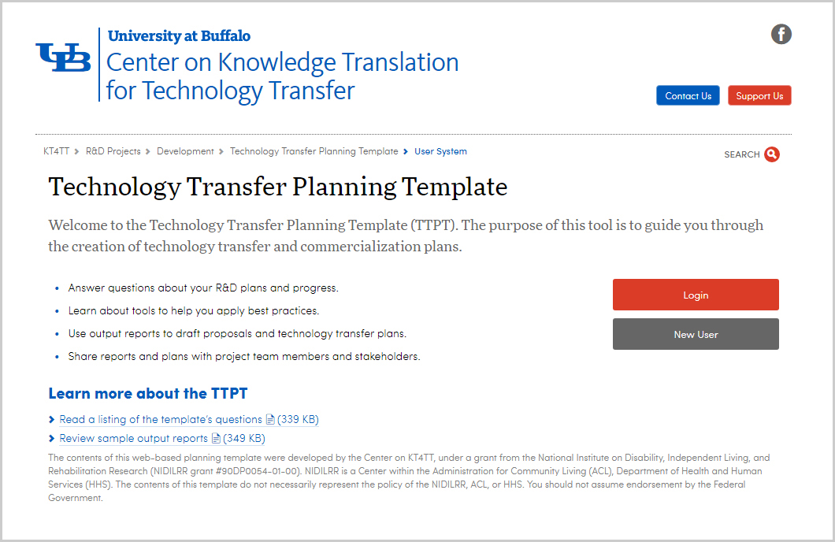
TTPT

Slide 18
What are the Key Questions?
What are you developing and why?
What is your planned role in the project?
How will the product get to the marketplace?
Who are the product users/prescribers/buyers, and how big is the market?
What competing products/ alternatives are used and why is your solution superior?
How much money can be made?
Notes:
So, what are the key questions that an investor would want to have answered? In a nutshell, they are…
These questions and responses are useful for establishing your own plans internally, and also for communicating with external stakeholders, such as potential collaborators or investors. The first three questions here are relatively straight-forward, though not always considered by inventors.
Keep in mind that the questions about your planned role and how the product will get to the market involve not only considering your own capabilities, but those of whatever team or group of partners you are bringing on board.
The next three are loaded questions, in that they require secondary research to answer, and this is where some of the other tools will come in handy. The TTPT asks pointed questions about each of the groups of important stakeholders (user, prescribers, buyers), and also provides links to resources where you can find statistics related to these target populations, which can be used to estimate market size and growth.
The question about how much money can be made is also a tricky one, in that it will depend on the market share you’re able to capture. However, in all cases, it’s important to understand the costs of producing, packaging, marketing, selling, and servicing your product before you estimate price. If you cannot cover your costs at a profit, there will be little incentive for others to join in on your endeavor.

Slide 19
TTPT Target Market Questions
Describe and quantify the size of the target market.
Describe the geographic area where the target market is located, including if the target market is domestic or international.
In what setting will the target market use the product?
Describe growth trends regarding the size of the target market.
Describe anticipated changes to rate of demand over time.
Notes:
These questions are drawn from Part 2 of the TTPT, and expand on the questions regarding who are the product users/ prescribers/ buyers and how big is the market?

Slide 20
TTPT Resources- Target Market
Resources: Links to disability statistics websites.
http://www.disabilitystatistics.org
http://disabilitycompendium.org
http://www.cdc.gov/ncbddd/disabilityandhealth/dhds.html
Repository of National/ international surveys on disability: http://disabilitysurvey.checkdesign.de
Industry Profiles: Information on market size, market segments and available products.
Vision(358 KB)
Education Technology(2.9 MB)
Wheeled Mobility(4.1 MB)
Cognition
Examples:
Sample Marketing Report(330 KB)
Sample Phase II SBIR Proposal(528 KB)

Slide 21
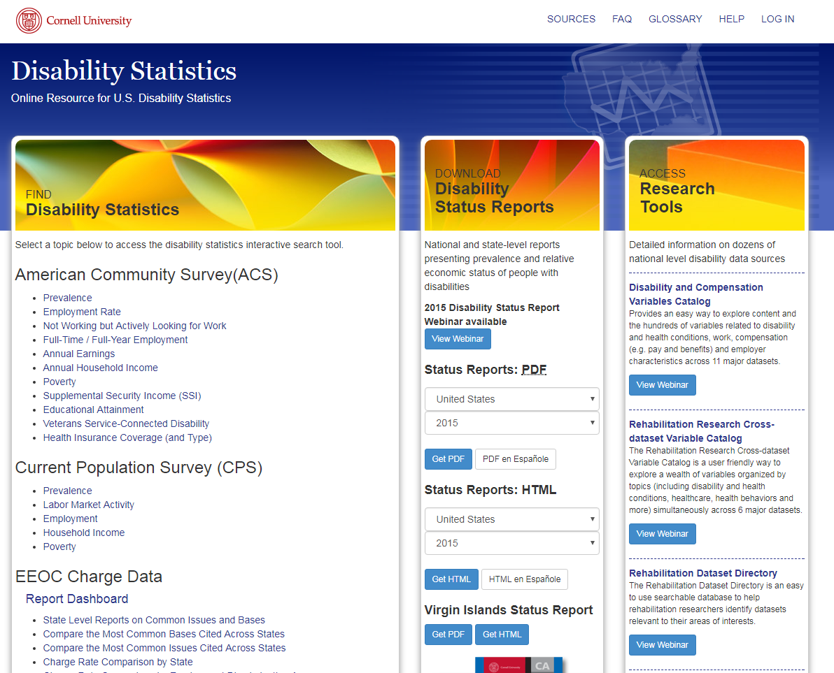
Target Market Statistics

Slide 22

Industry Profiles as a Resource
Information on market size, market segments and available products.
Vision Education Technology Wheeled Mobility Cognition

Slide 23
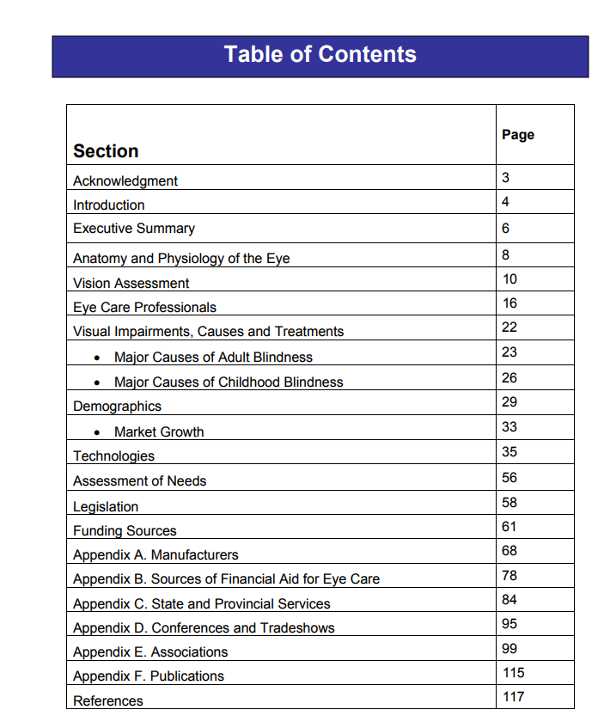
Vision Industry Profiles Sections
How big is the target market?
What products are currently on the market?
What legislation might impact purchase decisions?
Who are the major players?

Slide 24
Cognition Industry Profile Sections
Part 1- Insights from Industry
Manufacturers’ perspectives on working with grantees and inventors, and opportunities to conduct R&D.
Answer the question “What are we developing and why?”
Part 2- Sources of Demographic Information
Locate resources that will help you better understand and describe a particular target population.
Answer the question “How big is the market?”
Part 3- Company listing
Review companies and their product lines to identify collaborators and competitors.
Answer the question “How will the product get to the marketplace?”

Slide 25
Documenting Competing Products
Goal is to answer the question “What competing products/ alternatives are used and why is your solution superior?”
Industry Profiles
Competing Products Search Guide
Exploring the internet
Searching catalogs
Visiting stores
Talking to users

Slide 26
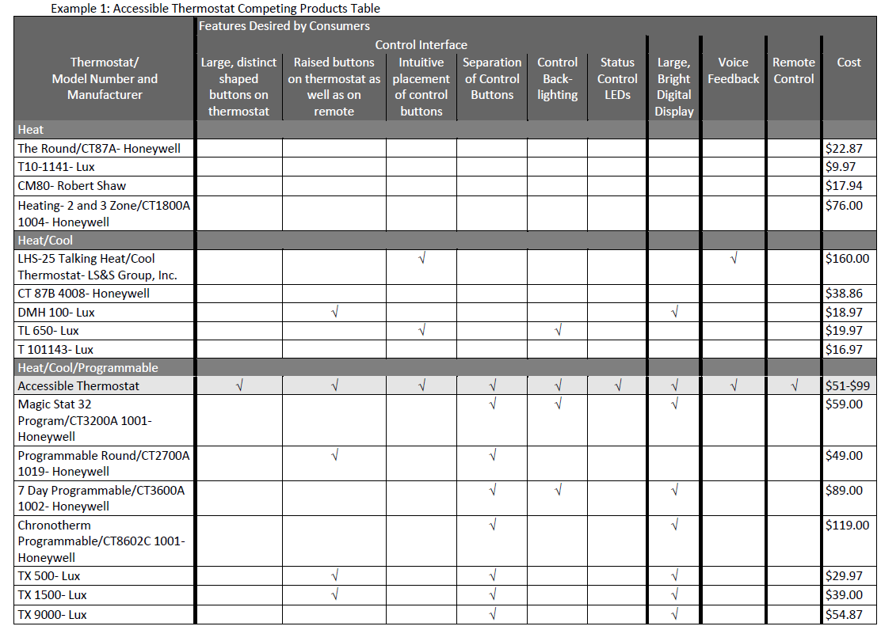
Matrix to Highlight Product Advantages

Slide 27
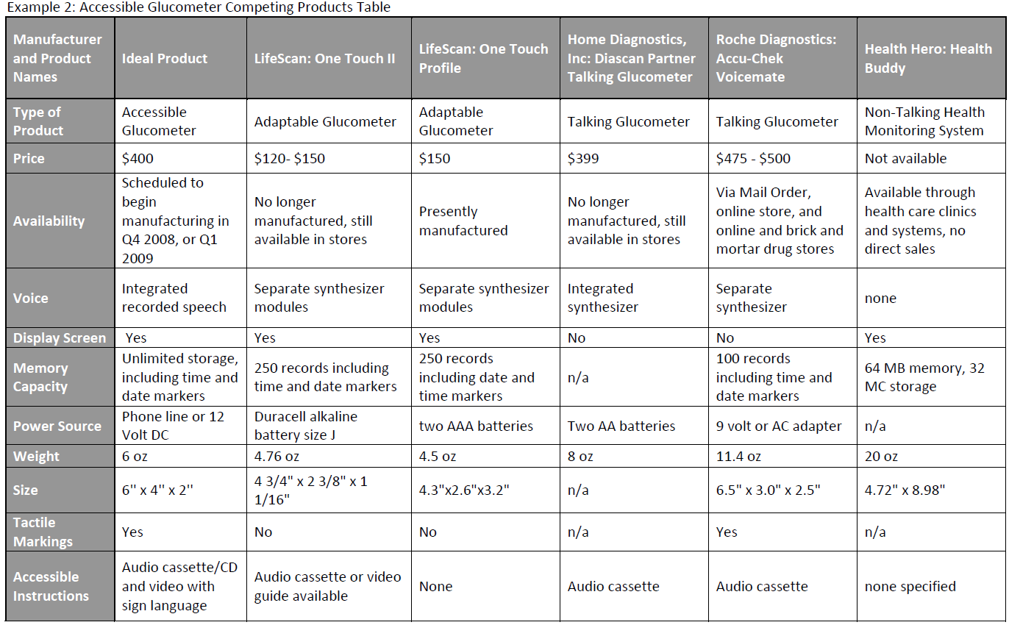
Matrix for Design / Development Decisions

Slide 28
Competing Product Resources
Chronological Guide for Inventors- Day by day guide for inventors, detailing what to do and when.
Fundamentals of Inventing- Describes the basics steps an inventor should take when embarking on the development and commercialization of an invention.
Industry Profiles- Demographic information, listings of companies and descriptions of products, and insights from AT manufacturers.
Center on KT4TT Resources page- Links to presentations and documents related to transferring and commercializing AT devices.

Slide 29
Calculating Potential Profit
Revenue – Expenses = Profit
Many factors fall into the expenses category!
Production costs
Materials
Shipping costs to acquire inventory
Assembly
Marketing and sales
Distribution
After-sales service
Profit calculator- “Educational tool to help the individual innovator understand the global market potential and financial implications when exploring the different routes to take a new product idea to market.”

Slide 30
Making the Pitch
You’ve completed all of your “homework” and you’re ready to talk with potential partners or investors.
Now is the time to compile your CKP, and practice talking about all of the information you’ve gathered…
What you’re developing and WHY
How it will get to the marketplace
Size and trajectory of the market
Competitive advantages
What you are seeking from them
Potential return on investment

Slide 31
If at first you don’t succeed…
Learn from their questions to improve your next pitch.
Try, try again!

Slide 32
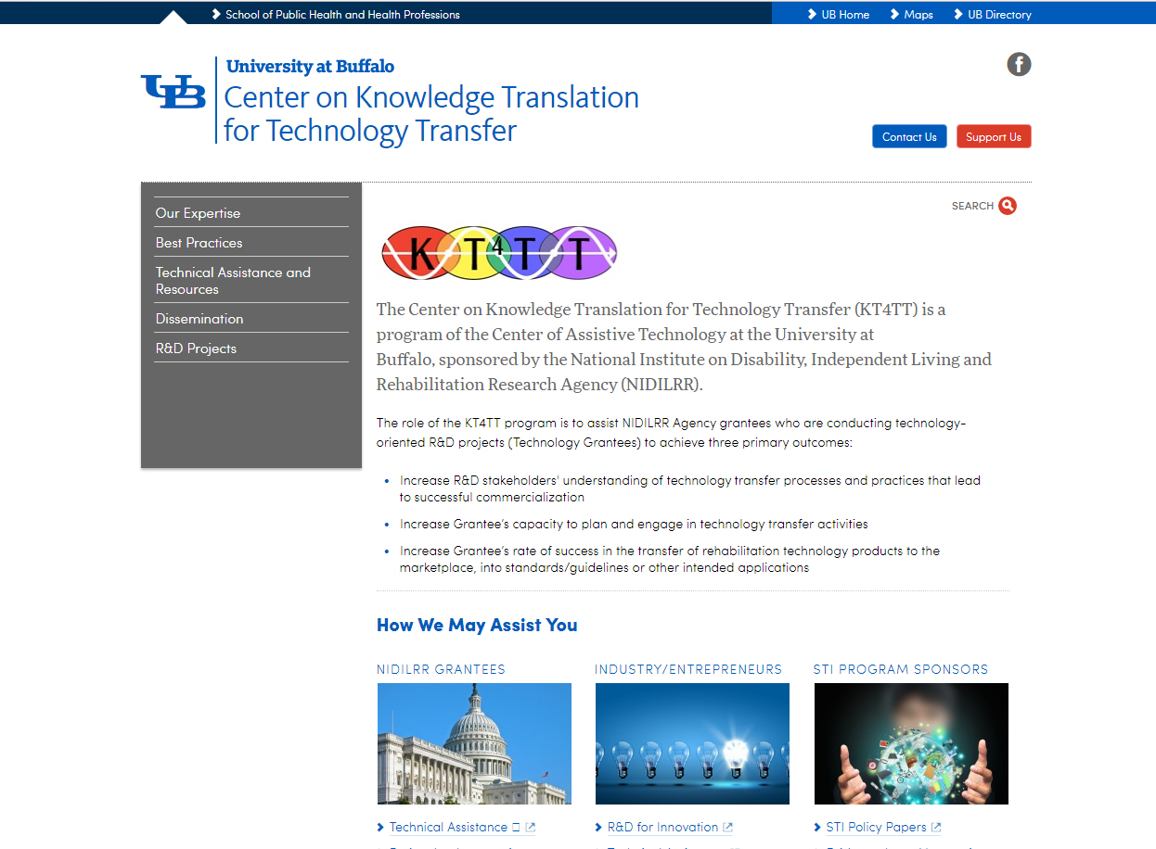
Summary
Visit the KT4TT web site for additional information, more examples and more resources.
https://sphhp.buffalo.edu/cat/kt4tt.html
Thank you!

Slide 33
Thank you for Attending!
CEUs: Session Code: RSCH-05
More info at: https://www.atia.org/conference/education-program/ceus/
Visit the information desk for more information on CEUs. ASHA and ACVREP forms must be submitted before departing the conference. AOTA and IACET forms can be submitted online.
ATIA is an Approved Provider for IACET and AOTA CEUs. Please note there is a $15 fee for AOTA CEUs.
Session Evaluation
Help us improve the quality of our conference by completing your session evaluation form in the mobile app.
Handouts
Handouts are available at: http://s3.goeshow.com/atia/orlando/2018/handouts.cfm
Handout link remains live for 3 months after the conference ends.

