Slide 1

HOW TO MARKET AN APP:
WHAT YOU NEED TO KNOW
James A. Leahy
KT4TT Center, University at Buffalo
http://sphhp.buffalo.edu/cat/kt4tt.html
1:00 – 2:00 p.m.
February 2, 2018
ATIA, Orlando Florida

Slide 2
KEY LEARNING OBJECTIVES
Explain the 4 reasons why an App fails in today’s marketplace
1
2
Identify 9 App marketing strategies appropriate for 2018
3
Identify 5 key factors in developing a budget for the development of a new App

Slide 3
AGENDA
1
Status of Apps
2
First major questions an App developer faces
3
Economics of marketing an app
4
App pricing strategy and app half life/decay
5
Wireless RERC’s App Factory
6
App Marketing Companies

Slide 4
APPS TODAY
2.8 million apps available for Android
2.2 million apps available for Apple IOS platform users
Millennials drive the app market
Social media apps and Amazon App are the most
frequently downloaded
FOMO drives app usage
21% of Millennials will delete an app because of an ugly logo

Slide 5
FIRST MAJOR QUESTIONS
AN APP DEVELOPER FACES

Slide 6

FIRST MAJOR QUESTIONS
How do I know if my app is worthwhile?
1
Does my app make sense?
2
How will I market my app?
3

Slide 7
FOUR REASONS AN APP FAILS
IN THE MARKETPLACE

Slide 8




WHY AN APP FAILS
Ignoring Platforms
Improper Testing
Poorly Researched Market/Audience
Poor User Experience

Slide 9
NINE STRATEGIES
TO MARKET YOUR APP

Slide 10

MARKETING STRATEGIES
1
Affiliate Marketing
2
App Store Optimization
3
Blogs and Multimedia
4
Internet Forums
5
Loyalty Programs

Slide 11
MARKETING STRATEGIES
6
Paid Advertising
7
Ratings and Reviews
8
Social Media
9
Public Relations (Press)

Slide 12
FIVE KEY FACTORS
IN DEVELOPING A BUDGET

Slide 13
BUDGETING
1
Development Priorities: Quality, Cost, Speed
2
In-House vs. Offshore Development
3
Waterfall vs. Agile Development Process
4
Fixed-Fee vs. Time-and-Materials Cost
5
Estimate Creation

Slide 14
PRICE STRATEGY
CONSIDERATIONS AND OPTIONS

Slide 15
PRICE STRATEGIES
FACTORS TO CONSIDER:
Purpose of
the app
Cost of creating
the app
Competitors apps
1
2
3
PRICING STRATEGIES:
1
FREE
2
3
4
FREEMIUM
PAID
PAIDMIUM

Slide 16
APP HALF LIFE AND DECAY
Half life: Point where an app has lost 50% of its monthly active users from the time of its highest number of users
Category | Median Half-Lifetime for App in months
News | 7
Health, Fitness, Medical | 6
Business and Communication | 6
Tools | 5.5
Travel | 4
Lifestyle | 4
Media | 4
Shopping | 4
Social | 3
Games | 2

Slide 17
WIRELESS INCLUSIVE TECHNOLOGIES RERC
APP FACTORY

Slide 18
APP FACTORY
“…promote access to and use of wireless technologies by people with disabilities and encourage the adoption of Universal Design approaches in future generations of wireless technologies”.
1
Bring highly talented and prolific private-sector developers into the process of designing apps that address AT user needs
2
Establish a “pay for performance” mechanism to encourage successful commercialization of useful apps.

Slide 19
APP FACTORY PROPOSAL
Must demonstrate a need that is not already addressed by an existing app
1
Developer must have the technical capacity to make it as well as have the available technology, time and money.
2
Show that the app is usable by the consumer, consumers like it and that it can have a lasting impact.
3

Slide 20
APP MARKETING
COMPANIES

Slide 21
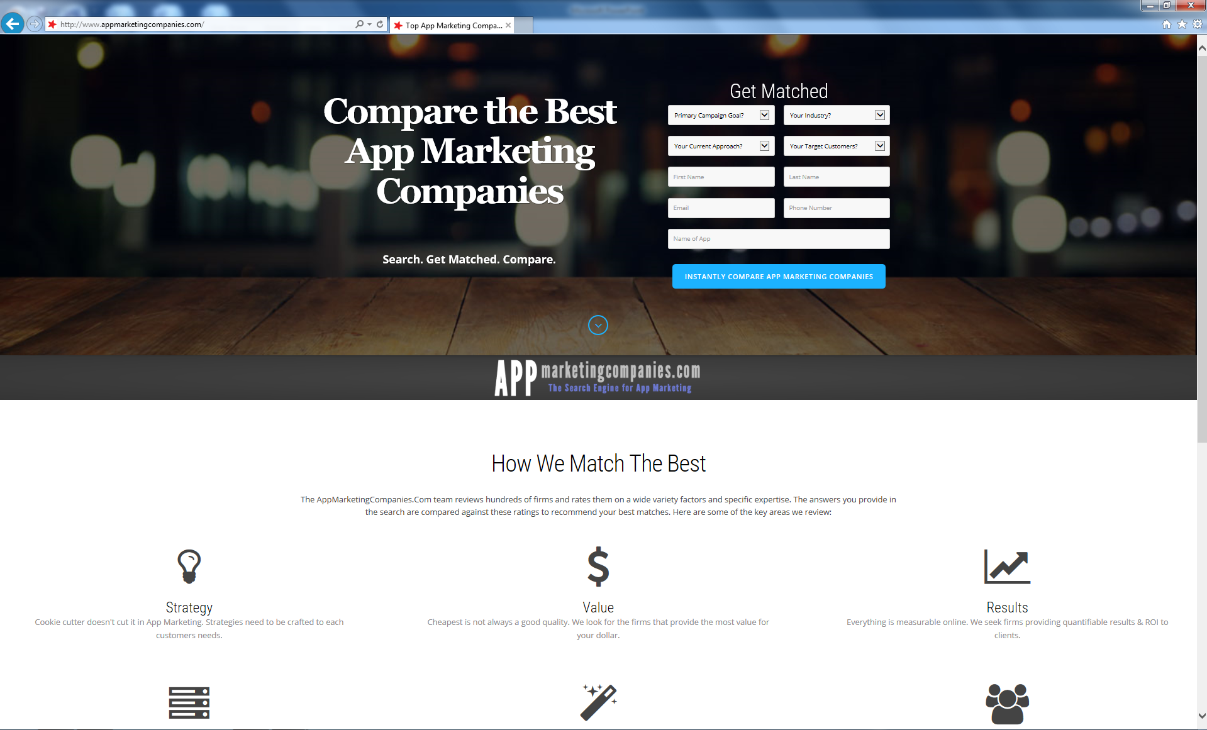
APP MARKETING COMPANIES
www.appmarketingcompanies.com

Slide 22
APP MARKETING COMPANIES
Company | Description
Apalon | App creation organization that focuses on marketing an app to make a consumer feel like the app will make their life easier.
AppMasters | App experts focusing on PR, content marketing, app store optimization and app store features.
Papaya Ads | Automated ad technology for global apps, games and e-commerce.
AppN2O | Creates a business mobile marketing strategy for your app to help increase consumers who discover your app.
Appular | iPhone marketing organization that specializes in competitive analysis, monetization strategies, and app placement.
App Annie | Delivers data and insights to succeed in the app economy.
Fetch | Full service mobile agency delivering global mobile media.
Yahoo Analytics | Multi-feature platform including analytics, publishing, in-app sharing and app marketing.
NativeX | Ad technology service for mobile games and apps.
Cheetah Media | Specializes in local market dynamics, traffic sources and audiences to ensure a return on mobile marketing investment.

Slide 23
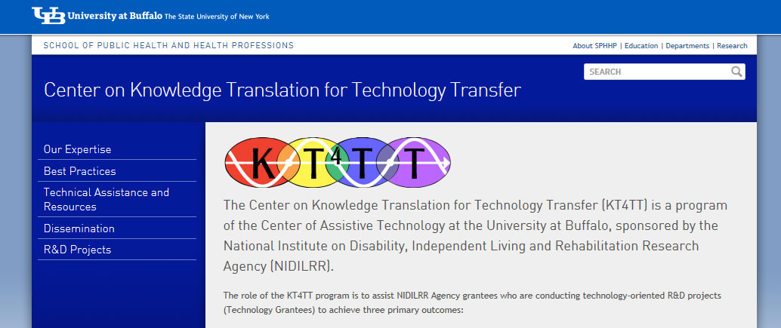
SUMMARY
Visit the KT4TT web site for additional information, more examples and more resources.
http://sphhp.buffalo.edu/cat/kt4tt.html
Thank you!

Slide 24
Thank you for attending!
CEUs: Session Code RSCH-04
More information at
https://www.atia.org/conference/education-program/ceus/
Visit the information desk for more information on CEUs. ASHA and ACVREP forms must be submitted before departing the conference. AOTA and IACET forms can be submitted online.
    ATIA is an Approved Provider for IACET and AOTA CEUs. Please note there is a $15 fee for AOTA CEUs.
Session Evaluation
Help us improve the quality of our conference by completing your session evaluation form in the mobile app
Handouts
Handouts are available at http://s3.goeshow.com/atia/orlando/2018/handouts.cfm
Handout link remains live for 3 months after the conference ends

Slide 25
ACKNOWLEDGEMENT
The contents of this presentation were developed under a grant from the National Institute on Disability, Independent Living, and Rehabilitation Research (NIDILRR grant number 90DP0054-01-00). NIDILRR is a Center within the Administration for Community Living (ACL), Department of Health and Human Services (HHS). The contents of this presentation do not necessarily represent the policy of NIDILRR, ACL, HHS, and you should not assume endorsement by the Federal Government.

