Slide 1
GRADUATE SCHOOL APPLICATION MANAGER
HOW TO COMPLETE THE APPLICATION: AN INSTRUCTIONAL GUIDE

Slide 2
Important contact information
For questions about volunteer hours, the application process or how to complete the application you can contact:
Jaclyn Levesque
Admissions & Enrollment Coordinator
jl388@buffalo.edu
For questions about the program, or to request course approvals, you can contact:
MaryAnn Venezia
Coordinator for Professional Programs
venezia3@buffalo.edu

Slide 3
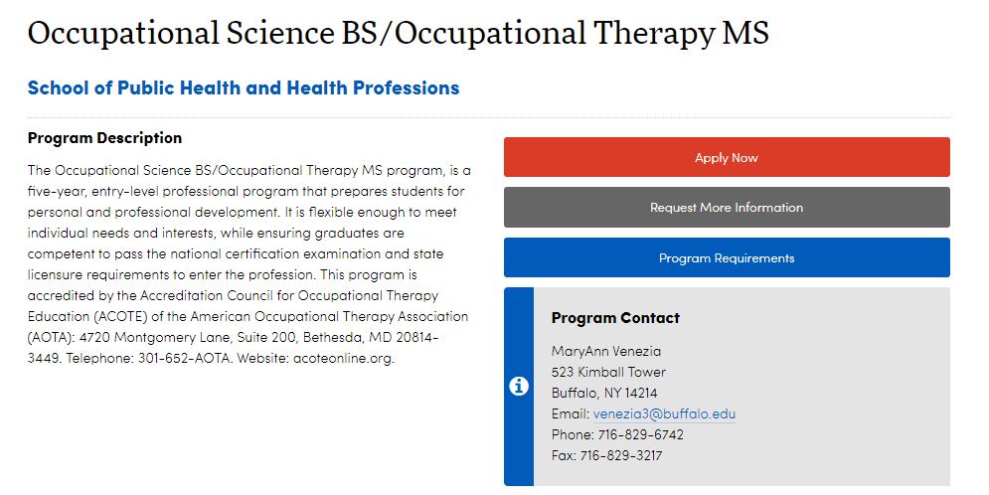
WHERE CAN I FIND THE APPLICATION?
The simplest way to access the application is by clicking this link:
https://grad.buffalo.edu/programs/occupational-science-bs-occupational-therapy-ms.html

Slide 4
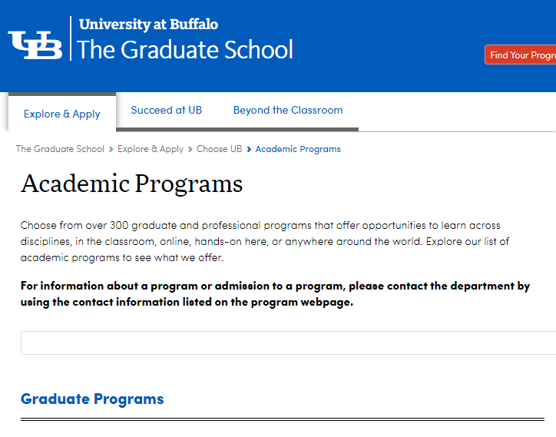
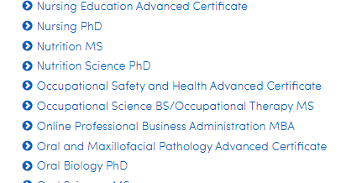
You will then be led to The Graduate School Academic Program page. On this page, you will see a list of Graduate Programs to select from. Scroll down until you see Occupational Science BS / Occupational Therapy MS.
What to select

Slide 5
TECHNICAL STANDARDS
It is important to read and understand the Technical Standards prior to applying to the Occupational Therapy program.
You will need to sign and submit your understanding of the Technical Standards by uploading your signed document in your application.
You can access this information in the Pre-Major Handbook which can be found online at:
https://sphhp.buffalo.edu/content/dam/sphhp/rehabilitation-science/ot-premajor-handbook.pdf
Signing the Technical Standards form indicates that you have read it and also indicates what level of accommodations, if any, that you require.
Your signature means that you also agree to the requirements listed on page four of the Technical Standards.

Slide 6
VOLUNTEER FORMS / VOLUNTEER PLAN
The volunteer form can be found online at:
  https://sphhp.buffalo.edu/content/dam/sphhp/rehabilitation-science/pdfs/OT-Volunteer-Hours-Form.pdf
Your volunteer form or volunteer plan MUST be uploaded in your application by January 12th.
If your volunteer form has already been submitted to our office, it will be uploaded to your application AFTER all applications have been submitted in January.
If you have previously applied and submitted volunteer hours and would like them brought forward, send an email request to Jaclyn Levesque, Admissions & Enrollment Coordinator at: jl388@buffalo.edu.
Forms MUST be signed by an OTR, OTR/L, OTA or COTA.

Slide 7
VOLUNTEER FORMS – Continued
If you are applying for 2024 admission, your volunteer hours must be completed between January 12, 2021 and January 12, 2024.
The Total Number of Hours MUST BE COMPLETELY FILLED IN. This line CANNOT BE LEFT BLANK.
**No part of the volunteer form can be left blank or it will be considered incomplete.**
Supplemental paperwork attached to your volunteer form DOES NOT REPLACE the volunteer form.
35 hours must be completed.
You may volunteer in no more than 3 sites to meet the 35 hour requirement.

Slide 8
THE APPLICATION

Slide 9
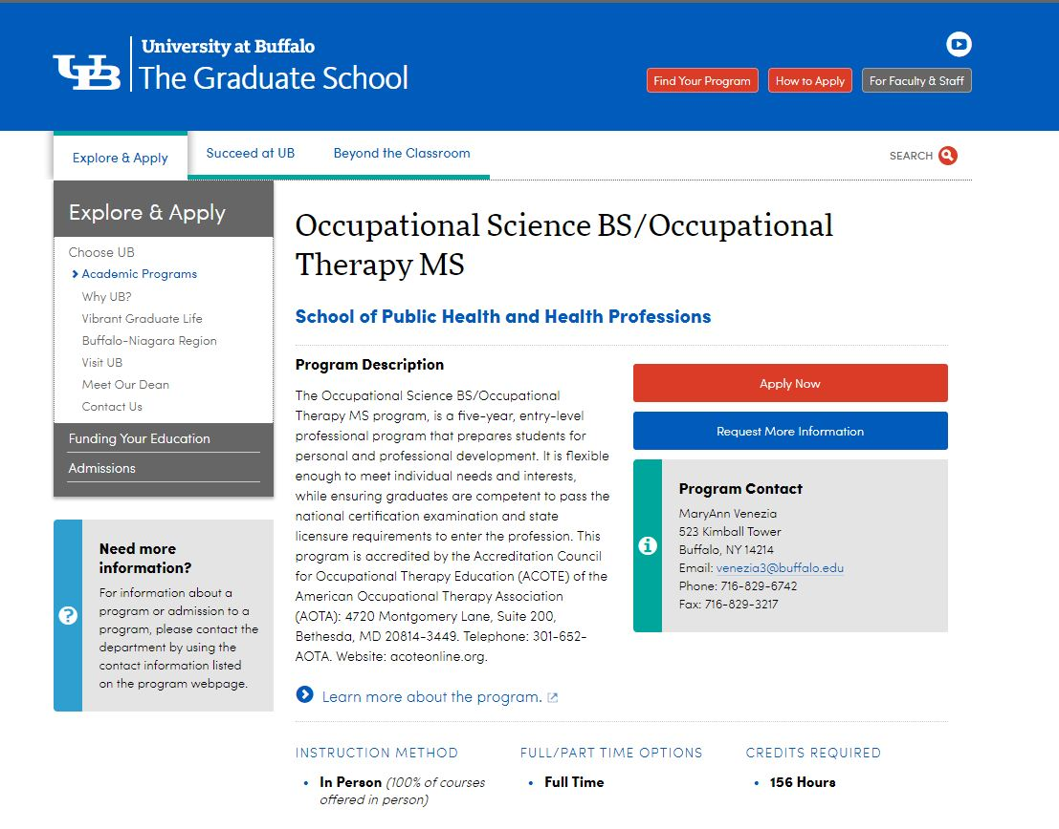
ACCESSING THE APPLICATION
THE APPLICATION WILL NOT BE VISIBLE FOR YOU UNTIL DECEMBER 28.
GO TO: https://grad.buffalo.edu/programs/occupational-science-bs-occupational-therapy-ms.html
Click “Apply Now”

Slide 10
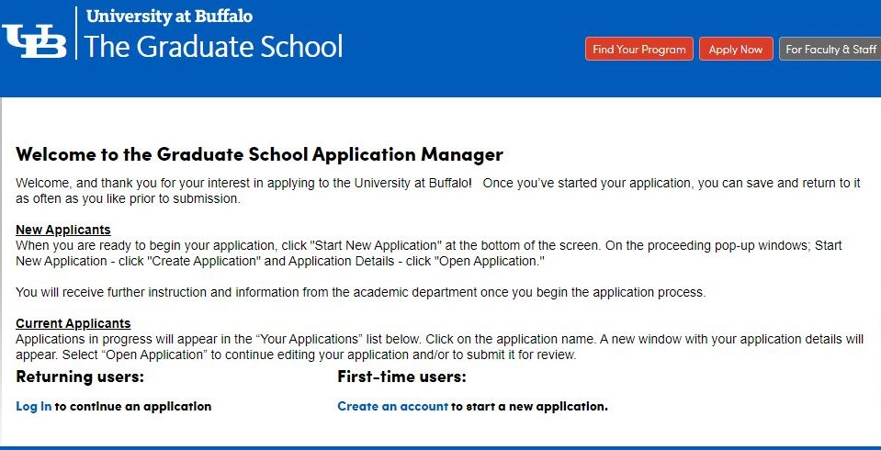
GETTING STARTED
You will need to Create an account using your @buffalo.edu email

Slide 11
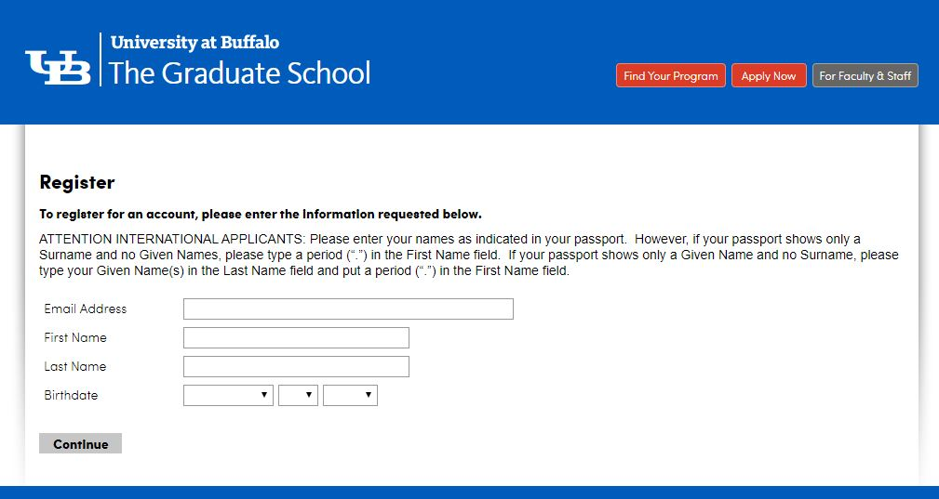
You MUST use your @buffalo.edu email. THIS LINKS TO YOUR HUB!
Be sure to put in your correct birthdate

Slide 12
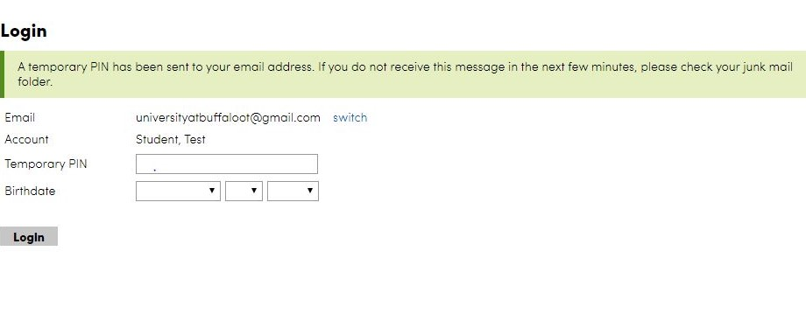
After you input your information on the first screen, you will be sent a temporary PIN. You will need that PIN
in order to begin the application.
You will also need to be sure to input the same birthdate information that you entered on the previous screen.
If you input the wrong birthdate, we have no way to correct that.
It is imperative that you carefully review the information that you input.

Slide 13
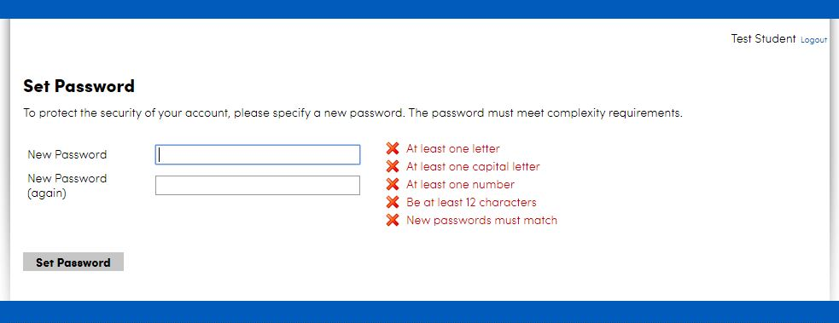
You will be prompted to create a new password on the next screen.
Be sure to SAVE this information somewhere for reference!

Slide 14
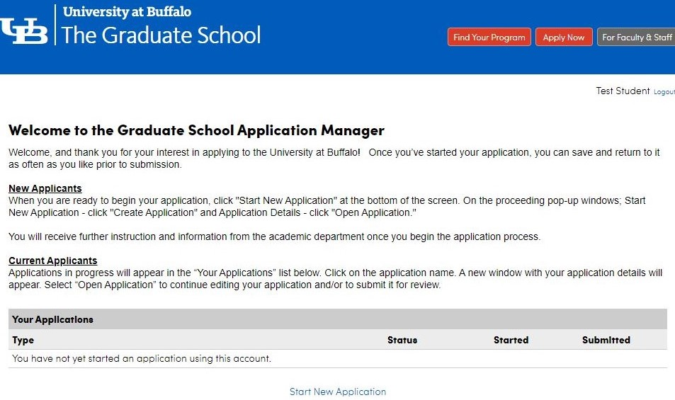
Click “Start New
Application”

Slide 15
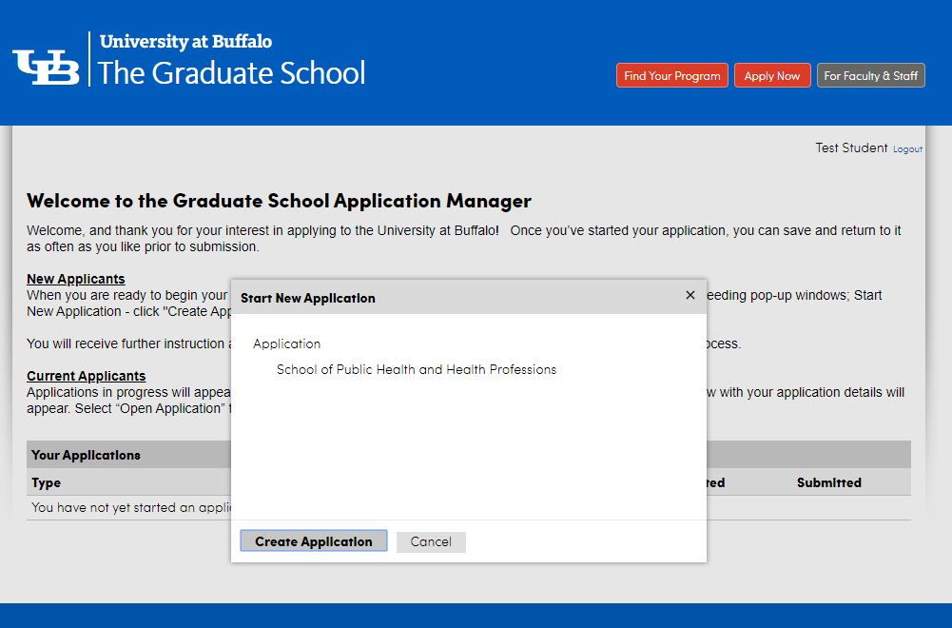
You will complete the application called “The School of Public Health and Health Professions”
You will click “Create Application”

Slide 16
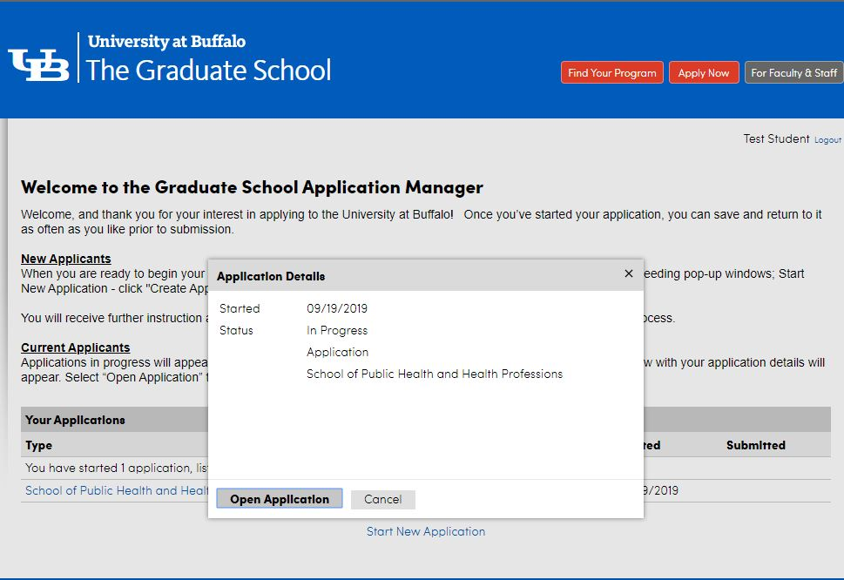
Once you create your application, an Application Details screen will pop up. You will then need to click “Open Application”

Slide 17
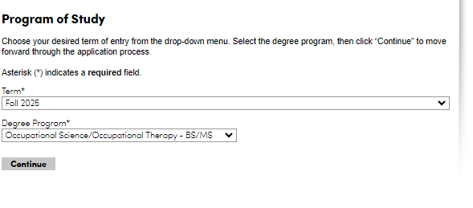
Once you open the application, you will go through each of the headings located on the left hand side.
In the first heading, “Program of Study”, for the Term, you will select: “Fall 2025” That is the ONLY way you will see the application.
The Degree Program you will see is: “Occupational Science/Occupational Therapy – BS/MS”

Slide 18
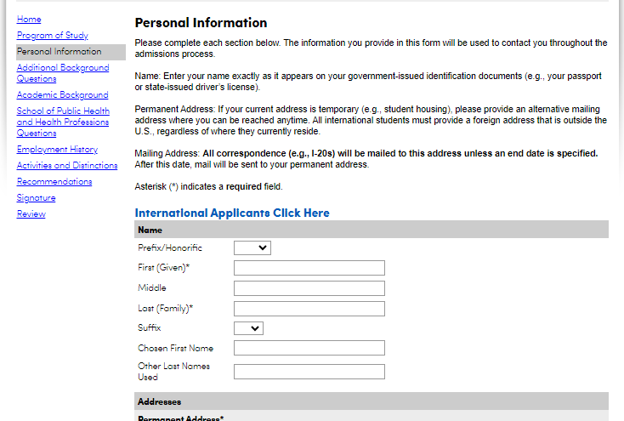
PERSONAL
INFORMATION
You will then begin completing the section labeled: “Personal Information”
Key things to be aware of:
The “chosen first name” is your Preferred Name in hUB.
There are a variety of questions that are optional. They are marked.
All information submitted is private.

Slide 19
INTERNATIONAL
APPLICANTS
If you are an international student, you will need to click on the link labeled “International Applicants Click Here”.
Within the application, you will have an additional tab to complete.

Slide 20
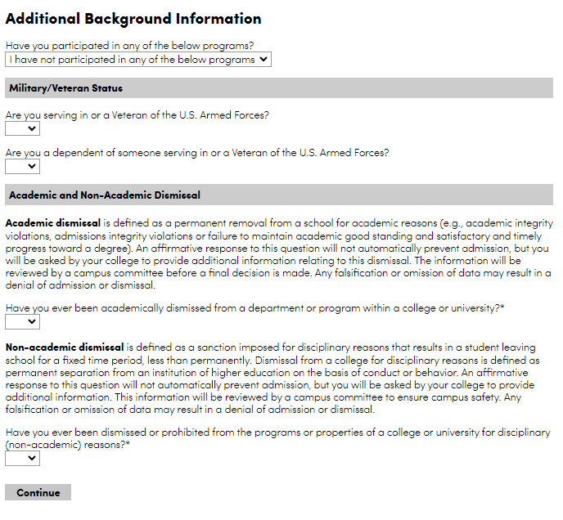
ADDITIONAL BACKGROUND INFORMATION
In this section you will provide information on:
If you partake in any EOP, HEOP, SEEK programs, etc.
If you are in the military or are a veteran.
If you have ever had an academic or non-academic dismissal.

Slide 21
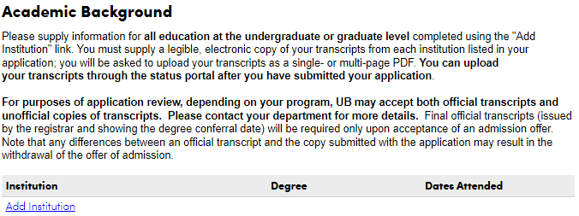
ACADEMIC BACKGROUND
This section is required and must be completed.
All applicants must complete this section.

Slide 22
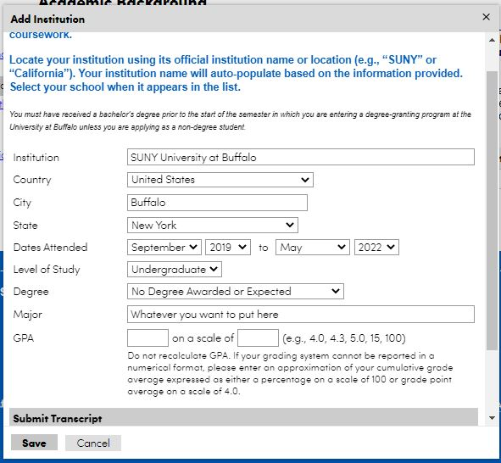
ACADEMIC BACKGROUND
Enter your UB information ONLY.
As you type, the application will provide name suggestions. Select “SUNY University at Buffalo “ from the drop-down option provided. If you don’t, the section will not autofill – it MUST autofill!
In the “Dates Attended” Section, please fill in the following
The Month/Year you started at UB to May 2023
Major: Add your current major
In the “Submit Transcript” section please upload your AAR.
Directions on how to access your AAR can be found here:
https://registrar.buffalo.edu/hub/aar.php
2020
2023
Bachelor of Science

Slide 23
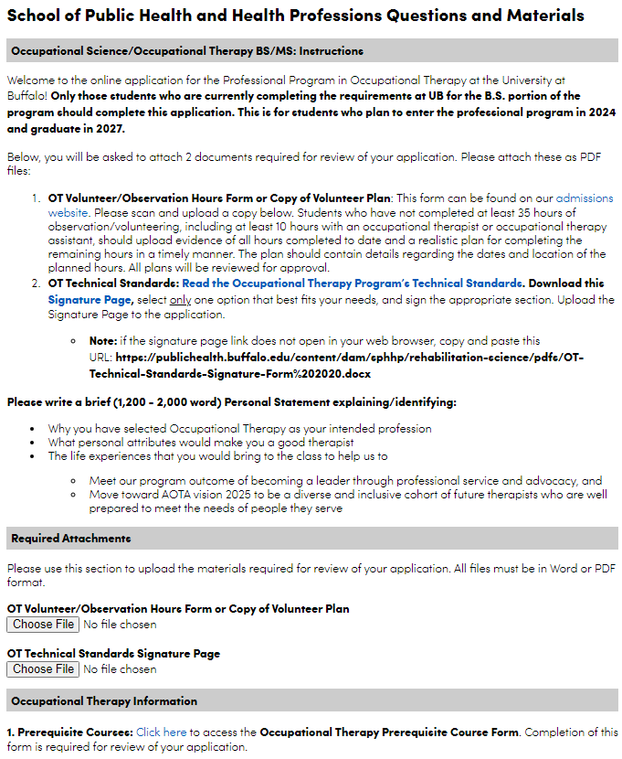
SCHOOL OF PUBLIC HEALTH & HEALTH PROFESSIONS QUESTIONS
In this section, you will upload the following:
Your volunteer form or volunteer plan
Signed Technical Standards form.
You will also provide your personal statement.
In this section, keep your AAR handy to reference it – you will need it when completing the “Prerequisite Course Form”
On this form, you will be inputting your course grades and course credits in this section.
You will also be adding your personal statement on this form.

Slide 24
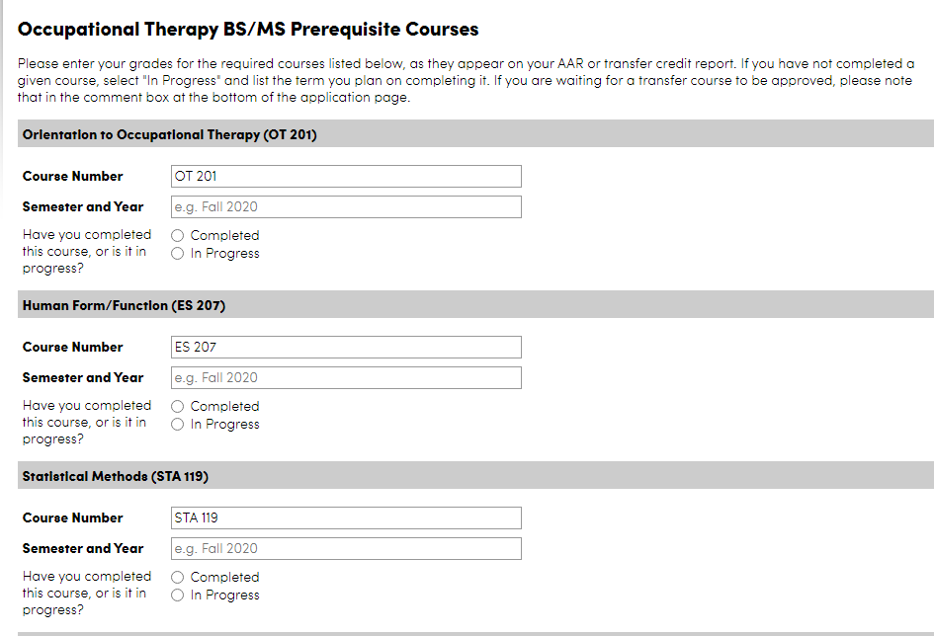
SCHOOL OF PUBLIC HEALTH & HEALTH PROFESSIONS QUESTIONS
OT PREREQUISITE COURSE FORM:
When you click to view the Occupational Therapy BS/MS Prerequisite Course Form
It will bring you to this page. Here, you will input the classes as they appear on your AAR.
If you are taking courses this fall, select “Completed” (by that time you will have your grades to input)
If you are taking them in the spring, select “In Progress”
When finished inputting, click “submit”. If not, click “save for later”

Slide 25
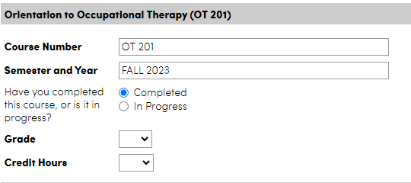
SCHOOL OF PUBLIC HEALTH & HEALTH PROFESSIONS QUESTIONS
OT Prerequisite Course Form
Course Number will be pre-populated – this can be changed if you have taken an alternate (ex: instead of STA 119, you took PSY 207 – you can enter that information here.)
You will need to input the semester and year you have taken or intend to take the course
If you have taken a course & select “Completed”, a “Grade” field and “Credit Hours” field will appear for you to fill in

Slide 26
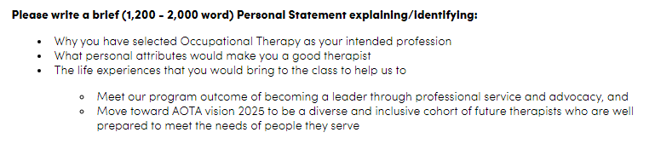
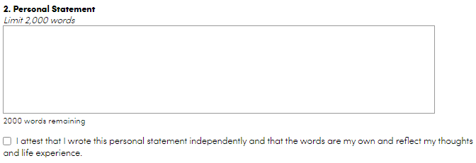
PERSONAL STATEMENT
There is a 2,000-word limit for the personal statement.
We recommend typing your personal statement in Microsoft Word so that you can review it, use word count and spell check.
Copy and paste your personal statement into the application.
You are required to write your personal statement and attest that you have written it.
Key things to remember:
  Spell check.
  Be mindful of the word limitation: If you have too many, your statement will be cut off!
  DO NOT put your name on your personal statement! The Admissions Committee wants to review the personal statements anonymously.
  Remember: Put your best foot forward!

Slide 27
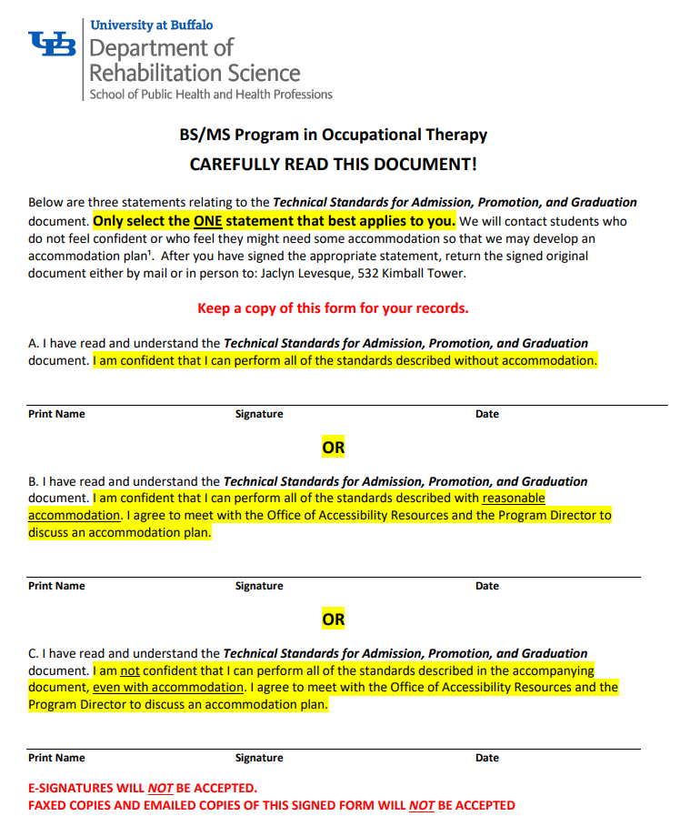
TECHNICAL STANDARDS
This document will need to be downloaded.
You will select ONE of the statements that best applies to you.
You will then need to UPLOAD the signed page to your application.
Electronic signatures and typed signatures will NOT be accepted. You will be emailed to re-submit the form with an actual signature if you provide an electronic signature or a typed one.

Slide 28
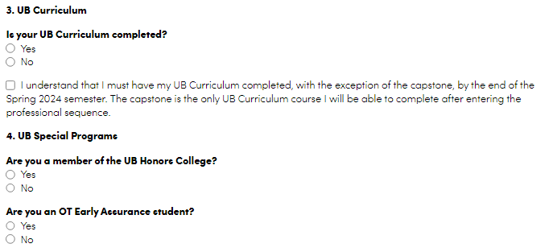
SCHOOL OF PUBLIC HEALTH & HEALTH PROFESSIONS QUESTIONS
Additional questions on this application that we ask that you answer are:
If your UB Curriculum has been completed
If you are a member of the Honors’ College
If you are an Early Assurance Student

Slide 29
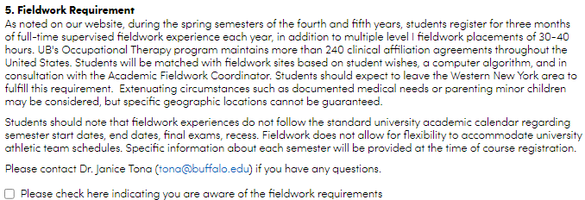
SCHOOL OF PUBLIC HEALTH & HEALTH PROFESSIONS QUESTIONS
Information on the Fieldwork Requirement
Please carefully read this section and check the box indicating your understanding of the material presented.
If you have any questions after reviewing this section, you can reach out to Dr. Tona at the email address provided.

Slide 30
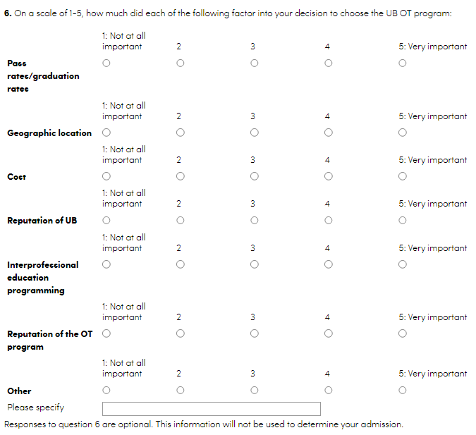
SCHOOL OF PUBLIC HEALTH & HEALTH PROFESSIONS QUESTIONS
Optional Questions
We value your feedback and would appreciate it if you would take the time to let us know why you chose the UB OT Program.
Responses to these questions are optional.

Slide 31
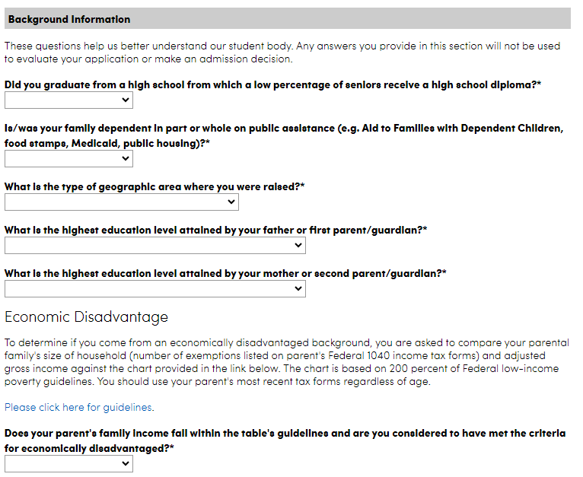
SCHOOL OF PUBLIC HEALTH & HEALTH PROFESSIONS QUESTIONS
You will provide additional background information in this section. You may elect NOT to answer the background information questions by selecting “I Prefer Not to Respond” or “I do not wish to report”.
You can also provide the following additional information:
if you come from an economically disadvantaged background
explanatory notes

Slide 32
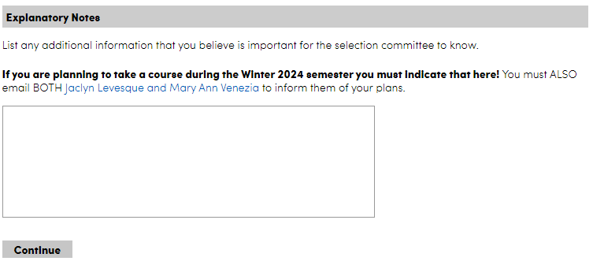
SCHOOL OF PUBLIC HEALTH & HEALTH PROFESSIONS QUESTIONS
If you are an Honor’s College student, we ask that you put this information in the Explanatory Notes section. You should also email Jaclyn Levesque at the email address shown.
Additional information you can add in the Explanatory Notes:
If you will be moving in the middle of the spring semester. Be sure to indicate that here.
If you are taking courses at another University during the Winter semester – which ones are you taking and where? (ex: PSY 101 at ECC, for example)
If you will be studying abroad or perhaps taking a leave of absence in the spring semester, indicate how we can reach you.

Slide 33
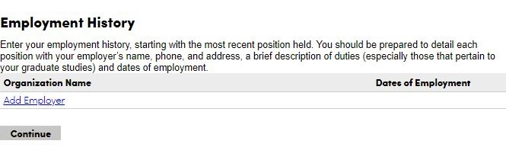
EMPLOYMENT HISTORY
LEAVE THIS PAGE BLANK
Information put here is NOT required and will NOT be reviewed.

Slide 34
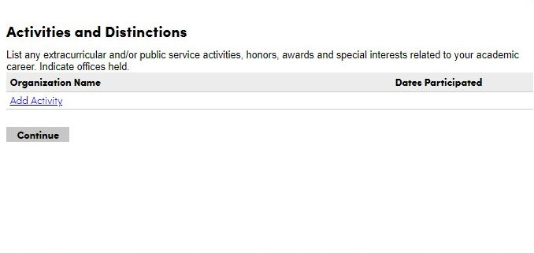
ACTIVITIES AND DISTINCTIONS
This section is NOT required to be completed. HOWEVER, the Department may refer back to it if there are scholarship opportunities in the future.
You can complete this section, but it is NOT required.
If you want us to know about any activities you have taken part in, we ask that you talk about that in your personal statement.

Slide 35
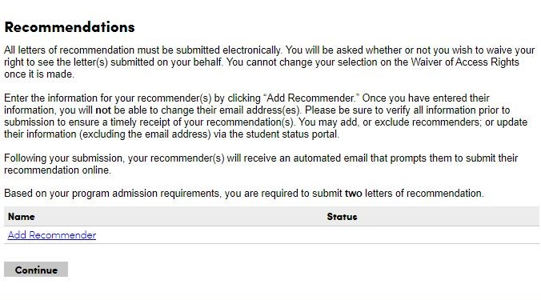
RECOMMENDATIONS
Letters of recommendation are NOT required, do NOT enhance your application and will NOT be reviewed.
Leave this section BLANK.

Slide 36
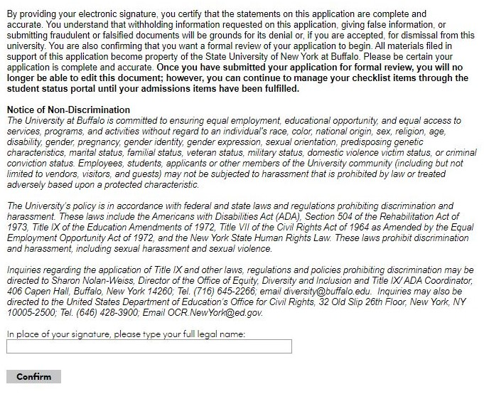
SIGNATURE
Your electronic signature is required prior to submitting your application.

Slide 37
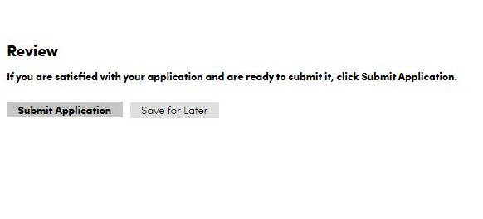
REVIEW & SUBMIT
You will then reach the end of your application.
We encourage you to review your application prior to submitting it.
Once you feel you have completed everything, you can click “Submit Application”.
If you want to come back to it on another day, select “Save for Later”.
Be sure to save your log in information!

Slide 38
SUBMITTING your application
Be sure to review your application and that it is filled in completely before you submit it.
Partially completed applications will not be evaluated.
You may save your data and come back to finish completing your application at a different time. BE SURE TO KEEP YOUR LOG IN INFORMATION. MULTIPLE APPLICATIONS SEEN AS “IN PROCESS” WILL BE DELETED.
Be sure to officially submit your application once complete.
SAVED APPLICATIONS THAT ARE NOT SUBMITTED WILL NOT BE CONSIDERED.
We are unable to make any changes to mistakes that you make in your application.

Slide 39
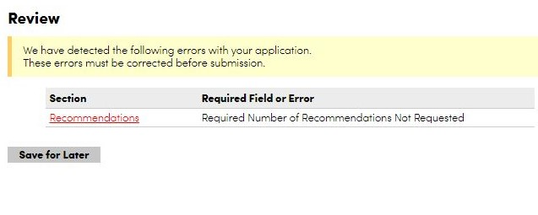
REVIEW
Once you have submitted your application, you will be at the Review screen, and it will look like this.
Simply click “Save for Later”.

Slide 40
WHAT HAPPENS AFTER YOU SUBMIT YOUR APPLICATION
After you submit your application, you will be prompted to remit the $50 application fee. There will be a link for you to click to remit payment.
It can take anywhere from 2 – 24 hours for supplemental materials that you have uploaded to appear in your checklist.

Slide 41
End of Application Instructions

Slide 42
ADDITIONAL INFORMATION
TO KNOW

Slide 43
INFORMATION ON PREREQUISITES
12 prerequisites are required.
Of those 12, 8 prerequisites MUST be completed before you apply.
These 8 must include:
    ES 207 –Human Form/Function
    OT 201 – Introduction to Occupational Therapy
    PHY 101 – College Physics I
    STA 119 (or PSY 207) – Statistical Methods
Follow your advisor’s recommendations in determining your prerequisite course plan.
Prerequisites taken over 5 years ago must be reviewed and approved by MaryAnn Venezia. You will need to send her an email to tell her if any of your prerequisite courses are over 5 years old.
If you are taking a prerequisite course outside of UB, be sure to let MaryAnn Venezia know.

Slide 44
TRANSFER COURSES: ARTICULATING GRADES
What does this mean?
Articulation refers to the process of comparing the content of the courses that are transferred between educational institutions and deciding if they are equivalent.
A course MUST be articulated through UB to be used as a prerequisite.
  OR
The syllabus must be reviewed and accepted for program credit.

Slide 45
RETAKING COURSES
  You may repeat up to 2 prerequisite courses.
  As stated in the UB Catalog, all second attempt grades will count as your official grade, regardless whether it is better or worse. The second grade that you earn will be the one that we look at.
  If you received lower than a C- in a course, but will be retaking the course this Spring, email us to let us know.
  To learn more about the repeat policy on courses, click this link:
    https://catalog.buffalo.edu/policies/repeat.html

Slide 46
GENERAL EDUCATION OR
UB CURRICULUM REQUIREMENTS
Students must either have:
    All general education requirements completed before entering the program/before beginning PAS 407.
    OR
    They must have their UB curriculum courses completed.
The only UB curriculum course completed in the Professional Program is UBE 399 (Capstone). It is taken in the spring semester of the first year of the professional program. All other UB curriculum courses must be completed.

Slide 47
Reminder:
Failure to provide the required and accurate information may prevent your application from being processed.
Check your email on a regular basis. You are responsible for the information and notices sent to your UB email address.

Slide 48
OFFICIAL TRANSCRIPTS FOR COURSES NOT TAKEN AT UB
All applicants must be enrolled as an undergraduate student at UB when applying to the program.
If you are taking any courses in Fall 2023, Winter 2024 or Spring 2024 semesters outside of UB, you must send your official transcripts to:
  MaryAnn Venezia, Coordinator for Professional Programs
  Department of Rehabilitation Science
  SUNY at Buffalo, South Campus
  3435 Main Street
  523 Kimball Tower
  Buffalo, NY 14214

Slide 49
DECISION LETTERS
Decision letters will be sent out by the end of March. Everyone will be notified at the same time. You will either be accepted, offered a place on the wait list or your application will be declined/rejected.
ACCEPTANCE
If you receive an acceptance letter, you must respond by accepting or declining your spot in the program by the stated deadline found in the letter.
Acceptance is conditional and is based on the successful completion of all prerequisite courses in the spring semester. Grades will be checked at the end of the semester.
WAIT LIST
Some students who are not initially accepted into the program may be invited to be placed on a wait list.
If you receive a wait list letter, you must respond by accepting or declining your spot in the program by the stated deadline found in the letter.
Waitlisted students MUST take PAS 407, Human Gross Anatomy in Summer 2024.

Slide 50
IF I DON’T GET ACCEPTED, WHAT DO I DO?
Schedule a follow-up meeting with the Office for Academic and Student Affairs (OASA)
    Kimball Tower, Fourth Floor
    716-829-5000 (call or email for an appointment)
    sphhp-oasa@buffalo.edu
  Career Services
    Call 716-645-2231 to make an appointment.
Students are strongly encouraged to schedule appointments with these offices to discuss their future plans.

Slide 51
Important contact information
For questions about volunteer forms, the application process or application procedures, you can contact:
Jaclyn Levesque
Admissions & Enrollment Coordinator
jl388@buffalo.edu
For questions about the program and to request course approvals, you can contact:
MaryAnn Venezia
Coordinator for Professional Programs
venezia3@buffalo.edu

