Slide 1
GRADUATE SCHOOL APPLICATION MANAGER
HOW TO COMPLETE THE APPLICATION:
AN INSTRUCTIONAL GUIDE FOR JANUARY 2025 APPLICANTS

Slide 2
Important contact information
For questions about volunteer hours, the application process or how to complete the application you can contact:
Jaclyn Levesque
Admissions & Enrollment Coordinator
jl388@buffalo.edu
For questions about the program, or to request course approvals, you can contact:
MaryAnn Venezia
Coordinator for Professional Programs
venezia3@buffalo.edu

Slide 3
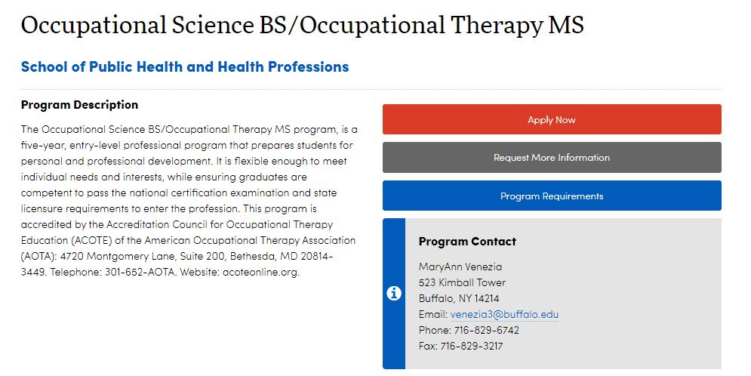
WHERE CAN I FIND THE APPLICATION?
The simplest way to access the application is by clicking this link:
https://grad.buffalo.edu/programs/occupational-science-bs-occupational-therapy-ms.html

Slide 4
ACCESSING THE APPLICATION
THE APPLICATION WILL NOT BE VISIBLE FOR YOU UNTIL DECEMBER 27.
GO TO: https://grad.buffalo.edu/programs/occupational-science-bs-occupational-therapy-ms.html
Click “Apply Now”

Slide 5
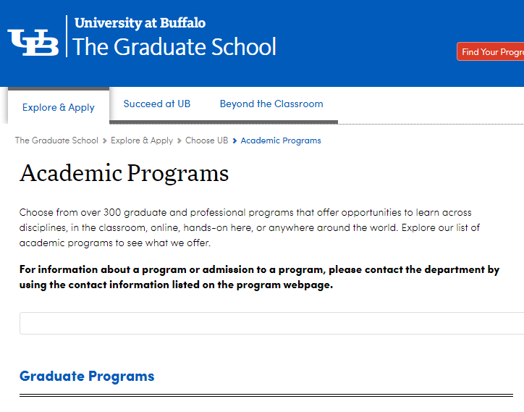
You will then be led to The Graduate School Academic Program page. On this page, you will see a list of Graduate Programs to select from. Scroll down until you see Occupational Science BS / Occupational Therapy MS.
What to select

Slide 6
TECHNICAL STANDARDS
It is important to read and understand the Technical Standards prior to applying to the Occupational Therapy program.
You will need to sign and submit your understanding of the Technical Standards by uploading your signed document in your application.
You can access this information in the Pre-Major Handbook which can be found online at:
https://sphhp.buffalo.edu/content/dam/sphhp/rehabilitation-science/ot-premajor-handbook.pdf
Signing the Technical Standards form indicates that you have read it and also indicates what level of accommodations, if any, that you require.
Your signature means that you also agree to the requirements listed on page four of the Technical Standards.

Slide 7
VOLUNTEER FORMS / VOLUNTEER PLAN
The volunteer form can be downloaded from the OT Admissions page:
https://publichealth.buffalo.edu/rehabilitation-science/education/occupational-therapy-bsms/admissions.html
Your volunteer form or volunteer plan MUST be uploaded in your application by January 13th.
If you have previously applied and submitted volunteer hours and would like them brought forward, send an email request to Jaclyn Levesque, Admissions & Enrollment Coordinator at: jl388@buffalo.edu.
Forms MUST be signed by an OTR, OTR/L, OTA or COTA.
If you are applying for 2025 admission, your volunteer hours must be completed between January 13, 2022 and January 13, 2025.

Slide 8
VOLUNTEER FORMS – Continued
The Total Number of Hours MUST BE COMPLETELY FILLED IN. This line CANNOT BE LEFT BLANK.
**No part of the volunteer form can be left blank or it will be considered incomplete.**
Supplemental paperwork attached to your volunteer form DOES NOT REPLACE the volunteer form.
35 hours must be completed.
You may volunteer in no more than 3 sites to meet the 35 hour requirement.

Slide 9
THE APPLICATION

Slide 10
GETTING STARTED
If you have previously applied or have applied to a different program in the past, click here
If this is your first time applying, click here

Slide 11
Students can use any email to register (so your UB email or personal email is fine).
Be sure that you take note of the information you input on this page – especially your birthdate!

Slide 12
After you input your information on the first screen, you will be sent a temporary PIN. You will need that PIN
in order to begin the application.
You will also need to be sure to input the same birthdate information that you entered on the previous screen.
Youremail@buffalo.edu
If you input the wrong birthdate, we have no way to correct that.
It is imperative that you carefully review the information that you input.

Slide 13
You will be prompted to create a new password on the next screen.
Be sure to SAVE this information somewhere for reference!

Slide 14
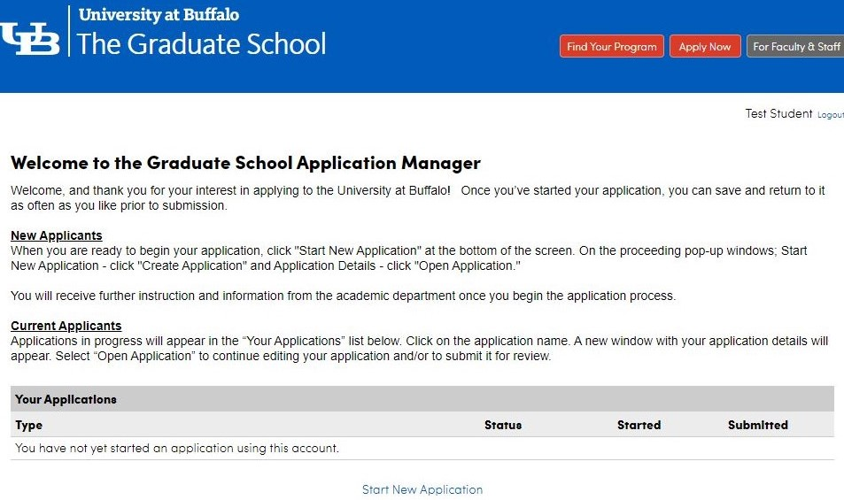
Click “Start New
Application”

Slide 15
You will complete the application called “The School of Public Health and Health Professions”
You will click “Create Application”

Slide 16
Once you create your application, an Application Details screen will pop up. You will then need to click “Open Application”

Slide 17
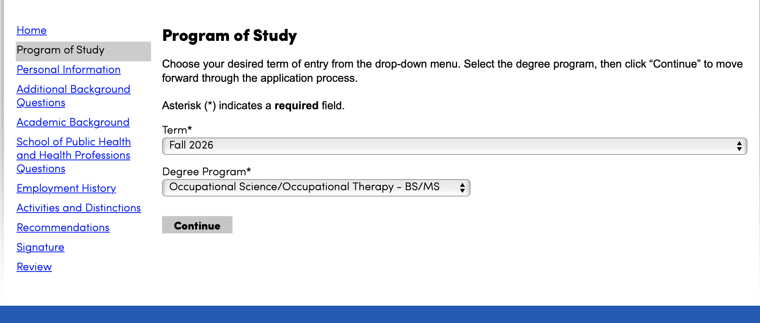
Once you open the application, you will go through each of the headings located on the left hand side.
In the first heading, “Program of Study”, for the Term, you will select: “Fall 2026” That is the ONLY way you will see the application.
The Degree Program you will see is: “Occupational Science/Occupational Therapy – BS/MS”

Slide 18
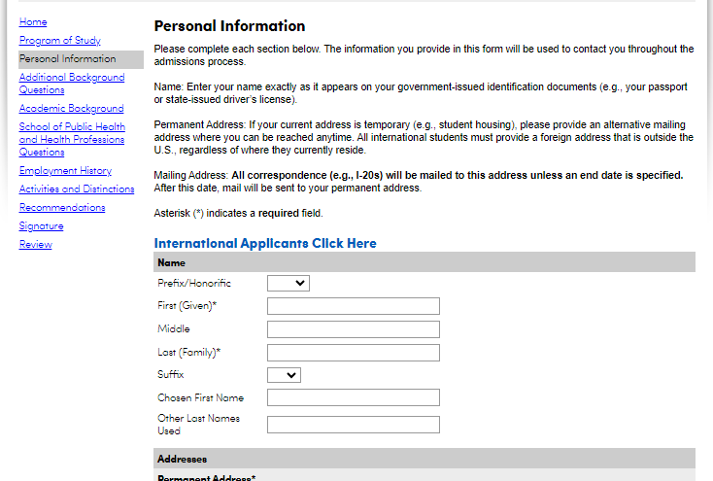
PERSONAL INFORMATION
You will then begin completing the section labeled: “Personal Information”
Key things to be aware of:
The “chosen first name” is your Preferred Name in hUB.
All information submitted is private.
All items marked with an asterisk (*) are required.
Outside of the questions that have an asterisk, the application requires the following questions to be answered:
Legal sex
Birth Country
Are you a NYS Resident
How long have you been a NYS resident?

Slide 19
INTERNATIONAL APPLICANTS
If you are an international student, you will need to click on the link labeled “International Applicants Click Here”.
Within the application, you will have an additional tab to complete.

Slide 20
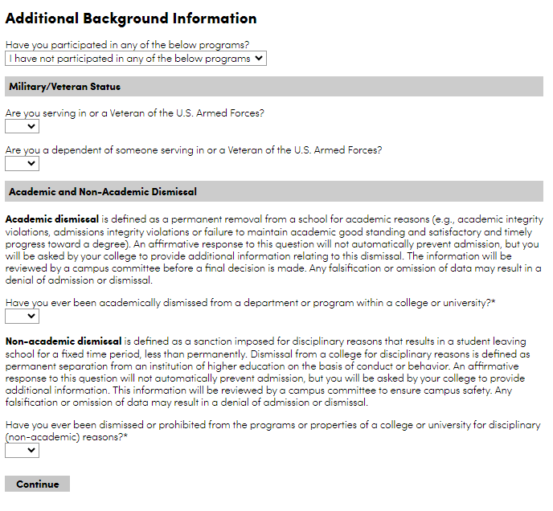
ADDITIONAL BACKGROUND INFORMATION
In this section you will provide information on:
If you partake in any EOP, HEOP, SEEK programs, etc.
If you are in the military or are a veteran.
If you have ever had an academic or non-academic dismissal.

Slide 21
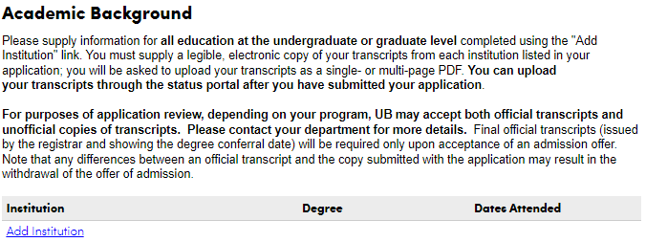
ACADEMIC BACKGROUND
This section is required and must be completed.
All applicants must complete this section.

Slide 22
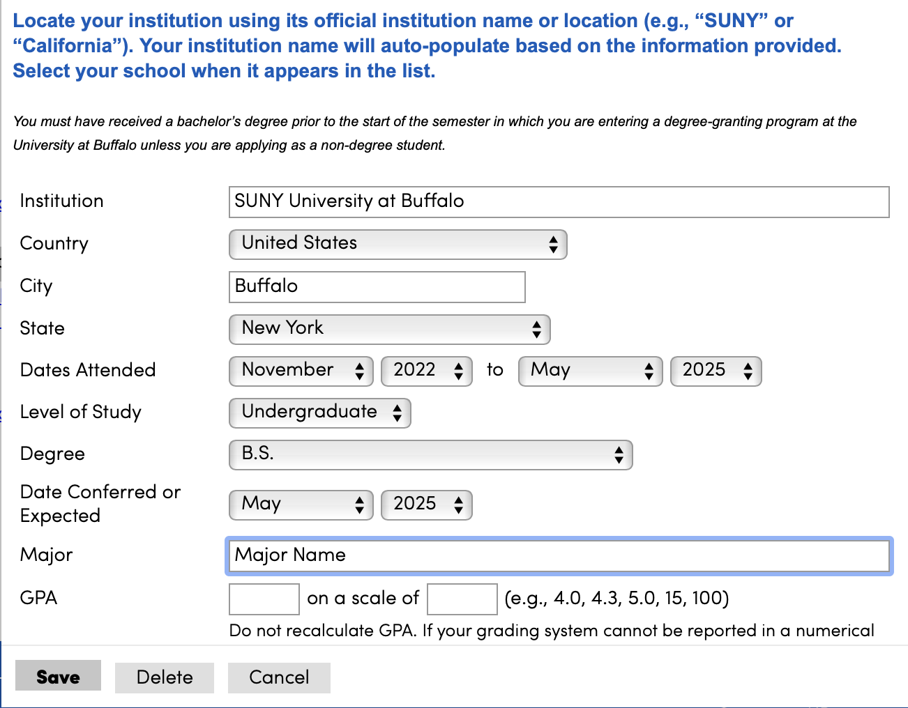
ACADEMIC BACKGROUND
For UB Applicants:
Enter your UB information ONLY.
As you type, the application will provide name suggestions. Select “SUNY University at Buffalo “ from the drop-down option provided. If you don’t, the section will not autofill – it MUST autofill!
In the “Dates Attended” Section, please fill in the following:
The Month/Year you started at UB to May 2025
Level of Study: Undergraduate
Degree Type: BS or BA
Major: Add your current major
You can add your GPA if you have it or enter a 0.0 to move past this screen. The scale should be “4.0”
In the “Submit Transcript” section please upload your AAR.
Directions on how to access your AAR can be found here:
https://registrar.buffalo.edu/hub/aar.php

Slide 23
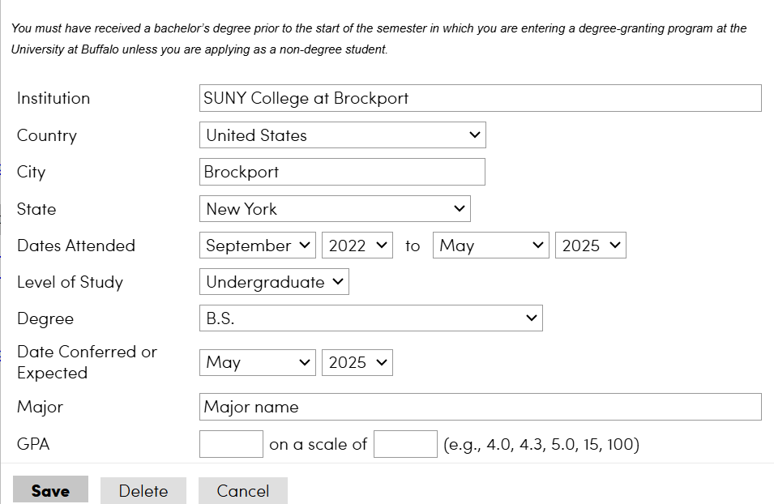
ACADEMIC BACKGROUND
For Non-UB Applicants:
Please complete this section with your school information
Please upload an unofficial copy of your transcript.
You will also need to mail an official transcript. This should be mailed to:
Jaclyn Levesque, Admissions & Enrollment Coordinator
University at Buffalo
532 Kimball Tower
Buffalo, NY 14214
Your official transcripts emailed to me at: jl388@buffalo.edu.
2020
2023
Bachelor of Science

Slide 24
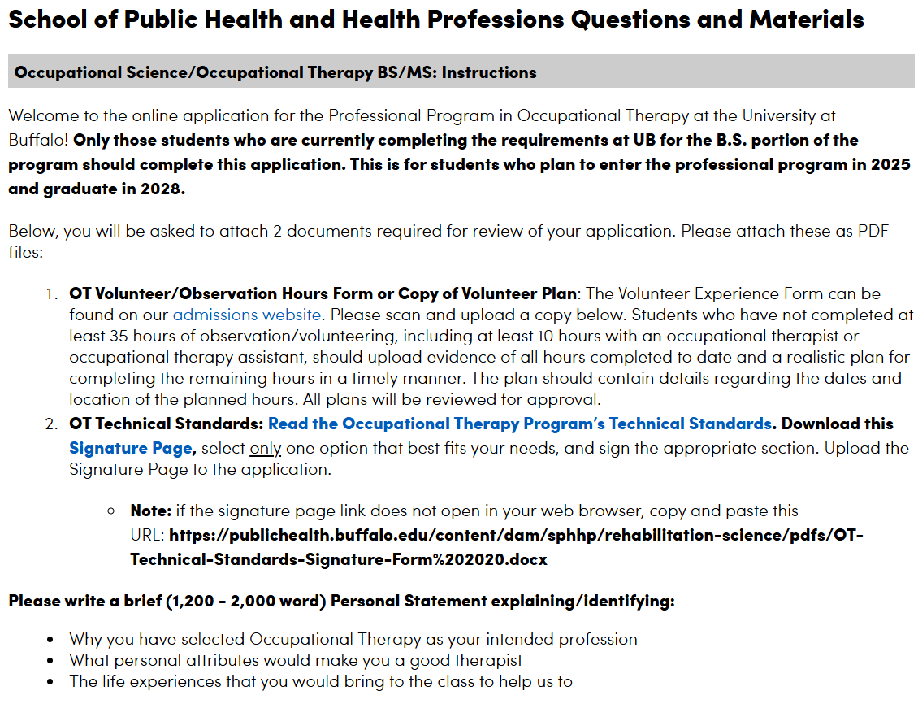
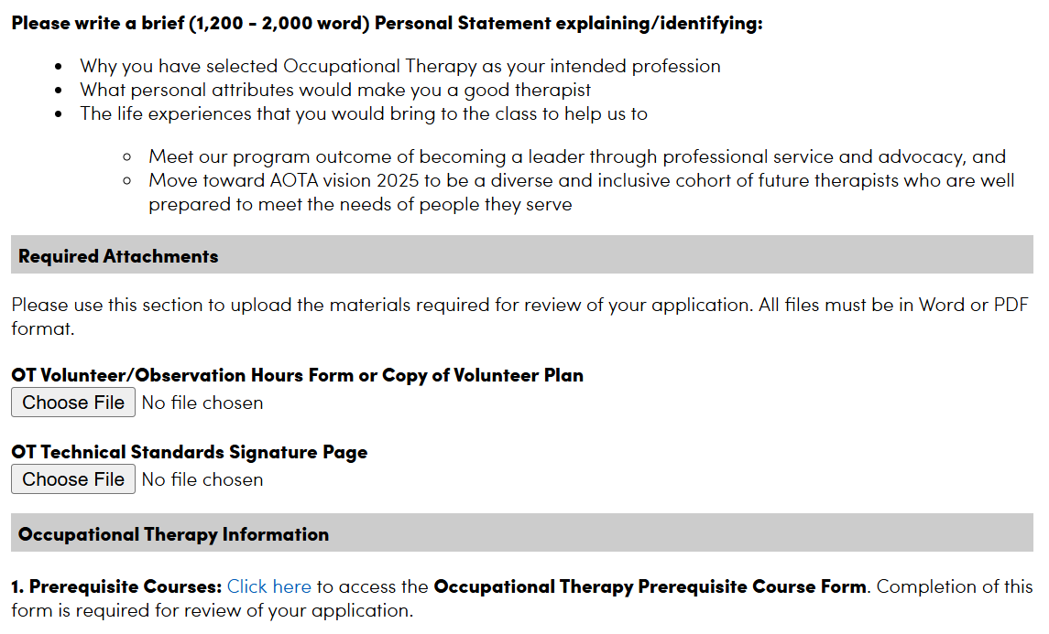
SCHOOL OF PUBLIC HEALTH & HEALTH PROFESSIONS QUESTIONS
In this section, you will upload the following:
Your volunteer form or volunteer plan
Signed Technical Standards form.
You will also provide your personal statement.
In this section, you will need your AAR to complete the “Prerequisite Course Form”
On this form, you will input the prerequisite course grades and course credits.

Slide 25
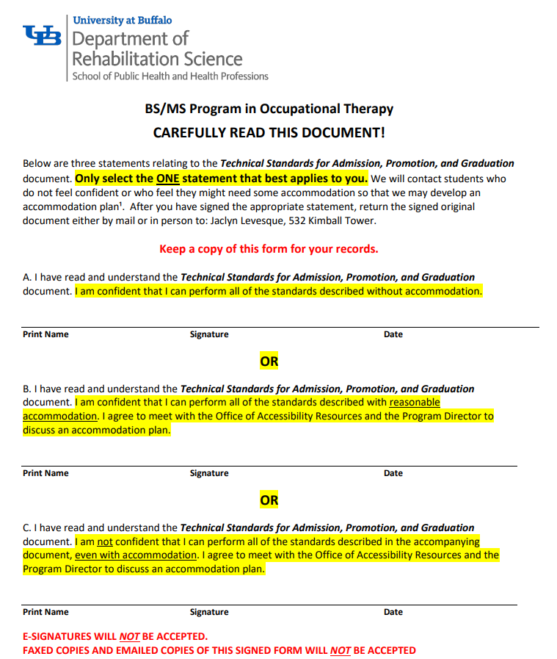
TECHNICAL STANDARDS
This document will need to be downloaded, printed and manually signed.
You will select ONE of the statements that best applies to you.
You will then need to UPLOAD the signed page to your application.
Electronic signatures and typed signatures will NOT be accepted. You must print and manually SIGN this document. You will be contacted to re-submit this form if you provide an electronic signature (such as a signature signed on a phone or iPad) or if you type your name.

Slide 26
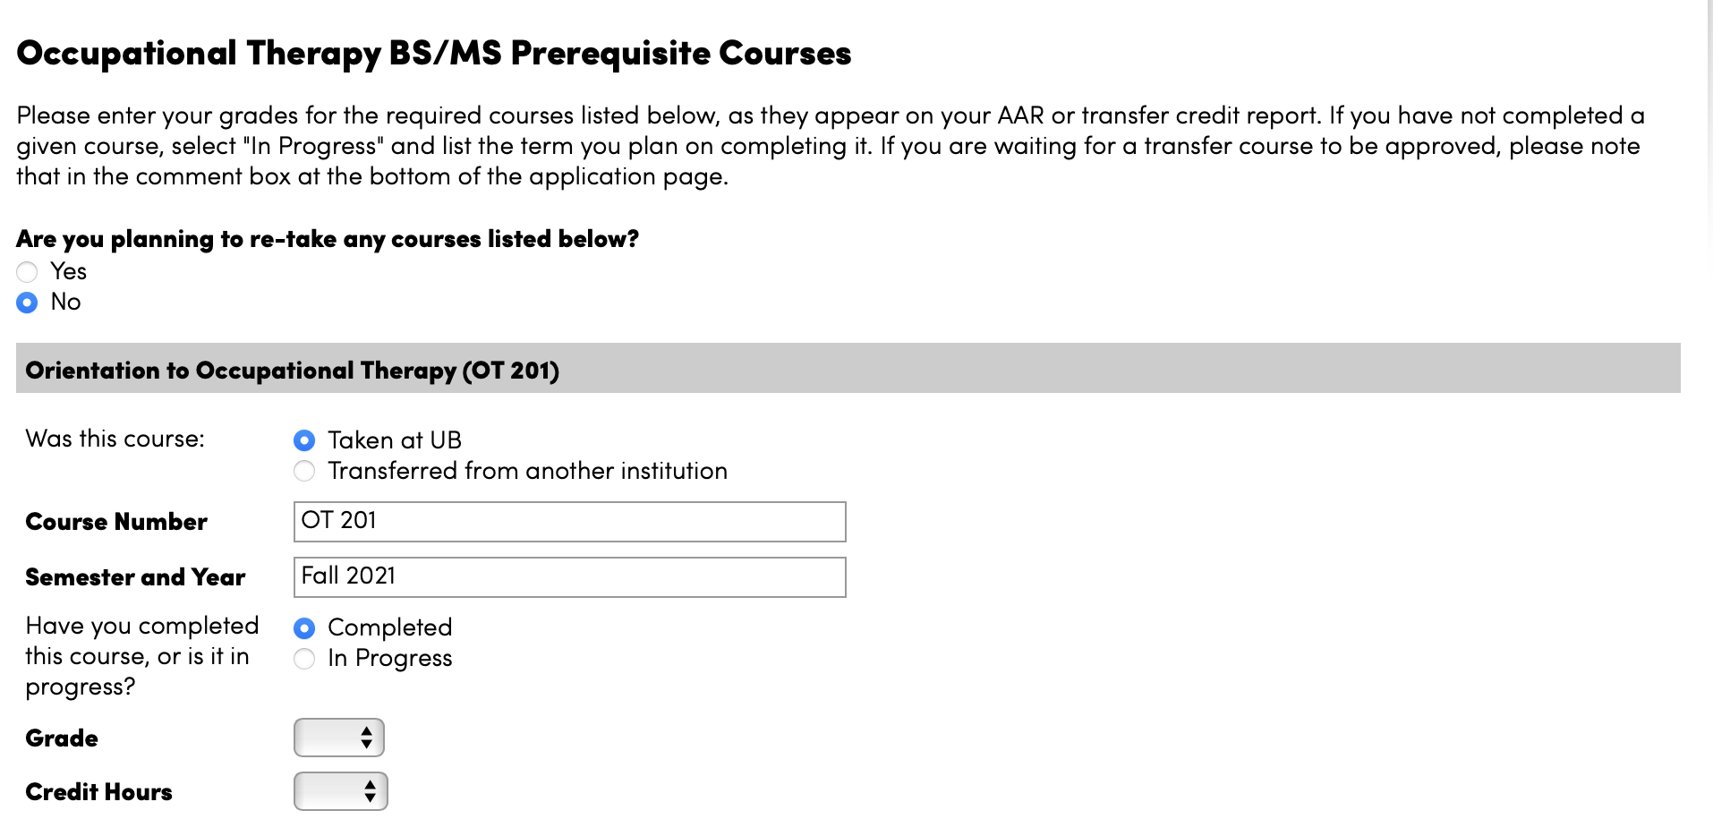
SCHOOL OF PUBLIC HEALTH & HEALTH PROFESSIONS QUESTIONS
PREREQUISITE COURSE FORM:
When you click to view the Occupational Therapy BS/MS Prerequisite Course Form, you will be led to this page. There will be a series of fields that are pre-populated with the required prerequisite course numbers.
There are two sections on this form that we will go over.

Slide 27
SCHOOL OF PUBLIC HEALTH & HEALTH PROFESSIONS QUESTIONS
The first section is found at the top of the page. Here, you will see a question asking if you are planning to retake any of the prerequisite courses listed on the prerequisite form.
- If you click “no” you can move on to the next part and begin to input your classes.
- If you click “yes”, you will need to add the courses that you will be retaking along with what semester you will be retaking them in.

Slide 28
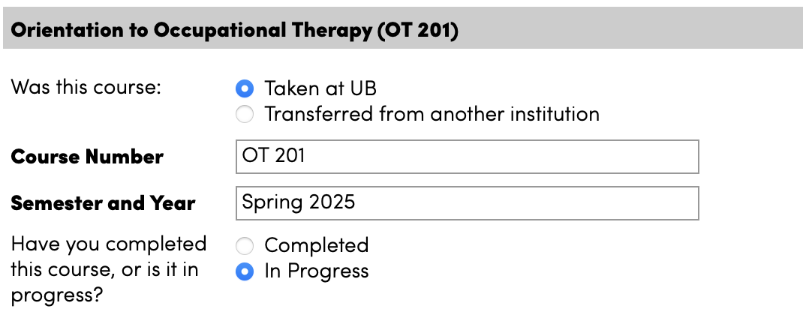
SCHOOL OF PUBLIC HEALTH & HEALTH PROFESSIONS QUESTIONS
PREREQUISITE COURSE FORM:
After you complete the first part of this form, you can begin to input your prerequisite courses.
It is in this section where you will input the classes you have taken as they appear on your AAR, as well as the classes you plan to take in the Spring semester.
If you are taking courses this fall, select “Completed” (by that time you complete this application, you will have your fall grades and will be able to add them)
If you are taking them in the Spring, select “In Progress”
When this form is complete, click “Submit”. If not, click “Save for later”

Slide 29
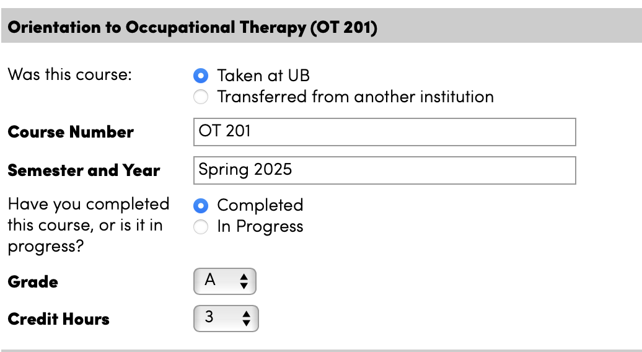
SCHOOL OF PUBLIC HEALTH & HEALTH PROFESSIONS QUESTIONS
Course Number will be pre-populated – this can be changed if you have taken an alternate (ex: instead of STA 119, you took PSY 207 – you can enter that information here.)
You will need to input the semester and year you have taken or intend to take the course
If you have taken a course & select “Completed”, a “Grade” field and “Credit Hours” field will appear for you to fill in

Slide 30
SCHOOL OF PUBLIC HEALTH & HEALTH PROFESSIONS QUESTIONS
NEW THIS YEAR!
If you have taken a prerequisite course at another University and it articulates to a required prerequisite course for OT,
you can input the course number from the University where you took the course.
In this example, if you took a course that articulates to OT 201 but has a different course prefix and number you can select that you have taken this course at another University, and you can then begin typing the University name and select it from the drop down menu as it appears. You can type over the default course information that is currently in the field and put the course # from the University where you took it in that space.

Slide 31
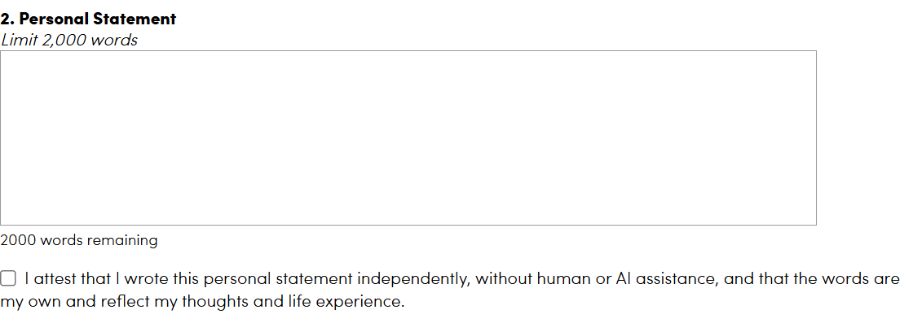
PERSONAL STATEMENT
There is a 2,000-word limit for the personal statement.
We recommend typing your personal statement in Microsoft Word so that you can review it, use word count and spell check.
Copy and paste your personal statement into the application.
You are required to write your personal statement yourself and attest that you have written it independently without human or AI assistance.
Key things to remember:
Spell check.
Be mindful of the word limitation: If you have too many, your statement will be cut off!
DO NOT put your name on your personal statement! The Admissions Committee wants to review the personal statements anonymously.
Remember: Put your best foot forward!

Slide 32
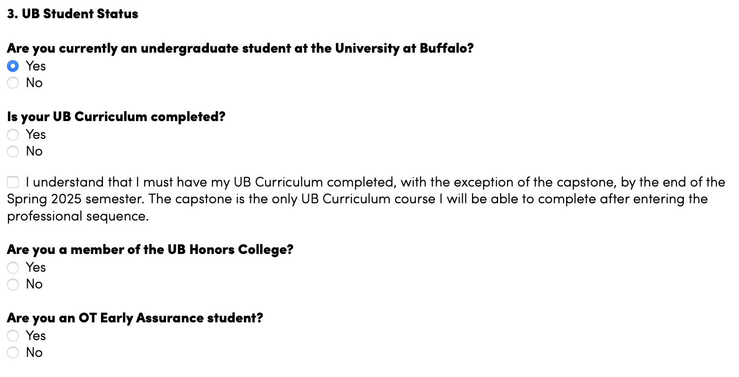
SCHOOL OF PUBLIC HEALTH & HEALTH PROFESSIONS QUESTIONS
You will then be prompted to answer questions about your current status as a UB student. If you are a current undergraduate student, you will then be asked:
If your UB Curriculum has been completed
You will also have to state that
you understand that your UB
Curriculum must be completed
If you are a member of the Honors’ College
If you are an Early Assurance Student

Slide 33
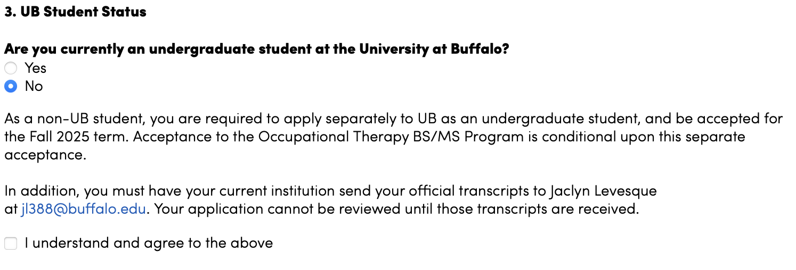
SCHOOL OF PUBLIC HEALTH & HEALTH PROFESSIONS QUESTIONS
If you are NOT a current UB student, and answer “no” to this question, you will have to agree to apply separately asa UB undergraduate student and be accepted to the fall 2025 term. This acceptance is conditional. In addition, you agree to have your official transcripts mailed to Jaclyn Levesque.

Slide 34
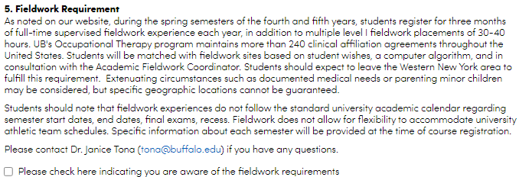
SCHOOL OF PUBLIC HEALTH & HEALTH PROFESSIONS QUESTIONS
Information on the Fieldwork Requirement
Please carefully read this section and check the box indicating your understanding of the material presented.
If you have any questions after reviewing this section, you can reach out to Dr. Tona at the email address provided.

Slide 35
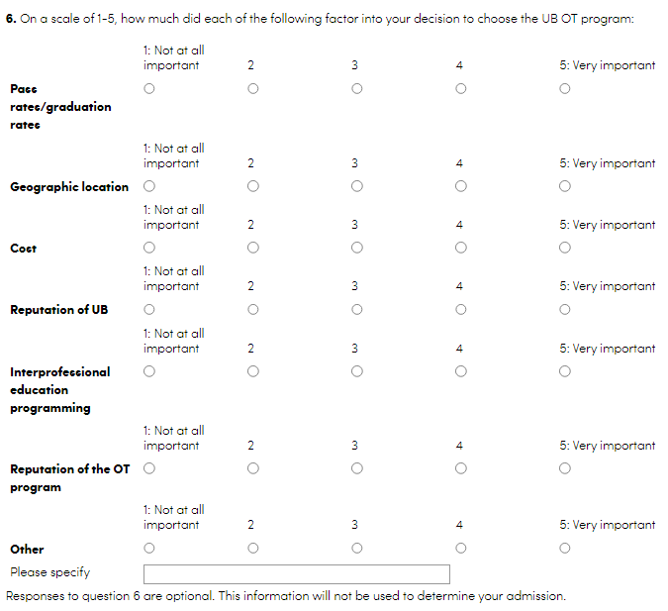
SCHOOL OF PUBLIC HEALTH & HEALTH PROFESSIONS QUESTIONS
Optional Questions
We value your feedback and would appreciate it if you would take the time to let us know why you chose the UB OT Program.
Responses to these questions are optional.

Slide 36
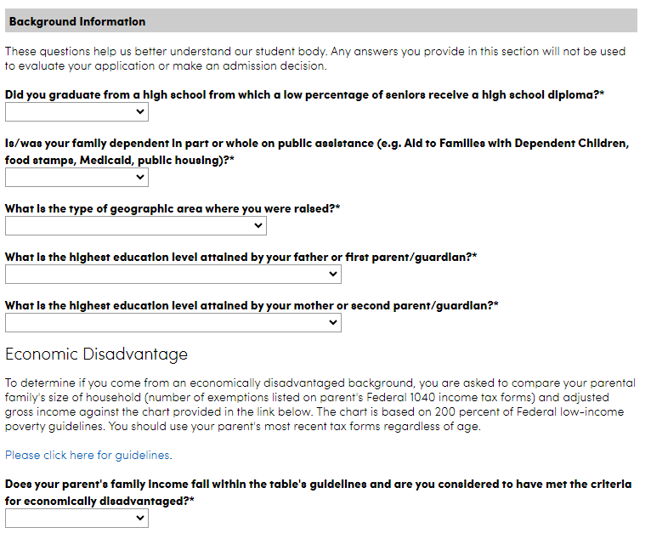
SCHOOL OF PUBLIC HEALTH & HEALTH PROFESSIONS QUESTIONS
You will provide additional background information in this section. You may elect NOT to answer the background information questions by selecting “I Prefer Not to Respond” or “I do not wish to report”.
You can also provide the following additional information:
if you come from an economically disadvantaged background
explanatory notes

Slide 37
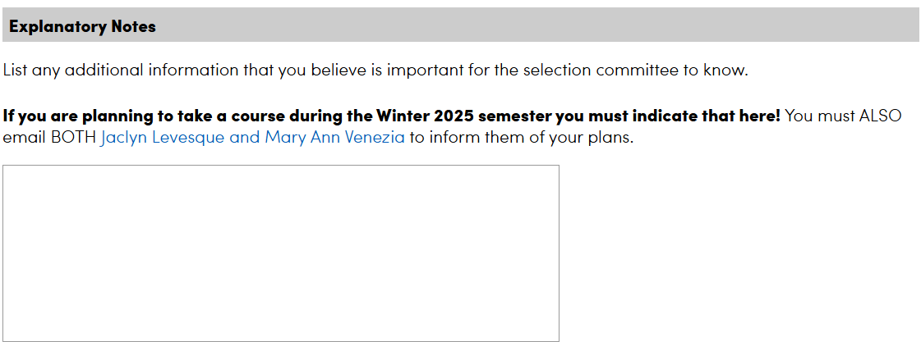
SCHOOL OF PUBLIC HEALTH & HEALTH PROFESSIONS QUESTIONS
If you are an Honor’s College or Early Assurance student, we ask that you put this information in the Explanatory Notes section. You will also need to email Jaclyn Levesque and Mary Ann Venezia. You can do this by clicking directly on our names in the application.
Additional information you can add in the Explanatory Notes:
If you will be moving in the middle of the spring semester. Be sure to indicate that here.
If you are taking courses at another University during the Winter semester – which courses are you taking and where? (ex: PSY 101 at ECC, for example)
If you will be studying abroad or perhaps taking a leave of absence in the spring semester, indicate how you can be reached.

Slide 38
EMPLOYMENT HISTORY
LEAVE THIS PAGE BLANK
Information put here is NOT required and will NOT be reviewed.

Slide 39
ACTIVITIES AND DISTINCTIONS
This section is NOT required to be completed. HOWEVER, the Department may refer back to it if there are scholarship opportunities in the future.
You can complete this section, but it is NOT required.
If you want us to know about any activities you have taken part in, we ask that you talk about that in your personal statement.

Slide 40
RECOMMENDATIONS
Letters of recommendation are NOT required, do NOT enhance your application and will NOT be reviewed.
Leave this section BLANK.

Slide 41
SIGNATURE
Your electronic signature is required prior to submitting your application.

Slide 42
REVIEW & SUBMIT
You will then reach the end of your application.
We encourage you to review your application prior to submitting it.
Once you feel you have completed everything, you can click “Submit Application”.
If you want to come back to it on another day, select “Save for Later”.
Be sure to save your log in information!

Slide 43
SUBMITTING your application
Be sure to review your application and that it is filled in completely before you submit it.
Partially completed applications will not be evaluated.
You may save your data and come back to finish completing your application at a different time. BE SURE TO KEEP YOUR LOG IN INFORMATION. MULTIPLE APPLICATIONS SEEN AS “IN PROCESS” WILL BE DELETED.
Be sure to officially submit your application once complete.
SAVED APPLICATIONS THAT ARE NOT SUBMITTED WILL NOT BE CONSIDERED.
We are unable to make any changes to mistakes that you make in your application.

Slide 44
REVIEW
Once you have submitted your application, you will be at the Review screen, and it will look like this.
Simply click “Save for Later”.

Slide 45
WHAT HAPPENS AFTER YOU SUBMIT YOUR APPLICATION
After you submit your application, you will be prompted to remit the $50 application fee. There will be a link for you to click to remit payment.
It can take anywhere from 2 – 24 hours for supplemental materials that you have uploaded to appear in your checklist.

Slide 46
End of Application Instructions

Slide 47
RETAKING COURSES
You may repeat up to 2 prerequisite courses.
As stated in the UB Catalog, all second attempt grades will count as your official grade, regardless whether it is better or worse. The second grade that you earn will be the one that we look at.
If you received lower than a C- in a course, but will be retaking the course this Spring, email us to let us know.
To learn more about the repeat policy on courses, click this link:
https://catalog.buffalo.edu/policies/repeat.html

Slide 48
GENERAL EDUCATION OR
UB CURRICULUM REQUIREMENTS
Students must either have:
All general education requirements completed before entering the program/before beginning PAS 407.
OR
They must have their UB curriculum courses completed.
The only UB curriculum course completed in the Professional Program is UBE 399 (Capstone). It is taken in the spring semester of the first year of the professional program. All other UB curriculum courses must be completed.

Slide 49
OFFICIAL TRANSCRIPTS FOR COURSES NOT TAKEN AT UB
All applicants must be enrolled as an undergraduate student at UB when applying to the program.
If you are a UB student taking any courses in Fall 2024, Winter 2025 or Spring 2025 semesters outside of UB, you must send your official transcripts to:
MaryAnn Venezia, Coordinator for Professional Programs
Department of Rehabilitation Science
SUNY at Buffalo, South Campus
3435 Main Street
523 Kimball Tower
Buffalo, NY 14214

